Slide 1

Federal Energy Regulatory Commission
Information Sharing Guidelines
By:
Jeff Holloway,
Branch Chief
FERC, Division of Dam Safety and Inspections, Atlanta Regional Office

Slide 2

Presentation Outline
General Information Sharing Procedures
Document Filing
Document Labeling
Sharing Risk Information
Information Sharing with EMAs
Public Education

Slide 3
General Information Handling Procedures
Handling of sensitive information governed by National Archives and Records Administration procedures (81 FR 63323), which provides guidance for labeling and handling of information.
FERC follows procedures governing controlled unclassified information (CUI)

Slide 4
Document Filing
All Division of Dam Safety and Inspections (D2SI) documents are electronically filed to our eLibrary system. This includes documents developed and submitted by the licensee and by D2SI
  Commission issuances, such as orders, licenses, license amendments, etc.
  Letters to and from licensees
  D2SI Inspection reports
  Technical studies, i.e. design and construction documents, analyses, etc. developed by the licensee or their consultant
  Supporting technical information
  Emergency action plans

Slide 5
Document Labeling
All D2SI issued documents are labeled as follows:
  Documents containing Critical Energy/Electric Infrastructure Information (CEII), see 18 C.F. R. § 388.113, are labeled CUI//CEII
  Documents containing information defined as privileged (see 18 C.F. R. § 388.112) is labeled CUI/PRIV.
  Documents containing multiple information types contain all applicable label types.
  CEII and Privileged information is segregated from CUI information before filing, i.e. on letters to licensee CEII is filed as a separate enclosure along with the cover letter labeled as CUI.

Slide 6
Document Labeling Continued
For licensee submitted documents, the licensee determines what is CEII and labels the document as such
For D2SI documents the employee who develops the document determines the correct label.

Slide 7
Sharing Risk Information
Emergency Action Plans (EAP) are the primary documents that communicate risk and risk management information at FERC regulated dams.
D2SI considers EAP documents CEII
EAPs are developed by licensees and the licensee can decide how much of the information to release to the public and cooperating emergency response agencies.
Public access to CEII information on eLibrary is restricted, but information can be obtained by making a request and signing a non-disclosure agreement.

Slide 8
Sharing Risk Information 2
EAP information is generally shared with:
  Local Emergency Response Agencies (EMAs).
  National Weather Service
  Other plan holders (i.e. federal and state agencies, upstream and downstream dam owners, etc)
  Public (limited to primarily education)

Slide 9
Emergency Action Plan
Program
Licensee
Coordination
And
Cooperation
Agencies
FERC

Slide 10
WHY COORDINATE?
Working together builds relationships
Having relationships improves coordination
Coordination saves time
Saving time in an emergency saves LIVES
Notes:
10
To quote a licensee on their experience with developing relationships with EMAs:
Working together builds relationships; having relationships improves coordination; coordination saves time; saving time in an emergency saves lives
So why coordinate? It is critical that essential EMA’s fully understand their responsibilities during emergencies.

Slide 11
Information Sharing with EMAs
While developing the EAP the licensee should coordinate with local Emergency Response Agencies (EMAs) to:
  Increase effectiveness of plan.
  Ensure EMAs have the EAP information needed to facilitate the implementation of their local Emergency Operations Plan or a Warning and Evacuation Plan.
  Allow the tasks and responsibilities of the licensee and the emergency management authorities that would be implemented during a dam emergency incident to be clearly stated and as compatible as possible.

Slide 12
Information Sharing with EMAs 2
Plan Development(cont)
  Enhance EMA confidence in using the EAP and in the accuracy of its components.
  Enhances the development of adequate recovery plans.
  Enhances communications .
  Ensure proper division of critical responsibilities to groups or individuals best equipped to handle them.
  Sharing of inundation maps is required by FERC guidelines to improve warning and evacuation plans. Inundation maps should be digital if local authorities have GIS capabilities.
  Include information on maps that is most useful to authorities responsible for evacuation (flood crest elevations, local road names, etc.)
  EAPs should include procedures for communicating with EMAs during dam emergencies to expedite response.

Slide 13
Information Sharing with EMAs 3
Plan Development(cont)
  FERC guidelines recommend making the EAP a controlled document and limit sharing of technical details. Different versions of EAPs can be developed, so that only needed information is shared with EMAs.

Slide 14
Information Sharing with EMAs 4
Notification Flow Charts
  Flow charts should be developed that clearly designate the responsible party for each contact.
  Flow charts are developed for 4 different emergency levels.

Slide 15
Information Sharing with EMAs 5
Plan Exercises
FERC’s EAP Exercise Program includes:
  Seminar
  Drill
  Tabletop Exercise
  Functional Exercise
  Full Scale Exercise

Slide 16
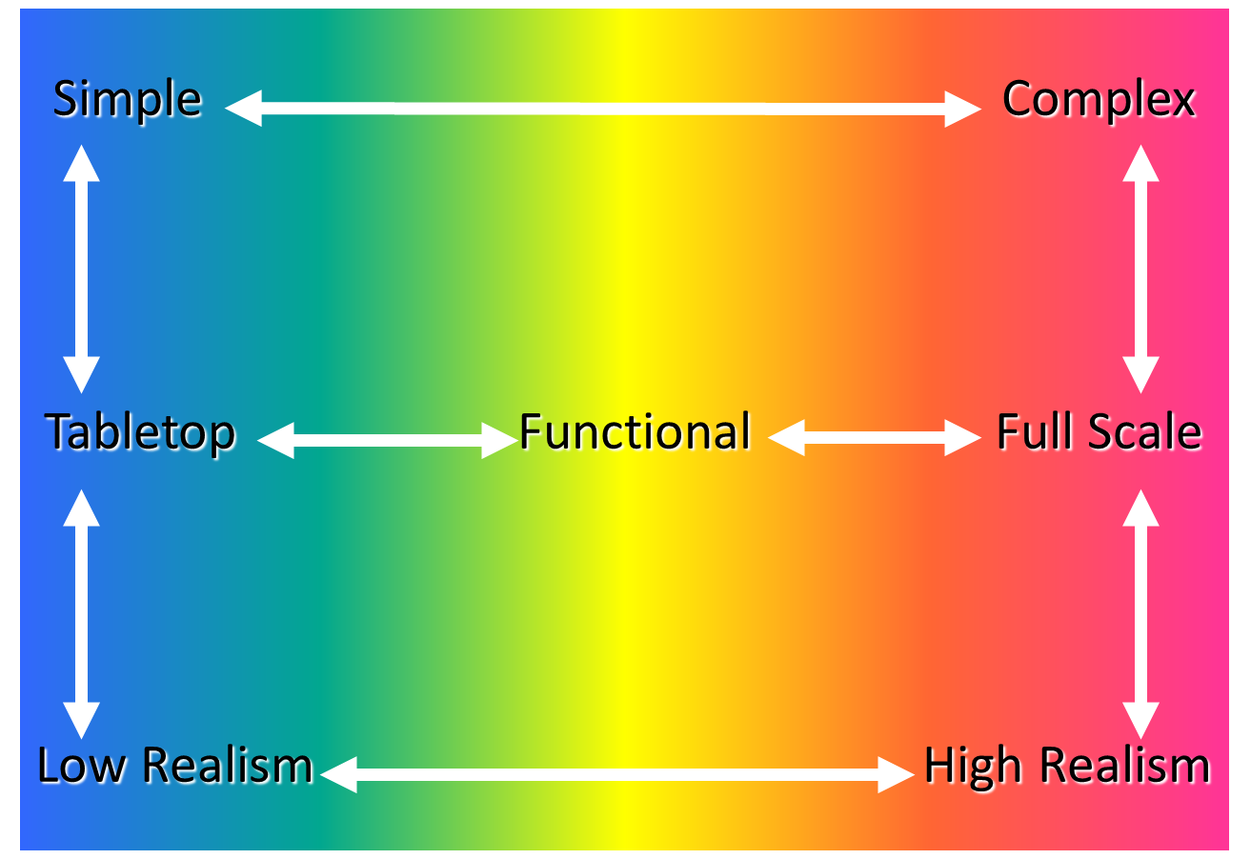
EXERCISE PROGRAM

Slide 17
Information Sharing with EMAs 6
Exercises should be coordinated with
  Emergency Management
  City/County Management
  Police/Fire
  Red Cross Shelters
  National Weather Service – Issue Flood Warnings
  911 Staff or Operators
  Public Works
  Health Department
  Public Information Office (Media)
  Environmental Protection
  FEMA
  Others

Slide 18
Information Sharing with EMAs 7
Plan Exercises
  Licensee lead in development of exercises for their projects.
  Exercises should be coordinated with local EMAs to maximize the benefit for EAP users
  Evaluation of the exercise is required and a report on the results is submitted to FERC.

Slide 19
Information Sharing with EMAs 8
Plan Exercises
  Exercises provide opportunities to update contact information
  Exercises test licensee staff and local EMA knowledge of roles and responsibilities during an emergency situation.
  Goal of exercise is to improve the EAP.

Slide 20
Information Sharing with EMAs 9
Plan Implementation
  Important to coordinate with EMAs and resource agencies on any pre-flood releases to draw down reservoir to provide additional storage.
  Notifications should be coordinated with National Weather Service to allow flood watches and warnings to be issued as needed.
  Licensees should provide as much information as possible to assist local authorities with the difficult call of declaring public emergencies during potential dam failure scenarios.

Slide 21
Information Sharing with EMAs 10
Plan Implementation
  After an emergency has ended the licensee is responsible for notifying authorities the condition at the dam has stabilized and provide enough information for authorities to determine when to declare an end to the emergency.
  The licensee should lead in the development of an after action evaluation of the emergency response. Local EMAs should be involved in the evaluation to provide input on the process and needed improvements.

Slide 22
Information Sharing with EMAs 11
Plan Implementation
  We recommend interaction with media during an emergency be implemented in coordination with local authorities (Joint Information Center). Licensees should work with the local authorities to provide up to date accurate information.

Slide 23
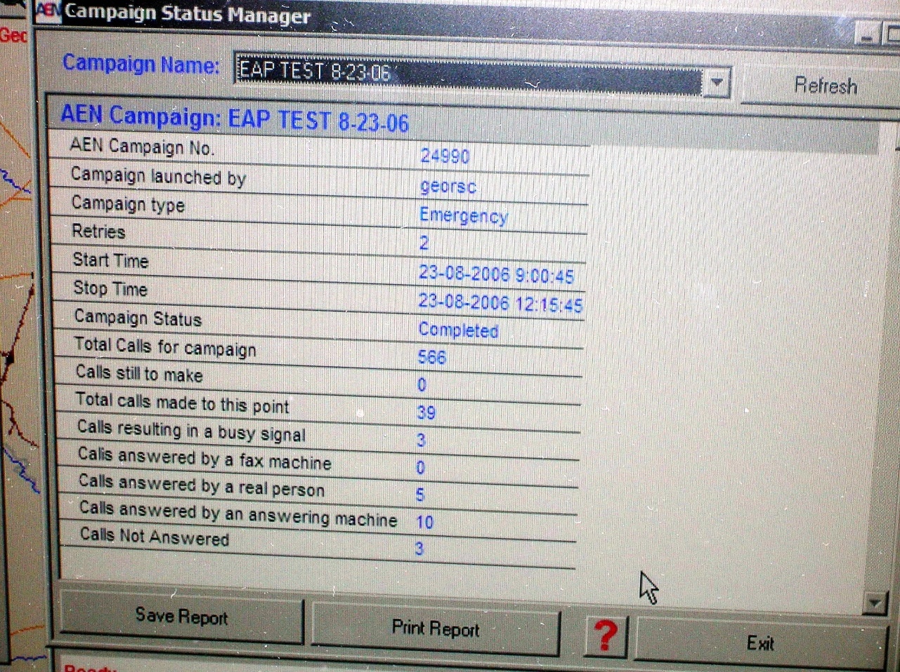
Time Sensitive EAPs
Licensees should coordinate with emergency management authorities to minimize the response times when there is inadequate time to warn downstream residents of a dam failure. Possible Emergency Management Authority Mitigations include:
Use Reverse 911 system to notify residents.
Prepare pre-scripted message for Reverse 911 system that explain what residents should do.
Use automatic alert system that sends text messages to residents.
Install sirens.
Provide NOAA radios to residents.
Have dam owner warn residents directly (upon agreement with emergency management authority).

Slide 24
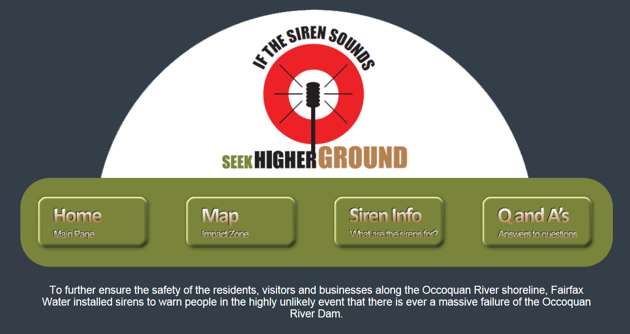
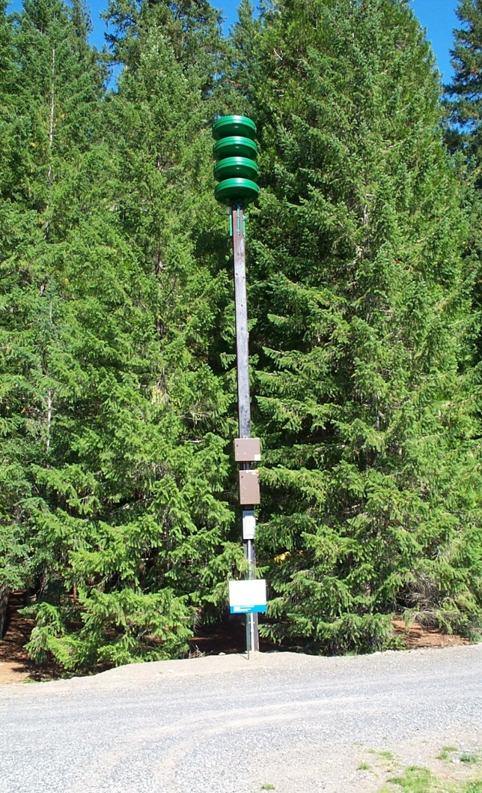
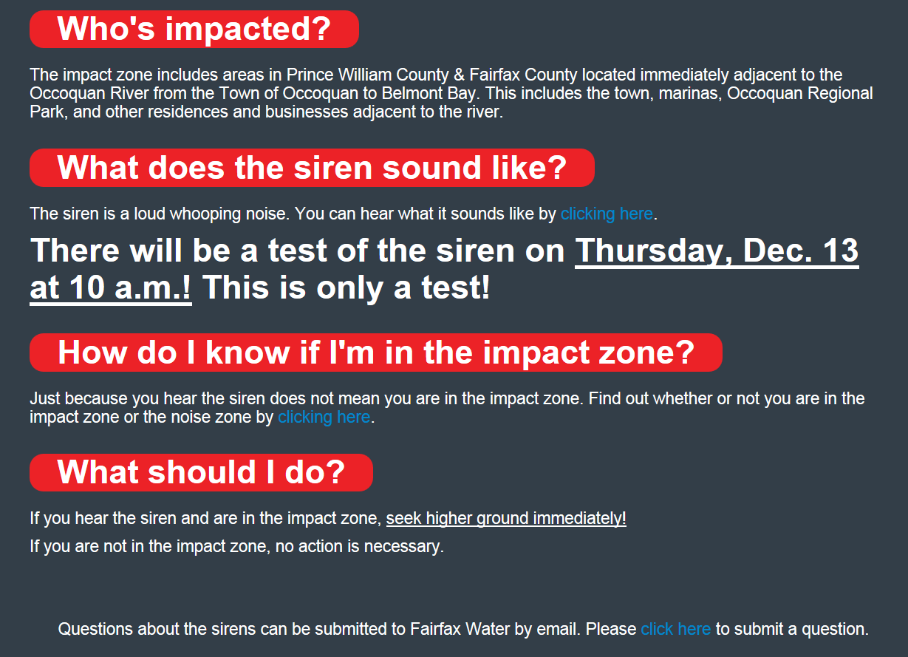
Public Education In Action

Slide 25
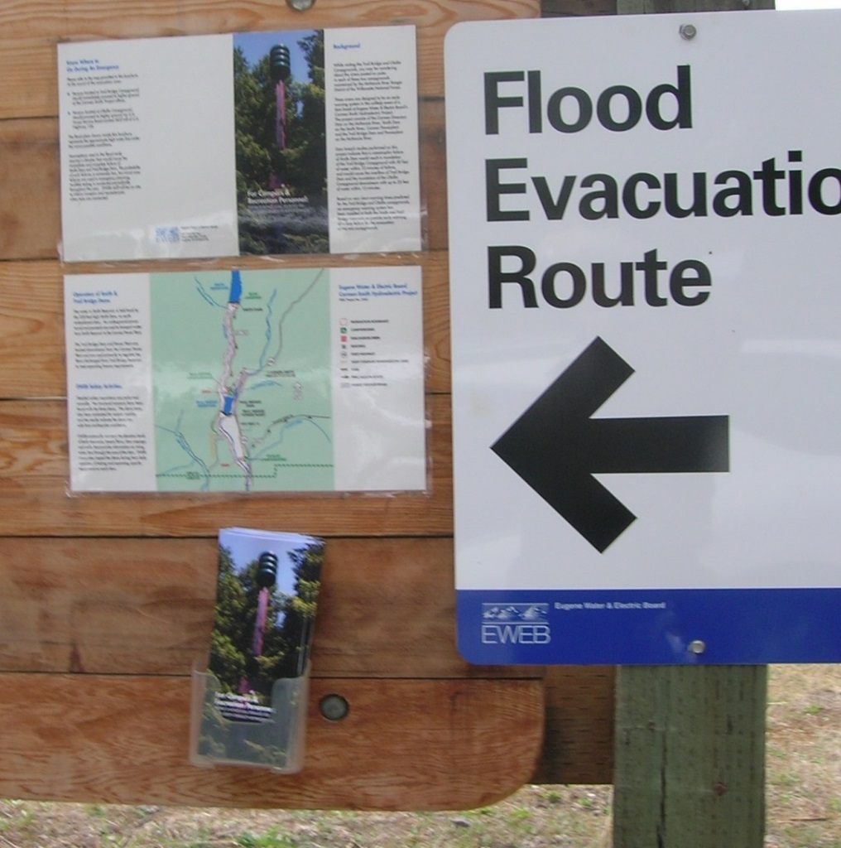
Public Education
The licensee should coordinate with the local emergency management authorities to develop and provide public education to critical downstream areas explaining what actions people should take during an emergency with the dam. It is recommended to provide annual public education to any residents within areas having a +15 minute excess response time or less.
The following are examples of how to provide public education:
Letters
Calendars with emergency information in front
Articles in community newsletters
Coordination through neighborhood volunteer liaisons
Public meetings (these are most effective following an incident that affects the community – such as the installation of a new siren or after a flood)
Signs showing evacuation routes (campgrounds/recreation areas)
Brochures/posters at campgrounds/recreation areas

Slide 26
Public Education Continued
The following are issues typically addressed with public education:
What people should do if they notice the river unexpectedly high and rising or they notice a problem with the dam.
What are signs that a problem is developing at the dam. (This is applicable primarily for residents that live within view of a remote structure.)
Where people could go to be out of the inundation zone.
How people should treat moving or deep standing water.
What residents should do if they are trapped in their house.
What people should do if they hear a siren or get a Reverse 911 call.
Who people should contact if they have questions.
It is up to both the licensee and the emergency management authority to reach a consensus on what information needs to be provided to the public. The licensee typically provides information about the area that could be inundated from a dam failure and describes what would indicate a problem with the dam. The emergency management authority typically provides information about how residents should respond to an emergency

Slide 27
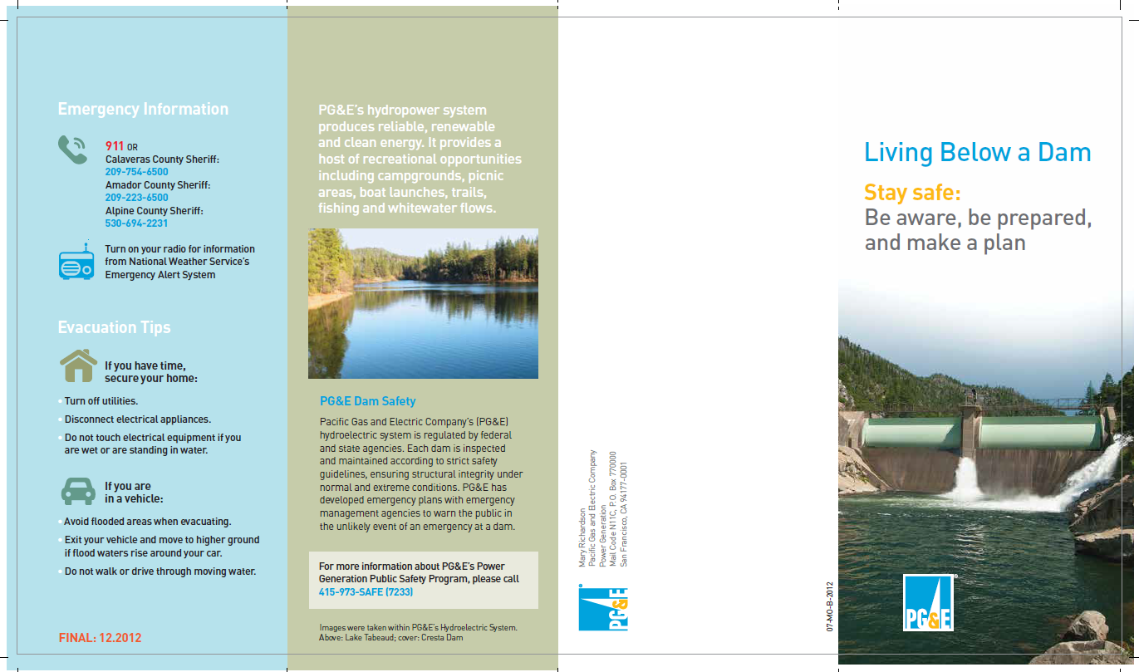
Living Below A Dam Brochure Example

Slide 28
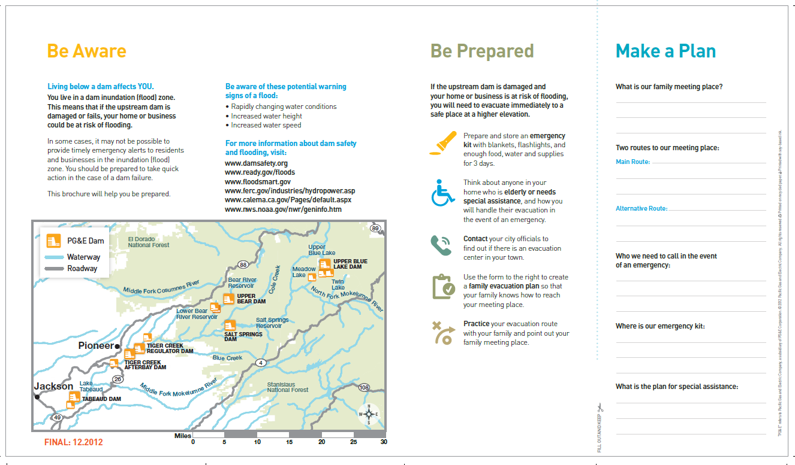
Be Aware, Be Prepared, Make a Plan Brochure

Slide 29
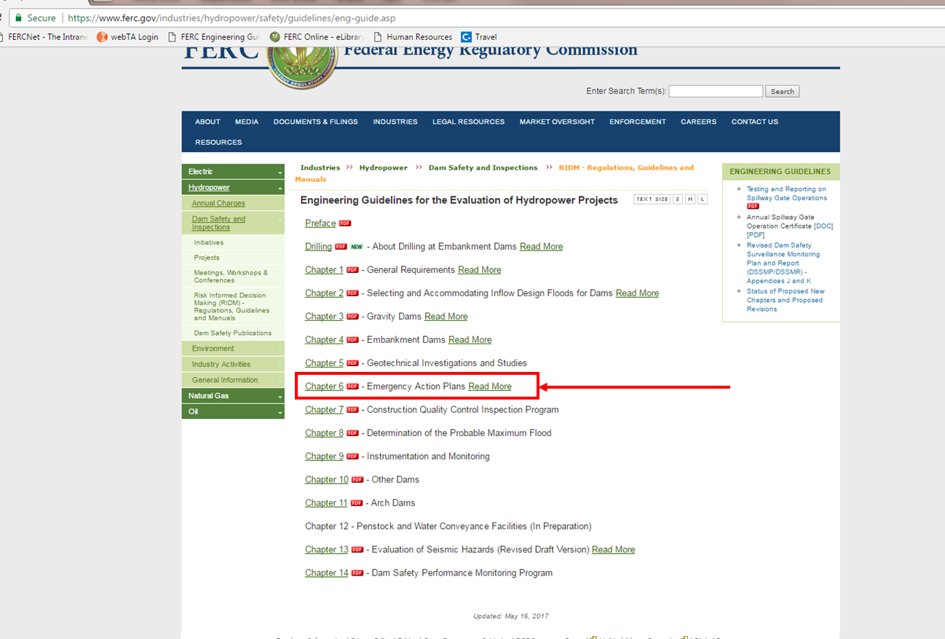
D2SI EAP Guidance
Chapter 6 of the FERC Engineering Guidelines provides guidance to licensee on the development, exercise and use of EAPs
Located here: https://www.ferc.gov/industries/hydropower/safety/guidelines/eng-guide/chap6.PDF

Slide 30
Questions

