Slide 1
Regional Resilience Assessment and Planning
Kyle Pfeiffer, Argonne National Laboratory
William McNamara, CISA
Stephen Cauffman, CISA
February 19-20, 2020

Slide 2
Regional Resilience Assessments

Slide 3
Regional Resiliency Assessment Program
The goal of the RRAP is to generate greater understanding and action among public and private sector partners to improve the resilience of a region’s critical infrastructure
  Resolves infrastructure security and resilience knowledge gaps
  Informs risk management decisions
  Identifies resilience-building opportunities and strategies
  Improves critical partnerships among stakeholders

Slide 4
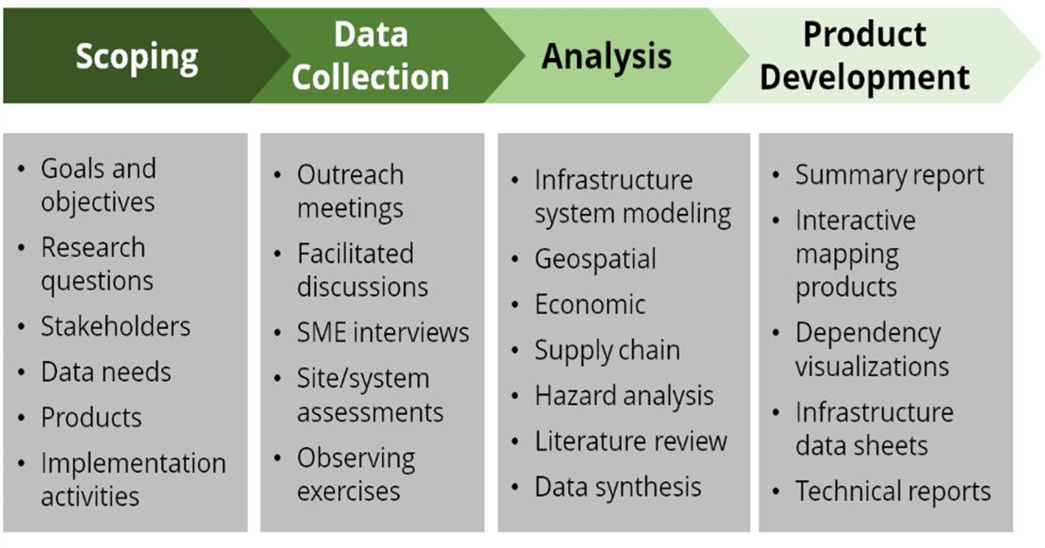
Typical RRAP Activities

Slide 5
Partnerships
Multidisciplinary partnerships are essential to building resilience
Local and regional partnerships are essential to assessments
Trusted information sharing is foundational to partnerships
Appreciating partner perspectives and needs, balancing with agency objective
“…the nature of the critical infrastructure risk environment precludes any one entity from managing risks entirely on its own…” (NIPP)

Slide 6
2016 Branson, MO RRAP Project

Slide 7
Regional Resilience Planning

Slide 8
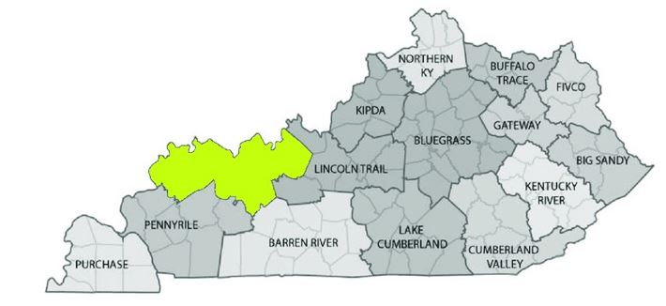
Genesis of the Project
  Background
  Desire by Commonwealth of Kentucky to reduce the incidence of repetitive losses due to flooding through enhanced hazard mitigation planning process
  Partner Objectives
  Develop a repeatable process for the regional development organizations to incorporate critical infrastructure resilience into hazard mitigation planning to reduce the cost of disasters to the State
  Reduce cost of disasters to impacted communities
  CISA Objectives
  Inform the revision and development of guidance, tools, and resources
  Create examples of IRPF applications
GREEN RIVER
Courtesy of Kentucky Association of Economic Development

Slide 9
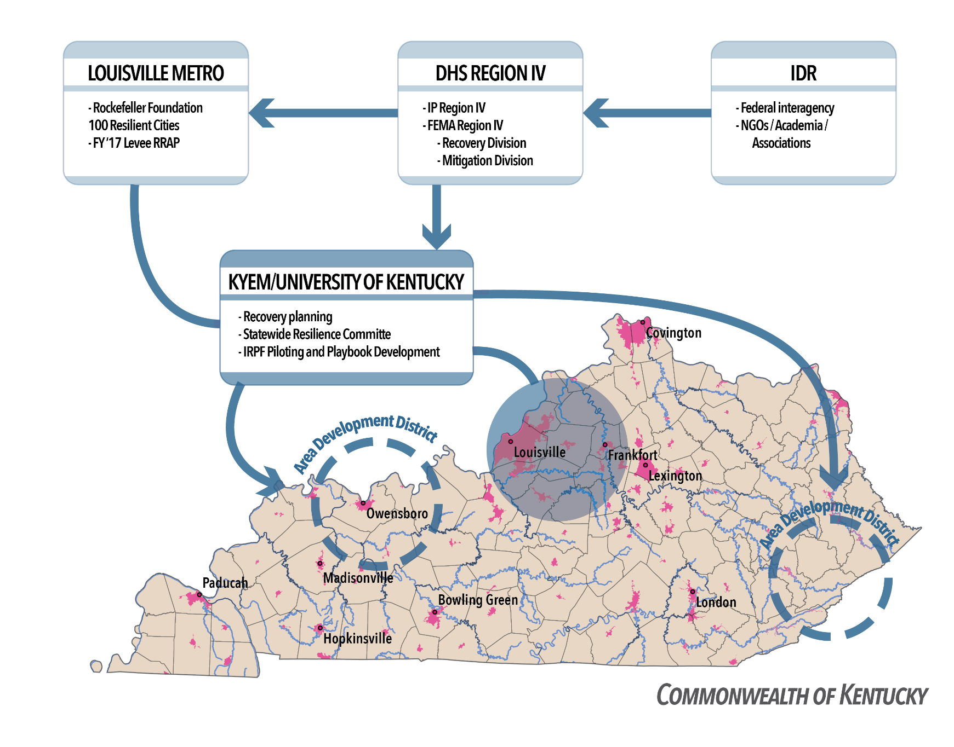
Kentucky Pilot Partners
Notes:
Who are the players in the pilot and what are we building from?
Acknowledge what GRADD is already doing and point out how IRPF/pilot will fill gaps
Purpose and process for the pilot:
- Develop: Create content for the IRPF, vet it with Federal partners including NIST, FEMA, and CISA Regions
Pilot: Work with state and local partners to identify gaps and tool requirements for the IRPF
Transfer: Revise the IRPF and tools based on stakeholder input and work with partners to transfer the capability to CISA regions and state and local partners.

Slide 10
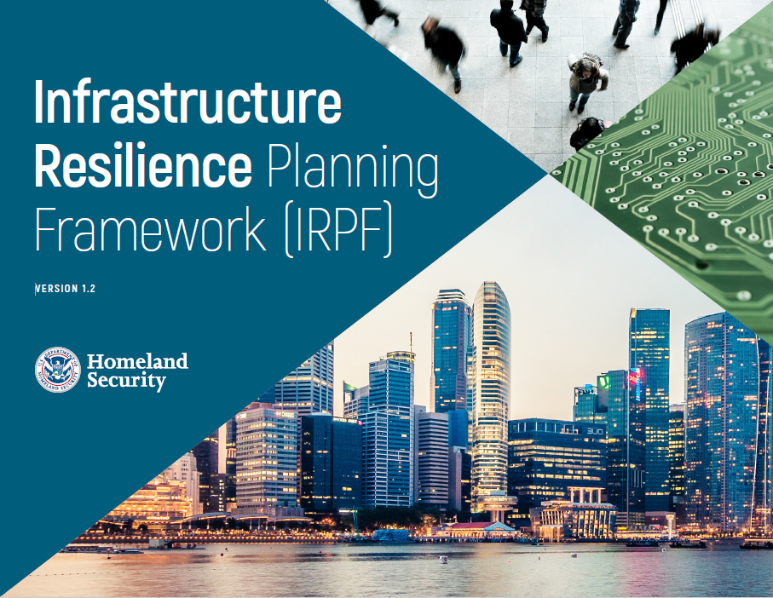
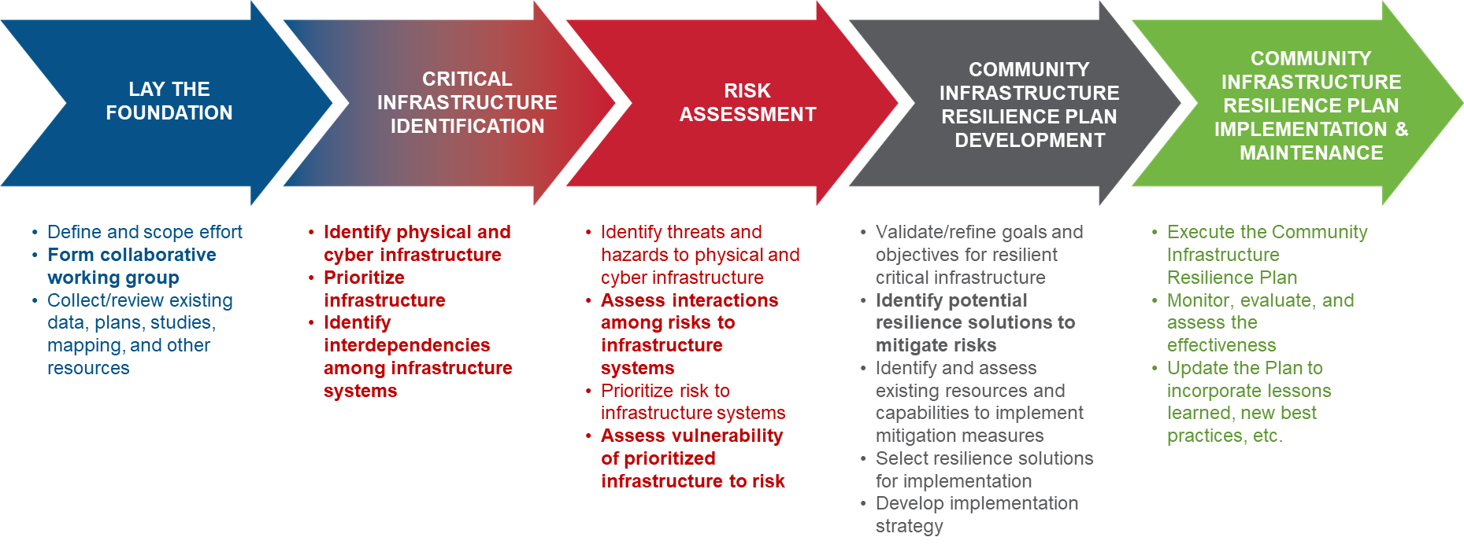
Infrastructure Resilience Planning Framework
Includes comprehensive, step-by-step planning guidance, templates, and other resources to inform long-term planning and investment decisions
Five steps from stakeholder engagement to risk assessment and implementation
Notes:
Developed with engagement and input, now ready to publish and working on web format. Needed use cases for SLTTGs to test and see its value.

Slide 11
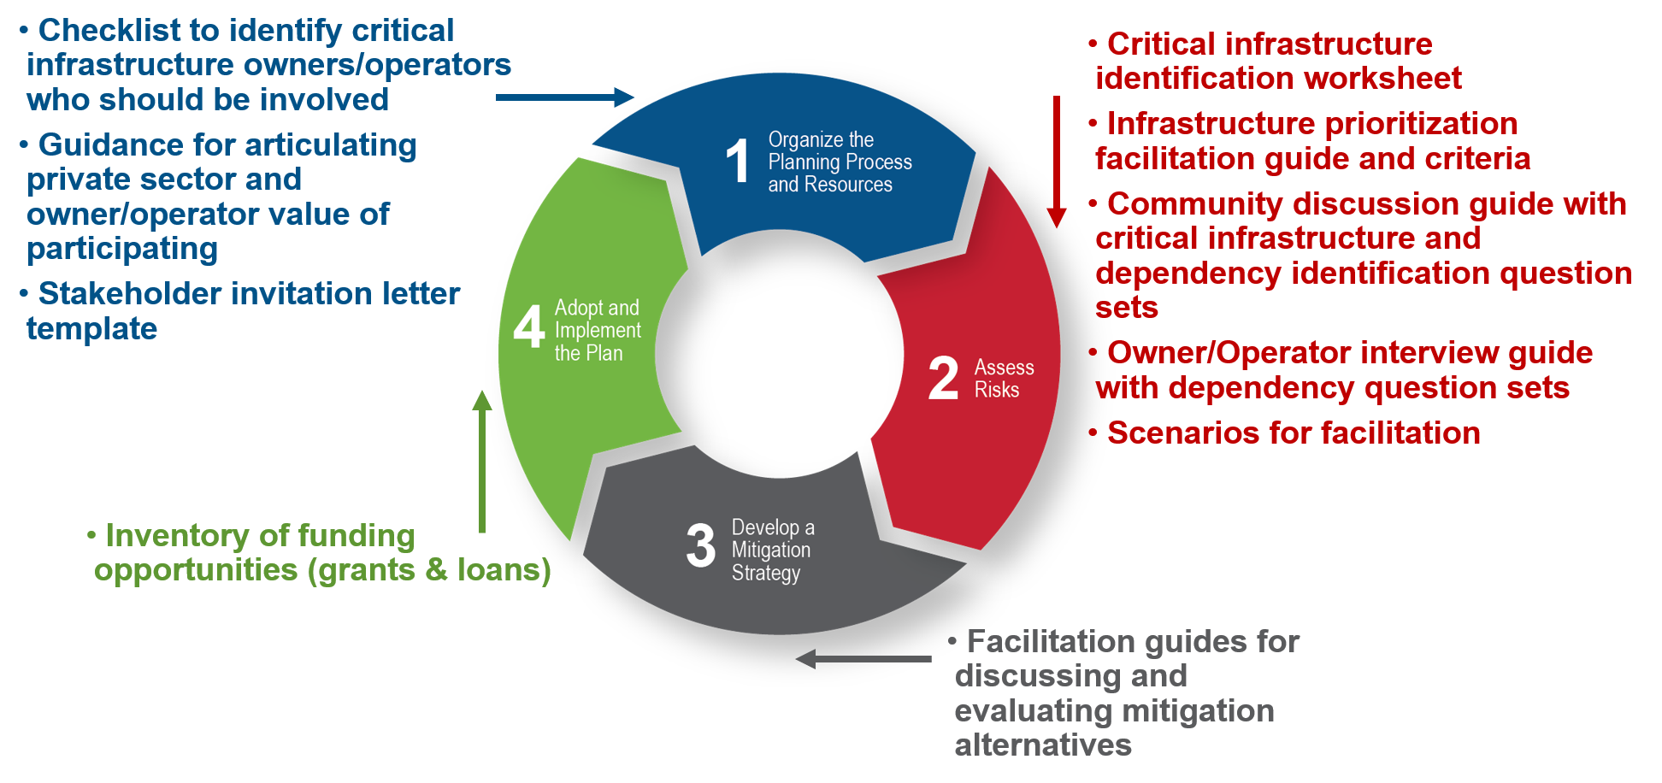
Project Activities
Worked with Commonwealth and GRADD to scope effort and identify opportunities
Developed tools and resources to support Hazard Mitigation Planning
Testing draft tools and resources in community meetings
GRADD pursuing FEMA grant to support plan integration and dependency identification

Slide 12
Pilot Outcomes
  Local Outcomes
  Reduce cost and consequences of disasters on impacted communities
  Use critical infrastructure dependency analyses to inform investment priorities and identify funding sources
  State Outcomes
  Develop methods and tools to support a replicable process for enhanced hazard mitigation planning that can be applied statewide
  CISA-ISD Outcomes
  Inform the revision and development of guidance, tools, and resources
  Build an example for Infrastructure Resilience Planning Framework application that can be disseminated through states, federal partners, CISA Regions and associations such as NADO
Notes:
Message: want to know what their objectives are of working with us and what benefits they see

Slide 13
Discussion/Questions

