Slide 1
Augusta Canal – Aging, Historical Landmark, Urban Environment, Complicated?
You name it – It’s got it!
National Dam Safety Program Technical Seminar | 2022
Notes:
Title slide + Image Option 2

Slide 2
Presentation Outline – Augusta Canal
About the Project
  Project Overview, Basic History, Current Purpose
Dam Safety Challenges
  General, Deficiencies
Addressing Challenges

Slide 3
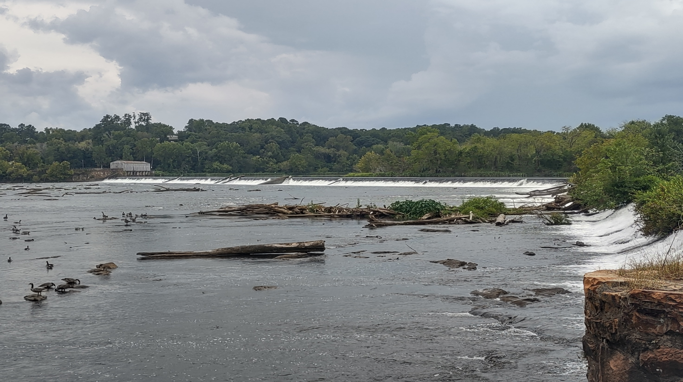
ABOUT/BACKGROUND

Slide 4
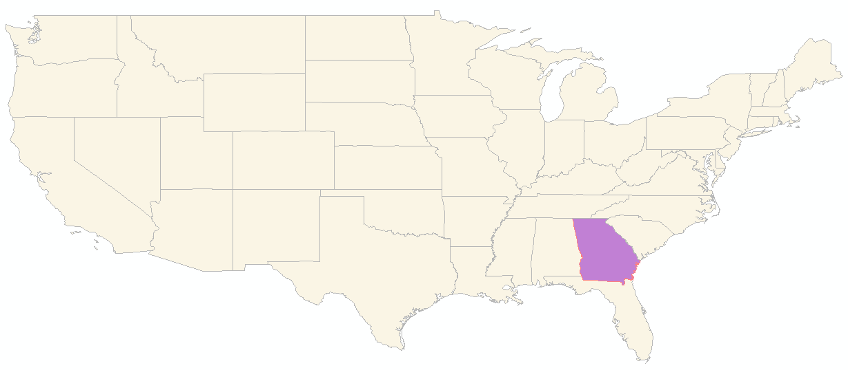
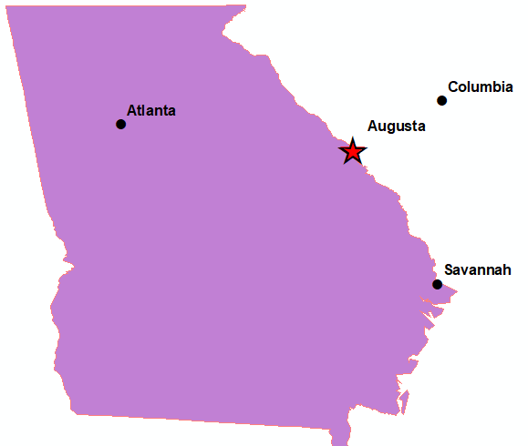
What and Where
Augusta Canal Hydropower Project
  Augusta, Georgia & Edgefield County, South Carolina
  Savannah River
  Augusta Canal

Slide 5
Augusta Canal - Layout

Slide 6
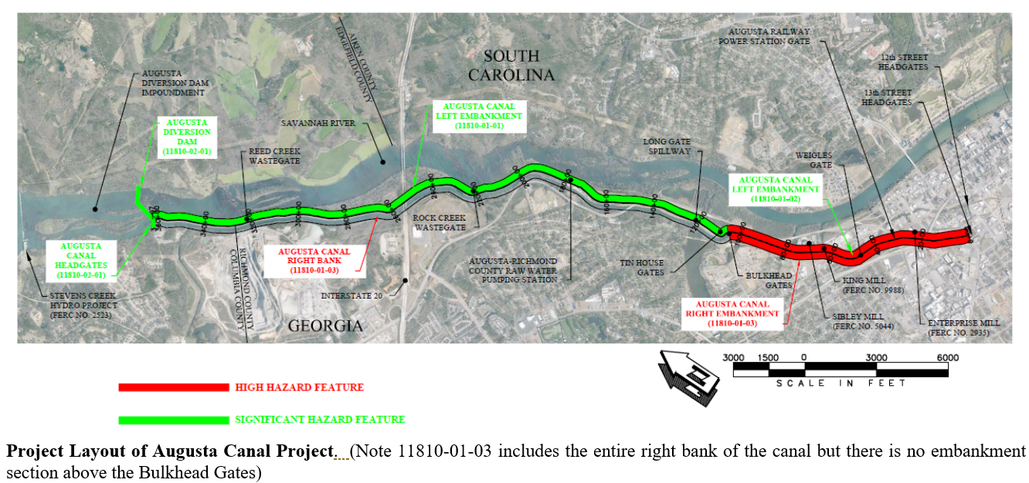
Augusta Canal – Layout (2)
Notes:
Discuss Bulkhead Gates are dividing point from Significant Hazard to High Hazard.
BH Gates can shut of inflow into high hazard section with no other inflows.

Slide 7
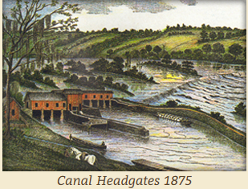
Augusta Canal - History
Originally designed and constructed in 1840s
Widened and deepened in 1850s and 1870s
  Powered multiple textile mills along the canal
Savannah River levee system constructed in 1910s
  Included construction of Bulkhead Gates
Multiple structural modifications made in last 100 years
  Mills switched to hydroelectric power ~1920s
Notes:
- Basic and broad history of the Augusta Canal.

Slide 8
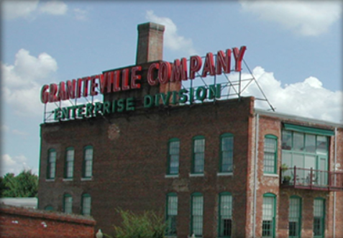
Augusta Canal – History (2)
Mid-20th century – Period of Neglect
Revival began starting in mid-1970s
Designated a Natural Heritage Area in 1996
Oldest continuously operating hydropower canal in USA
  Augusta Canal Website: https://augustacanal.com
Notes:
- Opt: Story about tree flagging and person taking it down.

Slide 9
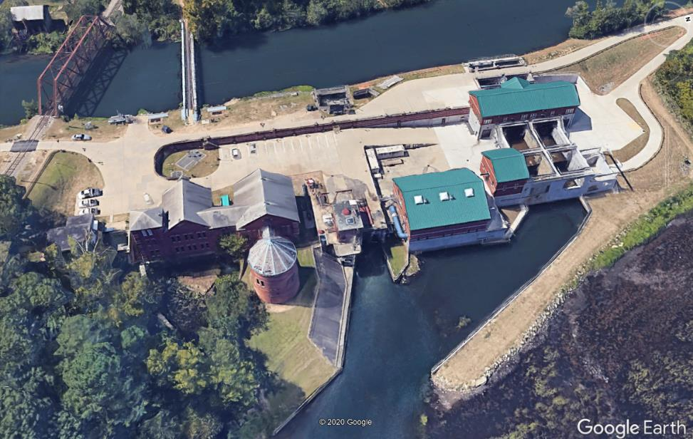
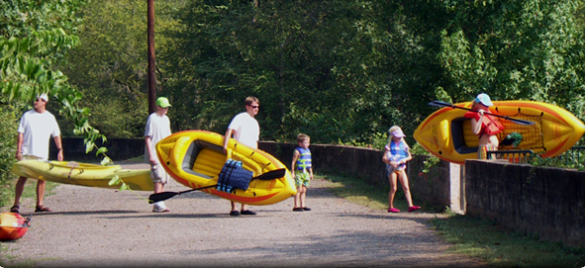
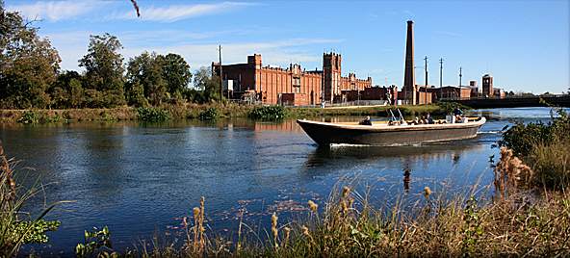
Augusta Canal - Present Purpose
Augusta Utilities
  Public drinking water supply
  Hydro-mechanical power
Augusta Canal Authority
  Hydroelectric power (3 Mills)
Community recreation activities
Notes:
- Not built with any real modern day design methods.

Slide 10
CHALLENGES

Slide 11
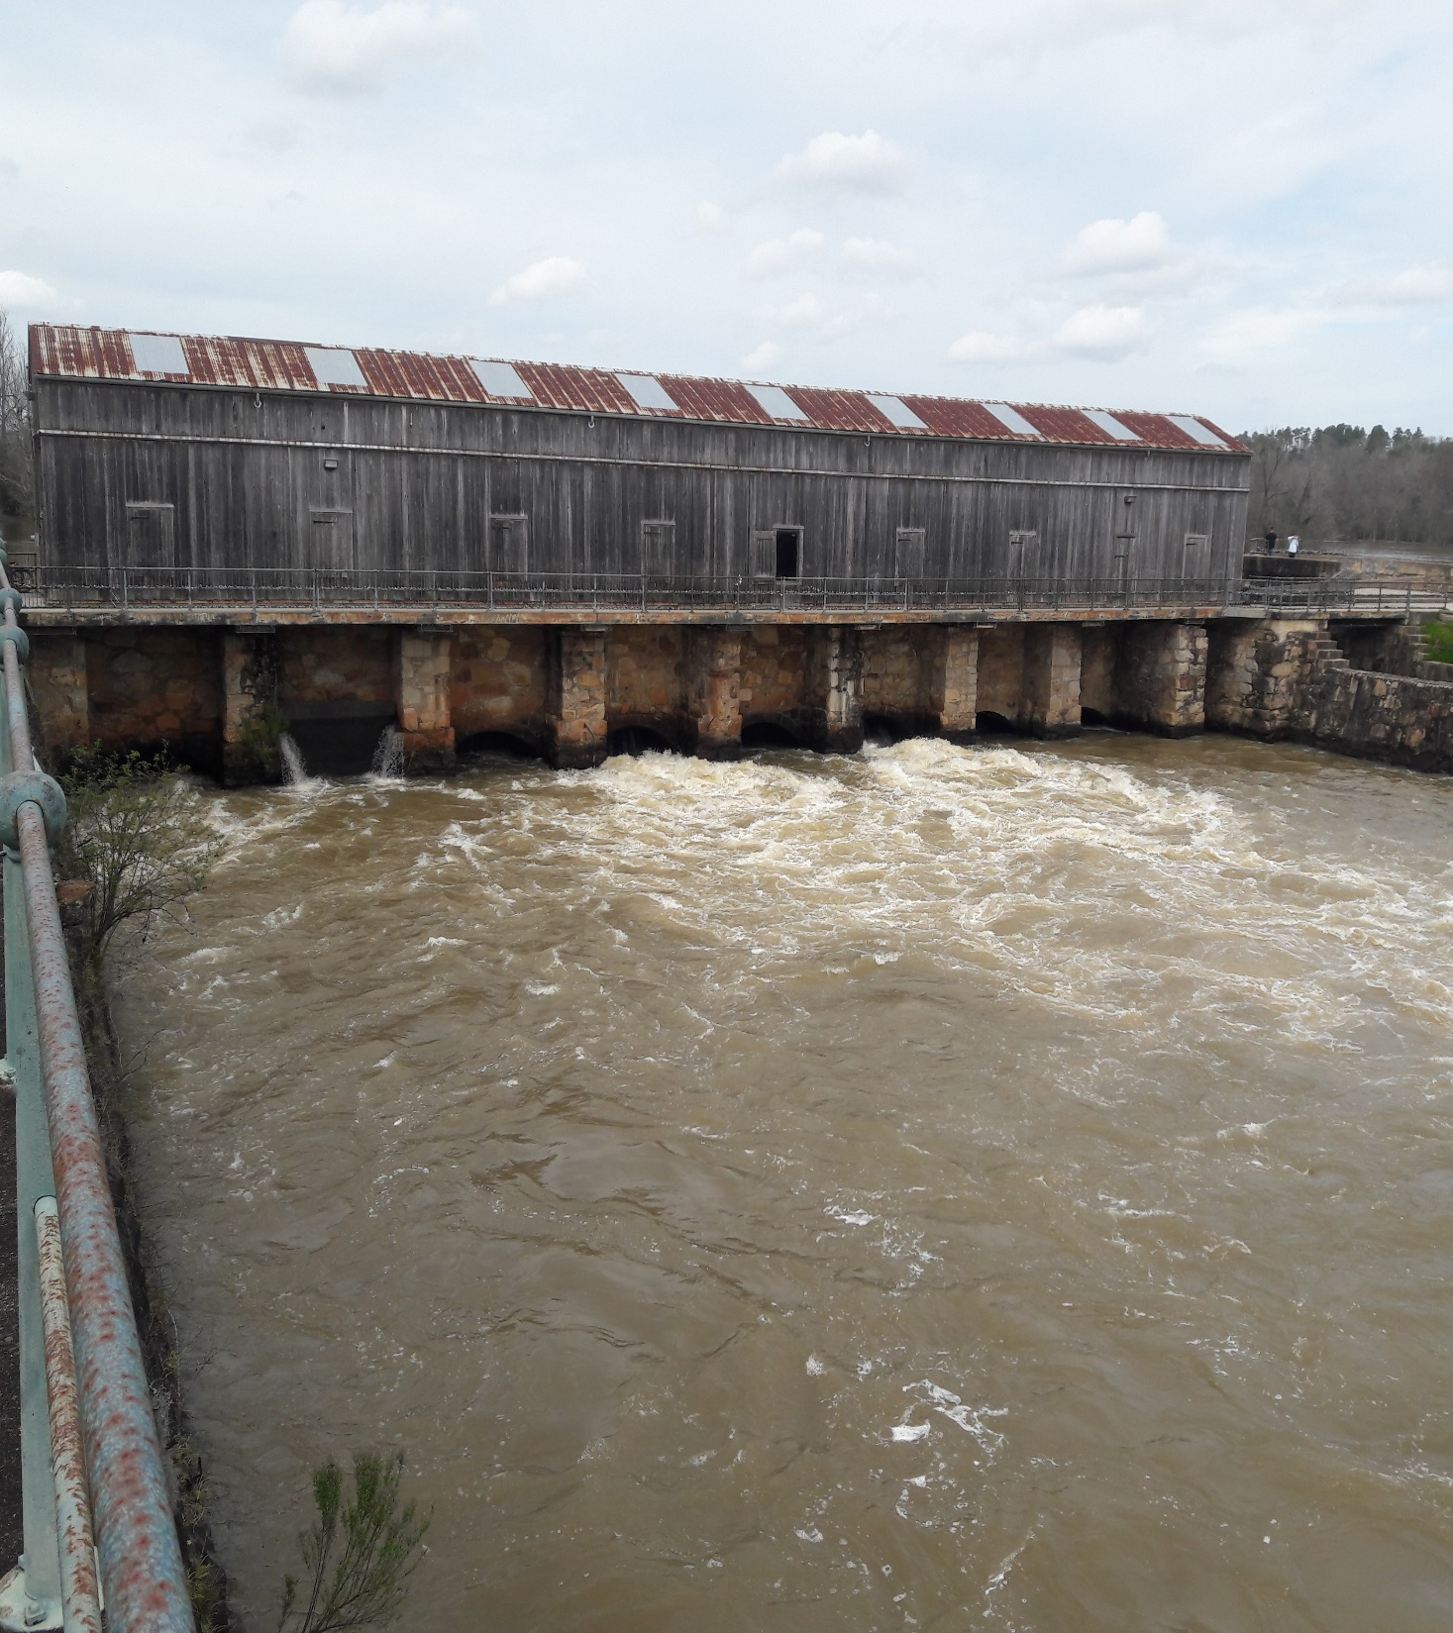
Dam Safety Challenges - General
Old and Aging
Long Embankments
Multiple Structures
  Dams, Intakes, Inflow/Outflow Gates, Spillways, Pump Station
A lot of Moving Parts
~ 8 Miles of Embankment
> 14 Structures
Canal Headgates
Notes:
- Not built with any real modern day design methods.

Slide 12
Location, location, location
High hazard, highly urbanized
Multiple structures immediately next to canal embankment
  Little to no warning time in case of breach

Slide 13
Multiple structures immediately next to canal embankment

Slide 14
Dam Safety Challenges – General (2)
Municipality
Resources
Public park and trail / a focal point of Augusta
  Can be a good thing
Historical Landmark
Fighting the “it’s been here forever” and “it’s fine” mindset
Getting a focus on dam safety priorities
  Compete with non-dam safety priorities (e.g. trees)
Notes:
- Opt: Story about tree flagging and person taking it down.

Slide 15
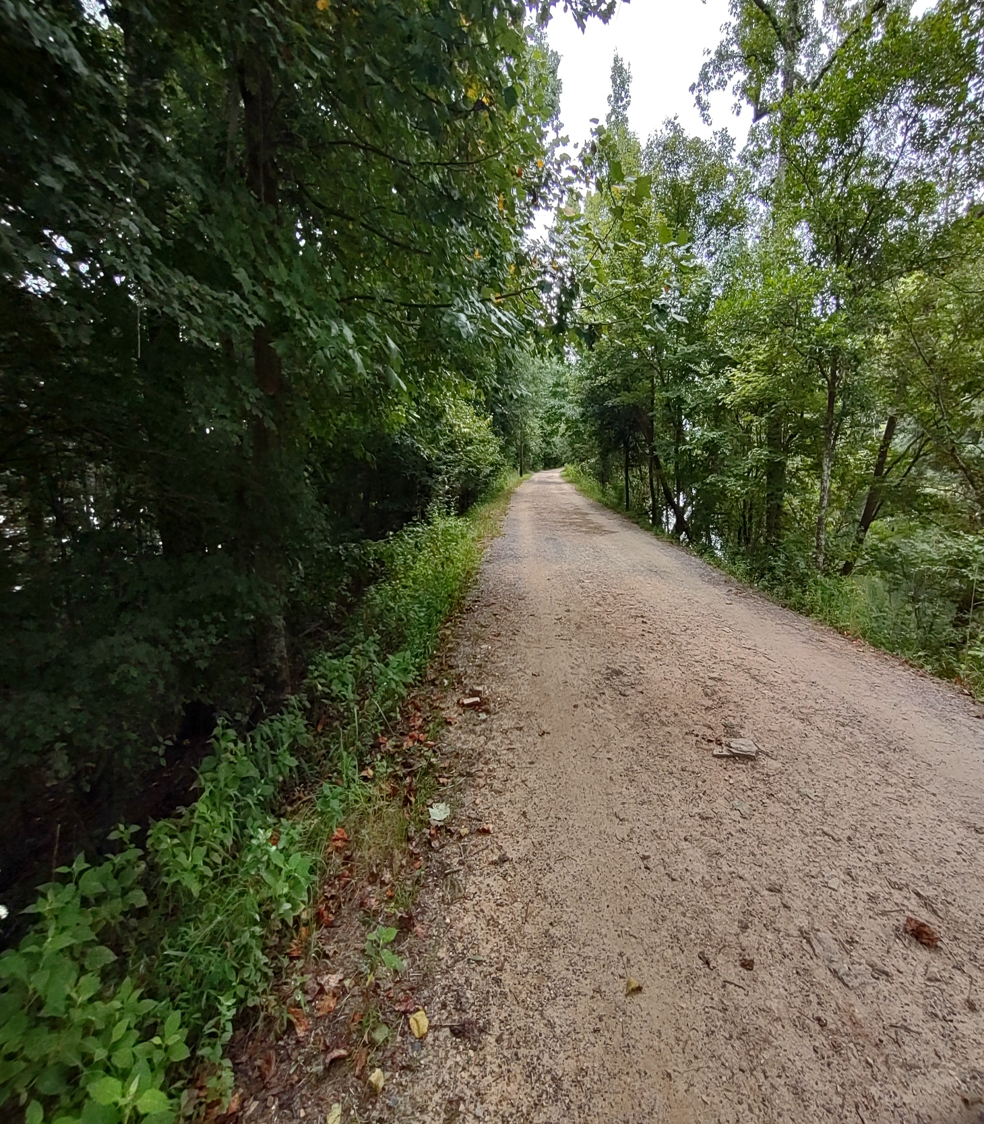
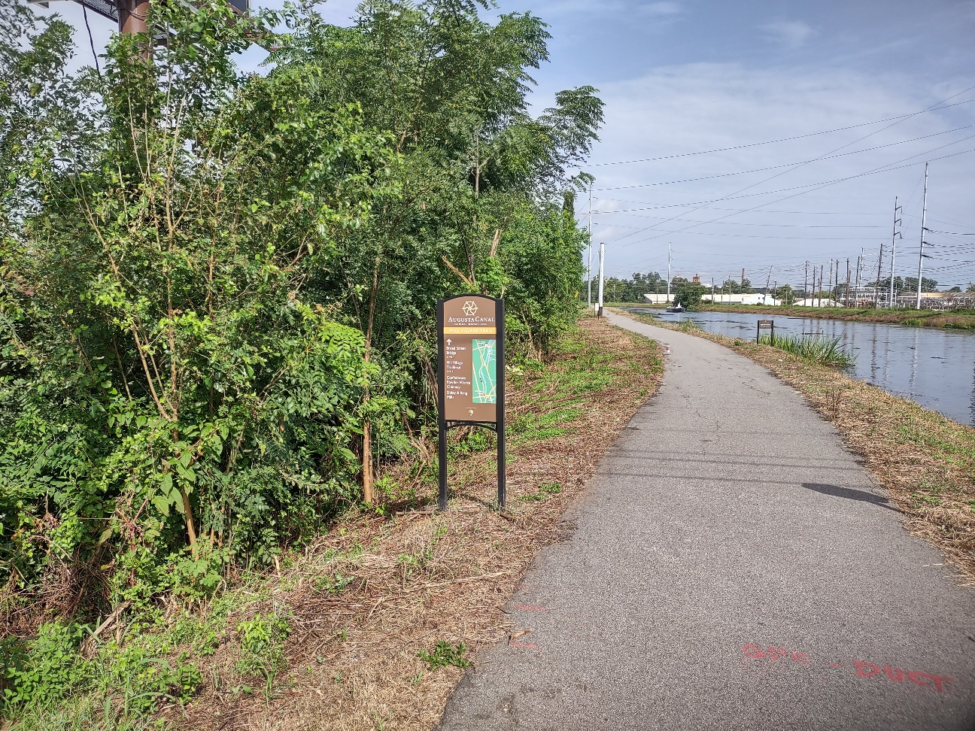
Dam Safety Challenges - Deficiencies
Heavy Trees/Vegetation
River | Canal
Left Embankment
Right Embankment
Notes:
- Opt: story about 2019 clearing and how people commented on liking the view of the river.

Slide 16
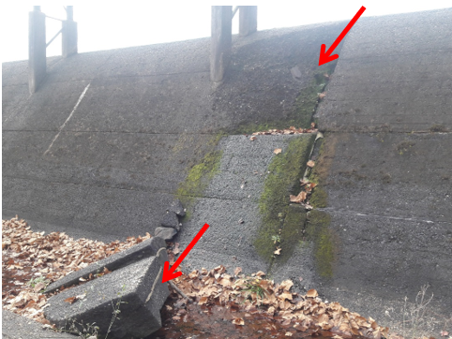
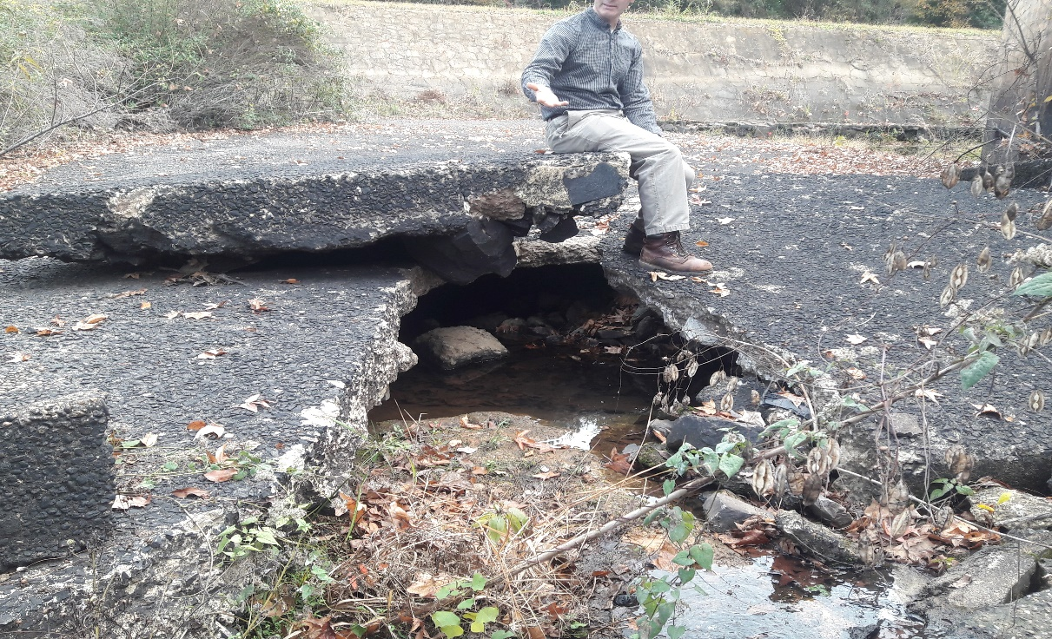
Dam Safety Challenges - Deficiencies
Long Gate Spillway
  Low flow gates spilled continuously for three months in 2016
  Spalling on spillway
  Undermining of downstream channel

Slide 17
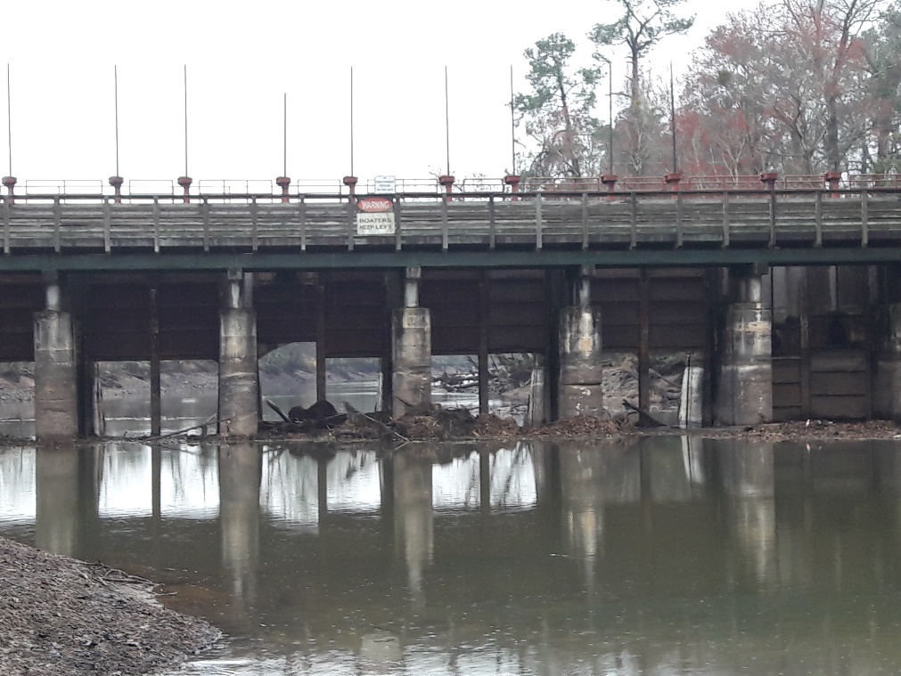
Dam Safety Challenges -Deficiencies (2)
Bulkhead Gates Structure
  Critical feature of the Canal
  Beginning of High Hazard Section
Notes:
- Opt: story about 2019 clearing and how people commented on liking the view of the river.

Slide 18
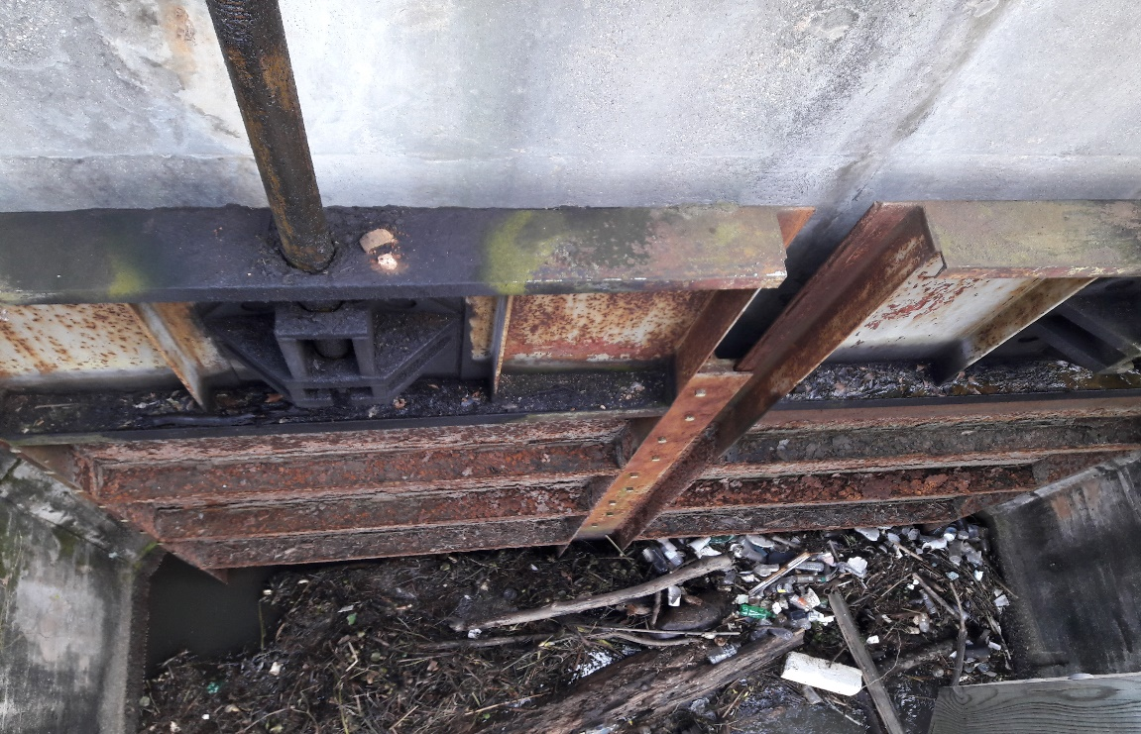
Dam Safety Challenges – Deficiencies (3)
Bulkhead Gates Structure
  “reached the end of their service life” (Part 12 Independent Consultant)

Slide 19
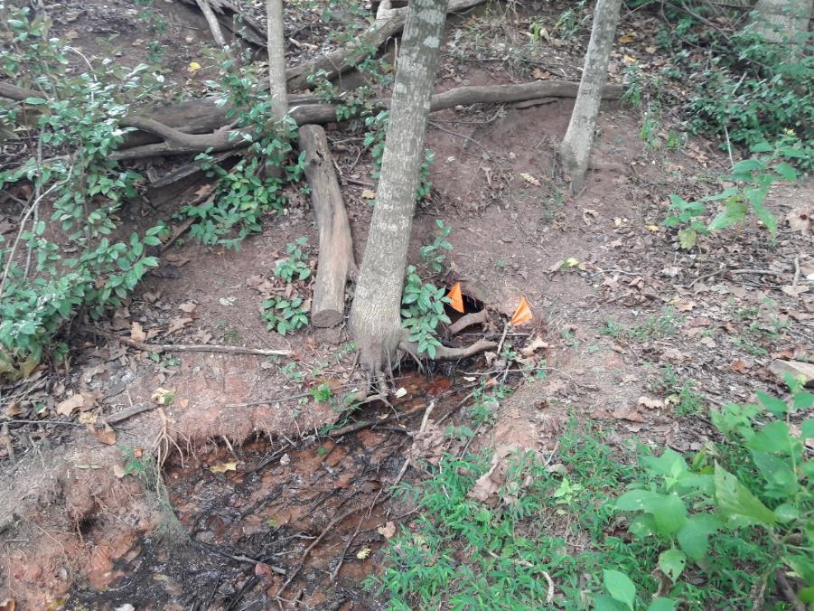
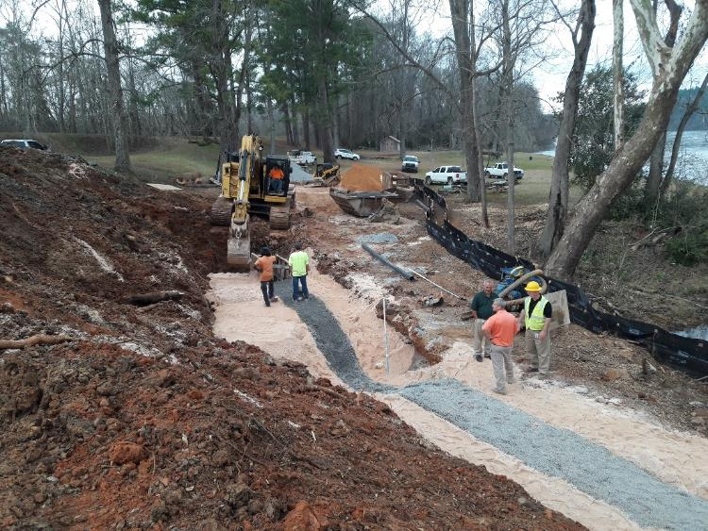
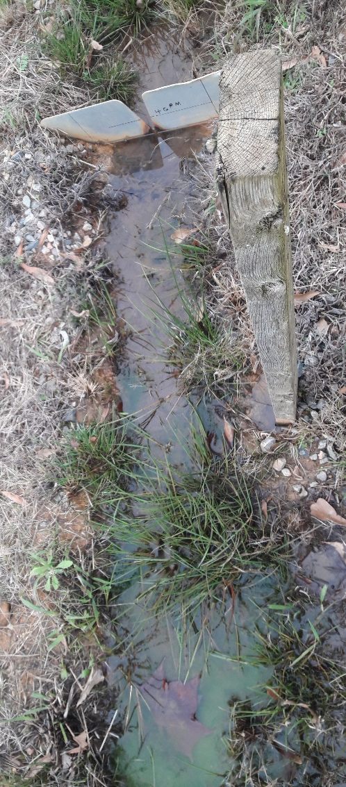
Dam Safety Challenges - Deficiencies – Seepage

Slide 20
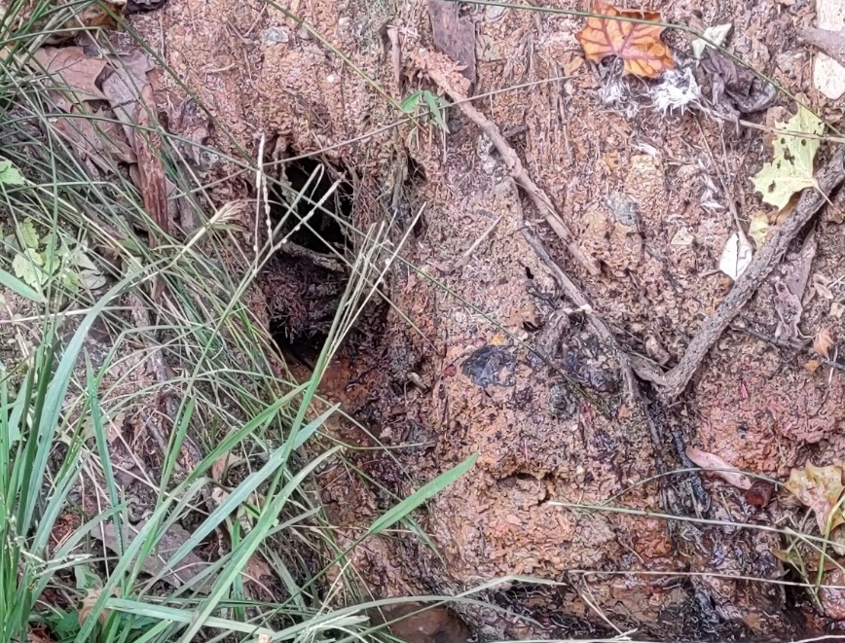
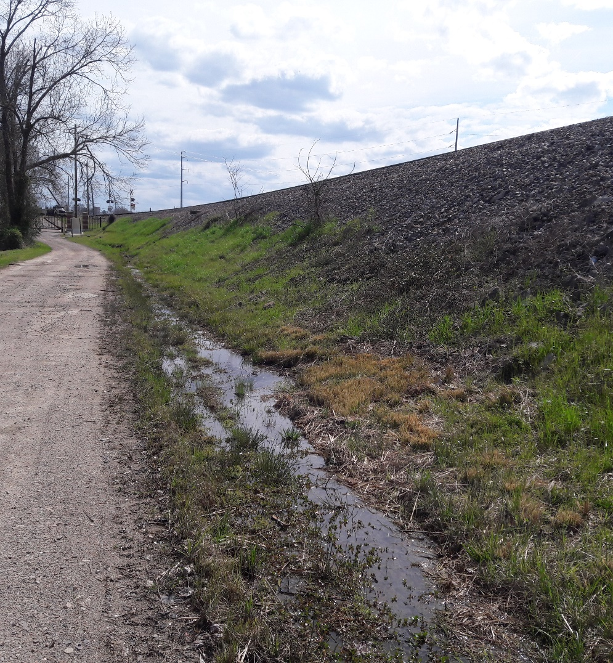
Deficiencies – Seepage

Slide 21
Dam Safety Challenges – General (3)
Compliance
  FERC project for a long time
  Only under D2SI w/in last 15-20 years
Most Recent Part 12 Report
  63 Recommendations
  With sub-recommendations, actually >100
Notes:
- Opt: Story about tree flagging and person taking it down.

Slide 22
ADDRESSING CHALLENGES

Slide 23
Addressing Challenges – Augusta Canal
Prioritization
  Dam Safety vs. Reliability vs. Compliance
Communication, Communication, Communication
Regulator Bias Viewpoint

Slide 24
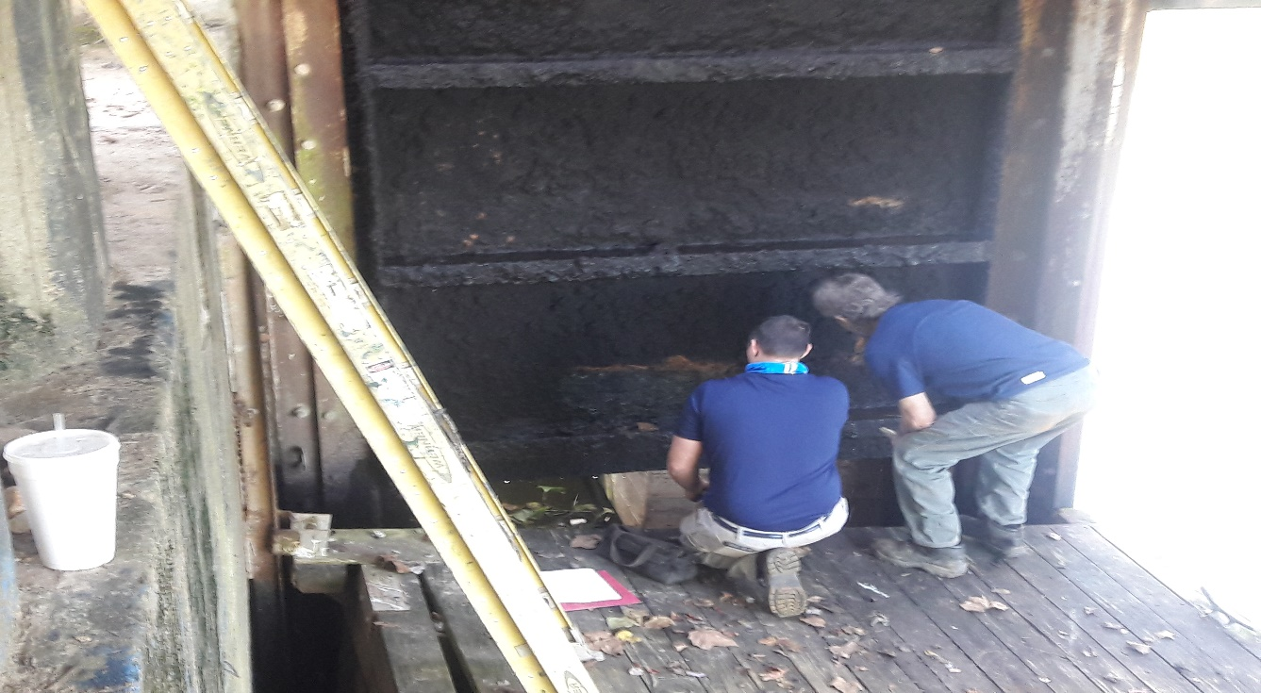
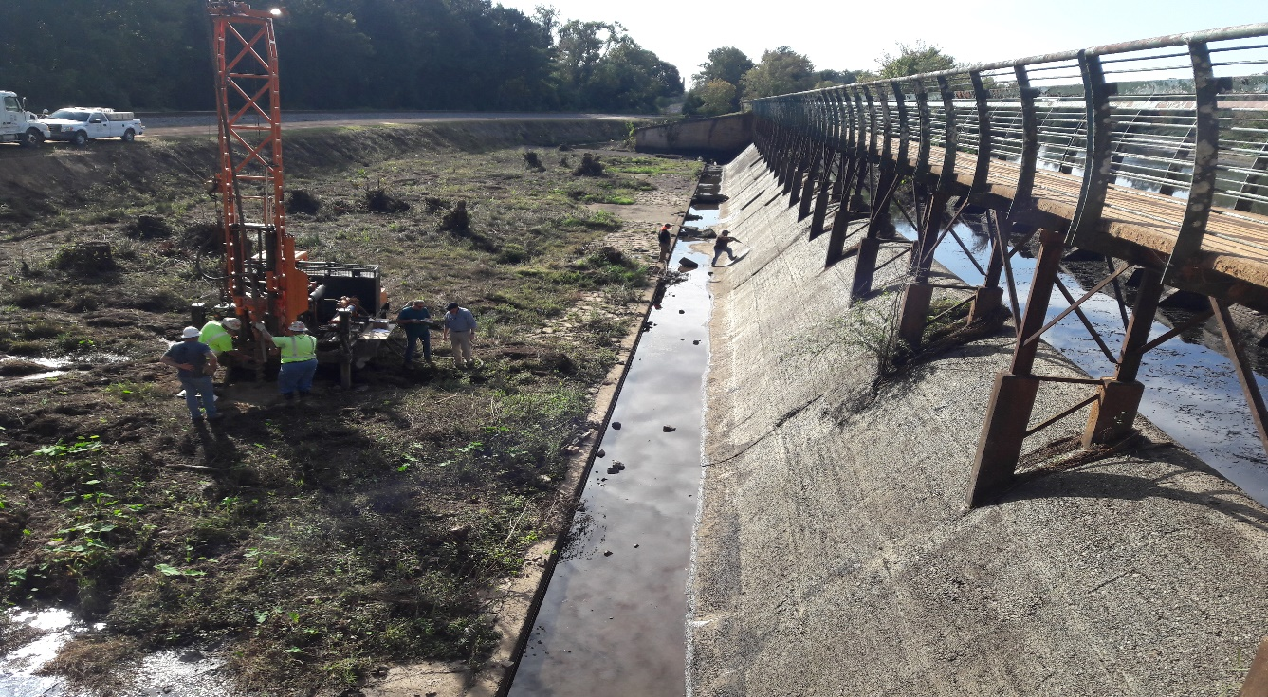
Prioritization
Bulkhead Gates, Bulkhead Gates, Bulkhead Gates!
Long Gate Spillway
Seepage
Other dam safety issues
Compliance
Interim Risk Reduction Measures
Sometimes it feels like juggling.

Slide 25
Addressing Challenges – Augusta Canal (2)
Communication
  Open and Consistent
  Work together
  Build Relationship
  Learn from each other
  Education to help focus on dam safety
  Compliance coordination

Slide 26


Addressing Challenges – Augusta Canal (3)
Set up Regular Conference Calls
  Participation from licensee staff, regulator, and consultants
  Build relationship
  Reduce out of sight out of mind
  Reduce likelihood of getting in letter writing campaign

Slide 27
Addressing Challenges – Augusta Canal (4)
Where do we go from here?
  Address critical items.
  Don’t have it all figured out. Never will.
  New challenges ahead.
  Continue communication.
  Continue to research technical and non-technical methods to help keep the project safe and reliable.

Slide 28
THANK YOU, QUESTIONS, AND CONTACT INFO
?

Slide 29

Contact Slide Option 2
Shae Hoschek
Civil Engineer
Federal Energy Regulatory Commission (FERC)
Atlanta Regional Office (ARO)
shae.hoschek@ferc.gov
678-245-3077

