Slide 1
Assessing Flood Risk in the California Delta
National Dam Safety Program Technical Seminar | February 16-18, 2021
Lawrence H. Roth, PE, GE, ENV SP
Jessica J. Ludy, CFM
Notes:
Title slide + Image Option 2

Slide 2
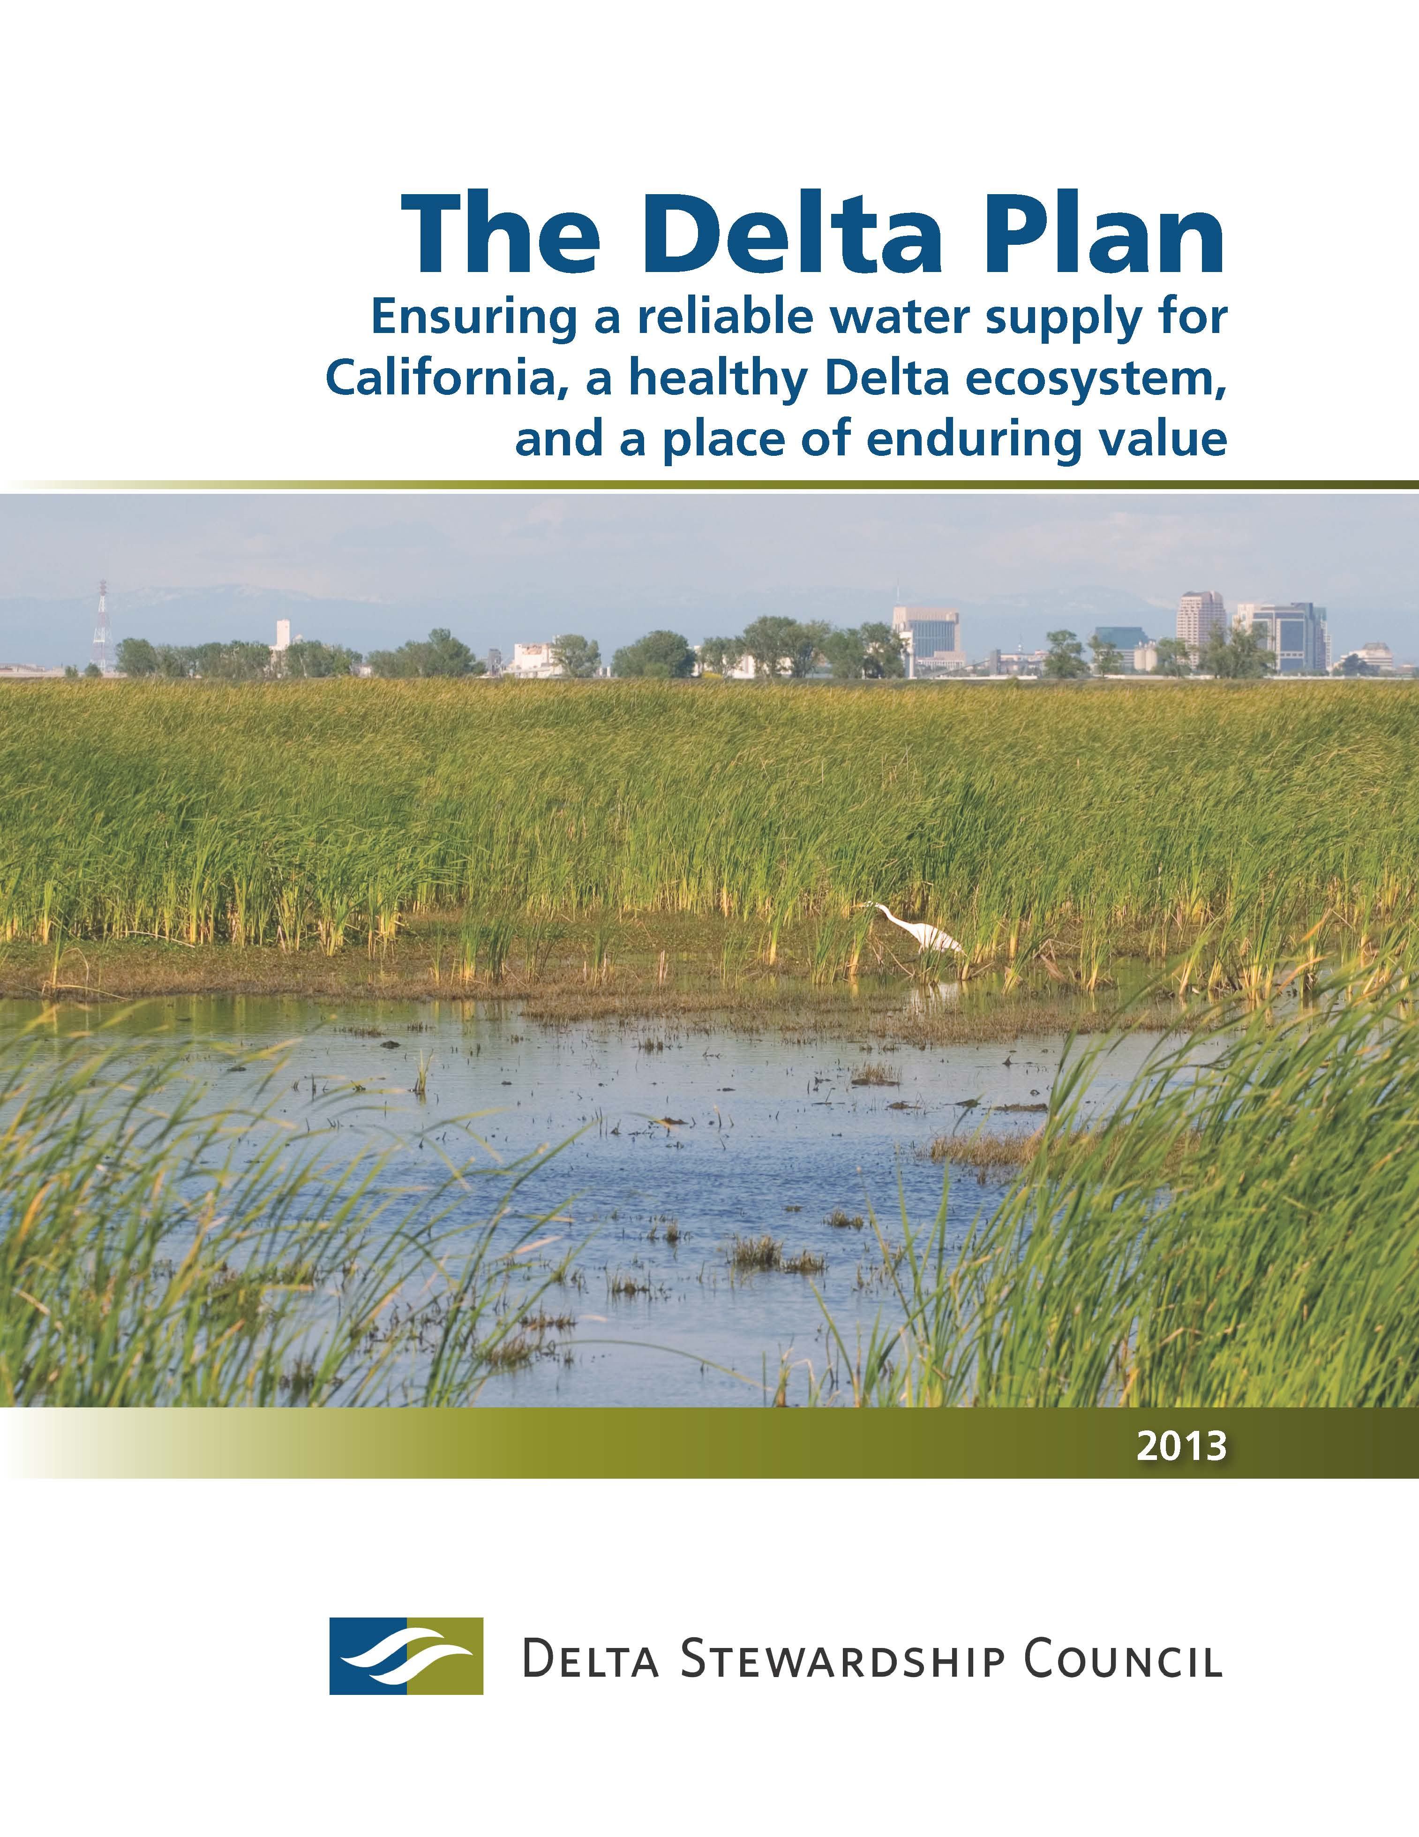
California’s Delta Stewardship Council
State agency created in 2009 by the Delta Reform Act
Mission is to advance the state’s coequal goals for the Delta
  Provide a more reliable statewide water supply
  Protect, restore, and enhance the Delta ecosystem
  Achieved while protecting the Delta as an evolving place
The Delta Plan is an enforceable, sustainable management plan
Recommend priorities for state investments in Delta levees to reduce flood risk and advance the coequal goals

Slide 3
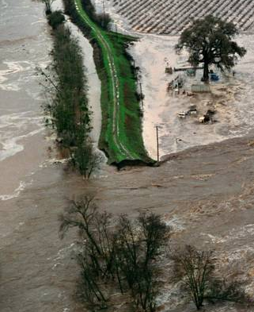
Today’s Discussion
Today’s discussion
The California Delta
Level of Protection
What is Risk?
Using Risk Analysis to Inform Decisions
What Does Risk Analysis Tell Us about the Delta?
Applying Tolerable Risk Guidelines
For More Information

Slide 4
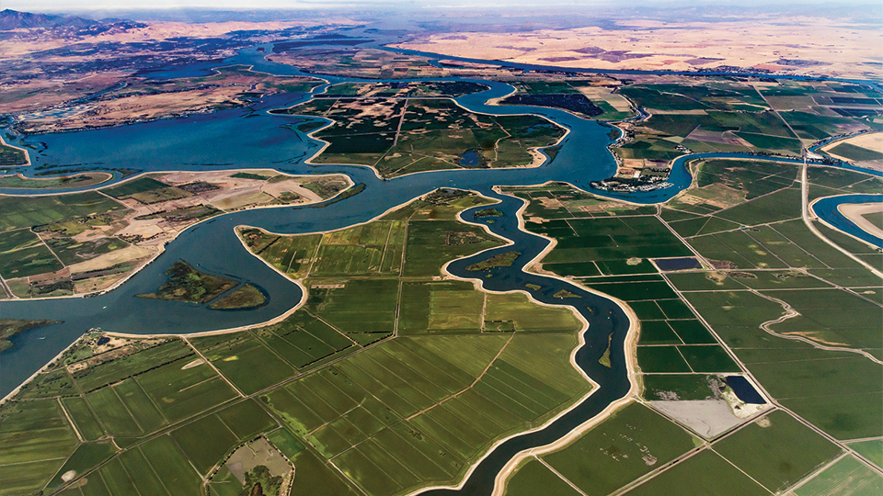
The California Delta

Slide 5
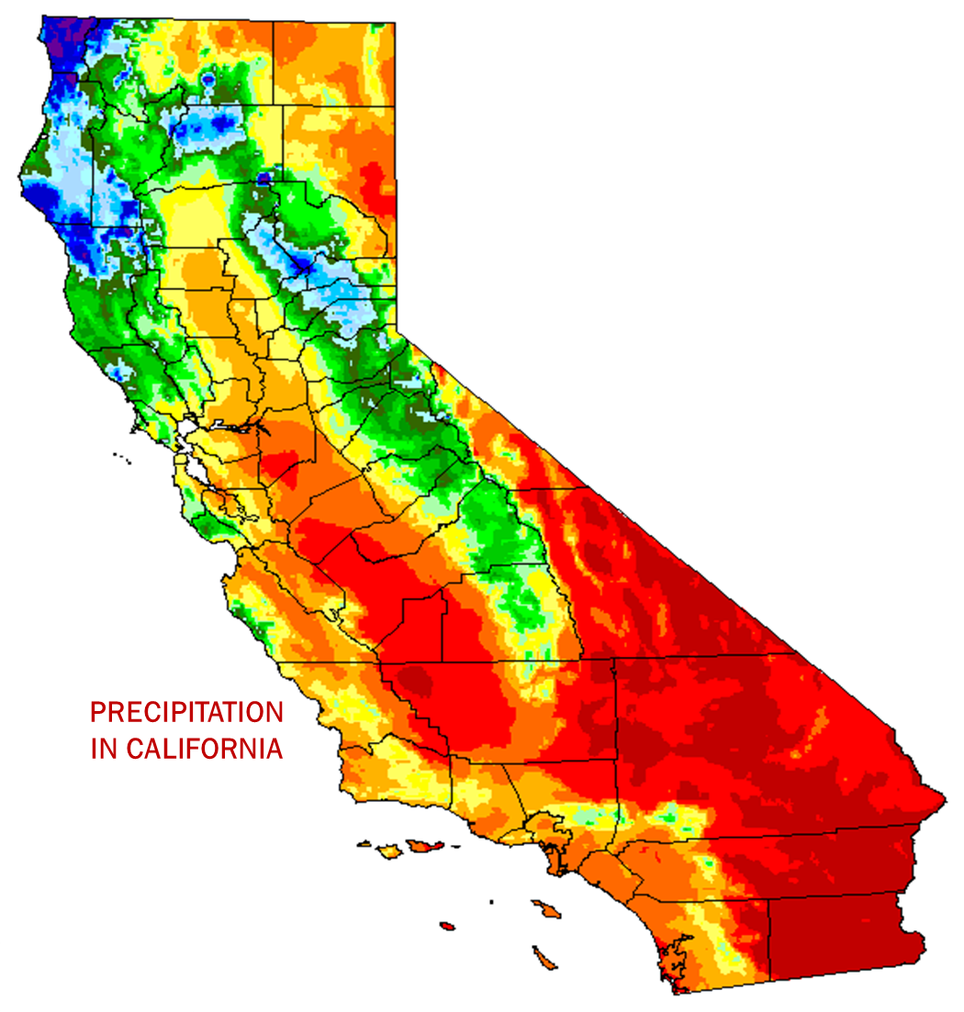
Water In California
Water in California
Most of the precipitation falls in the north and in the Sierra Nevada
Most of the agriculture demand is in the Sacramento and San Joaquin valleys
Most of the urban demand is in Southern California and the Bay area

Slide 6
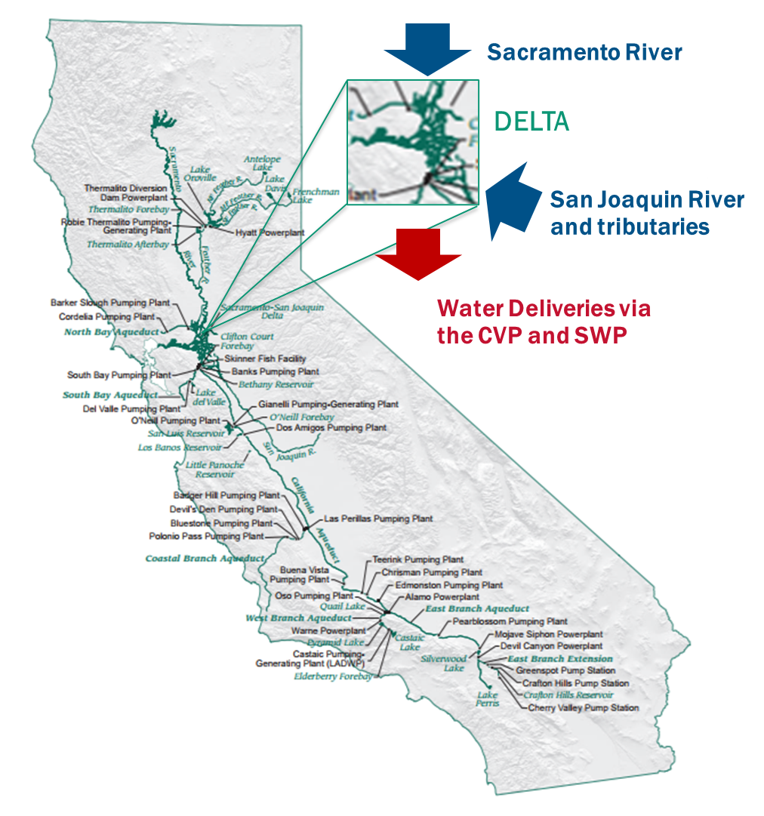
The Delta is the hub of the state’s water delivery system
The Delta is the hub of the state’s water delivery system
Confluence of the Sacramento and San Joaquin rivers
27 million people rely on water from the Delta
Water from the Delta irrigates about 4 million acres of farmland
Delta ecosystem depends on healthy and consistent flows

Slide 7
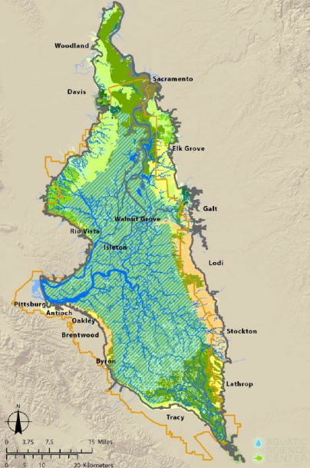
The Pre-1800s Delta
The Pre-1800s Delta
Called the American Serengeti
> 540 mi² freshwater wetlands
> 380 mi² tidal marsh
> 500 species of fish and wildlife
Periodic flooding created a vast inland sea

Slide 8
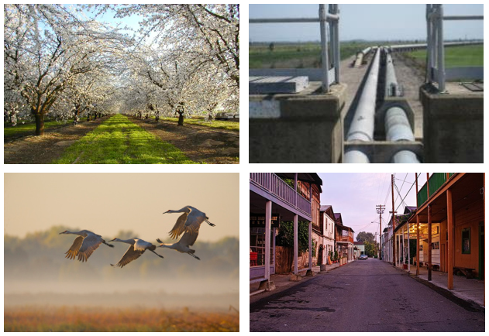
The California Delta (2)
The California Delta
Agriculture
Infrastructure
Fish and wildlife
Recreation and eco-tourism
Delta as a place

Slide 9
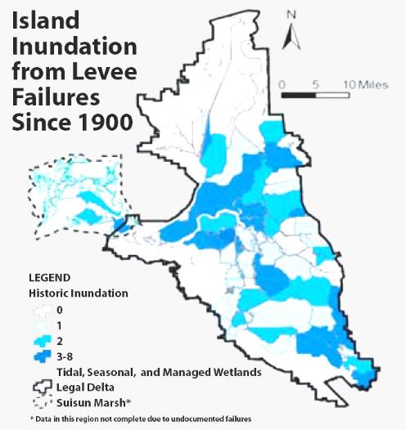
The California Delta (3)
The California Delta
~ 1200 mi²
> 150 islands and tracts
> 1100 mi. of levees
> 158 levee failures since 1900

Slide 10
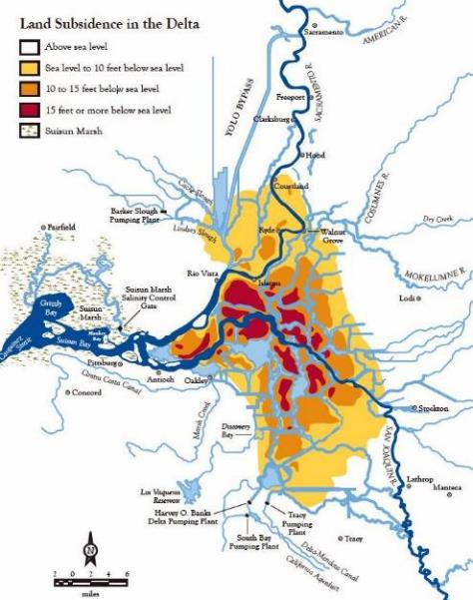
Island subsidence
Island subsidence
Extensive deposits of peat and organic soil
Subsidence caused by
  Oxidation
  Compaction
  Consolidation
  Wind erosion

Slide 11
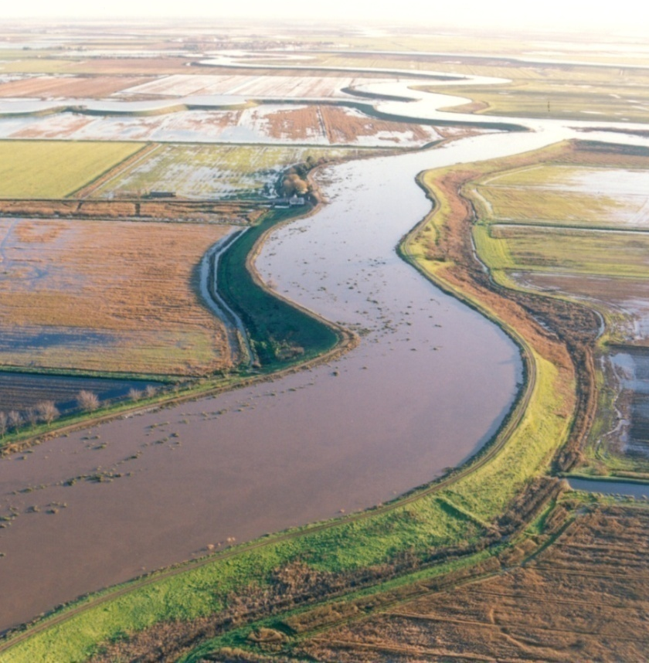
The California Delta (4)
The California Delta
Much of the land in the Delta is below sea level
Levees function as dams with water against them 24-7-365

Slide 12
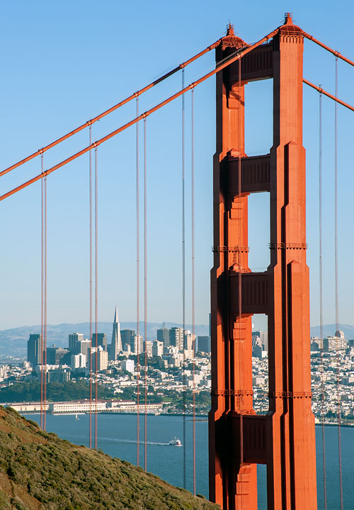
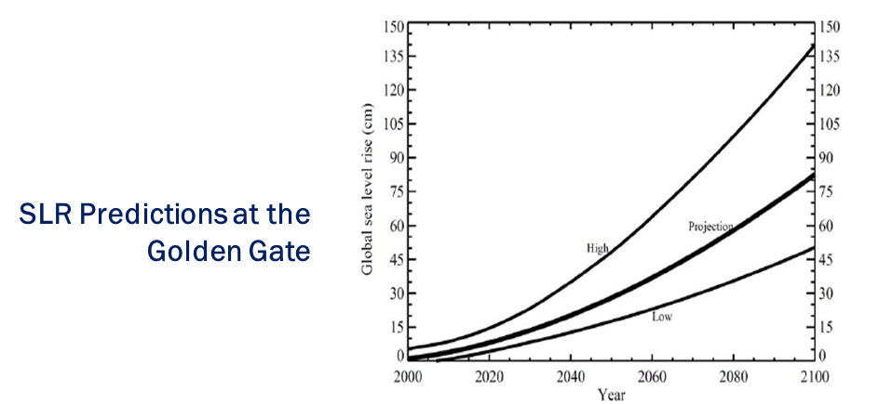
California SLR projections (2012)
California SLR projections (2012)
SLR projections at the Golden Gate
  11-24 inches in 2050
  55-65 inches in 2100
SLR projections in the Delta in 2050
  About 11 inches in the west Delta
  Near zero in Sacramento

Slide 13
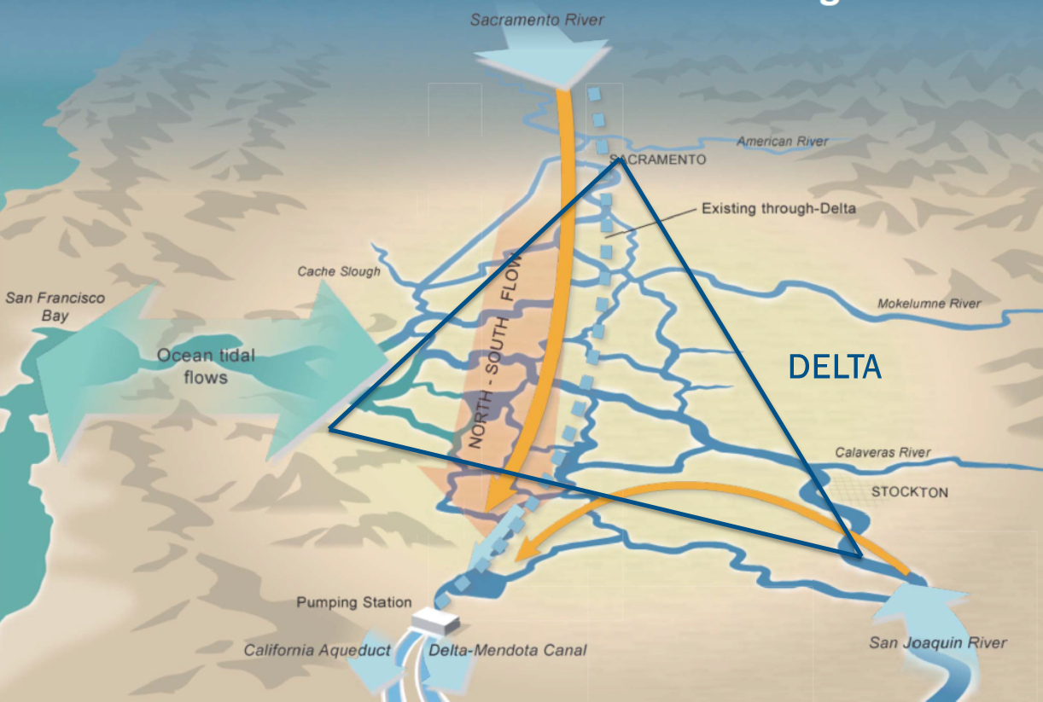
Levees are critical to the state’s water supply
Levees are critical to the state’s water supply
Provide path for fresh water across the Delta
Westernmost islands impede brackish water from entering the Delta

Slide 14
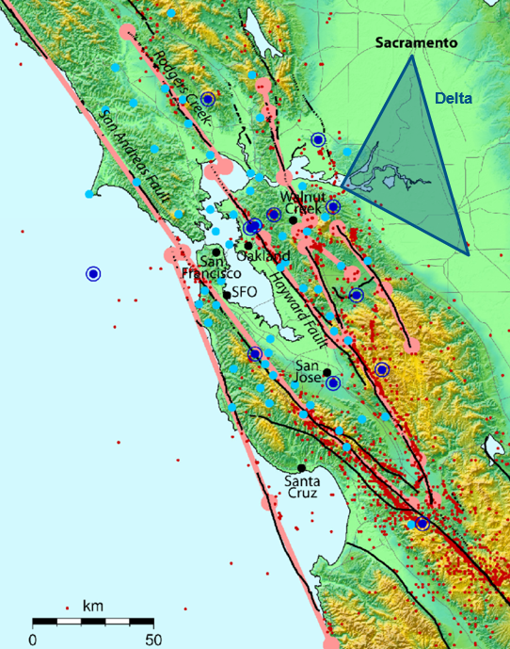
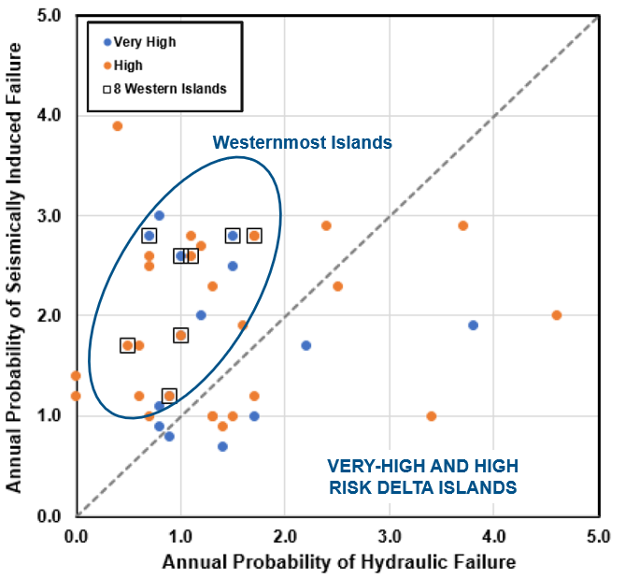
Delta Seismicity
Delta Seismicity

Slide 15
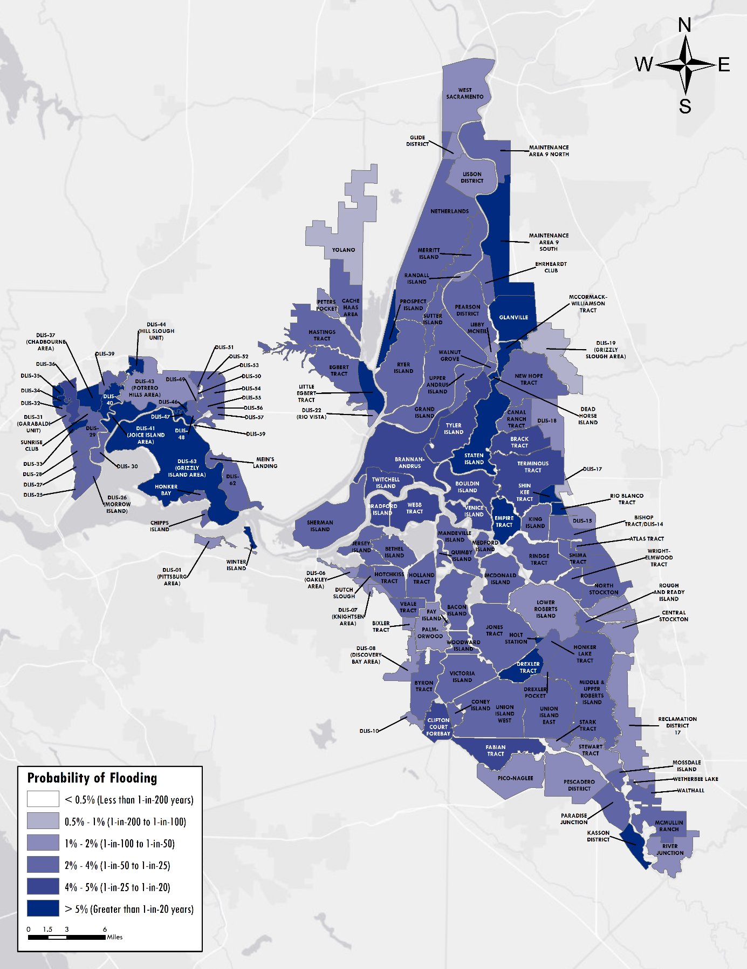
Delta flood hazard (2017)
Delta flood hazard (2017)
Many islands have < 1 in 50-year level of protection
Islands face ongoing threats
  Earthquakes
  Subsidence
  Sea level rise
  Climate-change driven changes in hydrology
$1-3 billion estimated cost to fix
$20-30 million per year current spending from state funds
Need to prioritize spending – even if we had the money, required work cannot be done at once

Slide 16
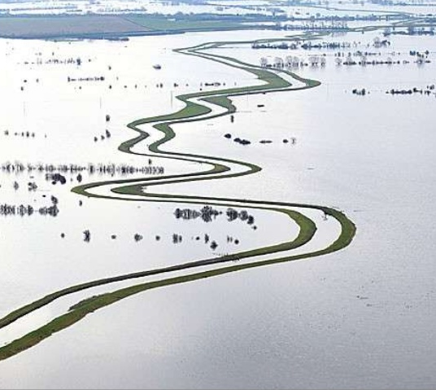
Level of Protection

Slide 17
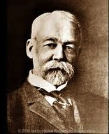
There are two types of levees
Those that have been overtopped by floodwaters
Those that will be overtopped by floodwaters
If there are consequences from flooding, then the risk is real.
William Hammond Hall, 1895
California’s first State Engineer

Slide 18
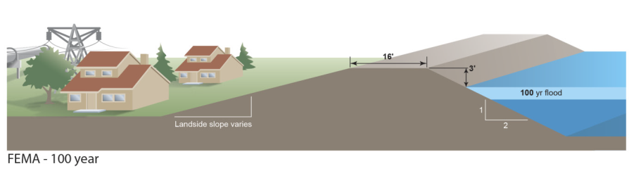
Current guidance
One percent Annual Exceedance Probability (AEP) – NFIP (44CFR 65.10)
“100-year” level of protection (LOP)
In general, the basis for certification and FEMA accreditation

Slide 19
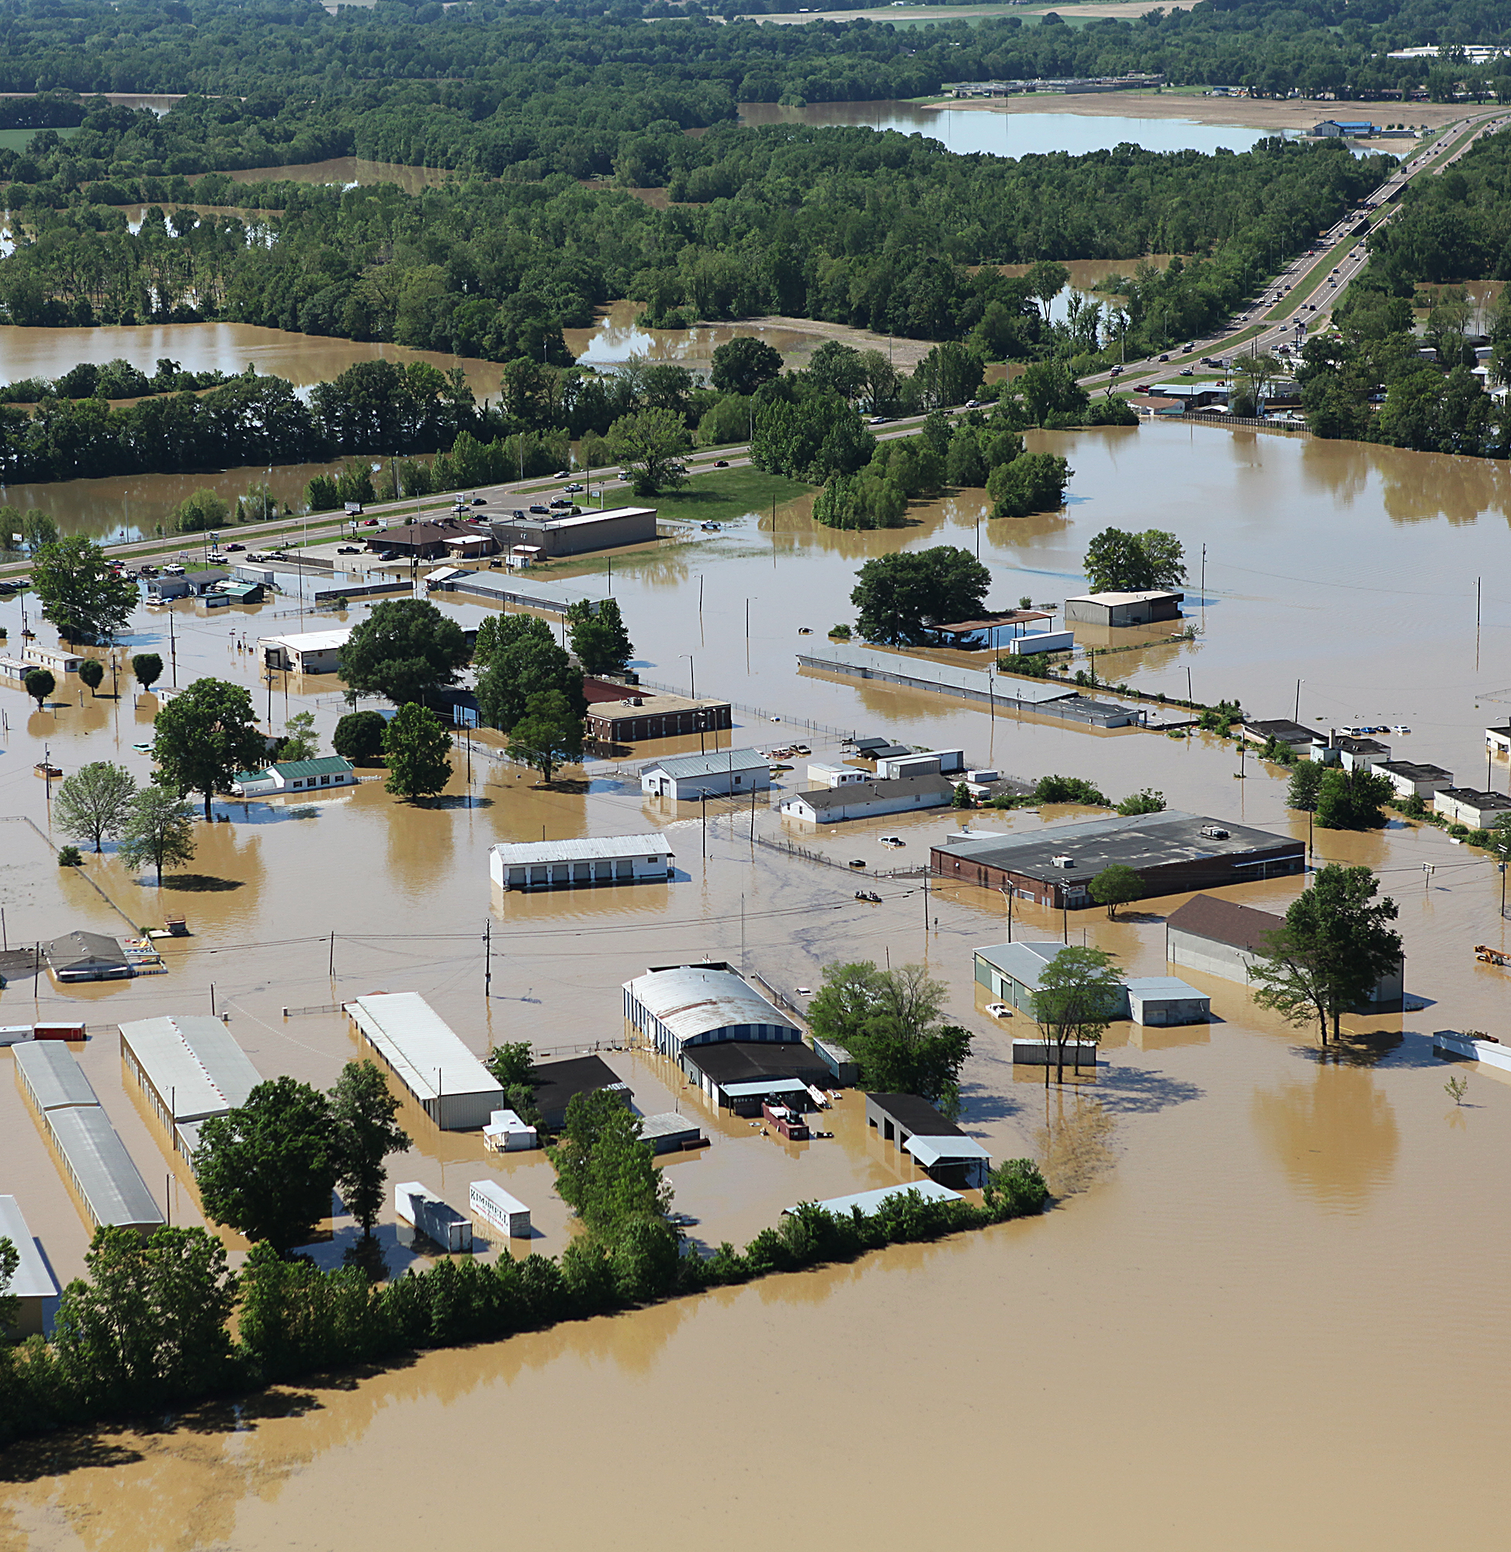
Limitations of the LOP approach
Limitations of the LOP approach
Focus is on the hazard
Does not account for consequences
Implies risk can be eliminated
Favors structural solutions
Hard to measure
  Risk reduction
  Cost-effectiveness

Slide 20

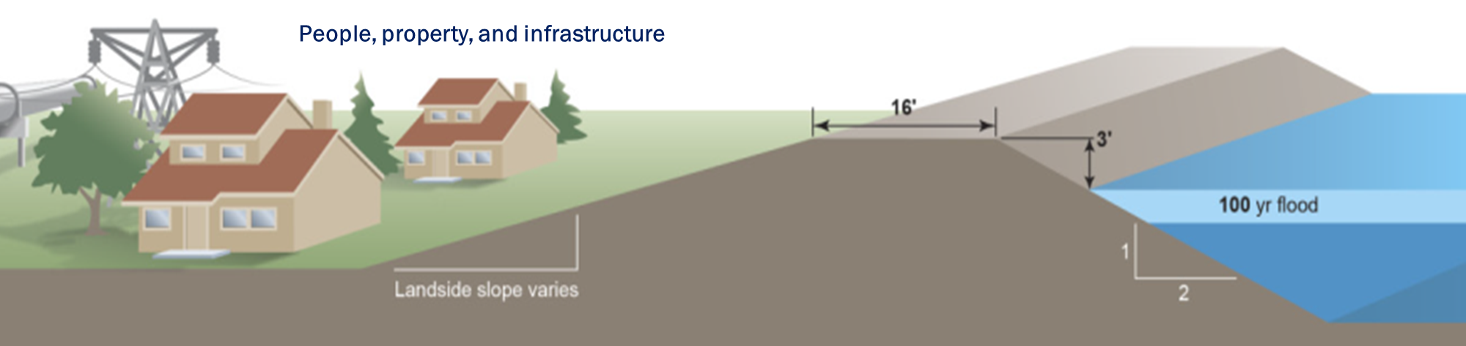
Making Decisions
Agricultural Land
How should we decide which levee should be fixed first?
How do we measure the cost-effectiveness of our decisions?

Slide 21
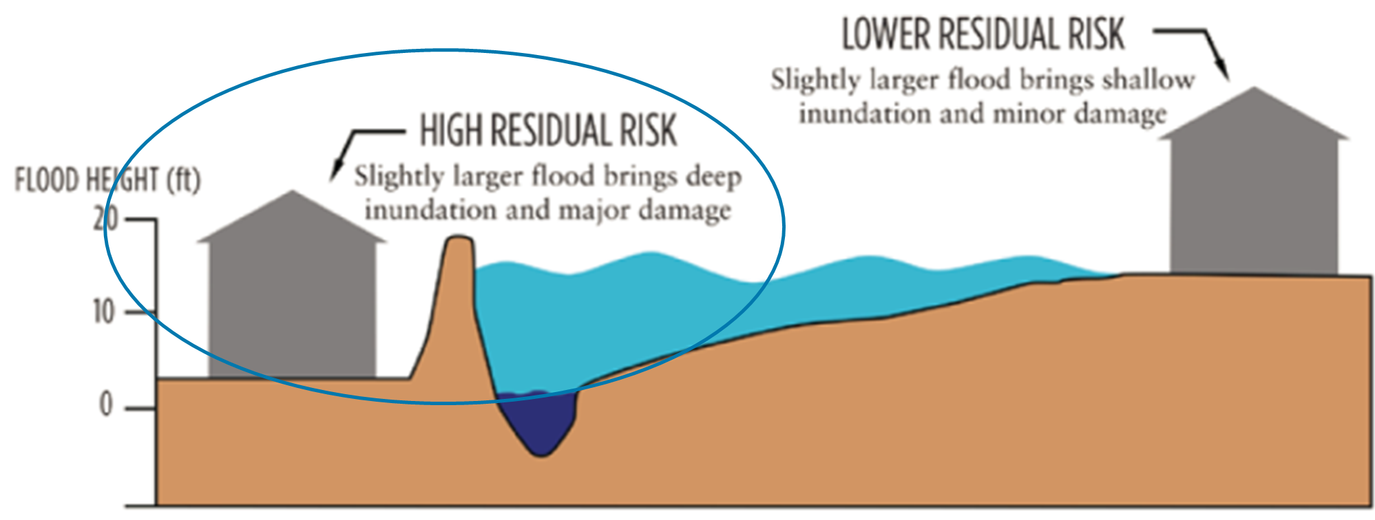
Using LOP ignores residual risk
Using LOP ignores residual risk
Residual risk is the flood risk that remains after all appropriate actions have been taken to reduce the risk

Slide 22
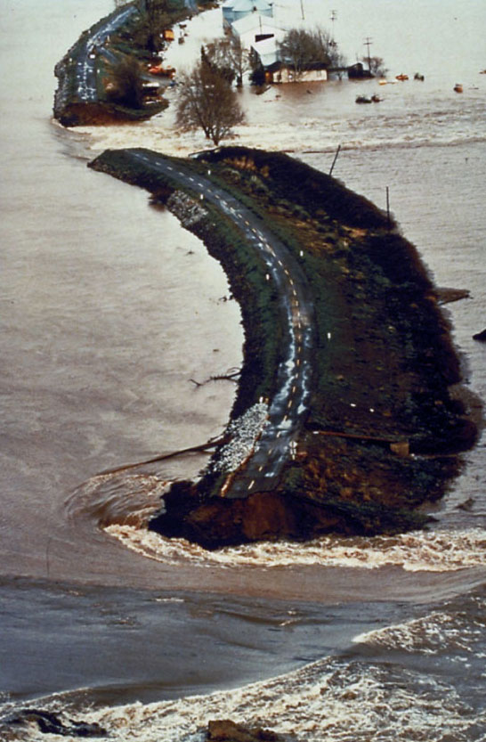
Ignoring risk has adverse consequences
Ignoring risk has adverse consequences
Public safety
Land use decisions
Infrastructure investment
Personal preparedness
Risk Analysis is a better approach

Slide 23
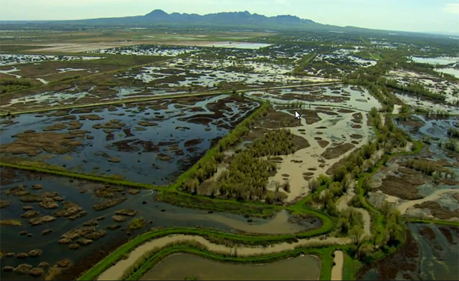
What is Risk?

Slide 24
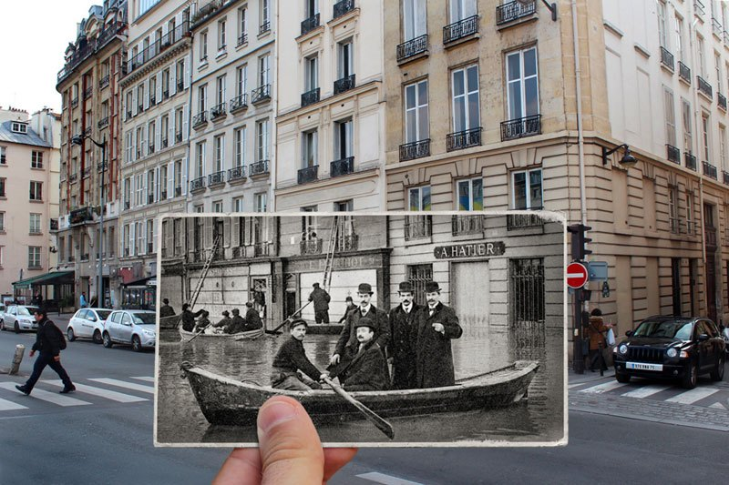
Common definitions of risk
The possibility that something bad will happen
Threats that can be identified, evaluated, and mitigated
Risk =
Probability x Consequences

Slide 25
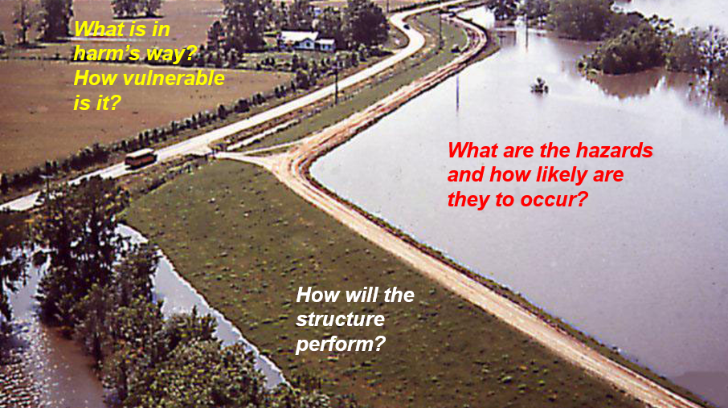
Questions

Slide 26
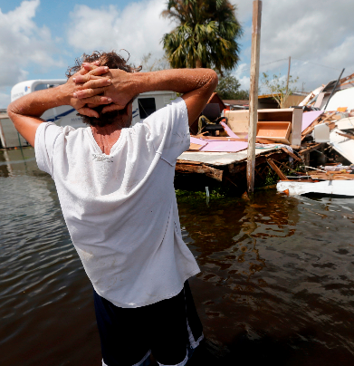
Risk analysis
Risk analysis
Can help answer
  What’s at risk and why
  Which risk is the greatest or most urgent
  How much residual risk remains
Enables
  Better understanding and communicating risk
  Deciding if more risk reduction is warranted
  Identifying actions to address the most urgent risks

Slide 27
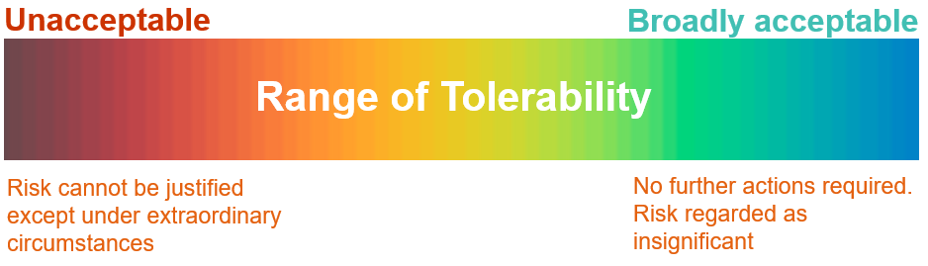

How much risk is tolerable?

Slide 28

We make decisions every day using tolerable risk

Slide 29
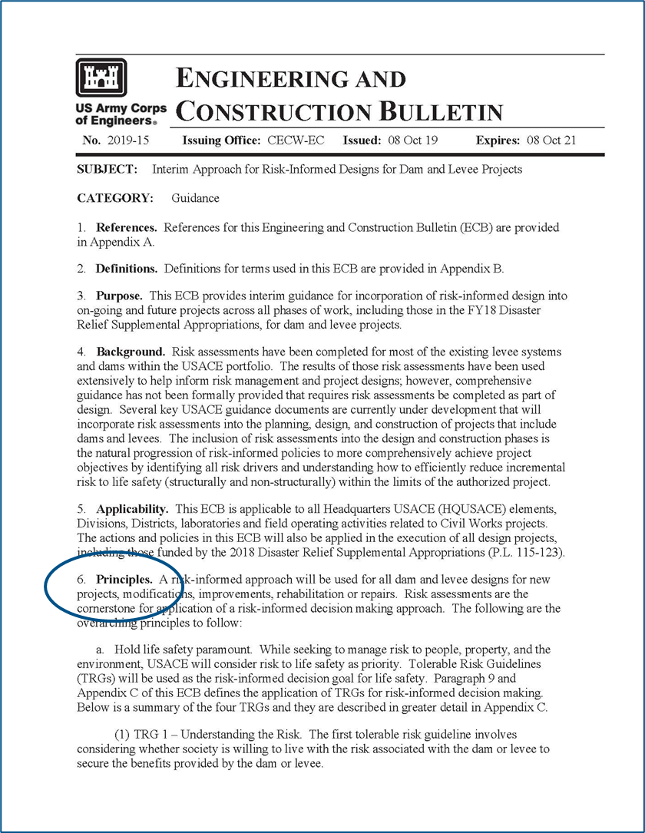
USACE principles of tolerable risk
USACE principles of tolerable risk
Hold life safety paramount
  Understand the risk
  Build risk awareness
  Monitor and manage the risk
  Find cost-effective, socially acceptable, environmentally acceptable ways to reduce risk
Take actions commensurate with the risk
Ensure open and transparent engagement
Learn and adapt
Do no harm

Slide 30
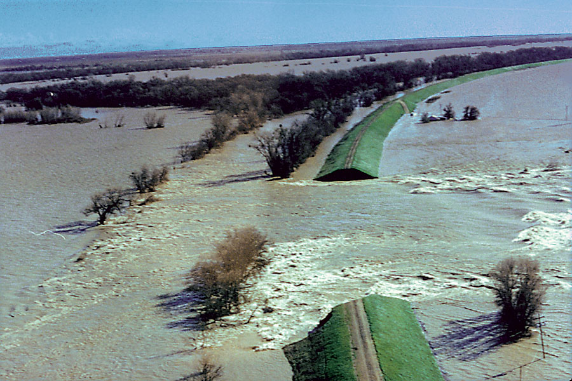
What risk is tolerable?
Risk cannot be ignored
Absolute safety cannot be guaranteed
Setting limits of tolerable risk
  Informed by analysis and expert judgment
  Considers individual risks and societal risks
  Considers equity in distribution of risk
Goal = as low as reasonably practicable (ALARP)
ALARP is what can be reasonably done without spending an inordinate amount of time, money, or resources relative to the risk reduction benefits

Slide 31
Using Risk Analysis to Inform Decisions

Slide 32
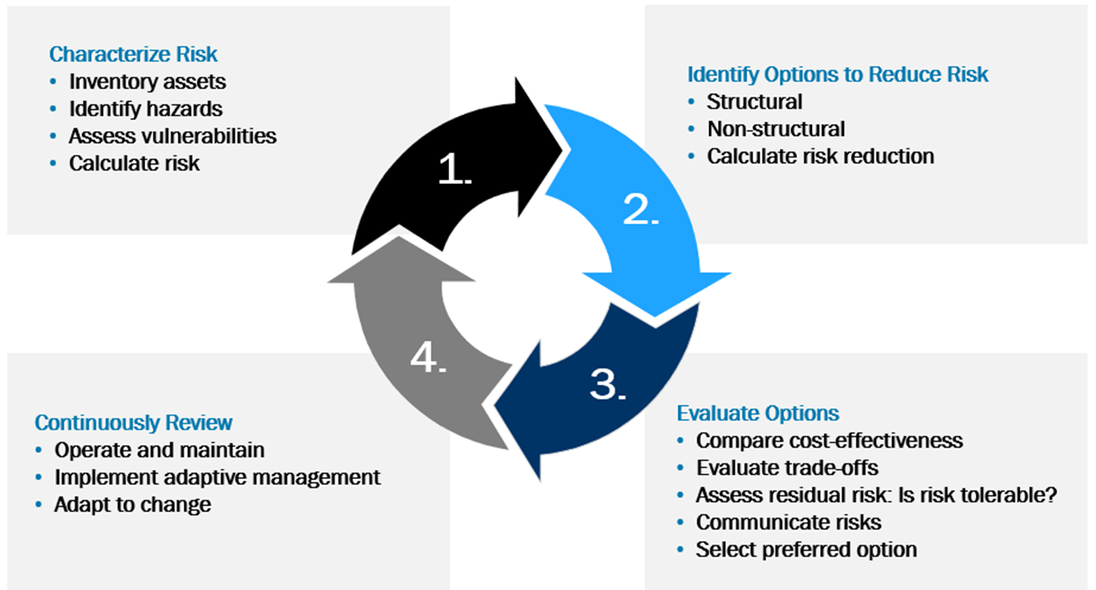
Applying tolerable risk guidelines
Applying tolerable risk guidelines

Slide 33
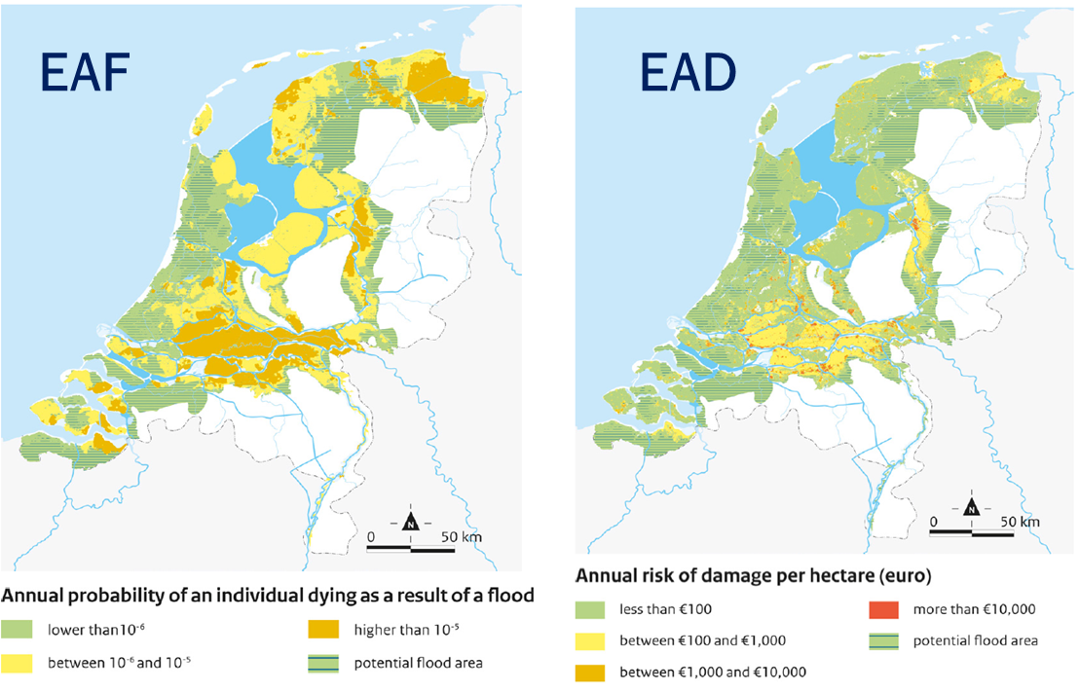
Common measurements of flood risk
Loss of life: Expected Annual Fatalities (EAF)
  Number of individuals exposed to floodwaters
  Affected by warning time, depth and velocity, rate of rise, temperature, etc.
Damage to property: Expected Annual Damages (EAD)
  Annual cost of flood damage
  Dependent on flood depth

Slide 34

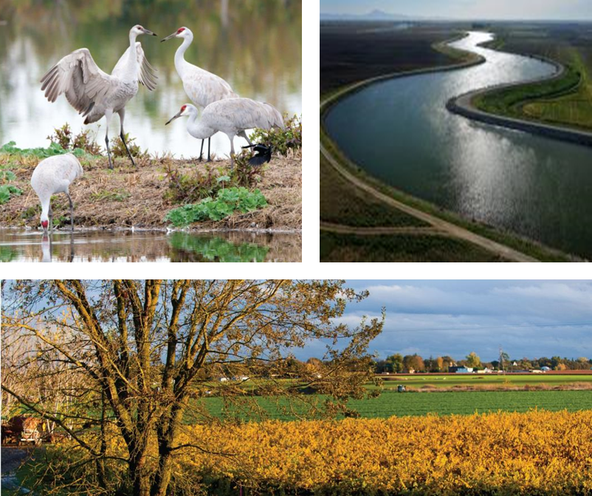
Reducing risk to state interests as defined in the Delta Plan
Protect life and property
Advance the coequal goals
  Protect water supply
  Enhance Delta ecosystem
Protect Delta as a place

Slide 35
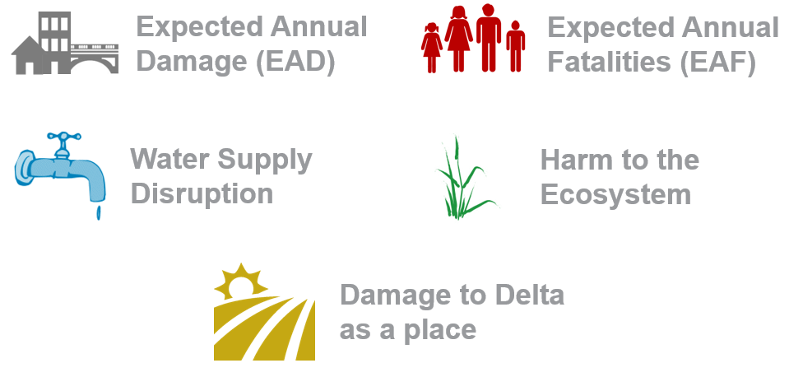
Risk metrics for state interests in the Delta

Slide 36
What Does Risk Analysis Tell Us about the Delta?

Slide 37
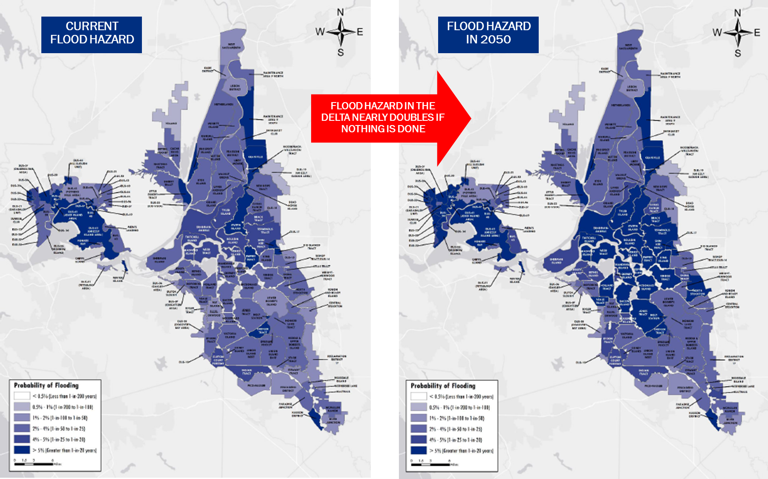
Map 1

Slide 38
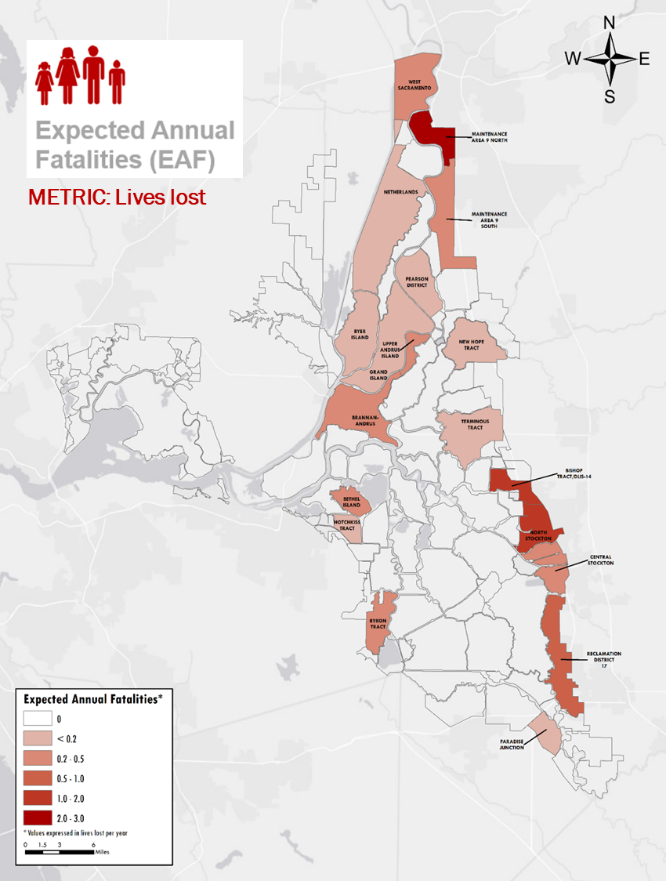
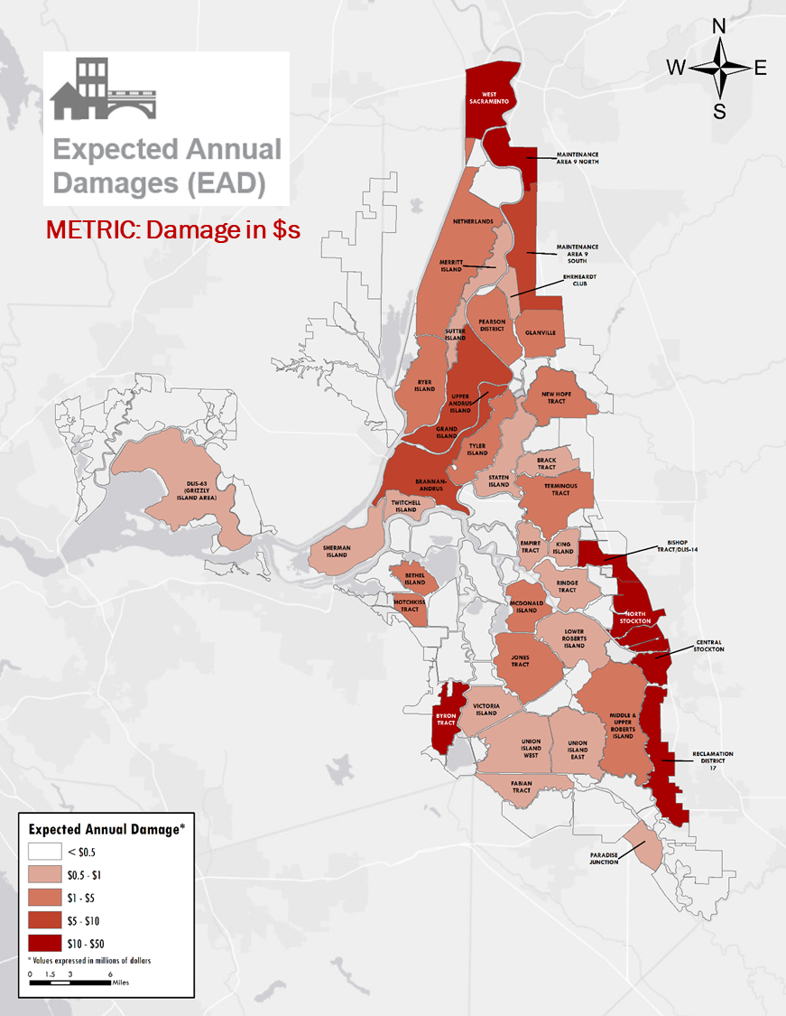
Map 2

Slide 39
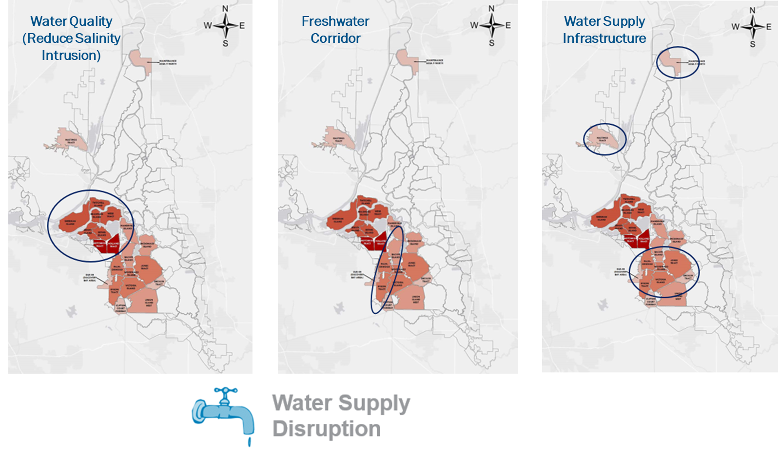
Map 3

Slide 40
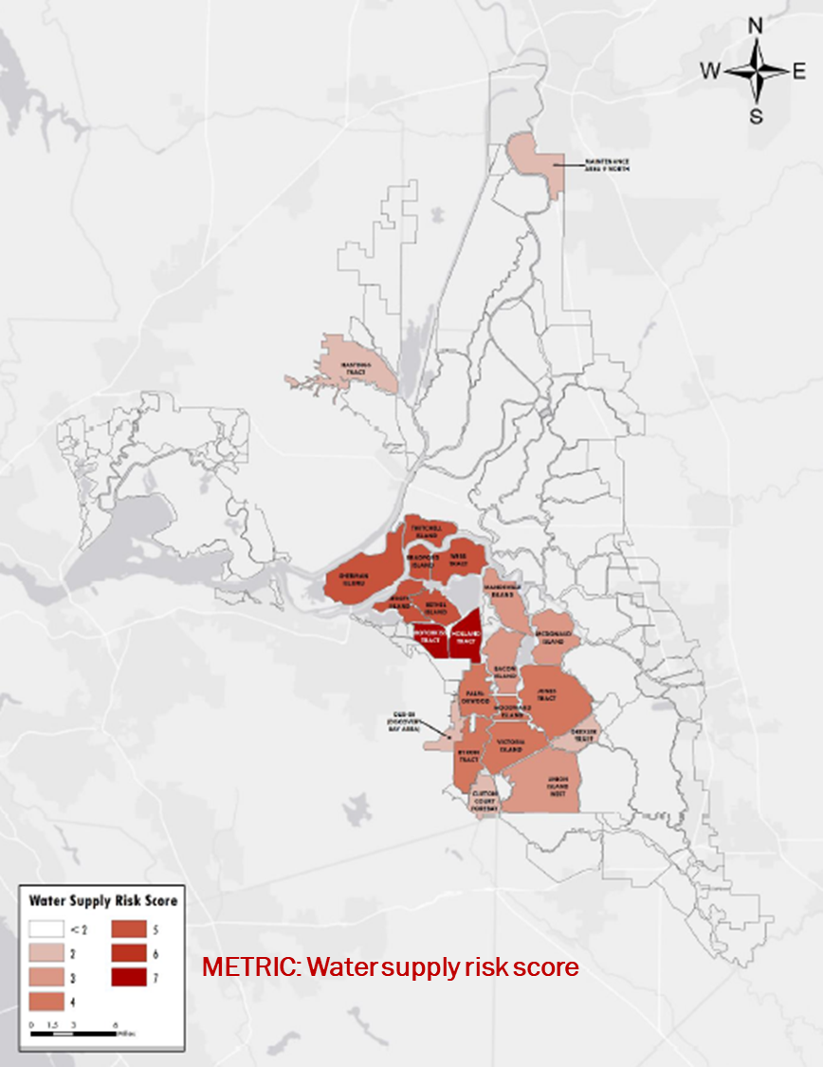
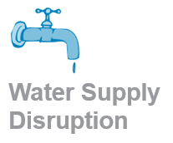
Map 4
Salinity barrier
Freshwater corridor
Water supply infrastructure

Slide 41
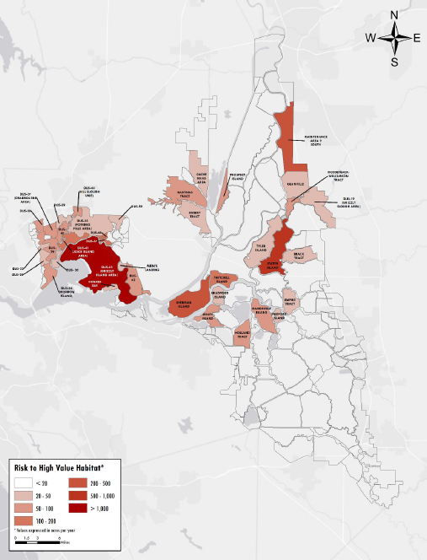
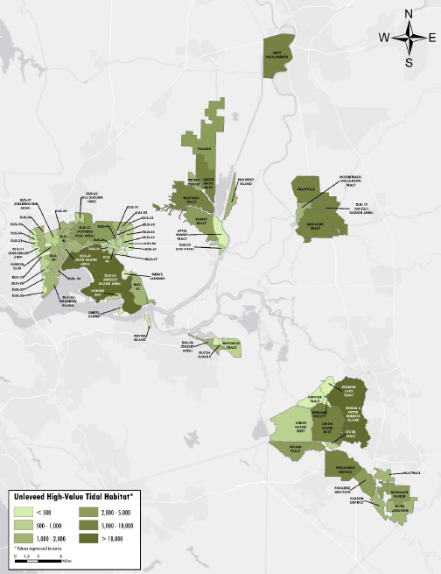
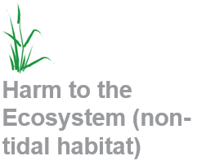
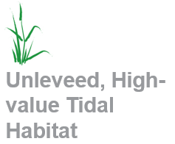
Map 5
METRIC: Damage in acres (or $s)
METRIC: Lost opportunity in acres (or $s)

Slide 42
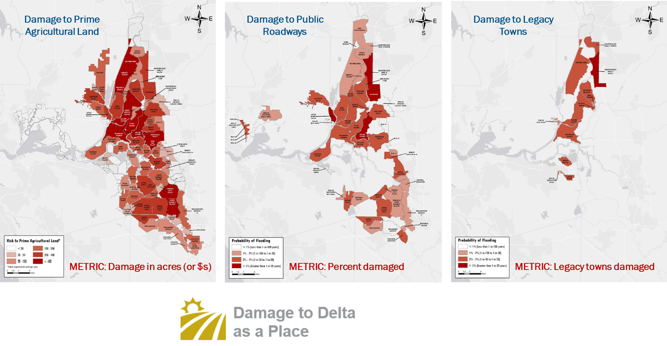
Map 6

Slide 43
Applying Tolerable Risk Guidelines (2)

Slide 44

Challenges in flood risk management
Risk analysis is a snapshot in time from best available data
Risk analysis can be a powerful tool to
  Evaluate the effectiveness risk reduction
  Compare trade-offs
No risk-based standards or guidelines to determine tolerable level of flood risk
Level of tolerable risk should be decided by those most affected by flood risk

Slide 45
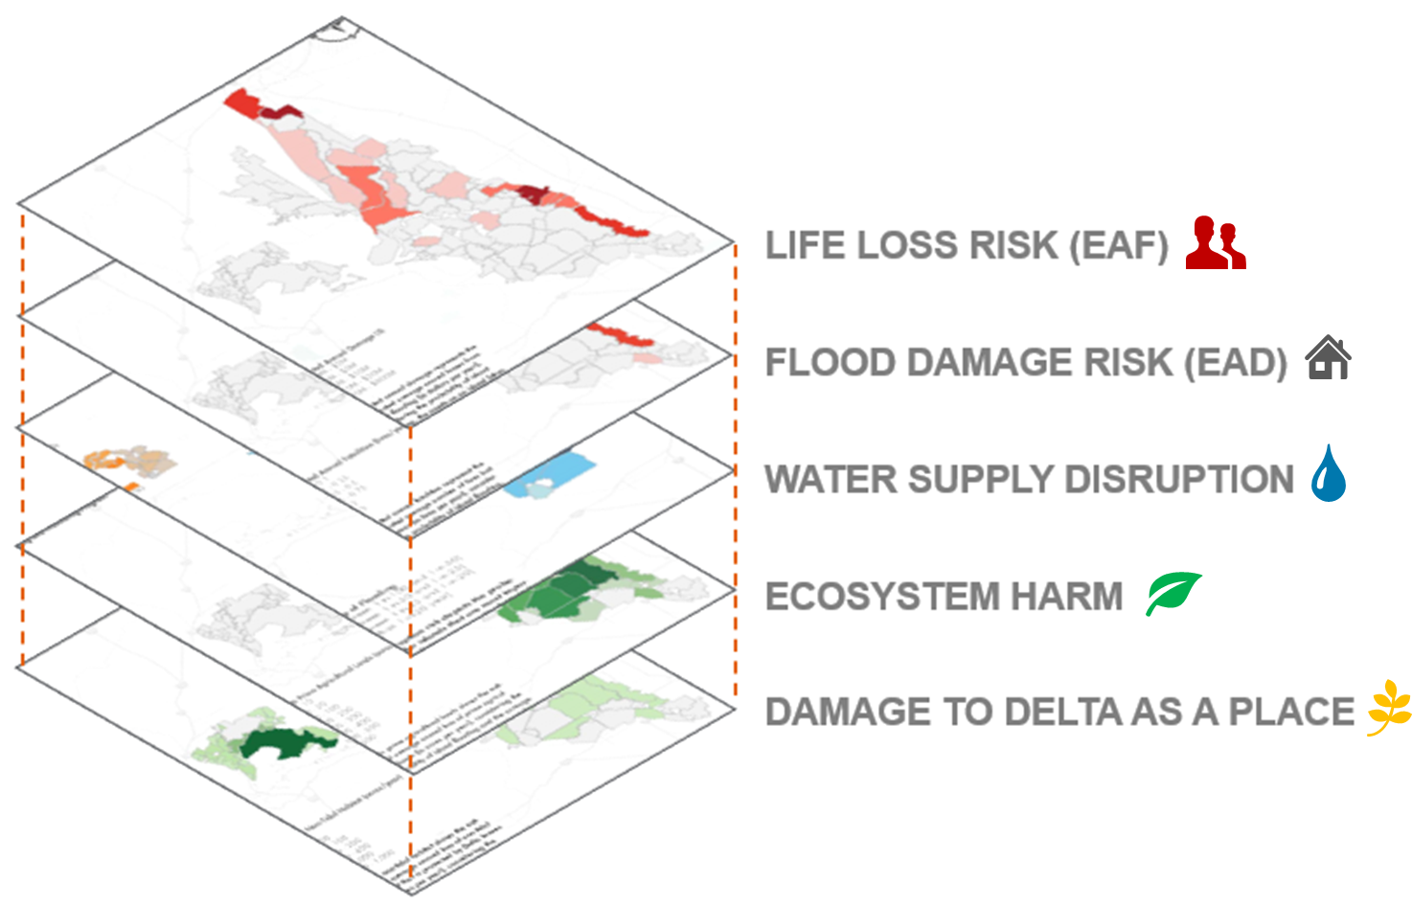
Putting it all together
Putting it all together

Slide 46
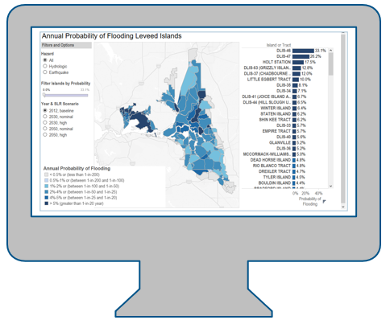
We developed a Decision Support Tool (DST) to:
Enable mixing risk components with different metrics
Apply weighting factors based on community values
Provide a visualization tool to support a deliberations and analysis
Evaluate the effectiveness of actions to reduce risk and compare trade-offs
Inform decision-making
Accommodate updates for changing conditions

Slide 47
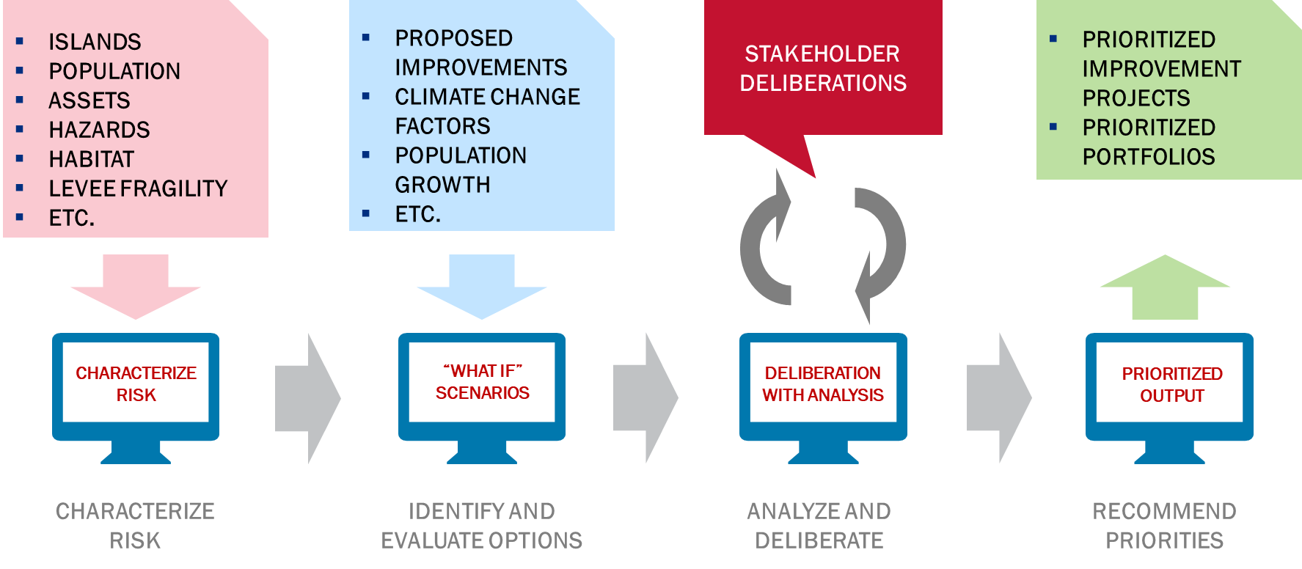
Using the Decision Support Tool
Using the Decision Support Tool

Slide 48
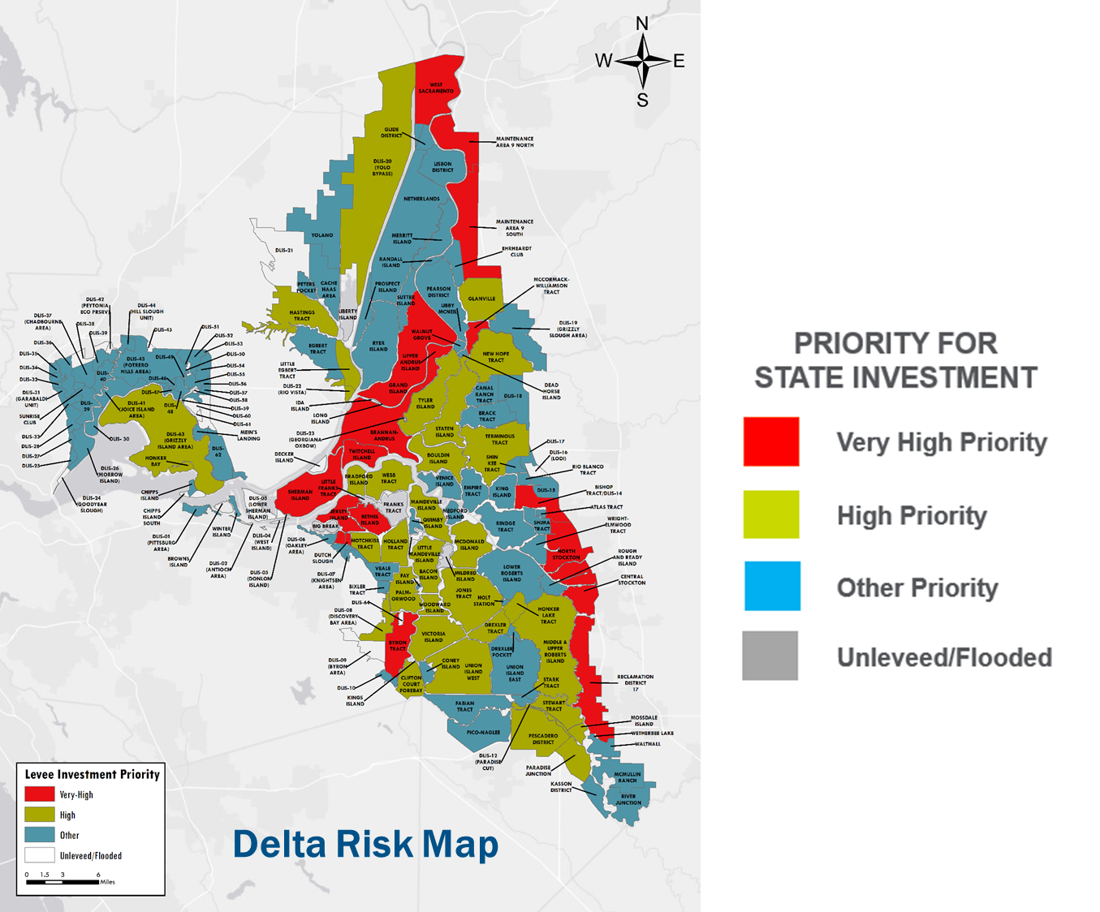
Delta Levees Investment Strategy
Delta Levees Investment Strategy

Slide 49
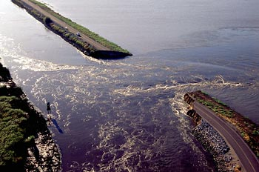
Applying Tolerable Risk Guidelines (TRGs)
Recognizes residual risk
Involves those most affected by the risk
Improves communications and understanding
Enables “what-if” scenarios to evaluate trade-offs
Determines where and when to act

Slide 50

Using TRGs in the Delta
Clearly communicates risk to decision-makers, stakeholders, and the public
Identifies areas of highest risk
Places appropriate focus on life safety
Enables using various risk metrics to inform decisions
  People and property
  Water supply
  Ecosystem habitat
  Delta as a place
Provides an open and transparent basis for prioritizing investments in levee improvements

Slide 51

Stakeholder comments
Delta Levees Investment Strategy included in Delta Plan Amendments (1-22-2018)
From Restore the Delta
  Our perception had been that DLIS was striving to rid the Delta of low-value islands
  The Council’s approach to Delta levees has improved in recent years
  We find much in the Council’s DLIS to support and appreciate
  We understand it is necessary to prioritize levee investments

Slide 52


Contacts
Lawrence H. Roth, PE, GE, ENV SP
Vice President
Arcadis
larry.roth@arcadis.com
Jessica J. Ludy, CFM
Planner, Civil Works
U.S. Army Corps of Engineers
Jessica.J.Ludy@usace.army.mil

Slide 53
For More Information

Slide 54


For more information (1)
Best practices identified by USACE and USBR (2015) https://www.usbr.gov/ssle/damsafety/risk/methodology.html
Revised EM 1110-2-1913 (forthcoming)
http://www.publications.usace.army.mil/USACE-Publications/Engineer-Manuals/

Slide 55


For more information (2)
Exploration of Tolerable Risk Guidelines
HSE Reducing Risks, Protecting People)
http://www.iwr.usace.army.mil/Portals/70/docs/iwrreports/10-R-8.pdf
http://www.hse.gov.uk/risk/theory/r2p2.pdf

Slide 56



For more information (3)
Delta Levees Investment Strategy
https://deltacouncil.ca.gov/dlis/
Civil Engineering, September 2016
http://cedb.asce.org/CEDBsearch/record.jsp?dockey=0432079

Slide 57
End Slide

