Slide 1
National Dam Safety Program
Tips, Tricks, and Tools to
Communicate Dam Risk
Preston Wilson
Civil Engineer, National Dam Safety Program

Slide 2
Power of First Impressions
7 seconds
2 minutes
7 years
University of Michigan
11 in 7
NYU researchers found that we make 11 major decisions about a person within the first 7 seconds of meeting them…
Notes:
But even prior to 45 seconds, the audience is evaluating you.
Did you know that you have 7 seconds to make a first impression?
Researchers from New York University found that we make 11 major decisions about someone within the first 7 seconds of meeting. These included making judgments about attributes such as likeability, trustworthiness, confidence, status, and ability.
A lot of that has to do with our clothing and smile. What first impression are we sending?
New data from the University of Michigan shares that the first impression lasts a long time. On average, those first few minutes stick in an audience’s mind for 7 years.

Slide 3
Key Community Stakeholders
Elected Officials
First Responders
Emergency Managers
General Public / Homeowners
Media
Dam owner/
operator

Slide 4
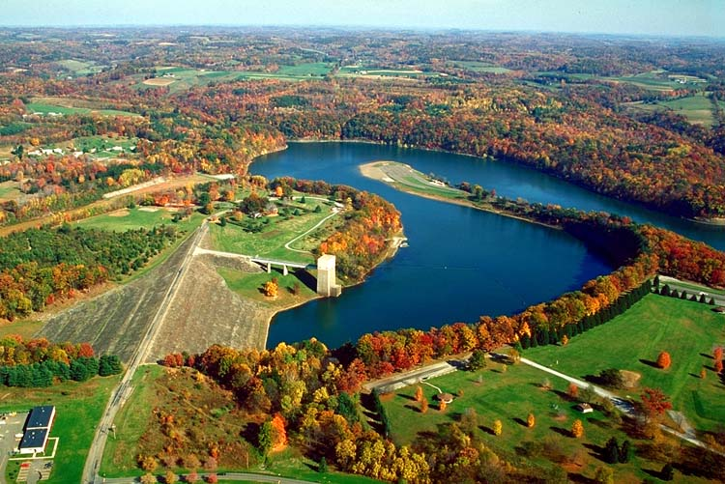
What Do Our Audiences Want?

Slide 5
Consider Your Audience

Slide 6
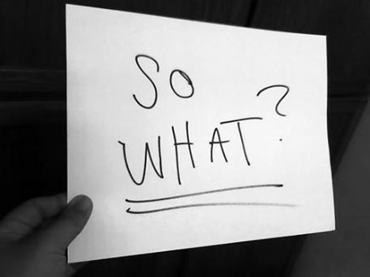

Audiences Are Selfish

Slide 7
Community Perceptions of Disaster
People’s initial belief is “it is not happening to me.”
People’s initial reaction is typically one of denial.

Slide 8
Warning Behavior
People do not automatically act on warnings.
The public does not panic of act immediately when they hear a warning.
Convincing the public that they are at risk and should take effective action in a timely manner is the challenge.
Source: A Guide to Public Alerts and Warnings for Dam and Levee Emergencies.
Dennis S. Mileti and John H. Sorensen, 2015

Slide 9
Trust Determination
Compassion
Conviction
Optimism

Slide 10
Message Mapping
Science-based discipline
Dam Safety application to:
  Increase knowledge and understanding
  Increase trust and credibility
  Create informed and appropriate beliefs, decisions, and behaviors
Avoid communication regret

Slide 11
Message Map

Slide 12
Rule of 3
High stress situations change the rules of communication.
Key to success is:
Anticipation
Preparation
Practice
On average, ninety-five percent of questions and concerns for virtually any high stress scenario can be predicted.

Slide 13
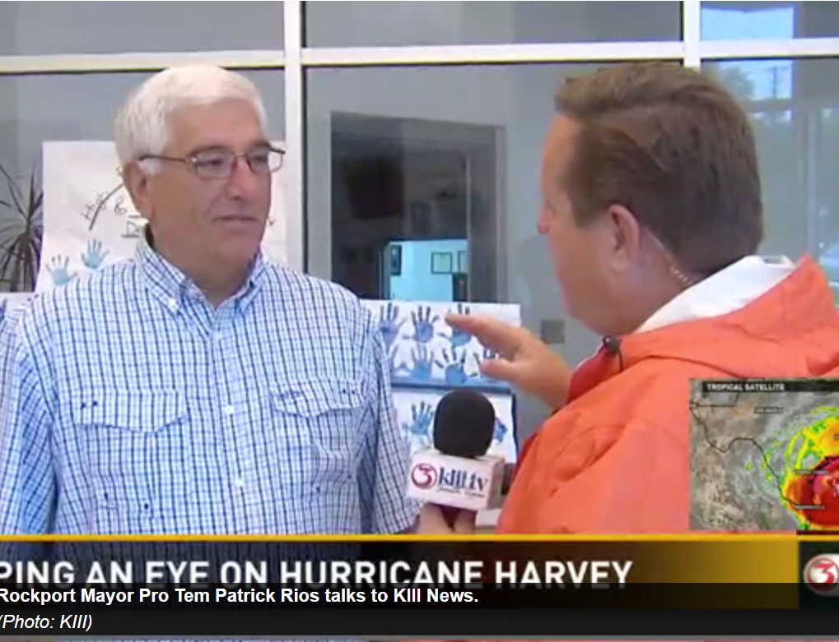
Public-Focused Example
Rockport Mayor Pro Tem Patrick Rios had a somber message to anyone planning on staying.
"We're suggesting if people are going to stay here, mark their arm with a Sharpie pen with their name and Social Security number," he said.
"We hate to talk about things like that.
"It's not something we like to do but it's the reality. People don't listen."

Slide 14
Identifying Communication Complexities
Different things mean different things to different people.

Slide 15
Culture
Customary beliefs, social forms, and material traits of a racial, religious, or social group; characteristic features of everyday existence shared by people in a place or time popular culture.
Shared attitudes, values, goals, and practices that characterizes an institution or organization a corporate culture focused on the bottom line.
The set of values or social practices associated with a societal characteristic.

Slide 16
Socioeconomics
Relating to, or involving a combination of social and economic factors.
Poverty level
Low income
Middle income
Upper middle income
High income

Slide 17
Literacy
Able to read and write; having knowledge or competence.
Of the nearly 62 million foreign-language speakers, 44 percent (27.2 million) were born in the United States. Of those who speak a foreign language at home, 25.1 million (41 percent) told the Census Bureau that they speak English less than very well.

Slide 18
Generation
A group of people born and living during the same time; the people in a family born and living during the same time; the average length of time between the birth of parents and the birth of their children.

Slide 19
Strategies for Addressing Communicating Complexities
Look at the BIG picture.
Have a current crisis communication plan.
Change hats.
Welcome/Insist on different viewpoints.
Anticipate, Prepare, Practice.
Speak early, speak often – Compassion, Conviction, Optimism.
Consistently Listen, Re-evaluate, Adjust.

Slide 20
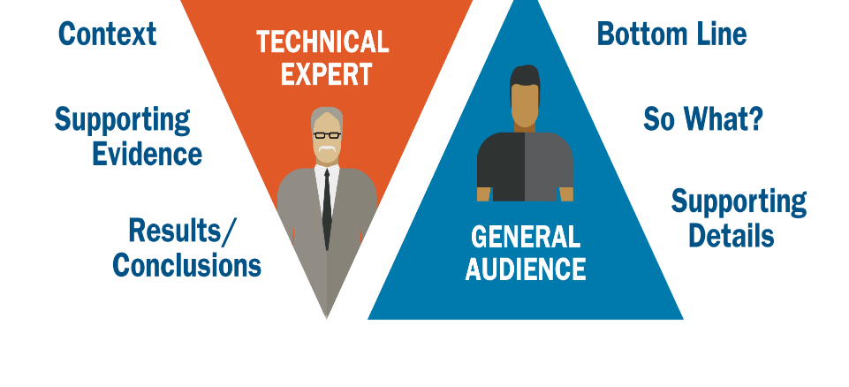
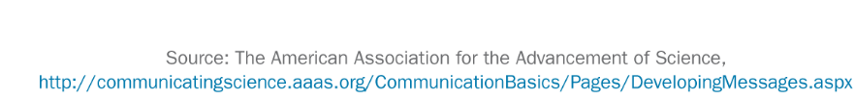
Connecting with Your Audience
Notes:
Let’s look at the difference in perspective between a scientist and the general public.
The scientist tends to want to talk about the methodology first – why we did what we did. Why we studied what we studied. Then the support details and then finally the bottom line – what we found / our conclusion.
The general public – the media – government leaders – want to reverse that equation entirely. Flip the triangle upside down.
Start with the punch line. Start with the bottom line and then tell us why it matters.
This is a very important difference – how is your message oriented?

Slide 21
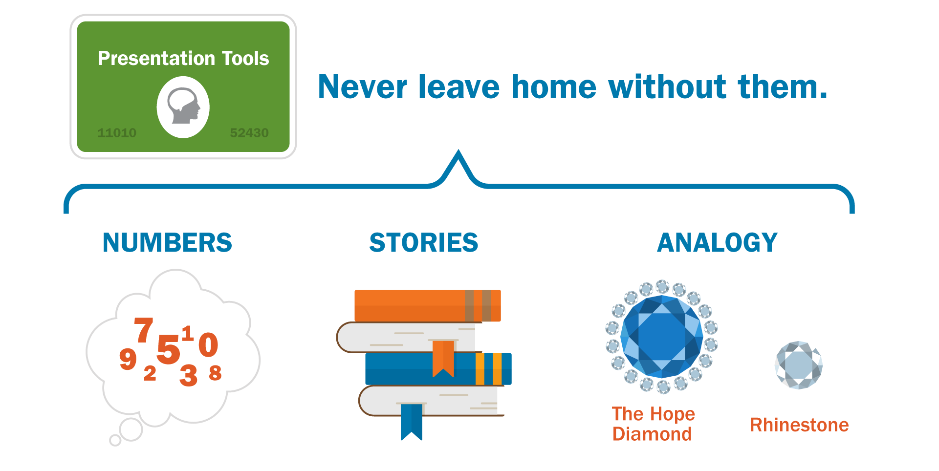
Making the Complex Simple

Slide 22
Visual Communication
When creating messages, a visual should be created to support each message.
Graphics
Analogies
Story telling

Slide 23
Analogies
Resilience = Prevention
  If you are at risk for heart disease…
Mandatory Flood Insurance Purchase = Car Insurance
  You wouldn’t drive across the state without auto insurance.
Mitigation Planning = Retirement Planning
  If you want to retire by 65, you build a plan.

Slide 24
Your Turn: Analogies
An Emergency Action Plan is like _______________________.
A Spillway is similar to a ________________________ because
_______________________________________.

Slide 25
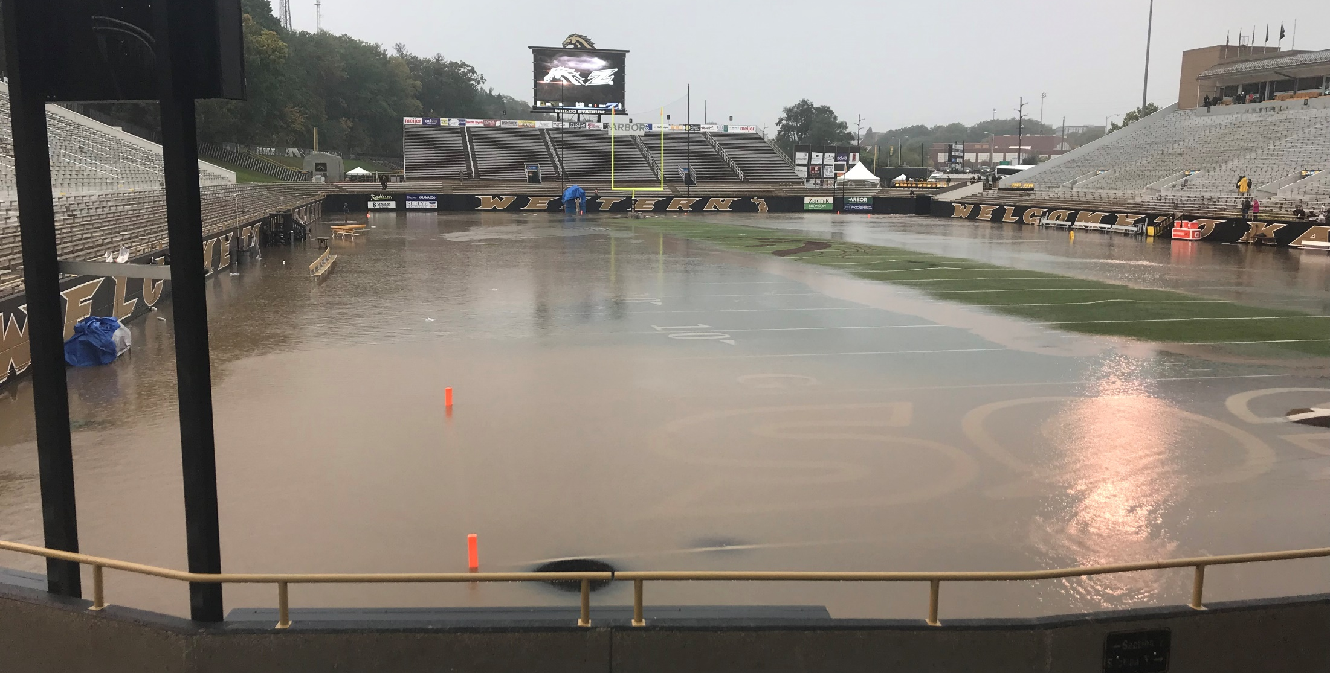
Flooded Field

Slide 26
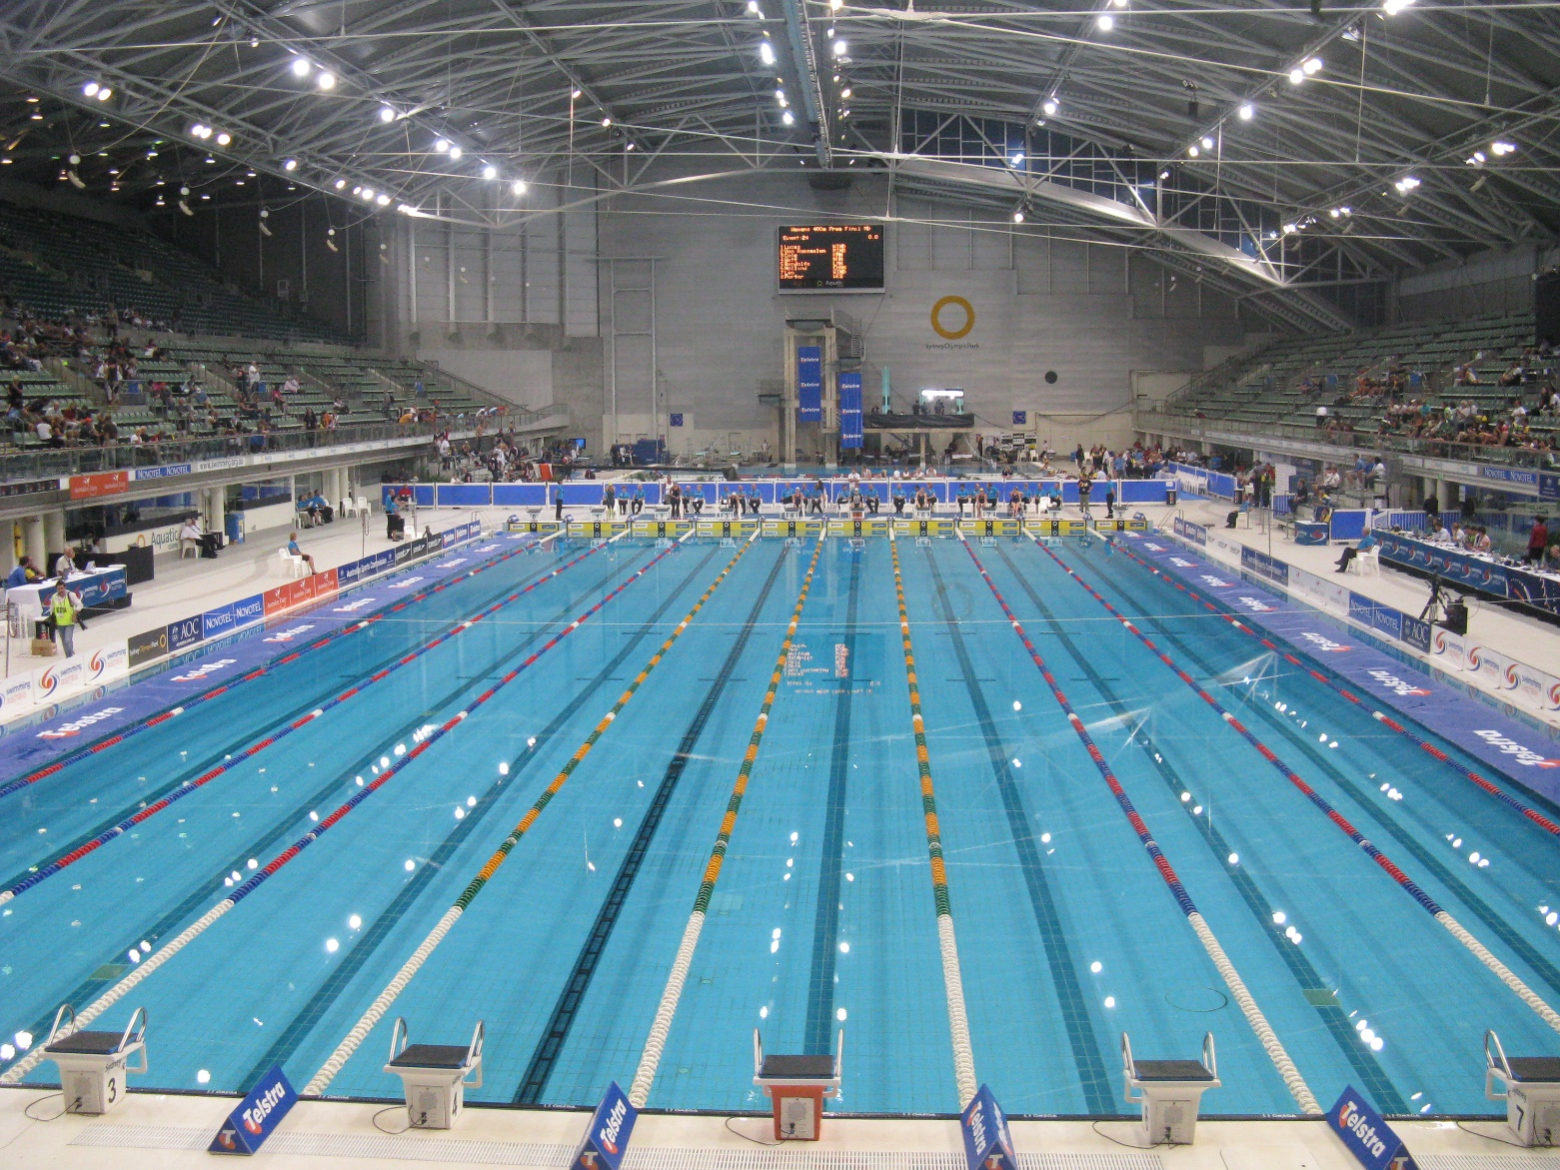
Acre-Foot
325,851
U.S. Gallons

Slide 27

The 100 Year Flood
It’s hard to conceptualize what a 1% probability actually looks like.
Imagine a bag full of 100 marbles.
Ninety-nine of the marbles are green and one marble is blue.
When you reach into the bag there is a 1% chance of you pulling out the blue marble.
Source: http://1mississippi.org/the-100-year-flood/

Slide 28
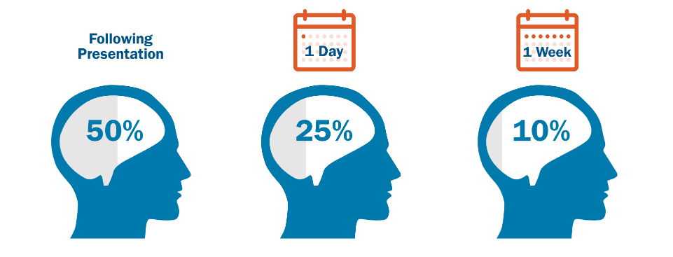
Making a Lasting Impression
Audiences retain only a limited amount of information after hearing a presentation.
Source: Perceptive Listening, Florence I. Wolff and Nadine C. Marsnick
Notes:
But what about our content? Do they remember that?
Research has validated what most of us already know: audiences will only remember a small fraction of what is said during a presentation or conversation.
Immediately following a presentation, listeners remember 50% of what was said.
By the next day, only 25%.
A week later, 10%.
It is important to make both your content and your delivery compelling and organized so that listeners walk away remembering your KEY point(s).

Slide 29
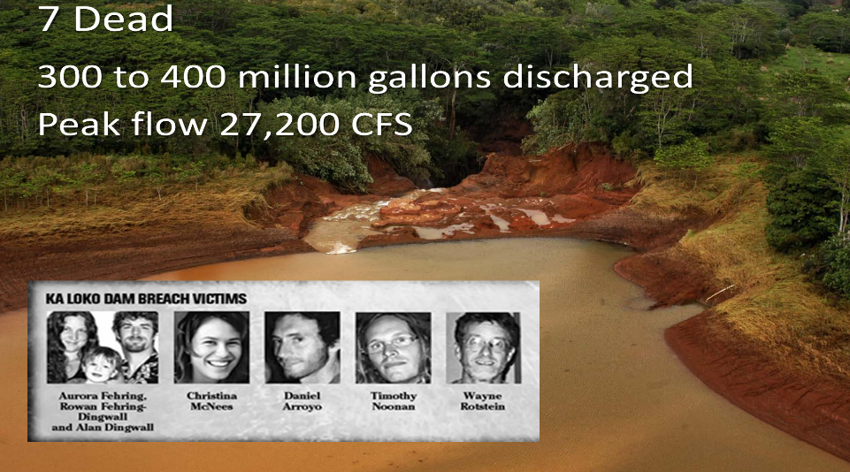
Case Study
Notes:
Not only do we not care about more than the single individuals, we don’t care about them or anyone as soon as statistics enter the story.
Her research compared the willingness of subjects to donate when they had three different options. The first was a story about an individual with a name and photo and no statistics at all. The second was a set of statistics showing the magnitude of the problem and how badly they need donations. And the third combined the story and the statistics.

Slide 30
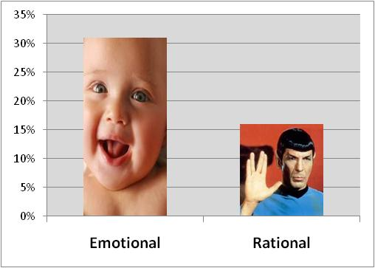
Emotion Drives Stronger Results
Source: IPA / Datamine analysis of 880 winners of Advertising Effectiveness Awards
Notes:
An analysis of 880 winners of Advertising Effectiveness Awards from the U.K.’s Institute of Practitioners in Advertising (IPA) revealed that advertising campaigns that emphasize emotion drive business goals far better than “rational” campaigns that sell benefits.

Slide 31
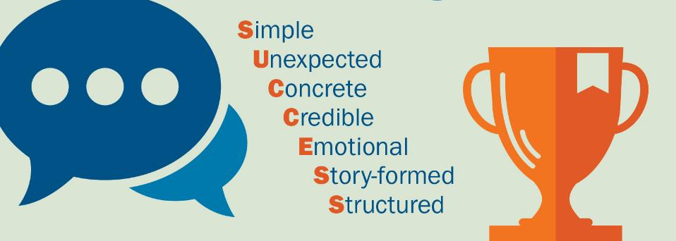
Great Messages Are…

Slide 32
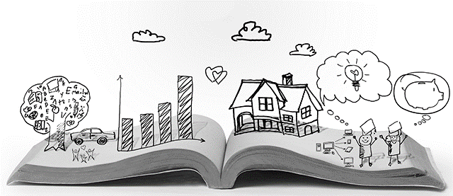
Telling a Powerful Story

Slide 33
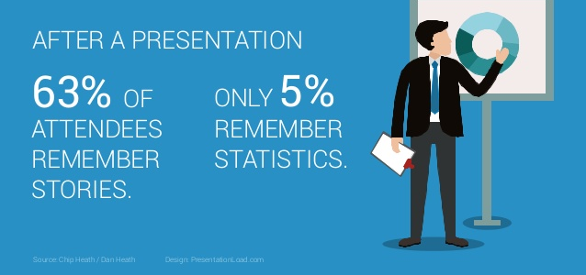
Presentation Facts

Slide 34
Four Types of Stories
1
The Overcomer
2
Rags to Riches
3
David vs. Goliath
4
A Quest

Slide 35
How to Tell GREAT Stories
Concise:
Less is more.
60 seconds –
2 minutes.
Connect:
Link the story to your message.
Pause:
The spaces between the words matter as much as the words.
Facial Expressions:
Your face communicates 1,000 words.
Prepare:
Great stories are planned, yet sound spontaneous.

Slide 36
Addressing Q&A

Slide 37
Baiting – Addressing Easy Questions
? = A + M
Question = Answer + Message

Slide 38
What to Say When You Can’t Say Anything
“IDK Template”
Alternatives:
I can’t answer that, but let me find someone who can.
I wish I could give you an answer, but…
What I can say is…
Follow up (with deadline).
Bridge to 1-3 things you do know.
Notes:
That’s a good question, and what is really important to know is…”
“Yes, (answer), and in addition to that…”
“No, (answer), let me explain…”
“I don’t have specifics in that area…but what I do know is…”
“I can’t speculate on that…but what I can tell you is…”
“Possibly…. the bigger issue here is…
“What’s important to remember is…”
“That’s an interesting question….what many people don’t recognize is…”
“There’s a lot of debate on that….from my point of view…”
“The data shows us…”

