Slide 1
Crisis Communications for Dam Emergencies:
The Local Perspective
John Holdsworth
Snohomish County
Department of Emergency Management

Slide 2
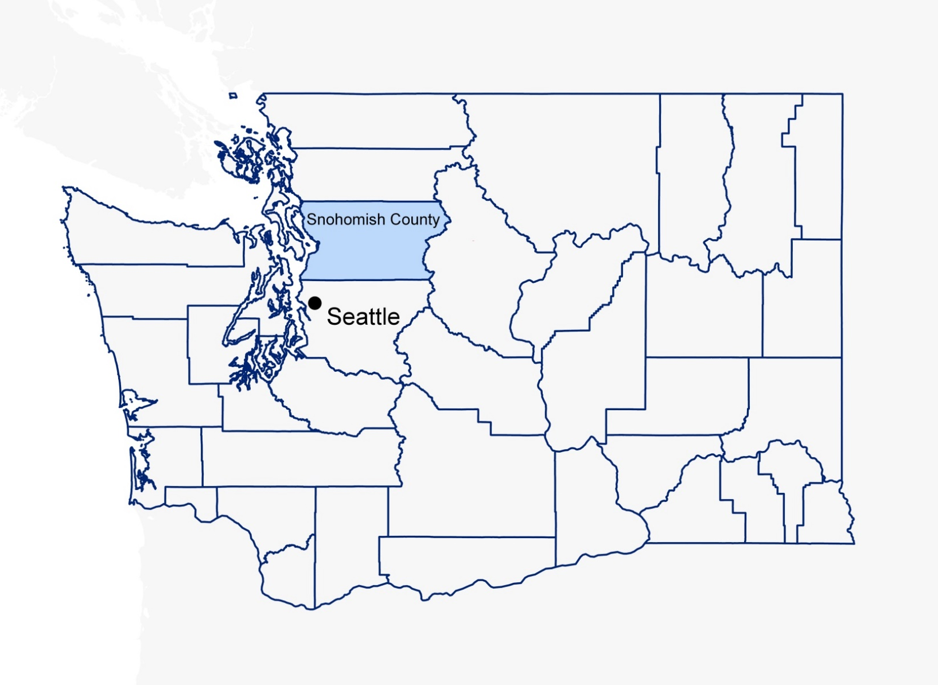
Snohomish County at a Glance
2
Notes:
Snohomish County
~800,000 people Population
Grow by 250,000 in next 25 years
Seattle = 20 miles

Slide 3
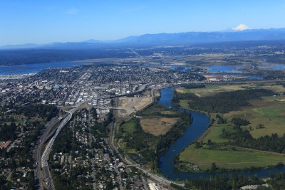
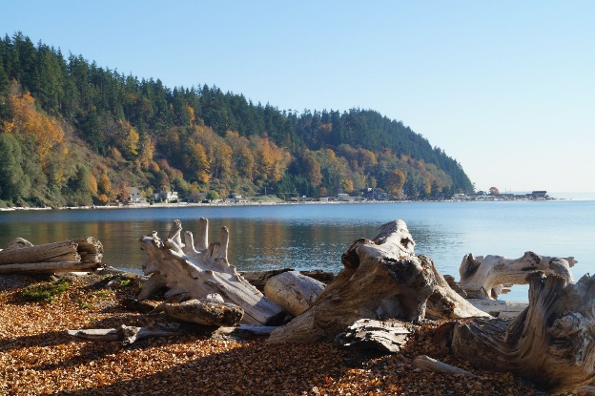
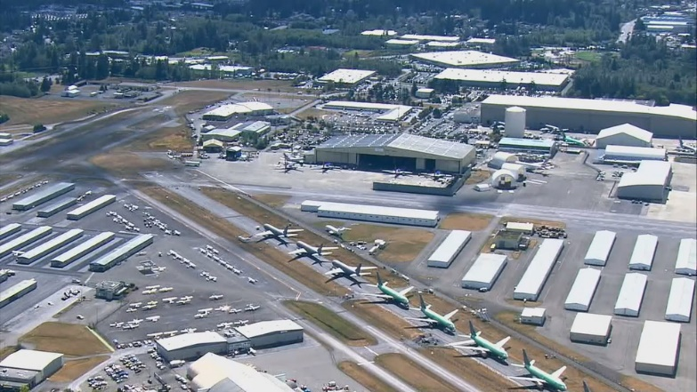
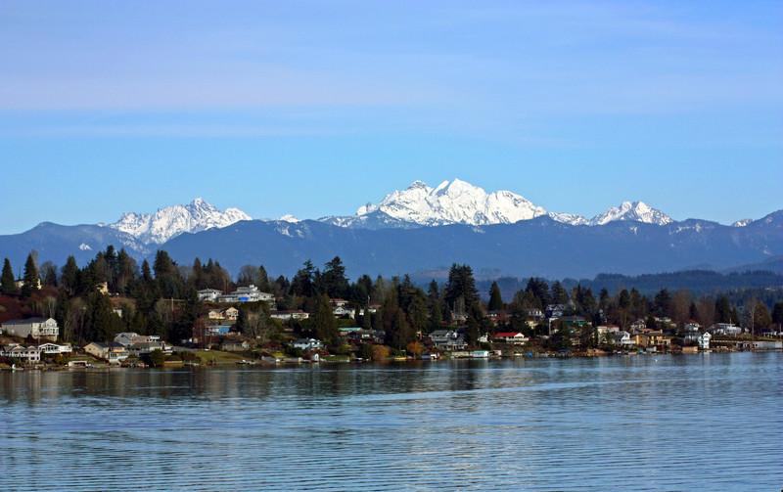

Snohomish County at a Glance (2)
3
Notes:
Snohomish County
Mountains, Sea, Farms, Urban Core
Salmon
Boeing
1/5 jobs is aerospace
35,000 jobs

Slide 4
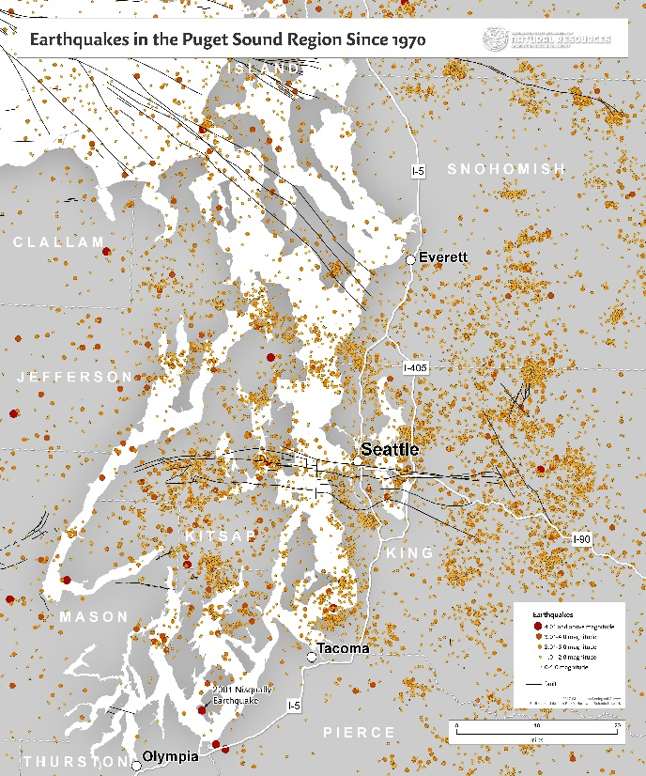
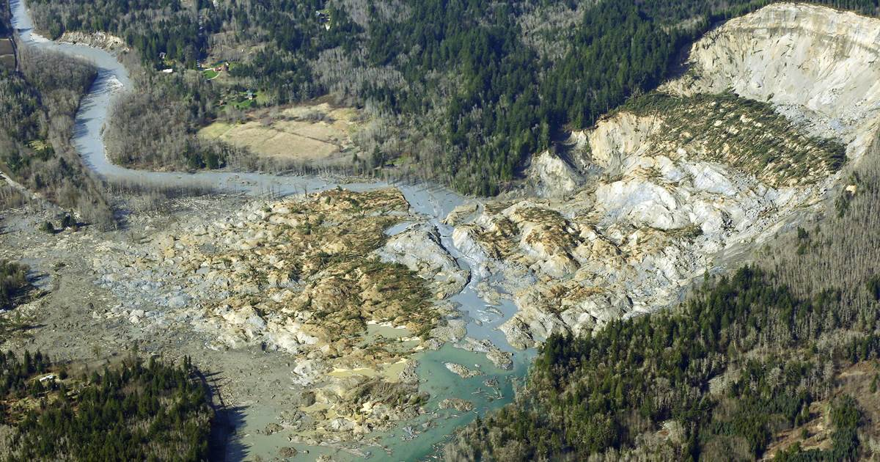
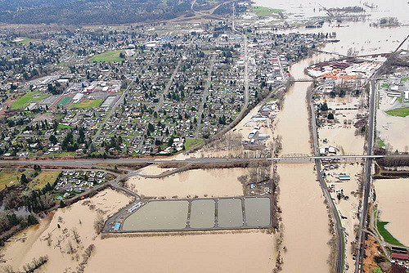
Snohomish County at a Glance (3)
Source: NBC News
Source: WADNR
Source: WSDOT
4
Notes:
Hazards/Disasters
Earthquakes
Floods
Annual Flood Messaging
Landslide/SR-530
Snow

Slide 5
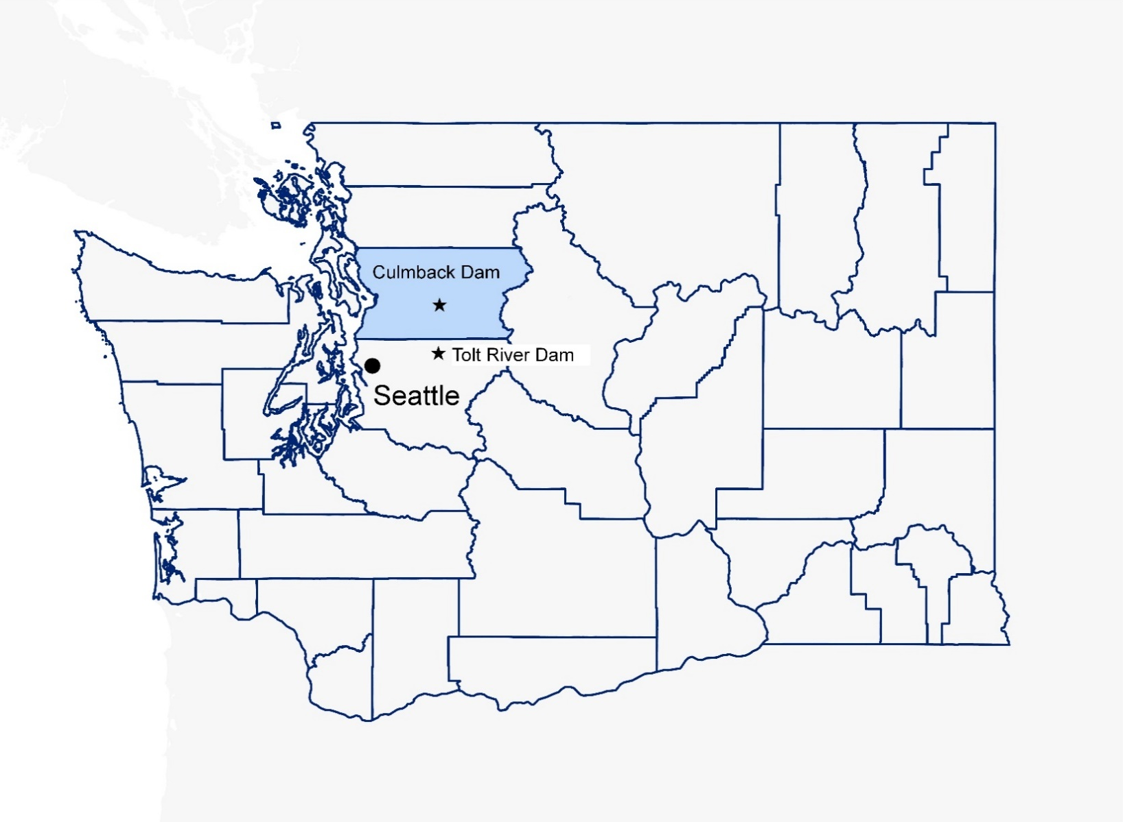
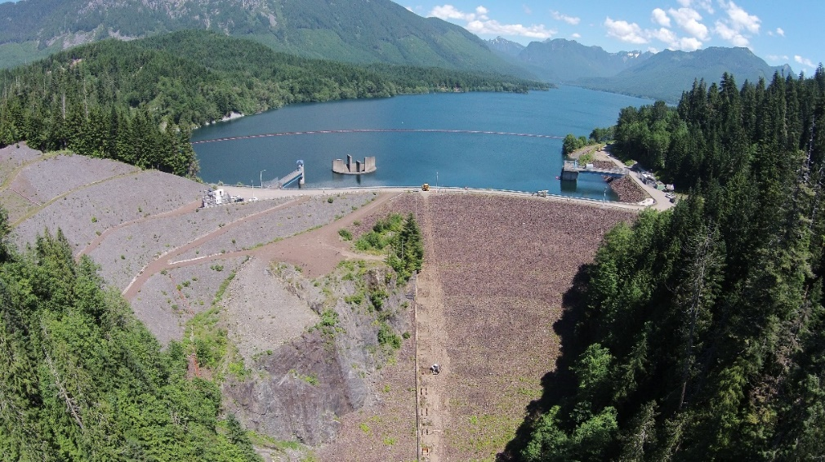
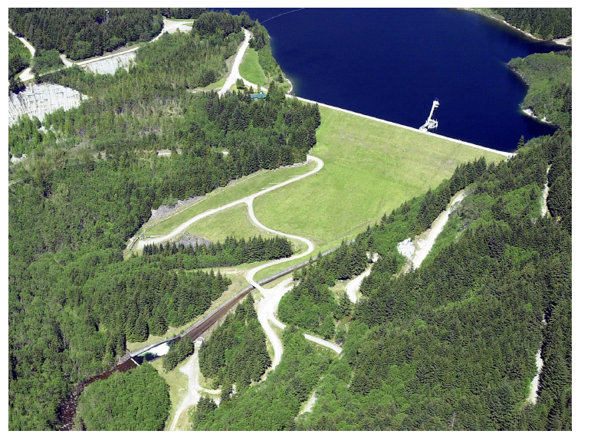
Snohomish County at a Glance (4)
Culmback Dam at Spada Lake
South Fork Tolt River Project
Source: IMCO Construction
5
Notes:
Hazards/Disasters
Culmback and Tolt both present risk for King and Snohomish Counties due to riverine valleys
Dams
58 dams
6 high hazard
2 dam failures in late ‘60s

Slide 6
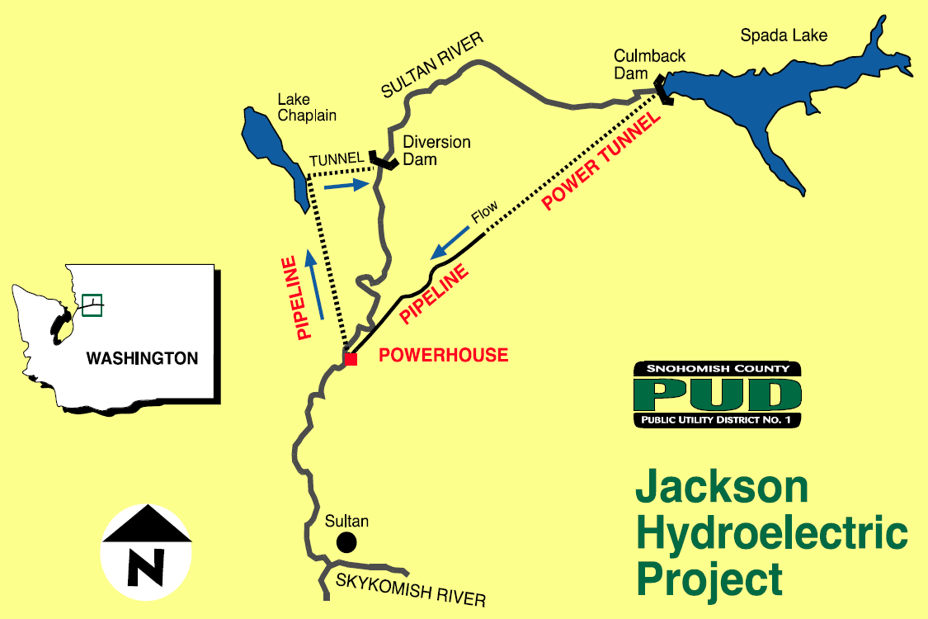
Culmback Dam Overview
6
Notes:
The Jackson Hydroelectric Project is a 111.8-megawatt (MW) Project consisting of a reservoir (Spada Lake Reservoir) behind Culmback Dam in the Sultan River basin.
Built: 1965
1,470 feet tall
640 feet long
Crest width of 25 feet
262 feet above the original streambed
The main embankment consists of compacted rock fill and gravel outer zone and an inner sloping central impervious core zone of rolled clay bordered by filter zones.
Power generation consists of an 8-mile tunnel and pipeline, and a powerhouse at RM 4.3 containing two 8.4-MW Francis turbines and two 47.5-MW Pelton turbines.
Water diverted from Spada Lake Reservoir drops 1,100 feet to the powerhouse. Water passed through the Francis units is re-routed uphill 400 feet through a 3-mile long return pipeline to a diversion structure on the shores of Lake Chaplain.
A portion of the flow enters Lake Chaplain for water supply and the remaining portion is returned via tunnel and pipeline to the river at RM 9.7, immediately above the Diversion Dam, for instream flow needs. After these two priorities have been met, any additional water may be passed through the Pelton units and then discharged to the river.
94-foot diameter uncontrolled morning glory spillway
The Diversion Dam is a concrete gravity overflow structure approximately 19 feet high and 120 feet wide. The Diversion Dam has a crest at elevation 655 feet. Diversion of flow from the Sultan River of up to 265 cubic feet per second (cfs) for municipal and industrial water supply
A 2,000-foot, 6-foot diameter reinforced concrete pipeline was installed as part of Stage II to replace the original wood stave pipeline.
At the Diversion Dam, water, which comes from the powerhouse via the Lake Chaplain pipeline, is discharged into the Sultan River to provide minimum instream flows for anadromous fish production. The original water diversion scheme (providing water from the Sultan River to the City of Everett for water supply) can be reactivated if needed by reversing the present flow between the diversion structure on Lake Chaplain and the Diversion Dam. This may be necessary during water supply outages for maintenance or repair of the power conduit, the powerhouse, or the return pipeline carrying water from the powerhouse to Lake Chaplain.

Slide 7

Culmback Dam Overview (2)
5%
7
Notes:
80% of County
5% of power
Coho Salmon Habitat
Riverbed restoration
Changes to water temp

Slide 8
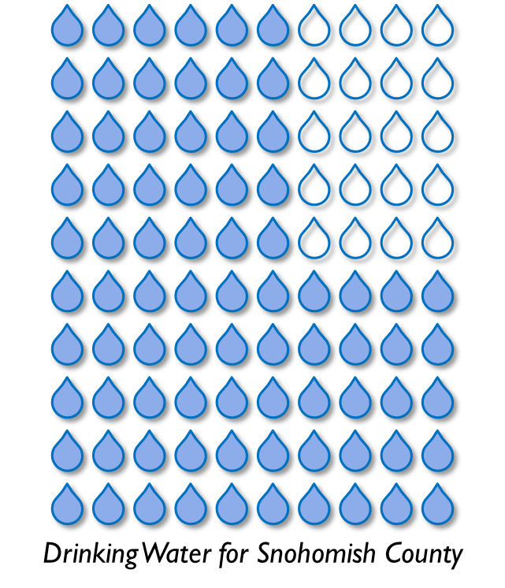
Culmback Dam Overview (3)
5%
80%
8
Notes:
80% of County
5% of power
Coho Salmon Habitat
Riverbed restoration
Changes to water temp

Slide 9

Culmback Dam Overview (4)
5%
80%
15 miles
Salmon Habitat
9
Notes:
80% of County
5% of power
Coho Salmon Habitat
Riverbed restoration
Changes to water temp

Slide 10
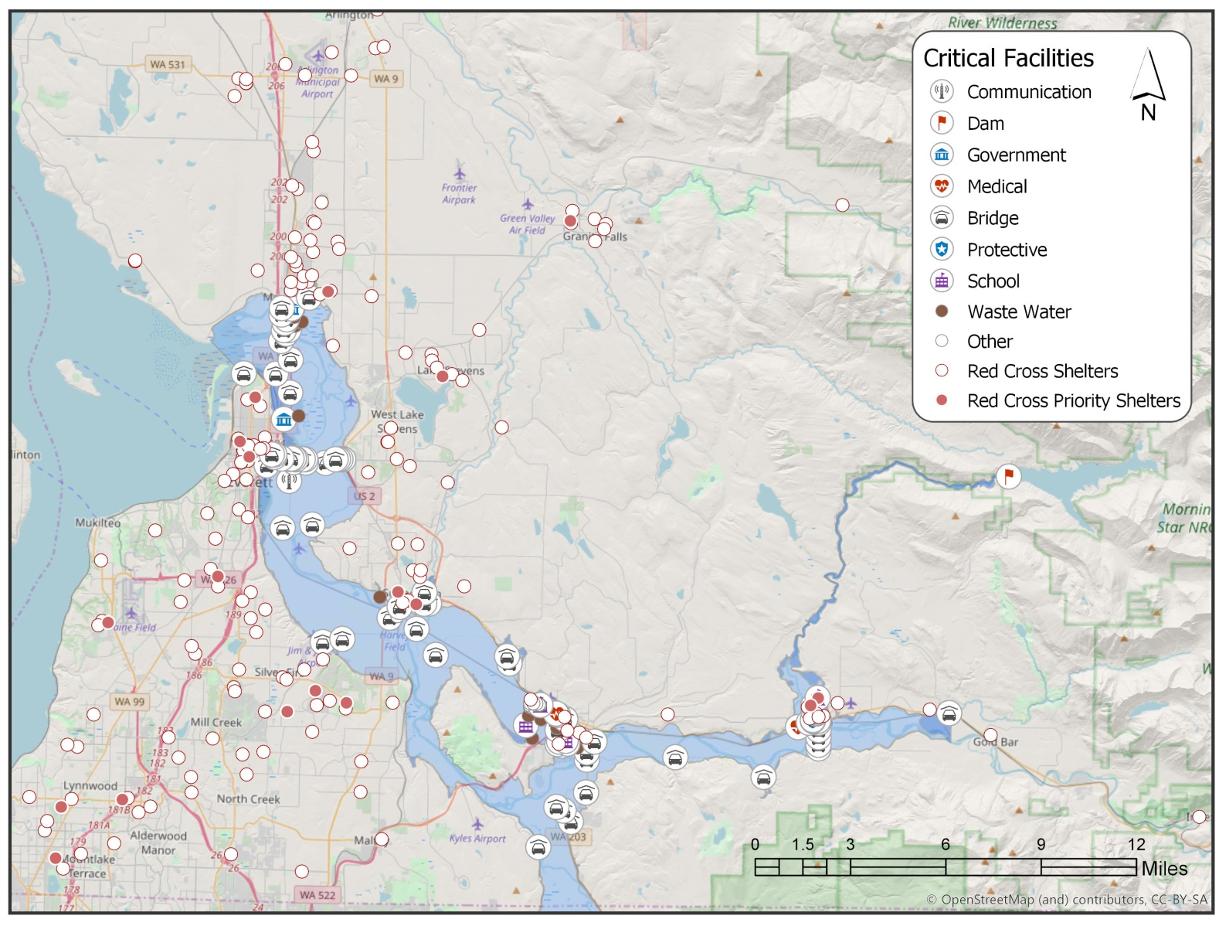
Culmback Dam Overview (5)
10
Notes:
Key challenges
45-foot wave arrive in Sultan in 54 minutes
10.5 feet/sec
+1.1 million CFS
18-foot height in Monroe in 4-5 hours
Limited ingress/egress
Highway 2
Mann Road Bridge
Fire/EMS

Slide 11
Culmback Dam Overview (6)
11
Notes:
Key challenges
45-foot wave arrive in Sultan in 54 minutes
10.5 feet/sec
+1.1 million CFS
18-foot height in Monroe in 4-5 hours
Limited ingress/egress
Highway 2
Mann Road Bridge
Fire/EMS

Slide 12
Culmback Dam Overview (7)
City of Sultan
45 feet
54 minutes
12
Notes:
Key challenges
45-foot wave arrive in Sultan in 54 minutes
10.5 feet/sec
+1.1 million CFS
18-foot height in Monroe in 4-5 hours
Limited ingress/egress
Highway 2
Mann Road Bridge
Fire/EMS

Slide 13
Culmback Dam Overview (8)
City of Monroe
18 feet
4-5 hours
City of Sultan
45 feet
54 minutes
13
Notes:
Key challenges
45-foot wave arrive in Sultan in 54 minutes
10.5 feet/sec
+1.1 million CFS
18-foot height in Monroe in 4-5 hours
Limited ingress/egress
Highway 2
Mann Road Bridge
Fire/EMS

Slide 14
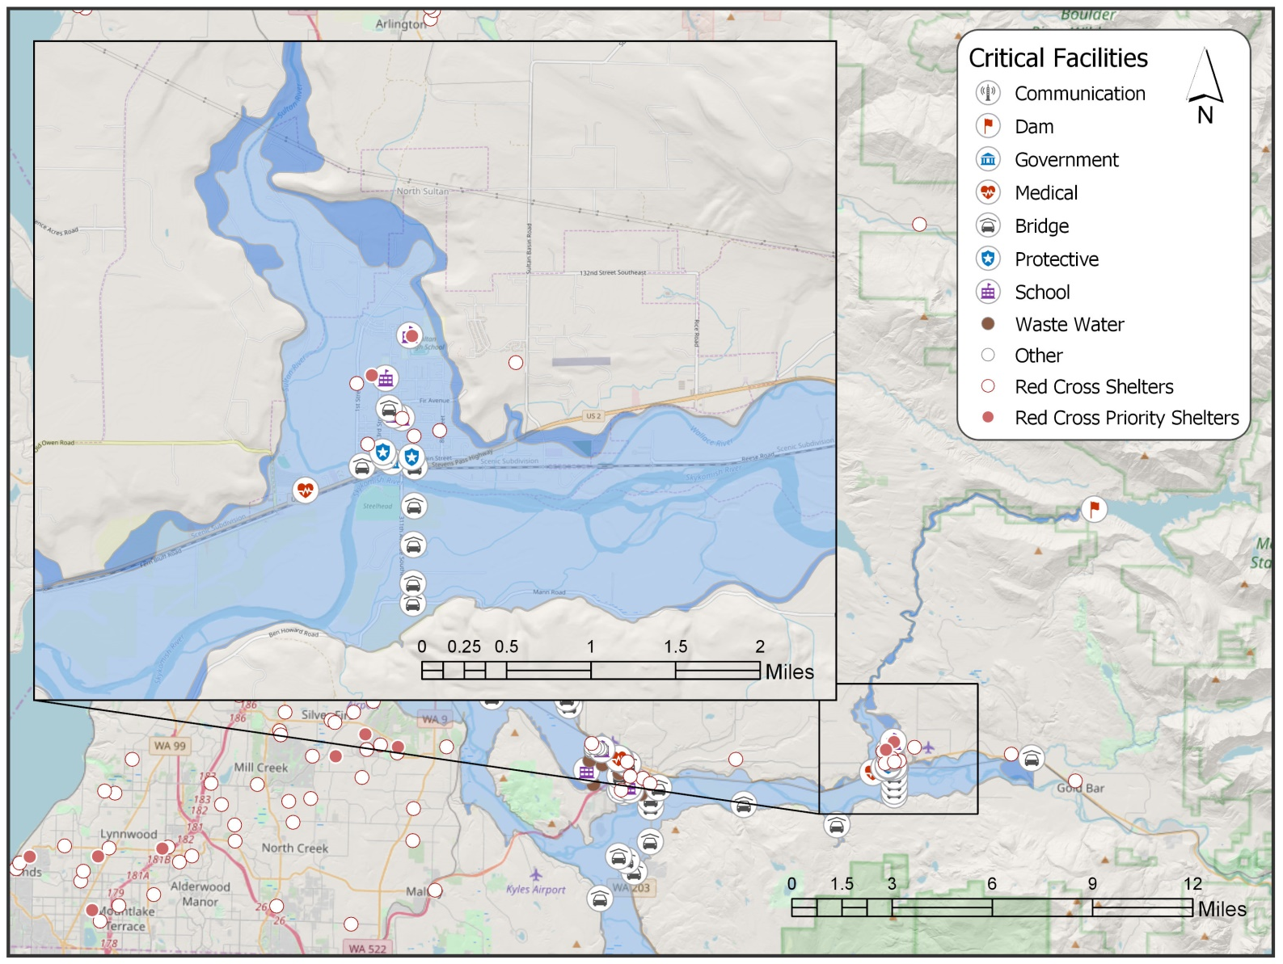
Culmback Dam Overview (9)
14
Notes:
Key challenges
Value of damaged property
$2.4 trillion
Schools and evacuations
Infrastructure
BPA lines
Waste water
Prison
US-2 Bridge

Slide 15
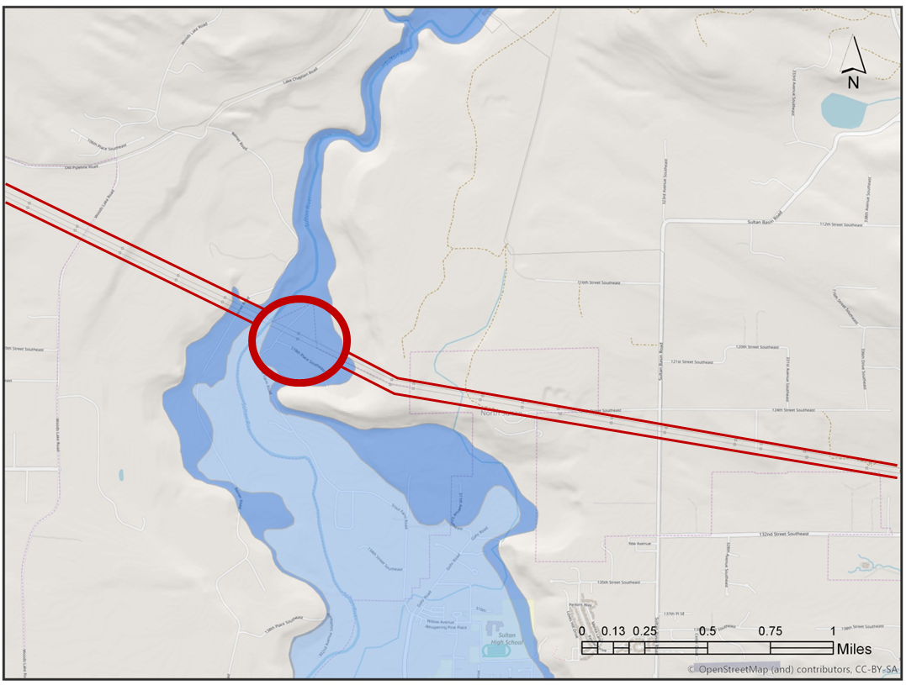
Culmback Dam Overview (10)
15
Notes:
Key challenges
Infrastructure
BPA lines
Waste water
Prison
US-2 Bridge

Slide 16
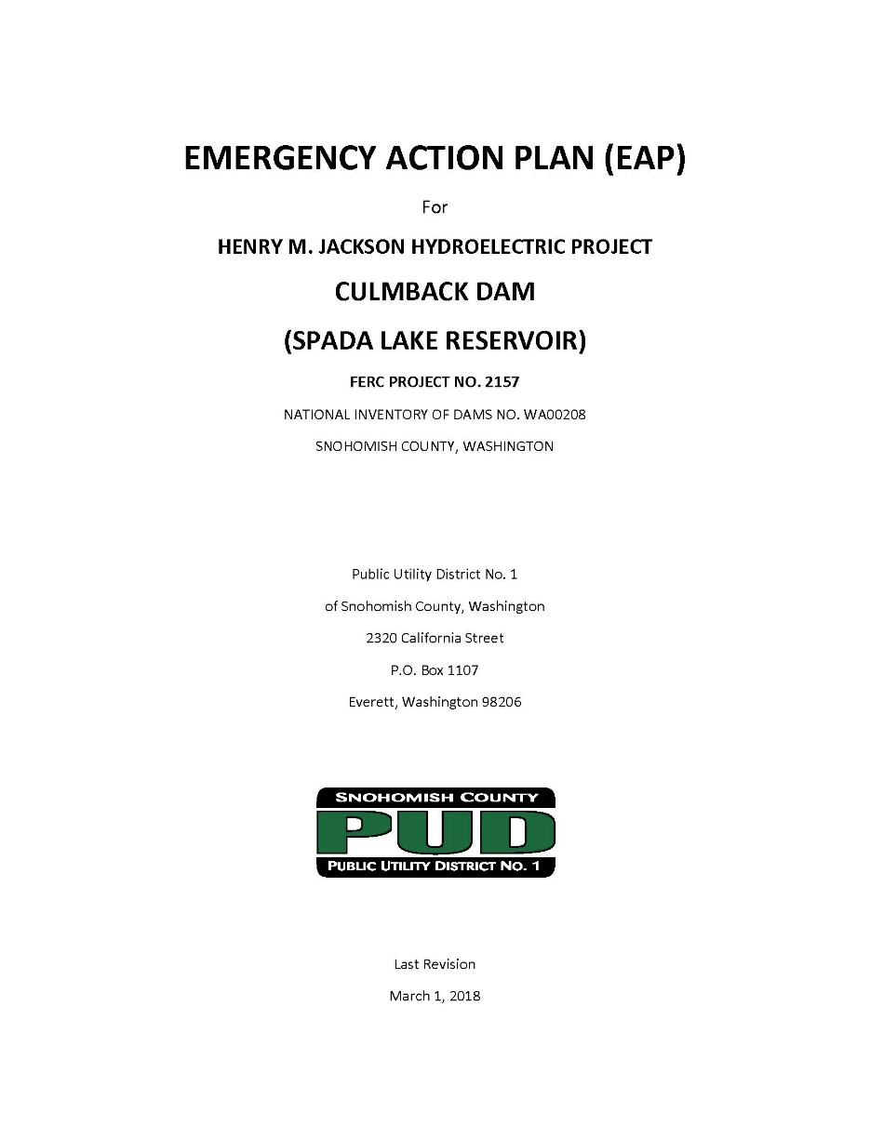
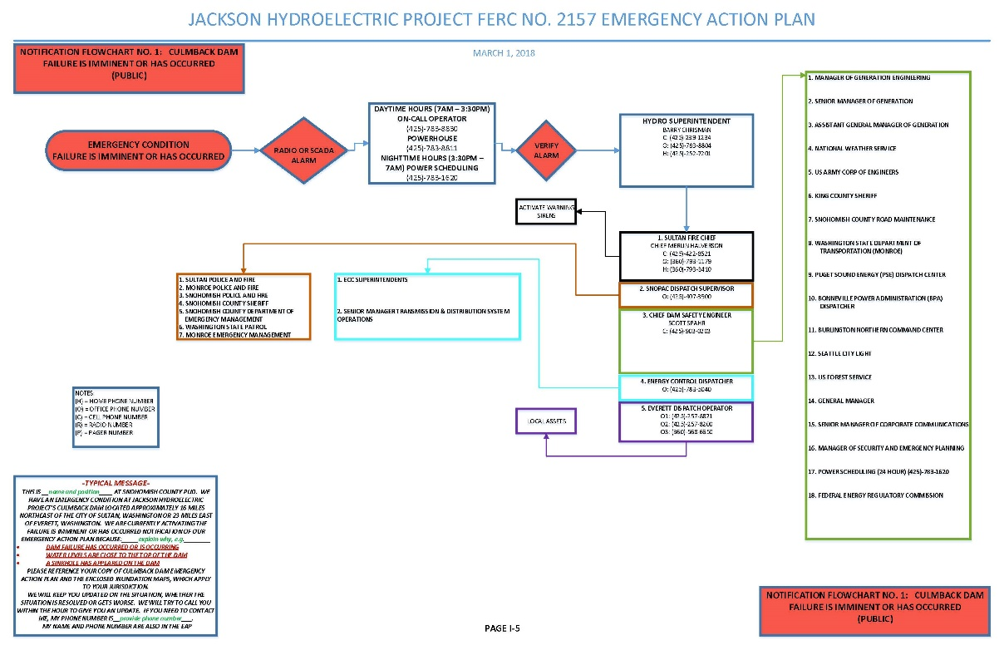
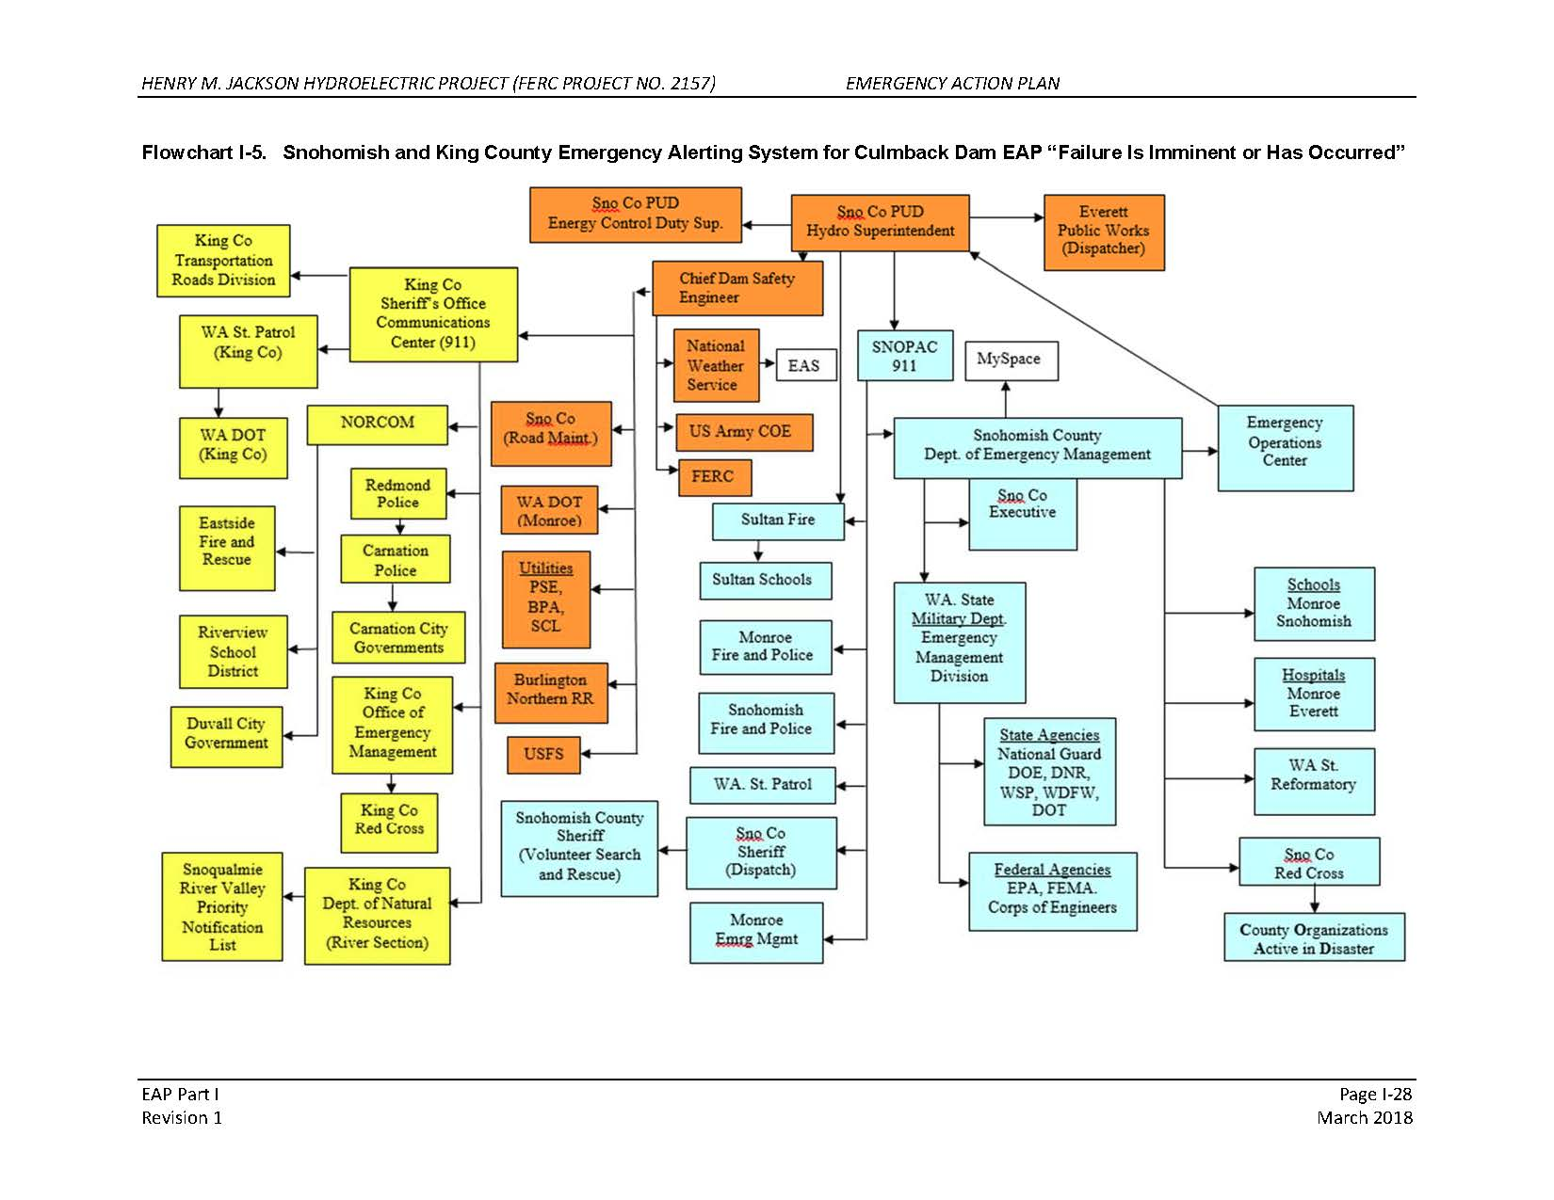
Dam Emergency Planning
16
Notes:
Receive EAP and EAP Updates
Shelved
Notification Flow Charts
Confusing
Single points of failure (individuals, not agencies), wrong numbers, multiple contacts from multiple entities
DEM = No dam emergency, evac or SIP plan
PUD/Dem = Test/comms = every five years per FERC

Slide 17
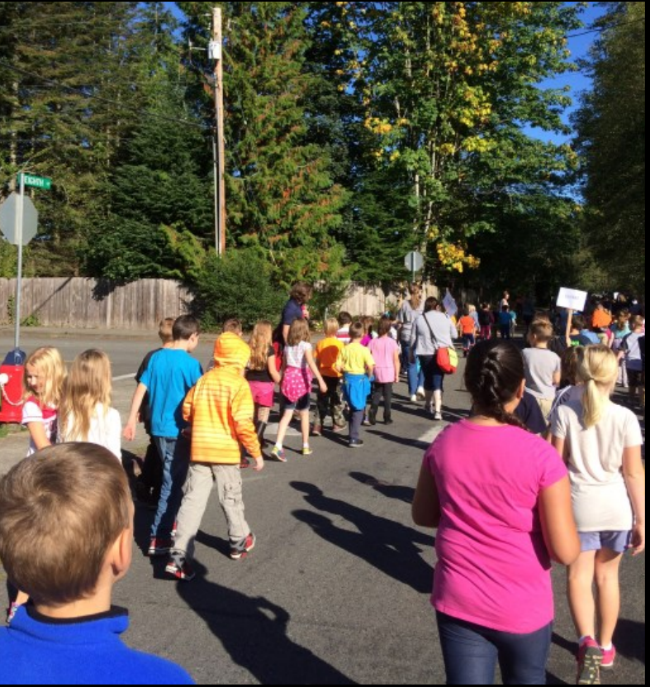
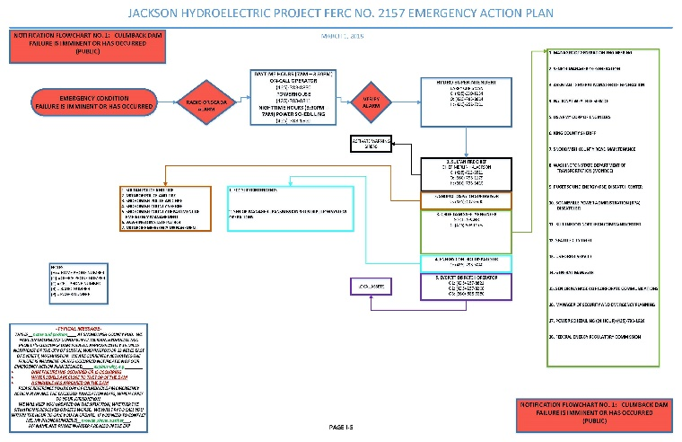

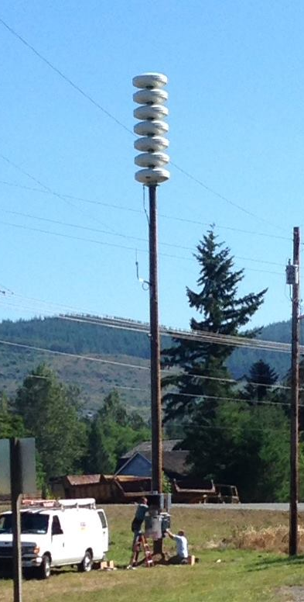
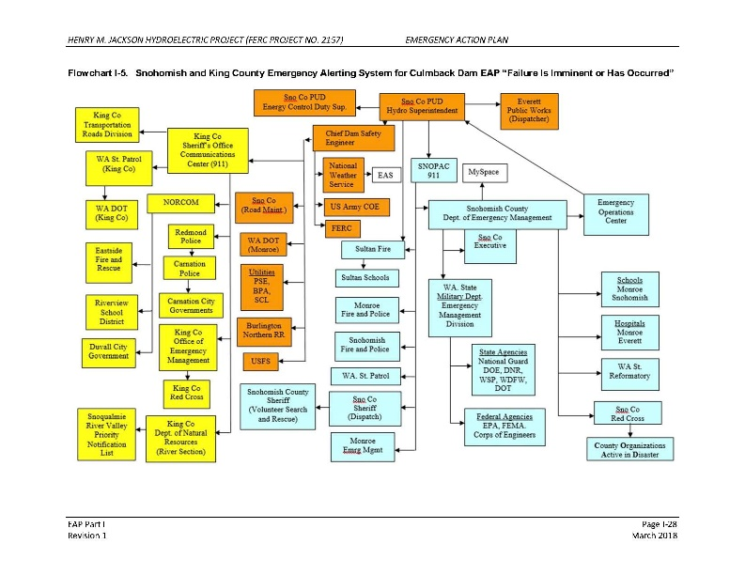
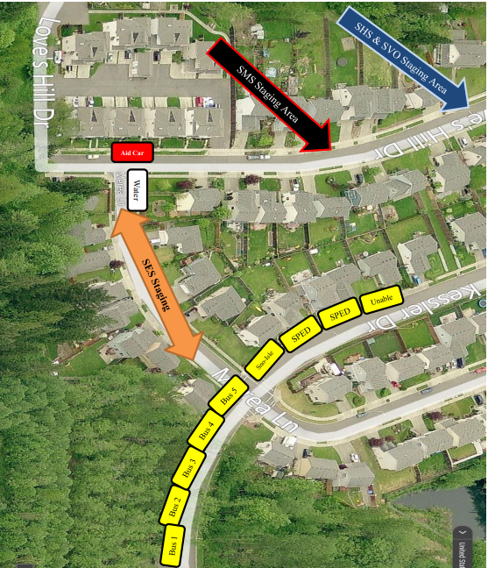
Dam Emergency Planning (2)
Source: Sultan School District #311
Source: Snohomish County Fire District 5
Source: Sultan School District #311
17
Notes:
School annual drill = uncoordinated with other efforts
Sirens = standalone, test but no other public messaging; City owned - fire district controls, fire station is in inundation zone

Slide 18










Disjointed Public Information
18
Notes:
No coordinated or canned messaging
Individual to each agency
PUD = initial messaging
SCSO = evacuation notices and routes
Fire District/City/School = evacuation and safety
DEM = mass care
WSP/WSDOT = state route messaging
New DEM and PUD PIO
SCSO and previous PUD had relationship in general JIC/JIS

Slide 19
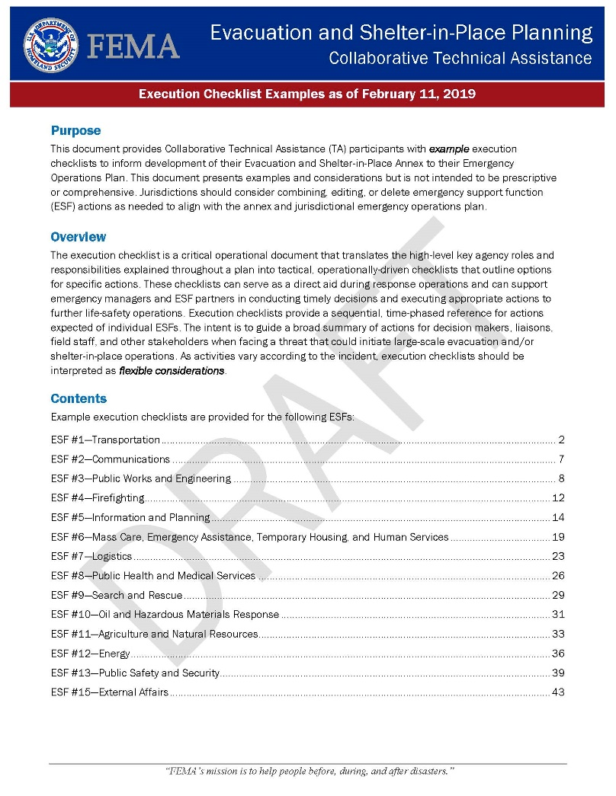
FEMA Technical Assistance
19
Notes:
Technical Assistance
SME
Planning, GIS, dam safety, communications
Planning support
Annex templates
New modeling
Expertise, software for small PUD
Regional
Local, Multi-county, State, Tribe, FEMA, Multiple dam owners
Risk communications
Message development, best practices, content development, exercise facilitation, workshop challenges/gaps/plans, JIC/JIS, spokesperson training

Slide 20
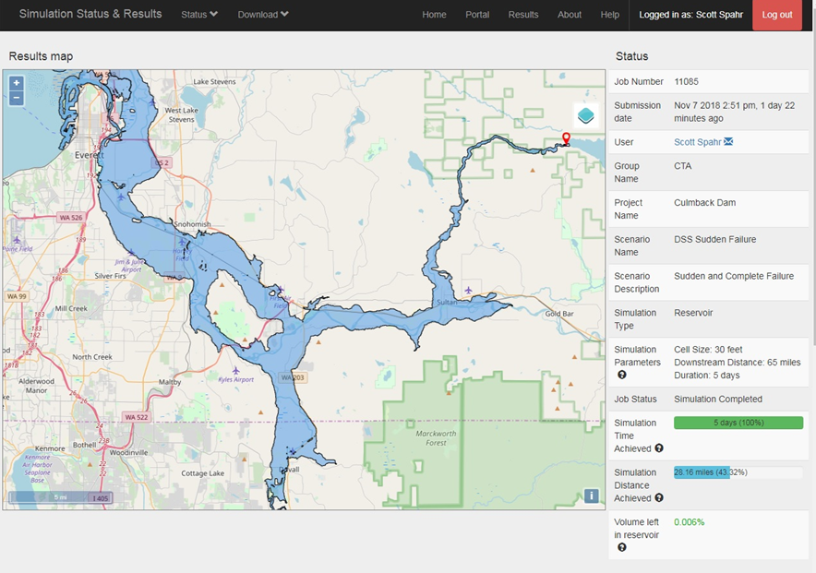
FEMA Technical Assistance (2)
20
Notes:
Technical Assistance
SME
Planning, GIS, dam safety, communications
Planning support
Annex templates
New modeling
Expertise, software for small PUD
Regional
Local, Multi-county, State, Tribe, FEMA, Multiple dam owners
Risk communications
Message development, best practices, content development, exercise facilitation, workshop challenges/gaps/plans, JIC/JIS, spokesperson training

Slide 21
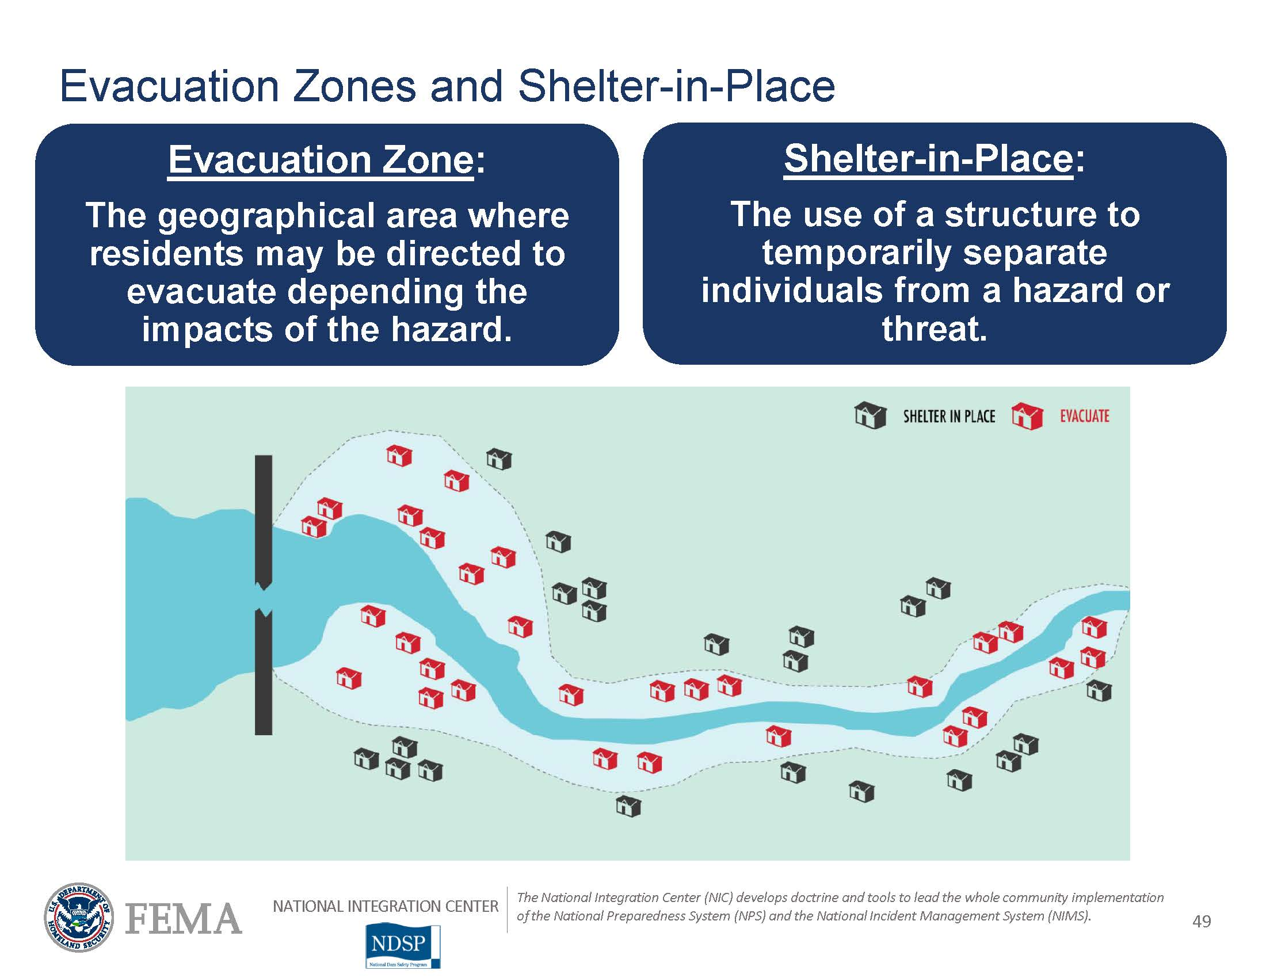
FEMA Technical Assistance (3)
21
Notes:
Technical Assistance
SME
Planning, GIS, dam safety, communications
Planning support
Annex templates
New modeling
Expertise, software for small PUD
Regional
Local, Multi-county, State, Tribe, FEMA, Multiple dam owners
Risk communications
Message development, best practices, content development, exercise facilitation, workshop challenges/gaps/plans, JIC/JIS, spokesperson training

Slide 22
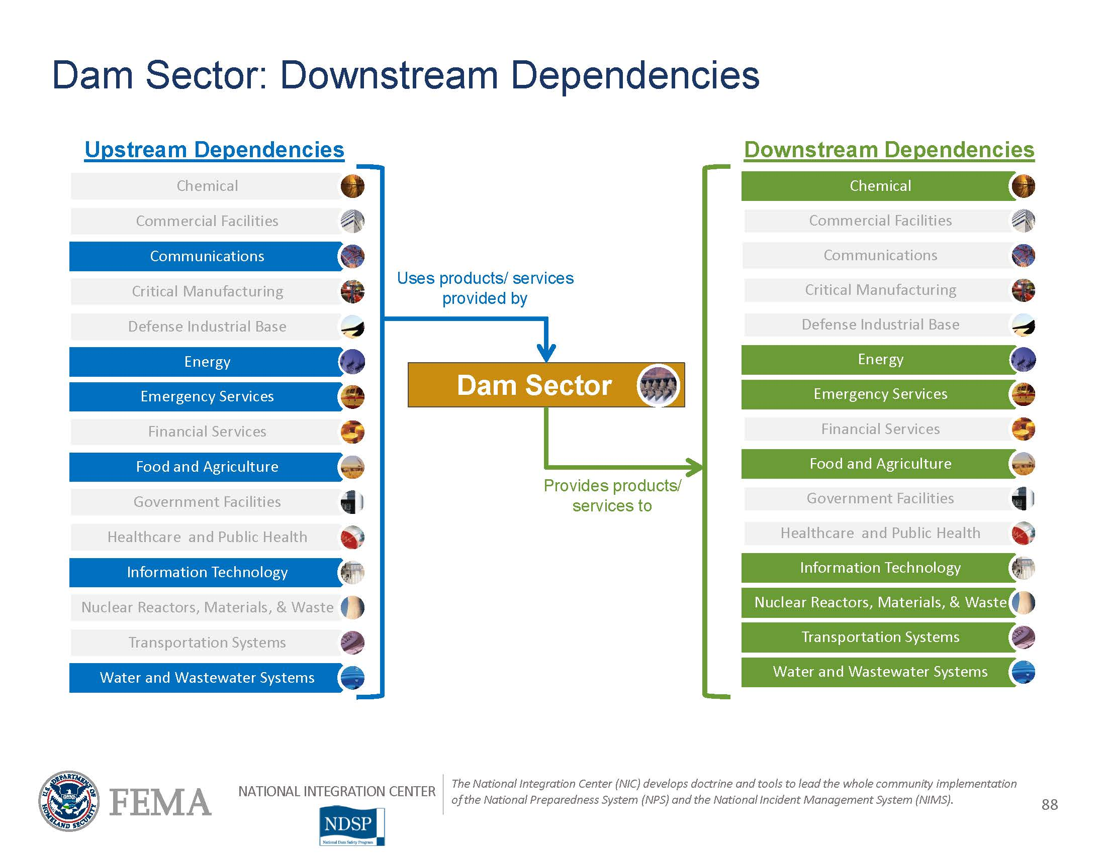
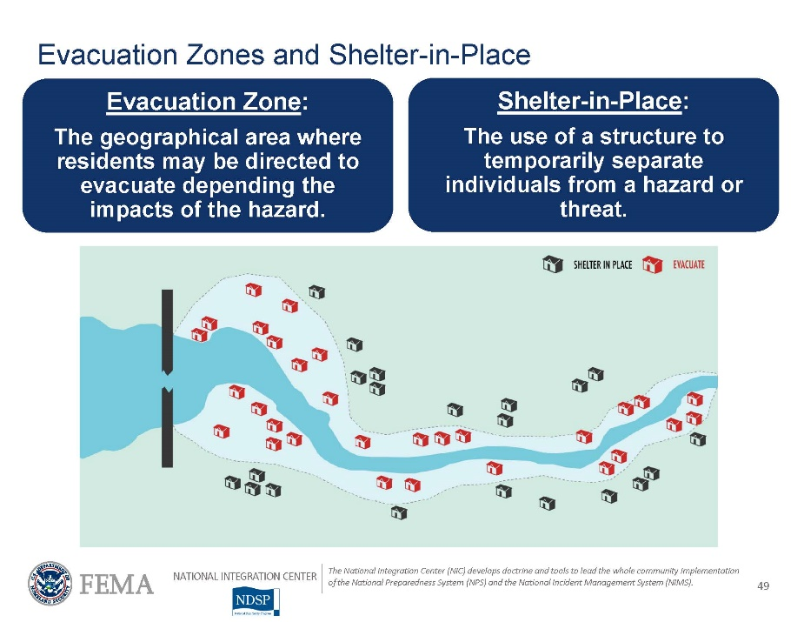
FEMA Technical Assistance (4)
22
Notes:
Technical Assistance
SME
Planning, GIS, dam safety, communications
Planning support
Annex templates
New modeling
Expertise, software for small PUD
Regional
Local, Multi-county, State, Tribe, FEMA, Multiple dam owners
Risk communications
Message development, best practices, content development, exercise facilitation, workshop challenges/gaps/plans, JIC/JIS, spokesperson training

Slide 23
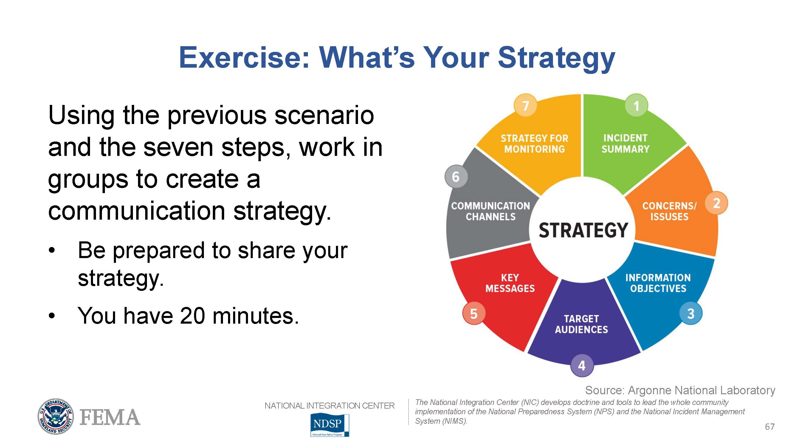
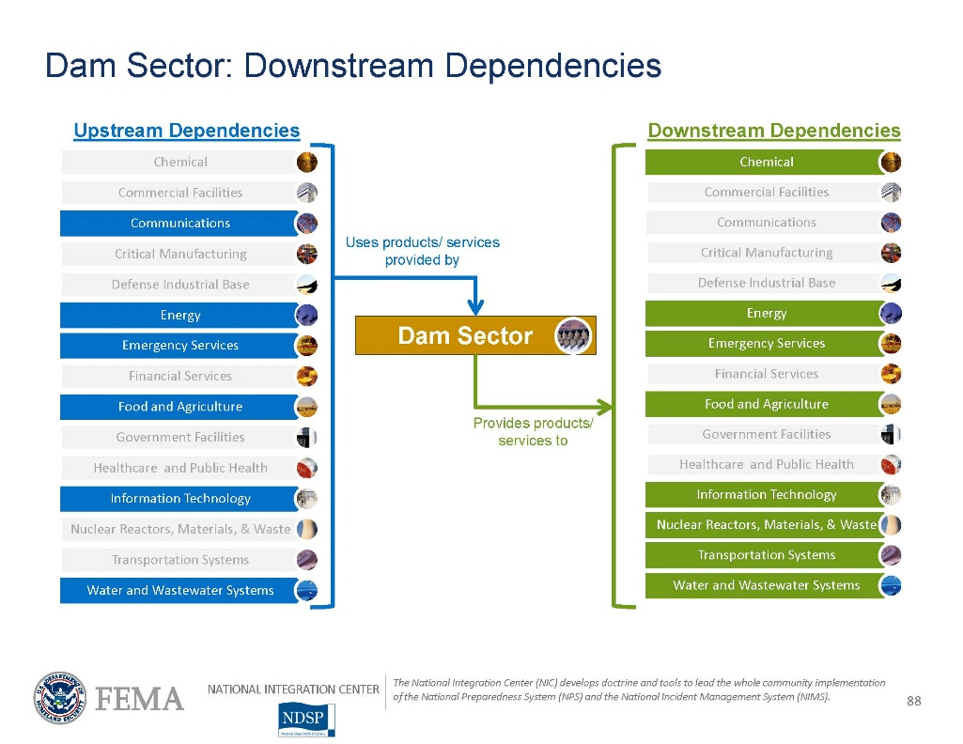
FEMA Technical Assistance (5)
23
Notes:
Technical Assistance
SME
Planning, GIS, dam safety, communications
Planning support
Annex templates
New modeling
Expertise, software for small PUD
Regional
Local, Multi-county, State, Tribe, FEMA, Multiple dam owners
Risk communications
Message development, best practices, content development, exercise facilitation, workshop challenges/gaps/plans, JIC/JIS, spokesperson training

Slide 24
Comprehensive Dam Emergency Planning
Snohomish County Comprehensive Emergency Management Plan
24
Notes:
County Plans
County CEMP

Slide 25
Comprehensive Dam Emergency Planning (2)
Snohomish County Comprehensive Emergency Management Plan
Emergency Support Function (ESF) Annexes
Incident Specific Annexes
Jurisdiction Specific CEMP Annexes
25
Notes:
County Plans
County CEMP
Emergency Support Function Annex
Jurisdiction Specific Annex
Incident Specific Annex

Slide 26
Comprehensive Dam Emergency Planning (3)
Snohomish County Comprehensive Emergency Management Plan
Emergency Support Function (ESF) Annexes
Incident Specific Annexes
Jurisdiction Specific CEMP Annexes
Dam Emergency
26
Notes:
County Plans
County CEMP
Emergency Support Function Annex
Jurisdiction Specific Annex
Incident Specific Annex
Public messaging
Critical transportation
Evacuation and shelter-in-place
Jurisdiction Specific Attachment
Checklists for specific actions

Slide 27
Comprehensive Dam Emergency Planning (4)
Snohomish County Comprehensive Emergency Management Plan
Emergency Support Function (ESF) Annexes
Incident Specific Annexes
Jurisdiction Specific CEMP Annexes
Dam Emergency
Checklists
Pre-Approved Messaging
Jurisdiction Specific Appendix
Mass Care and Shelter Attachment
Alert, Warning and Public Information Appendix
Evacuation / Shelter-in-Place Appendix
27
Notes:
County Plans
County CEMP
Emergency Support Function Annex
Jurisdiction Specific Annex
Incident Specific Annex
Public messaging
Critical transportation
Evacuation and shelter-in-place
Jurisdiction Specific Attachment
Checklists for specific actions

Slide 28
Comprehensive Dam Emergency Planning (5)
Snohomish County Comprehensive Emergency Management Plan
Emergency Support Function (ESF) Annexes
Incident Specific Annexes
Jurisdiction Specific CEMP Annexes
Dam Emergency
Checklists
Pre-Approved Messaging
Jurisdiction Specific Appendix
Mass Care and Shelter Attachment
Alert, Warning and Public Information Appendix
Evacuation / Shelter-in-Place Appendix
28
Notes:
County Plans
County CEMP
Jurisdiction Annex
Dam Appendix
Jurisdiction Specific Attachment

Slide 29
Comprehensive Dam Emergency Planning (6)
Snohomish County Hazard Mitigation Plan
Risk Assessment
Dam Failure
Jurisdiction Specific Annex
Mitigation Actions
Snohomish County Comprehensive Emergency Management Plan
Emergency Support Function (ESF) Annexes
Incident Specific Annexes
Jurisdiction Specific CEMP Annexes
Dam Emergency
Evacuation / Shelter-in-Place Appendix
Jurisdiction Specific Appendix
Checklists
Alert, Warning and Public Information Appendix
Mass Care and Shelter Attachment
Pre-Approved Messaging
29
Notes:
County Plans
Hazard Mitigation Plan

Slide 30
Comprehensive Dam Emergency Planning (7)
Snohomish County Hazard Mitigation Plan
Risk Assessment
Dam Failure
Jurisdiction Specific Annex
Mitigation Actions
Snohomish County Comprehensive Emergency Management Plan
Emergency Support Function (ESF) Annexes
Incident Specific Annexes
Jurisdiction Specific CEMP Annexes
Dam Emergency
Evacuation / Shelter-in-Place Appendix
Jurisdiction Specific Appendix
Checklists
Alert, Warning and Public Information Appendix
Mass Care and Shelter Attachment
Pre-Approved Messaging
30
Notes:
HMP Risk Assessment Informs Dam Emergency Annex

Slide 31
Comprehensive Dam Emergency Planning (8)
Snohomish County Hazard Mitigation Plan
Risk Assessment
Dam Failure
Jurisdiction Specific Annex
Mitigation Actions
Snohomish County Comprehensive Emergency Management Plan
Emergency Support Function (ESF) Annexes
Incident Specific Annexes
Jurisdiction Specific CEMP Annexes
Dam Emergency
Evacuation / Shelter-in-Place Appendix
Jurisdiction Specific Appendix
Checklists
Alert, Warning and Public Information Appendix
Mass Care and Shelter Attachment
Pre-Approved Messaging
31
Notes:
HMP Action Items inform emergency plans, physical items, etc.

Slide 32
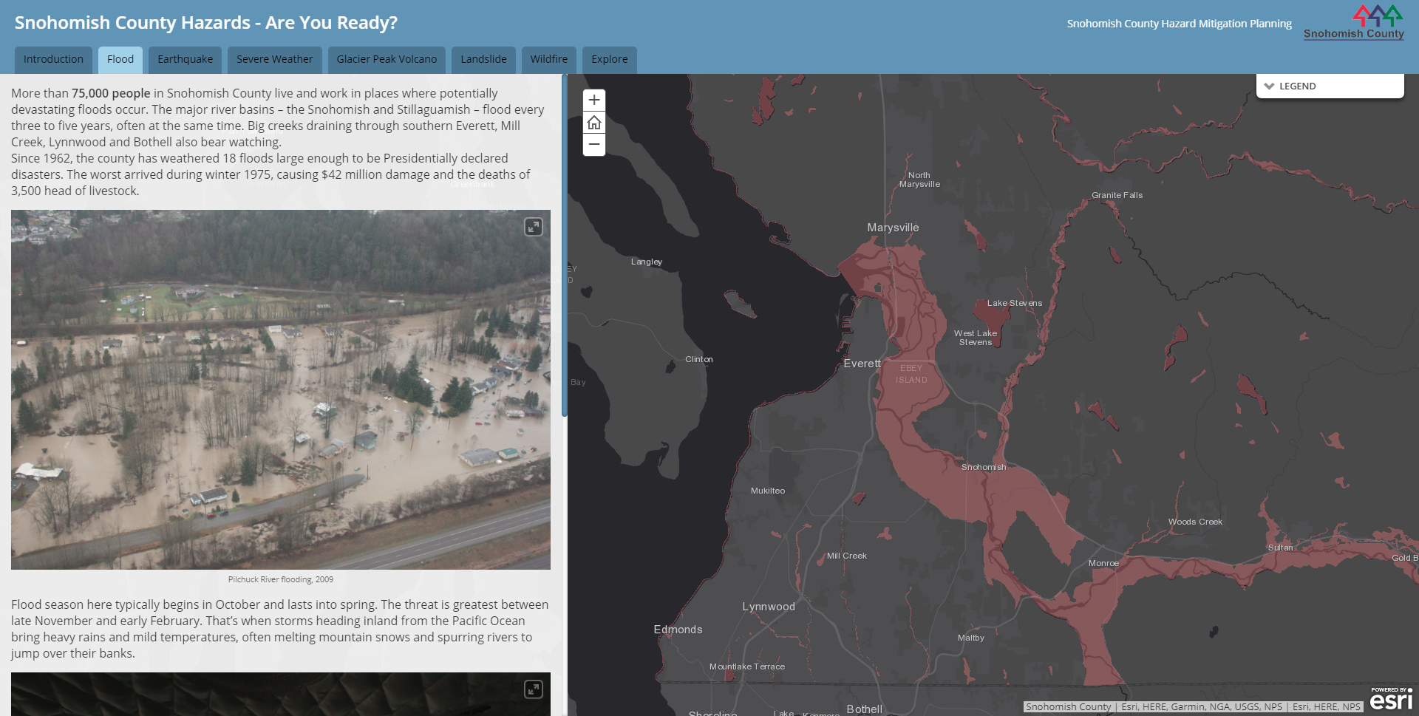
Joint Information
32
Notes:
All hazards
Volcano, floods, tsunami, wildfire
Connection with dam staff
New PUD PIO
New dam engineer
Seattle City Light/Seattle Public Utilities
Public information relationship
Snow storm and power outage
Hazards map
Flood Tab
Dam Tab
GIS coordination with PUD, DEM, PDS, PW
Multi-county messaging
Consistent across dams, dam owners, jurisdictions
Pre-canned
Limited English Proficiency
Authorization for County to send message on behalf of jurisdictions

Slide 33

Joint Information (2)
33
Notes:
All hazards
Volcano, floods, tsunami, wildfire
Connection with dam staff
New PUD PIO
New dam engineer
Seattle City Light/Seattle Public Utilities
Public information relationship
Snow storm and power outage
Hazards map
Flood Tab
Dam Tab
GIS coordination with PUD, DEM, PDS, PW
Multi-county messaging
Consistent across dams, dam owners, jurisdictions
Pre-canned
Limited English Proficiency
Authorization for County to send message on behalf of jurisdictions

Slide 34
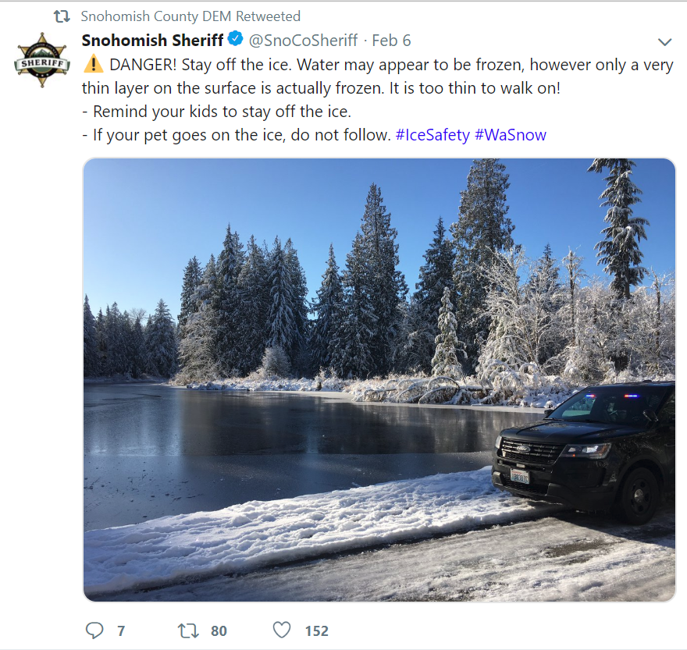
Joint Information (3)
34
Notes:
All hazards
Volcano, floods, tsunami, wildfire
Connection with dam staff
New PUD PIO
New dam engineer
Seattle City Light/Seattle Public Utilities
Public information relationship
Snow storm and power outage
Hazards map
Flood Tab
Dam Tab
GIS coordination with PUD, DEM, PDS, PW
Multi-county messaging
Consistent across dams, dam owners, jurisdictions
Pre-canned
Limited English Proficiency
Authorization for County to send message on behalf of jurisdictions

Slide 35
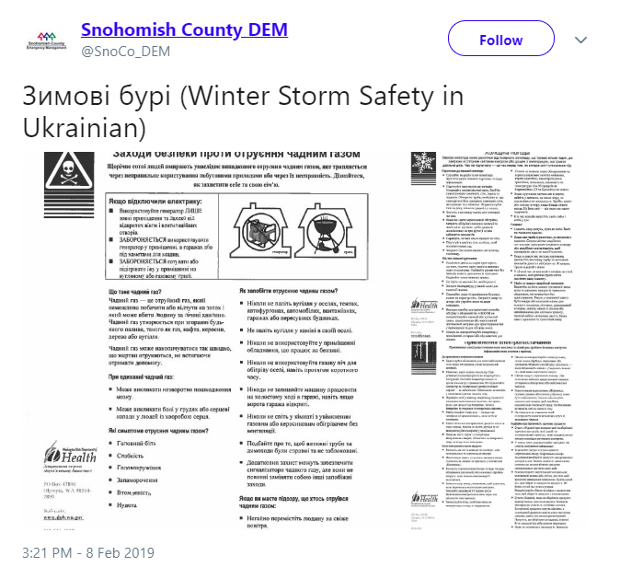
Joint Information (4)
35
Notes:
All hazards
Volcano, floods, tsunami, wildfire
Connection with dam staff
New PUD PIO
New dam engineer
Seattle City Light/Seattle Public Utilities
Public information relationship
Snow storm and power outage
Hazards map
Flood Tab
Dam Tab
GIS coordination with PUD, DEM, PDS, PW
Multi-county messaging
Consistent across dams, dam owners, jurisdictions
Pre-canned
Limited English Proficiency
Authorization for County to send message on behalf of jurisdictions

Slide 36



Joint Information (5)
36
Notes:
Exercise
Connection with dam staff
New PUD PIO
New dam engineer
Seattle City Light/Seattle Public Utilities
Public information relationship
Snow storm and power outage
Hazards map
Flood Tab
Dam Tab
GIS coordination with PUD, DEM, PDS, PW
Multi-county messaging
Consistent across dams, dam owners, jurisdictions
Pre-canned
Limited English Proficiency
Authorization for County to send message on behalf of jurisdictions

Slide 37
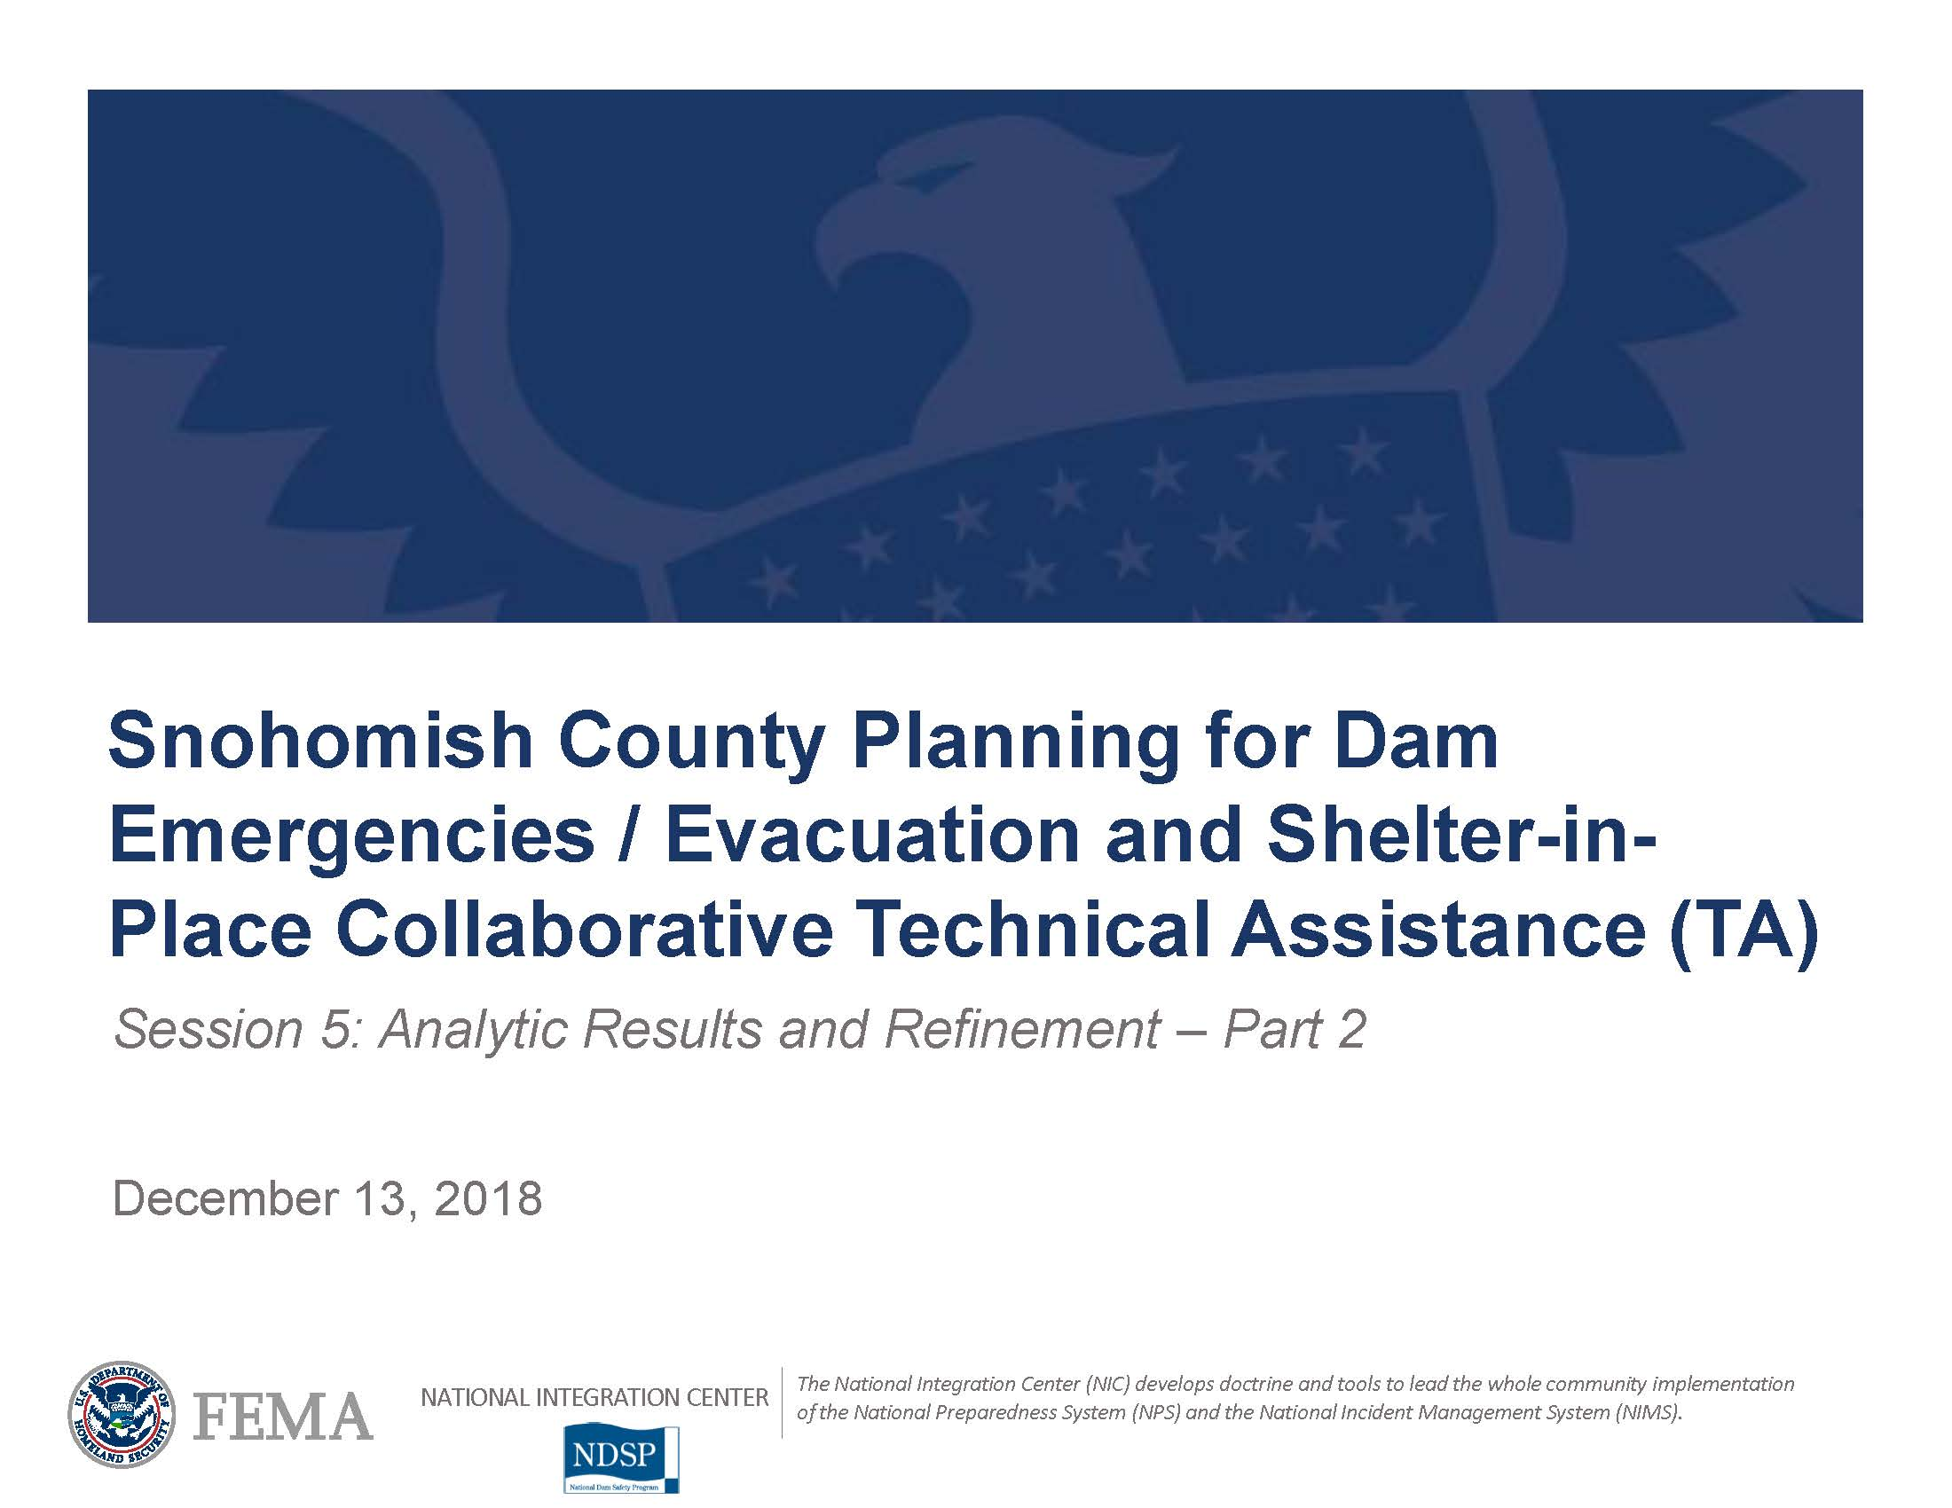
Moving Forward
Session 9: Tabletop Exercise
May 2019
37
Notes:
All hazards
Volcano, floods, tsunami, wildfire
May 2019 exercise
Quarterly dam planning group
Regional
May 2019 FERC full scale
Tolt River
Fall 2019 TTX
2020 Full scale

Slide 38

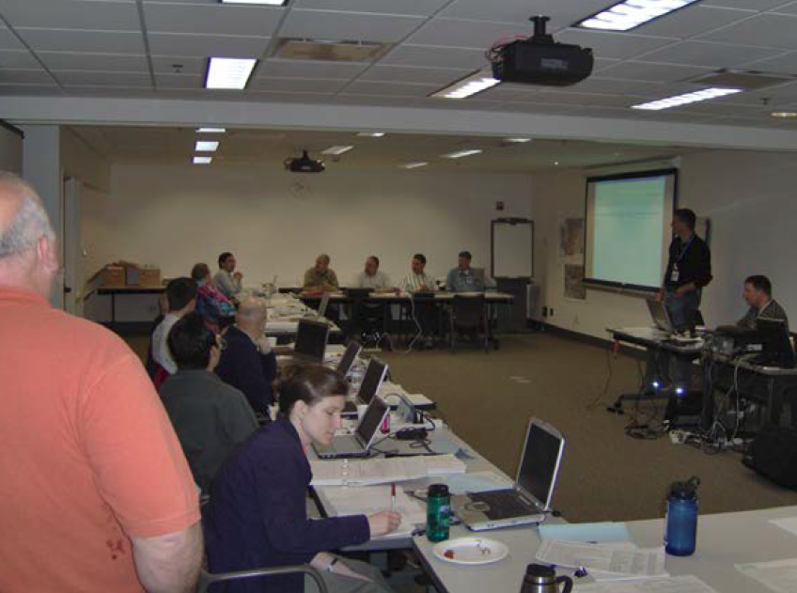
Moving Forward (2)
Session 9: Tabletop Exercise
May 2019
38
Notes:
All hazards
Volcano, floods, tsunami, wildfire
May 2019 exercise
Quarterly dam planning group
Regional
May 2019 FERC full scale
Tolt River
Fall 2019 TTX
2020 Full scale

Slide 39
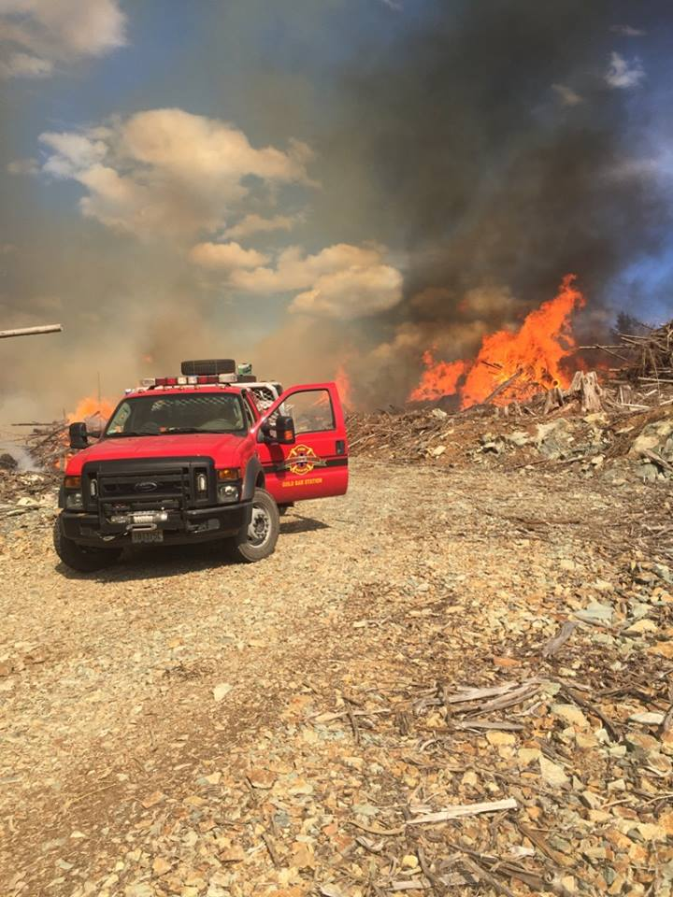
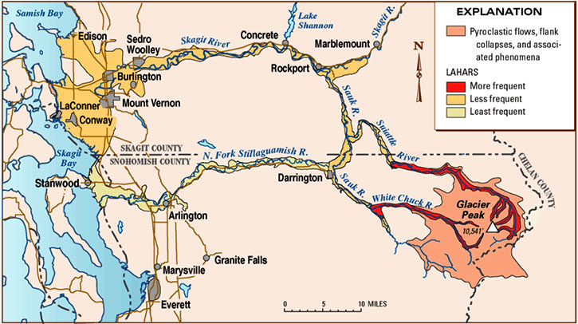
Moving Forward (3)
Session 9: Tabletop Exercise
May 2019
39
Notes:
All hazards
Volcano, floods, tsunami, wildfire
May 2019 exercise
Quarterly dam planning group
Regional
May 2019 FERC full scale
Tolt River
Fall 2019 TTX
2020 Full scale

Slide 40




Special Thanks
40
Notes:
FEMA NIC TA
NDSP
Argonne
Hagerty

Slide 41
Questions?
John Holdsworth
Emergency Program Manager
Snohomish County Department of Emergency Management
425-388-5074
John.Holdsworth@snoco.org
Facebook: @SnoCoDEM
Twitter: @SnoCo_DEM

