Slide 1
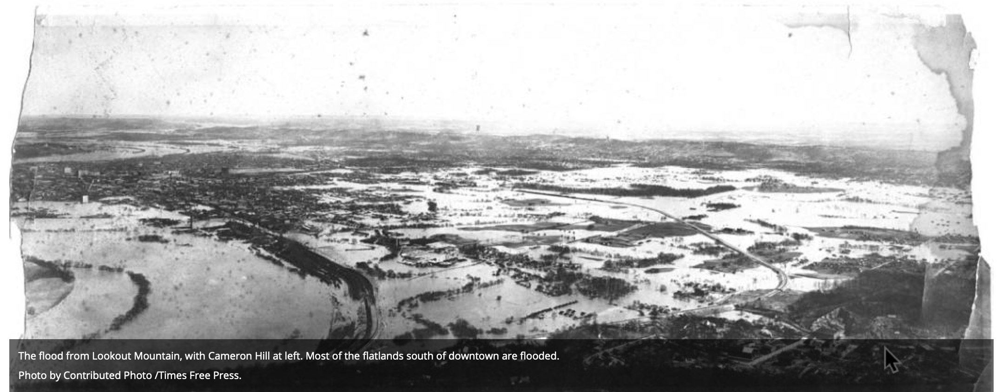
TVA Water Risk Management:
Past, Present and Future
Curt Jawdy-TVA
cmjawdy@tva.gov

Slide 2
TVA’s Integrated Watershed Management
Objectives
Flood Reduction
Navigation
Hydropower
Water Supply
Water Quality
Recreation
What do you keep hydrologists around for?
Improving operational decisions
Taking the long view
Preparing for the extremes

Slide 3
Smart Capital Allocation to Manage Extremes
What are the main extremes for us?
Too much water
Not enough water
Hot water
Change in strategy
Moving from design-basis approaches to risk-informed approaches
What harm would a failure cause?
How HIGH does the water get?
Does the
dam fail?
How does it fail?

Slide 4
Risk-Informing Decisions
RIDM requires a change in mentality
Probabilities drive the decision-making
You might need to quantify a 1:1,000,000 risk with 100 years of data
For our deeply integrated system, you must understand the time and space pattern of rainfall events
You must very clearly tie your analyses to decisions and communicate well

Slide 5
Example Application
PMF overtops dam by 8’
However, morning glory has never even been used
What decisions would a 1:1,000-yr overtopping trigger?
What decisions would a 1:1,000,000,000-yr overtopping trigger?
We want to understand loadings at extreme levels
?
Overtop 2012’
Morning Glory 1975’

Slide 6
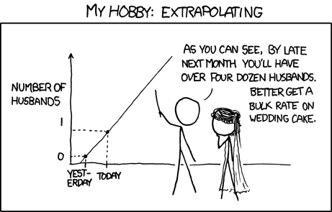
My Hobby: Extrapolating
Such a deep extrapolation requires minimizing errors as much as possible
Notes:
Critical aspects of the synthetic precipitation generation include:
maintenance of hyetograph patterns
maintenance of appropriate spatial relationships between distributed precipitation locations
preservation of storm seasonality
Goal: to develop an extended synthetic precipitation time series (1000 years) for the TVA watershed that maintains the statistical properties of the historical precipitation data sets, but also adds additional diversity to the extended series beyond what was observed.

Slide 7
Processes to Account for
Starting pool levels
Starting soil moistures
Rainfall depth
Rainfall timing
Rainfall spatial distribution
Runoff processes
Dam releases per policy
Integration of dam responses
Probability of each process
Interactions of processes

Slide 8
Stochastic Event Flood Model
Stochastic Event
Simulation
Long-Term Simulation
Sample date from the Long-term simulation
Soil moisture states
Reservoir states
Set states for the chosen date
River states
Create synthetic event
Many thousands of simulations
Calculate runoff, route downstream
Simulate reservoir operations and report max levels
Precipitation Analysis
Storm seasonality
Storm depth from frequency curve
Compile and summarize results
Storm precip template

Slide 9
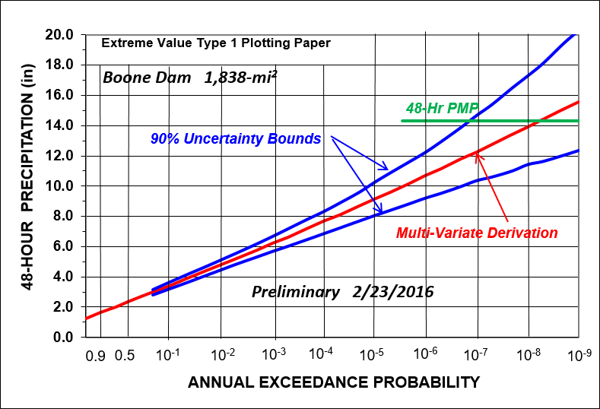
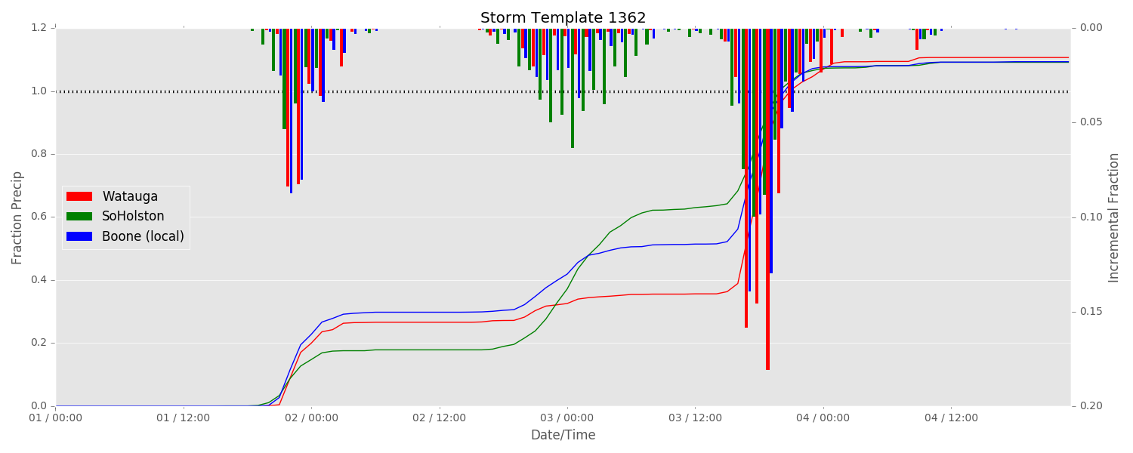
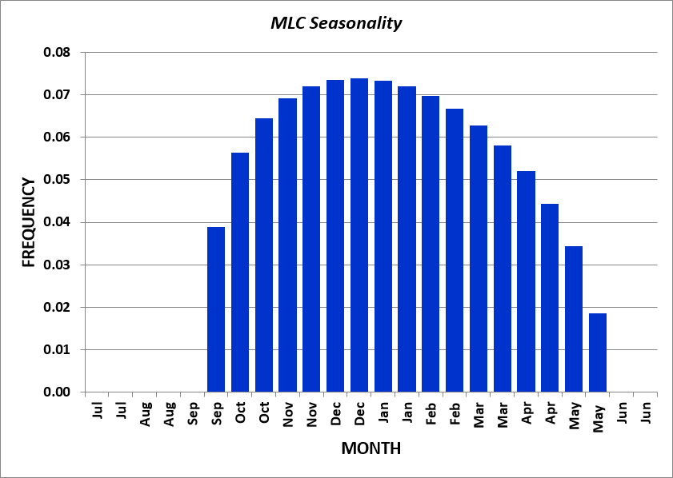
Rainfall Processing
Pick storm depth
Pick storm template
Scale storm template by sampled depth
Pick storm date from seasonality
1
2,3
5
4
Insert storm into long-term rainfall time series

Slide 10
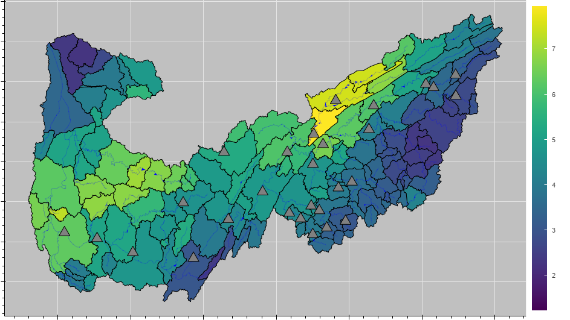
Extended Synthetic Time Series Generation
Goal: Develop an extended synthetic precipitation time series (1000 years) with greater diversity of events than observed
Storm Event Depth [in]
Maintain the statistical properties of the historical precipitation
Temporal patterns
Storm seasonality
Spatial relationships in distributed precipitation
Long-term trends
Notes:
Critical aspects of the synthetic precipitation generation include:
maintenance of hyetograph patterns
maintenance of appropriate spatial relationships between distributed precipitation locations
preservation of storm seasonality
Goal: to develop an extended synthetic precipitation time series (1000 years) for the TVA watershed that maintains the statistical properties of the historical precipitation data sets, but also adds additional diversity to the extended series beyond what was observed.

Slide 11
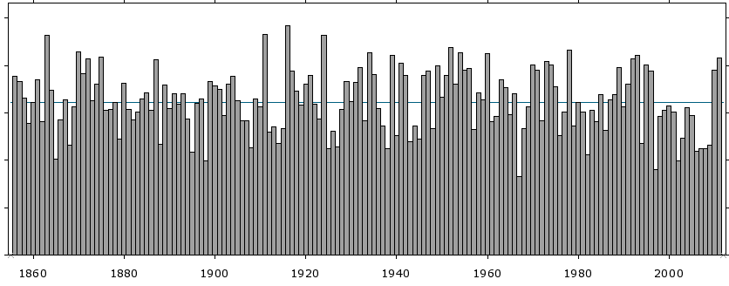
Alternating Renewal Method – Mining
Historical record
Step 1
DRY PERIODS
WET PERIODS
Notes:
Basic Bootstrapping - Simplest approach:
(Bootstrap is the method of estimating population statistics by resampling a single dataset with replacement – may need a definition slide for this)
First – classify historical data into contiguous dry and wet periods

Slide 12
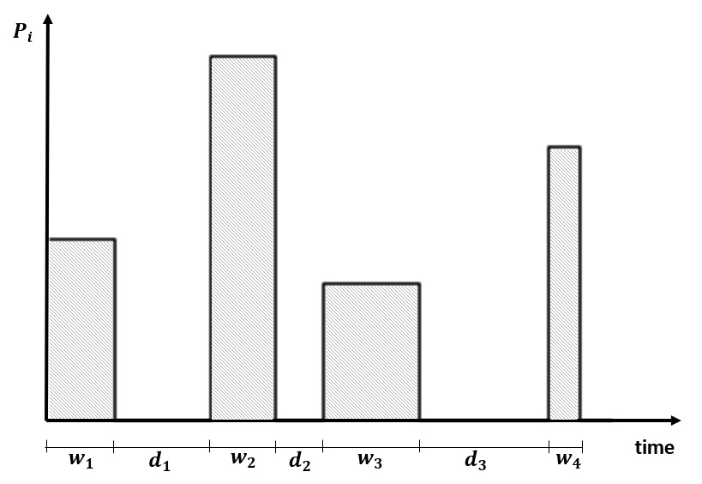
Alternating Renewal Method – Basic Approach
Step 2
DRY PERIODS
WET PERIODS
Simple
Limited to set of events in the observed record
Notes:
Simplest approach:
Bootstrap resampling of historical wet/dry periods to create a unique sequence of events by alternating back and forth between independent wet and dry periods.
Issues with this approach is that it does not generate a set of events that go beyond those observed in the historic period
**Does not capture full extent of the feasible extremes

Slide 13
ARM – RTI-TVA Enhanced Approach
Enhanced Approach
Build histograms of wet period precipitation depths by month
Fit a theoretical distribution to allow sampling from the ‘tail’ (extremes)
Frequency
Storm total precip
Notes:
RTI approach (TVA):
Main idea is using a fitted distribution to allow the depths to be greater than those observed in the period of record by sampling out into the tails (extremes) of the distribution.
Additional steps (scaling, nearest neighbor) necessary to maintain temporal patterns and spatial relationships

Slide 14
Sample and Loop to Generate Synthetic Series
Resample alternating wet and dry periods
Creates diversity due to:
Wet periods larger than observed (tails)
New sequence of events
WET PERIODS
DRY PERIODS
…

Slide 15
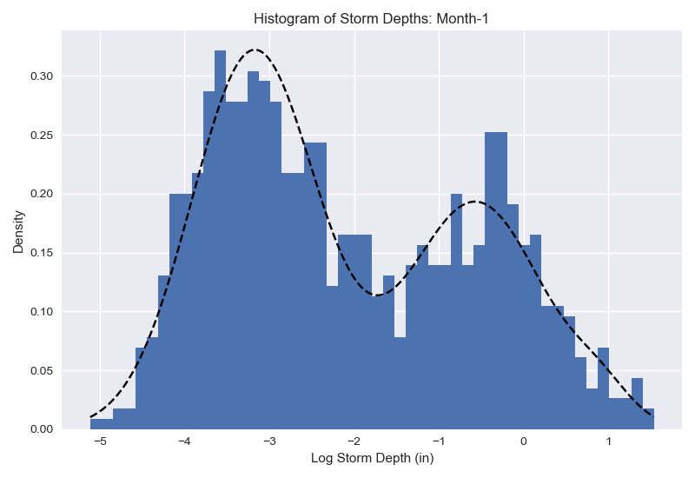
Sample and Loop to Generate Synthetic Series
January Wet Periods Fitted Distribution
Repeat 1000’s of times until full time series is generated
DRY PERIODS
WET PERIODS
Select dry period
Storm depth
Select wet event (depth) from fitted distribution
Apply space and time patterns from real events in historical record
Start
e.g. Jan 1

Slide 16
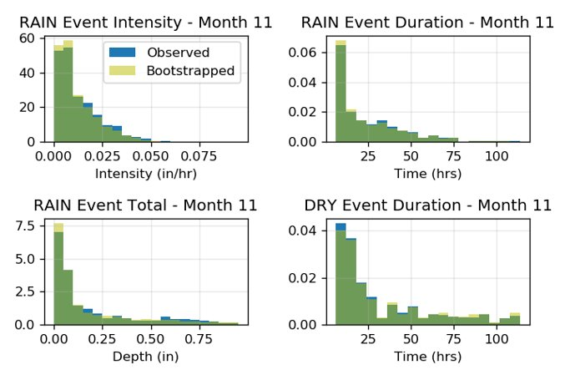
ARM – RTI Enhanced Approach
Diagnostic Tests
Statistical properties and distribution maintained
Larger events achieved
Adjust distributions for climate impact studies
Notes:
Diagnostic tests were completed to ensure the synthetic series matched the properties of the observed series, even with events greater than those observed in the record
There is no significant difference between the observed and bootstrapped event empirical distribution functions.

Slide 17
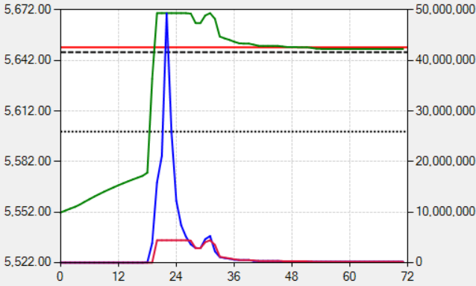
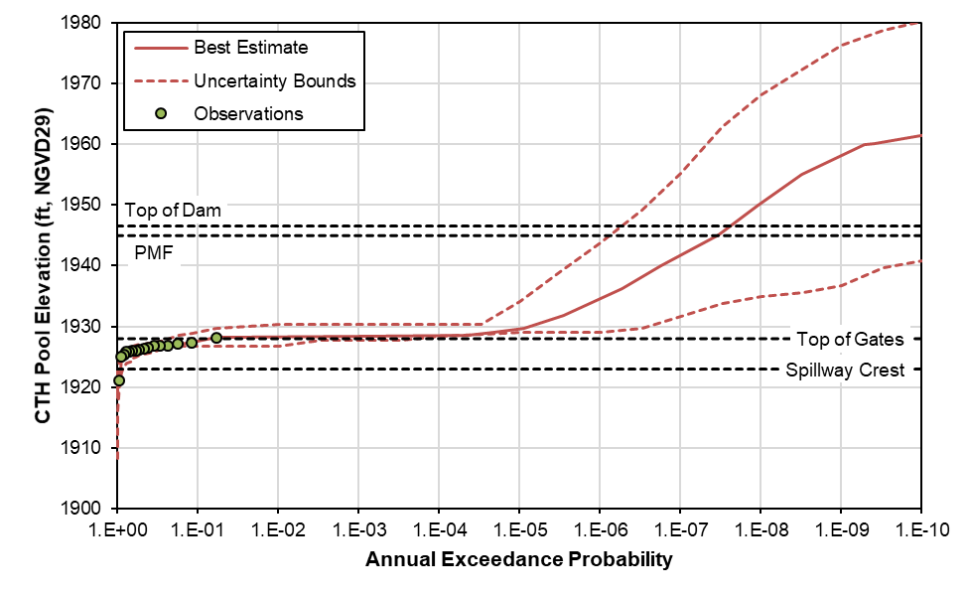
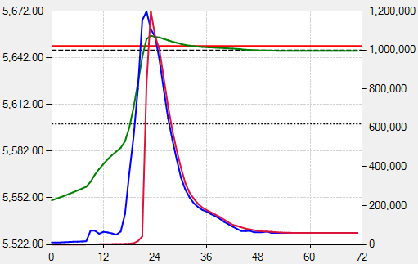
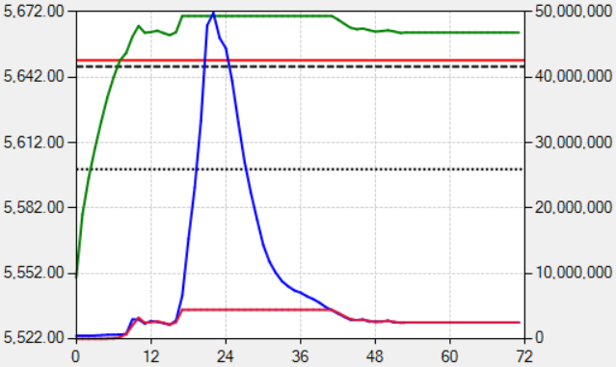
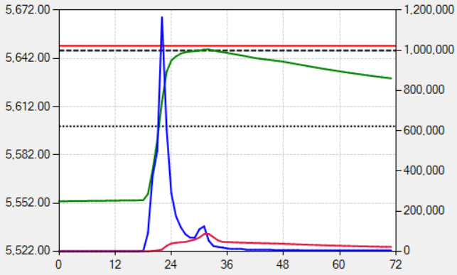
Now Back to SEFM
Generate thousands of realistic storms from these starting conditions
Simulate hydrologic and system response to storms
Aggregate statistics from each storm to make hazard curves
Notes:
Generate thousands of realistic storms and starting conditions

Slide 18
Back to Our Example
PFHA extended the observed record
The impact of reservoir operation is clear
Overtopping risk was found to be minimal
Risk workshop determined that morning glory clogging may be a risk driver
Subsequent work showed that clogging would be ~50%, and would not shift the curve significantly
Overtop 2012’
Morning Glory 1975’
Notes:
The final datasets:
Maintain long-term trends, as identified by relationships to PNA and to dendro data
Maintain temperature autocorrelation
Maintain monthly statistical characteristics of precipitation events (magnitude) and dry periods (length)
Maintain inter-event spatial/temporal variability

Slide 19
How much can we trust these results?

Slide 20
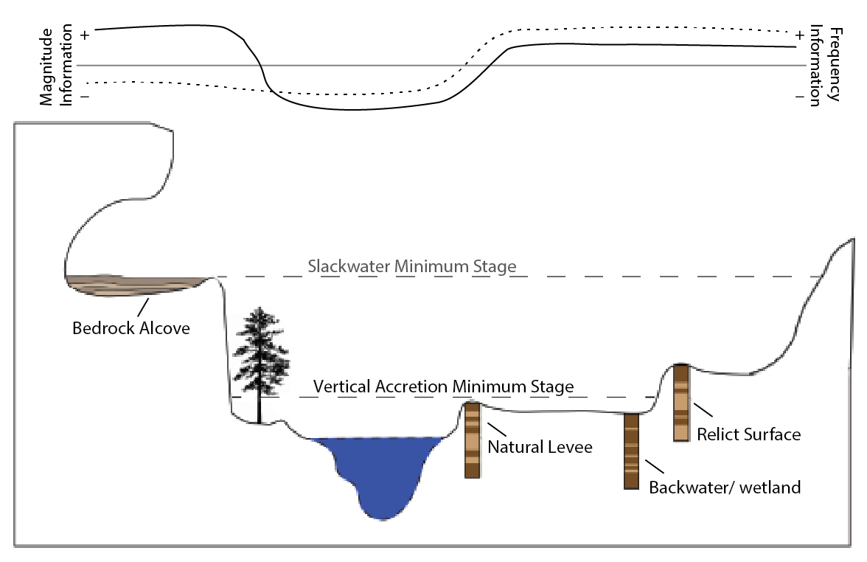
Paleoflood Studies
Extend the record longer and higher
Reduce uncertainty
Help you sleep at night
PBJ Site
Big Oak Site

Slide 21
Solving for the Terrace Flowrate

Slide 22
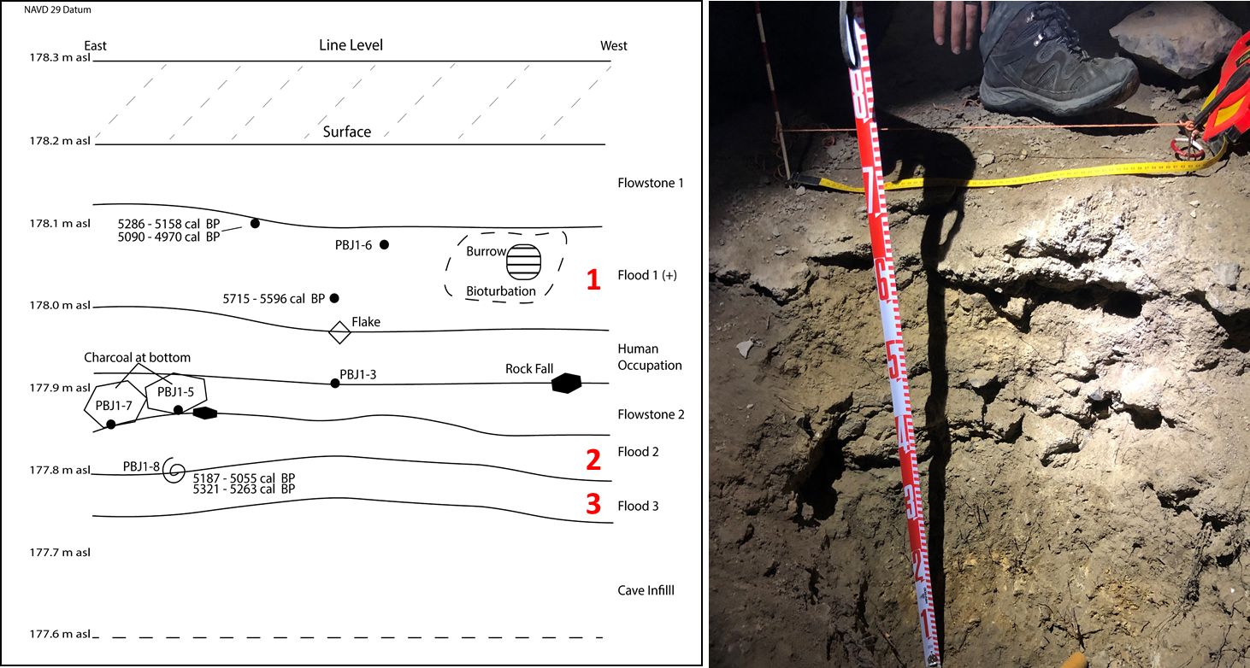
Cave Site
Three deposits
All larger than more recent floods
All beyond 5,000 years ago

Slide 23
Building Blocks
Type | Age Range (CE/BCE) | Discharge Range (cfs)
Terrace | 1867 CE | 450000 | - | 353000
Terrace | 1610-1690 CE | 422000 | - | 333000
Terrace | 1500-1580 CE | 422000 | - | 333000
Terrace | 730-810 CE | 398000 | - | 315000
Terrace | 590-670 CE | 395000 | - | 313000
Cave | 3300 - 3200 BCE | 450000 | - | 575000
Cave | 3600 - 3500 BCE | 450000 | - | 575000
Cave | 3770 - 3650 BCE | 450000 | - | 575000
Non-exceedance Bound | > 8,000 years | 10,000,000
11 pre-dam observations | 1925 through 1936 CE | 114000-282000

Slide 24
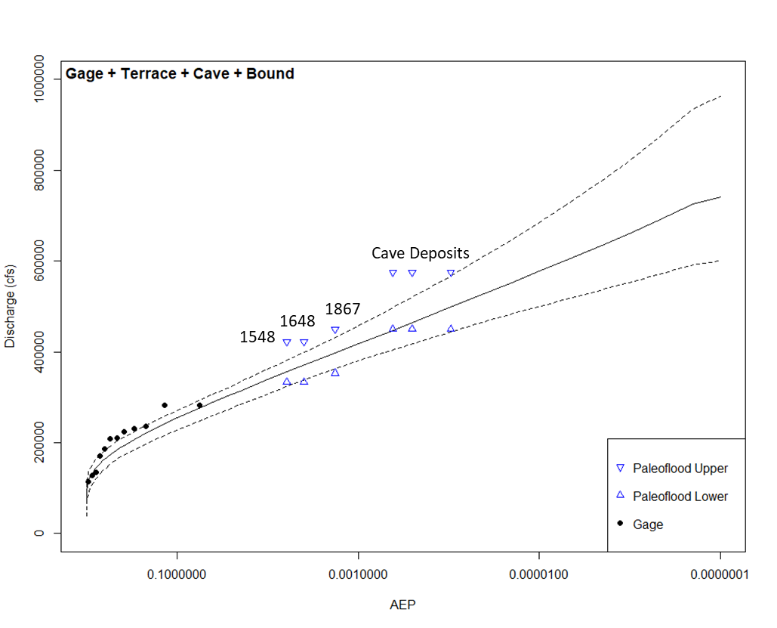
Resulting AEP Curve

Slide 25
Only one problem…these floods happened prior to dams
So, the PFHA and paleoflood results can’t be compared directly
We built and calibrated a “naturals” hydrology model to represent the system flows prior to the dams being built
We then used this model to reconstruct flows from 1950-2016

Slide 26
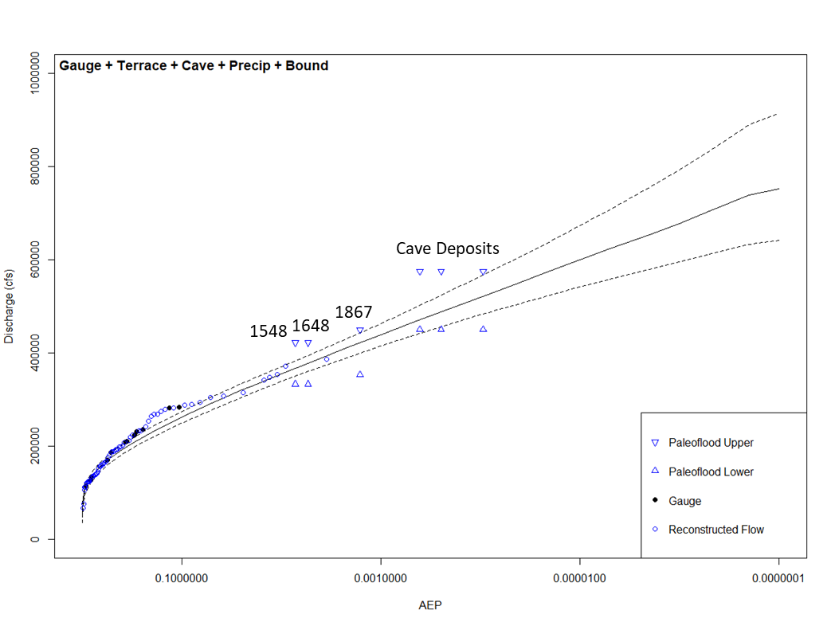
With Natural Reconstruction

Slide 27
To utilize both information streams
Adjust precip-frequency for good fit
Run Naturals PFHA
Create Natural PFHA AEP Curve
Overlay Curves
Run “with dams” PFHA
Create “with dams” PFHA AEP Curve
Complete Paleoflood Studies
Create Observed + Paleo AEP Curve
We hope to have our first results from this method within a year

Slide 28
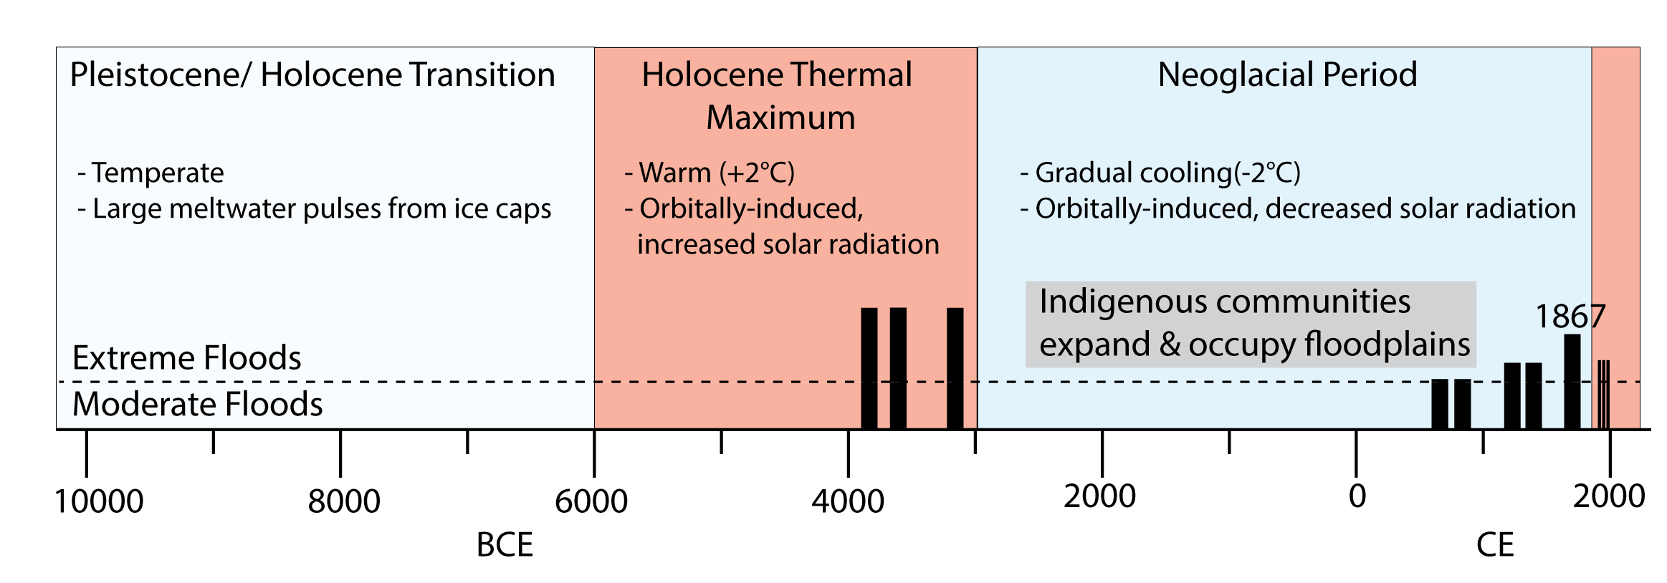
Correlation of floods and climate
However, the paleoflood results showed a correlation with overall climate trends. This should be consider as we apply the results.

Slide 29
Correlation of Floods and Overall Climate
If the climate-extreme flood connection proves strong in other studies, then:
You could deselect floods from cooler periods and select floods from warmer periods to account for the connection in flood frequency studies
For our site, this has the effect of raising discharge levels for very rare floods

Slide 30
And remember…
The best insurance policy for climate change water risk is…
a dam
Notes:
Not getting into the details of this study.
An important aspect of planning is to recognize the large uncertainties in what the future will look like
Not just uncertainty in rain/temperature—uncertainty in demand, in legal environment, in infrastructure

Slide 31
Thank You!
Thank You!
Mel Schaefer – MGS Consulting
Shaun Carney, Jonny McIntosh – RTI
Ed Roush – Infisys
Tess Harden – USGS
Dr. Lisa Davis, Rachel Lombardi – U. Alabama
Miles Yaw - TVA

