Slide 1
Unit 8: BCAs for Drought Mitigation, Generators, and Other Types of Projects

Slide 2
Unit 8 Overview
This unit will cover:
Project basics, data and documentation requirements, and BCA Toolkit exercises for:
Drought mitigation projects
Generators
Other types of mitigation projects

Slide 3
Unit 8 Objectives
At the end of this unit, participants will be able to:
Explain BCA data and documentation requirements and complete a BCA for:
Drought mitigation projects
Generators
Other types of mitigation projects

Slide 4
Drought Mitigation Projects

Slide 5
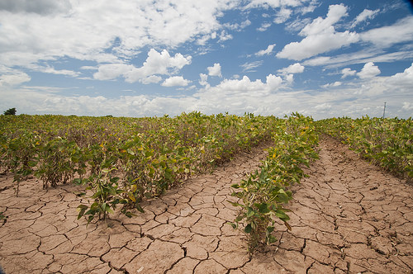
Drought mitigation
Aquifer storage and recovery (ASR) project type
Serves primarily as a drought management tool, but can also be used to reduce flood risk, mitigate salt water intrusion, and restore aquifers that have been subject to overdraft.
Concept is to capture water when there is an abundant supply, store the water in subsurface aquifers, and recover water from the storage aquifer if and when there is a need.

Slide 6
Drought recurrence intervals (RIs)
The recurrence of drought is very complex and there are many variables to be understood in predicting drought.
It is necessary to determine the recurrence interval associated with the severity of scenario drought events.
Establishing a traditional recurrence interval for drought may be difficult; however, the subapplicant should use the best available data and methodology deemed appropriate by a licensed professional engineer or similarly qualified professional.

Slide 7
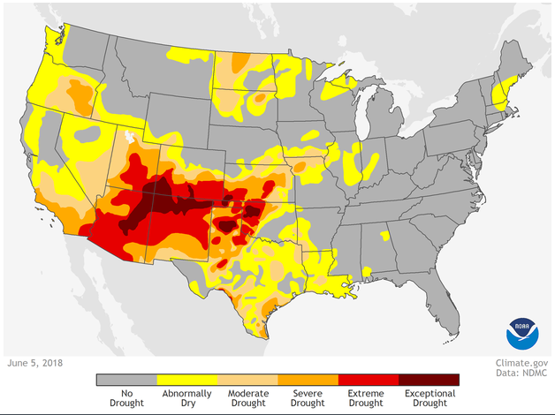
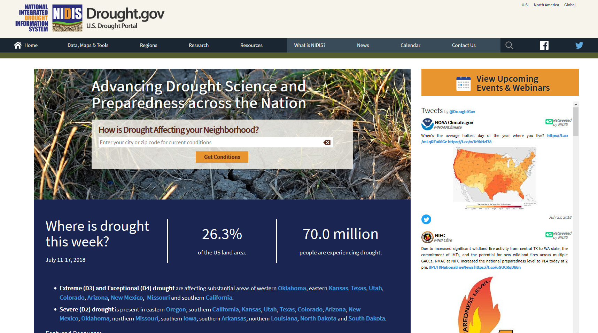
Drought data sources
USDA
NOAA
drought.gov
National Drought Mitigation Center
Universities and other academic sources

Slide 8
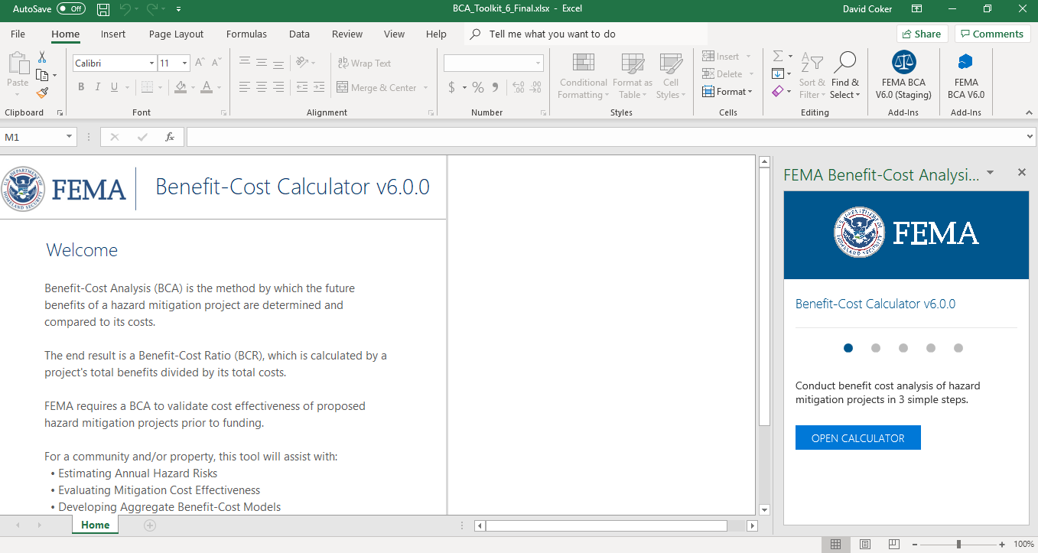
BCA Toolkit Exercise, Part 1
Notes:
The instructor should open the BCA Toolkit on their computer and instruct the students to do the same. Use the following slides to describe each data point as it is input. You may use one of the provided case studies (or another example from a Region or state) to guide the students through data entry on the Project Configuration and then the Project Information screens.
You may also show students the Data Documentation Templates for this project type, which may be found at https://www.fema.gov/benefit-cost-analysis.

Slide 9
Recurrence interval
What it is:
The recurrence interval for drought at that location.
You may run the BCA with one RI, but at least 3 are preferred for drought projects.
Input required? | Potential sources | Recommended documentation with application
Yes | USDA NOAA drought.gov National Drought Mitigation Center Universities and other academic sources | Screenshot(s) of data and source used Relevant page(s) from study from credible source
Notes:
What it is:
The recurrence interval for drought at that location.
Source(s):
USDA
NOAA
drought.gov
National Drought Mitigation Center
Universities and other academic sources
Recommended BCA documentation with application:
Screenshot(s) of data and source used
Relevant page(s) from study from credible source

Slide 10
Water demand
What it is:
The daily water demand in million gallons per day (mgd) of the system/area being mitigated under normal, non-drought conditions.
This is calculated by dividing the total annual production (in millions of gallons) by 365.
Note: The Help Content in the BCA Toolkit states that the annual production should first be divided by the population; this is an error.
Input required? | Potential sources | Recommended documentation with application
Yes | Utility company | Letter from utility company
Notes:
What it is:
The daily water demand of the system/area being mitigated under normal, non-drought conditions.
This is calculated by dividing the total annual production (in millions of gallons) by 365.
Note: The Help Content in the BCA Toolkit states that the annual production should first be divided by the population; this is an error.
Source(s):
Utility company
Recommended BCA documentation with application:
Letter from utility company

Slide 11
Before & after mitigation conditions
What it is:
The (1) supply yield and (2) duration of impact, before and after the mitigation project, associated with the RI(s) entered.
Supply yield: The estimated average supply. This is calculated within the tool
Duration of impact: The number of days the water system is affected (i.e. experiencing abnormal conditions).
Input required? | Potential sources | Recommended documentation with application
Yes | Utility company Project engineer | Letter from utility company Note from project engineer describing how values were derived
Notes:
What it is:
The (1) supply yield and (2) duration of impact, before and after the mitigation project, associated with the RI(s) entered.
Supply yield: The estimated average supply. This is calculated within the tool
Duration of impact: The number of days the water system is affected (i.e. experiencing abnormal conditions).
Why it’s important:
The BCA Toolkit compares the before and after mitigation conditions to calculate the project benefits.
Source(s):
Utility company
Project engineer
Recommended BCA documentation with application:
Letter from utility company
Note from project engineer describing how values were derived

Slide 12
Population served
What it is:
The number of people who would be both impacted by drought and who would benefit from the proposed ASR project.
Input required? | Potential sources | Recommended documentation with application
Yes | Utility company Project SOW GIS data U.S. Census Bureau | Letter from utility company Note from project engineer or BCA analyst describing how values were derived
Notes:
What it is:
The number of people who would be both impacted by drought and who would benefit from the proposed ASR project.
Why it’s important:
The economic value of loss of water (i.e., damages) is dependent upon the number of people impacted by a drought.
Source(s):
Utility company
Project SOW
GIS data
U.S. Census Bureau
Recommended BCA documentation with application:
Letter from utility company
Note from project engineer or BCA analyst describing how values were derived

Slide 13
Generator Projects

Slide 14
Generator BCAs
HMA will only fund generators for critical public facilities, such as police/fire stations, utilities, hospitals, and EOCs.
HMA requirements for generator projects may be found in the HMA Guidance and in this Job Aid.
Generator BCAs are run using historical damages or professional estimated (future) damages.
Generators mitigate infrastructure failure due to loss of power, not a specific hazard (e.g. wind or flood). As such, the main benefits of generators are avoided loss of service/function.
You will need to have a clear idea of what function the generator ensures during a power outage and the level of protection (i.e., at what point will the generator fail).
Notes:
This unit discusses how to perform a BCA for generator projects. It does not cover overall project requirements for generators. Refer to the HMA Guidance and the generator Job Aid for eligibility questions.
HMA will only fund generators for critical public facilities, such as police/fire stations, utilities, hospitals, and EOCs. HMA requirements for generator projects may be found in the HMA Guidance and in this Job Aid.
Generator BCAs are run using historical damages or professional estimated (future) damages.
Generators mitigate infrastructure failure due to loss of power, not a specific hazard (e.g. wind or flood). As such, the main benefits of generators are avoided loss of service/function.
You will need to have a clear idea of what function the generator ensures during a power outage and the level of protection (i.e., at what point will the generator fail). Generator projects are often straightforward, but can get tricky when they are put on facilities that serve multiple functions. For example, you want to put a generator on a school that serves as an emergency shelter. The generator is not for the school, it is for the emergency shelter function.

Slide 15
Data sources for generator BCAs
Recurrence intervals
ATC wind speed website
NOAA/National Weather Service
Before-mitigation damages
Utility outage information
After-mitigation damages
Utility company
Project engineer

Slide 16
BCA Toolkit Exercise
Notes:
The instructor should open the BCA Toolkit on their computer and instruct the students to do the same. Use the following slides to describe each data point as it is input. You may use one of the provided case studies (or another example from a Region or state) to guide the students through data entry on the Project Configuration and then the Project Information screens.
You may also show students the Data Documentation Templates for this project type, which may be found at https://www.fema.gov/benefit-cost-analysis.

Slide 17
Other Types of Projects

Slide 18
Other hazards and project types
As long as you have certain data, the BCA Toolkit can analyze any mitigation project type, including (but not limited to):
Electrical/power line mitigation
Infrastructure protection
Tsunami protection

Slide 19
Data needs
For most “other” project types, you will use the Historical Damages or Professional Expected Damages methodologies.
As such, the main pieces of data you’ll need are the damages before and after mitigation.
Notes:
If time allows, the instructor may use one of the provided case studies to show an example of a less-common project type. The instructor may also solicit feedback from the students about whether there is a particular hazard or project type they would like to see an example for.

Slide 20
Unit 8 Review
In this unit we covered:
Project basics, data and documentation requirements, and BCA Toolkit exercises for:
Drought mitigation projects
Generator projects

