Slide 1
Unit 6: BCAs for Tornado and Hurricane Safe Rooms and Hurricane Wind Retrofits

Slide 2
Unit 6 Overview
This unit will cover:
Project basics, data and documentation requirements, and BCA Toolkit exercises for:
Tornado safe rooms
Hurricane safe rooms
Hurricane wind retrofits

Slide 3
Unit 6 Objectives
At the end of this unit, participants will be able to:
Explain BCA data and documentation requirements and complete a BCA for:
Community tornado safe room
Hurricane safe room
Hurricane wind retrofit of a critical facility

Slide 4
Tornado Safe Rooms
Notes:
First we’ll talk about tornadoes and tornado safe rooms.

Slide 5
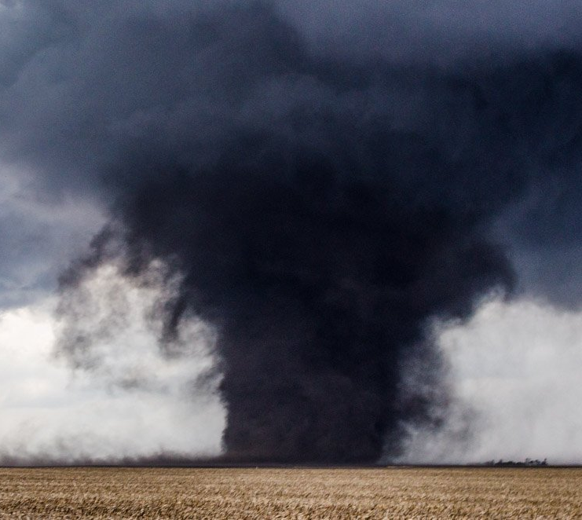
Tornadoes
A tornado is a violent, rotating, funnel-shaped cloud that extends from a thunderstorm to the ground, with winds that can reach 300 miles per hour.
Tornadoes are classified by the Enhanced Fujita (EF) Scale, which correlates wind speeds with damage, and takes into account the quality and type of structure that has been damaged to estimate wind speeds.

Slide 6
Tornado occurrence
Notes:
The map in the image shows the total number of tornadoes per county between 1955 and 2014.
Source: National Oceanic and Atmospheric Administration (NOAA)

Slide 7
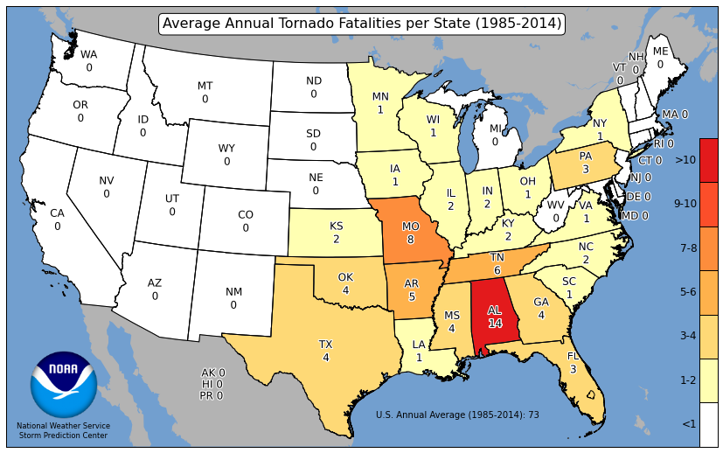
Tornado risk
Average Annual # of Tornadoes per State (1985-2014)
Average Annual # of Tornado Fatalities per State (1985-2014)
Notes:
The maps in the image show (1) the average annual number of tornadoes per state between 1955 and 2014 and (2) the average annual tornado fatalities per state between 1955 and 2014.
Source: National Oceanic and Atmospheric Administration (NOAA)

Slide 8
Enhanced Fujita (EF) scale classifications
Category | 3-Second Wind Gust
EF0 | 65-85 mph
EF1 | 86-100 mph
EF2 | 111-135 mph
EF3 | 136-165 mph
EF4 | 166-200 mph
EF5 | >200 mph

Slide 9
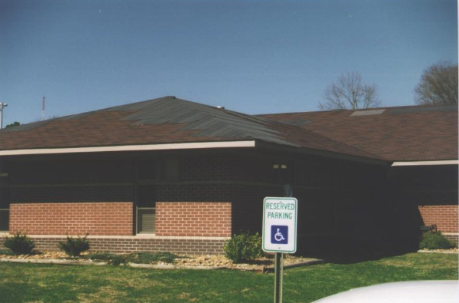
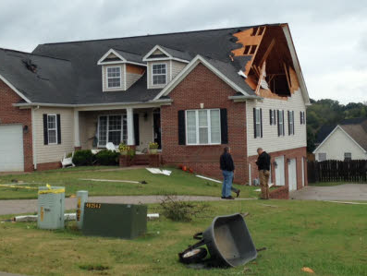
EF0 and EF1
EF0: Gale Tornado Category
65-85 mph
Light damage
EF1: Moderate Tornado Category
86-110 mph
Moderate damage

Slide 10
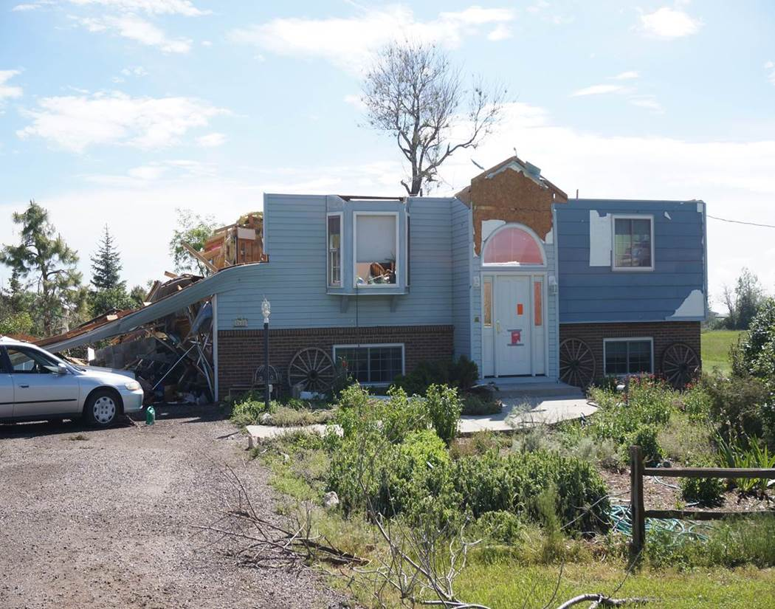
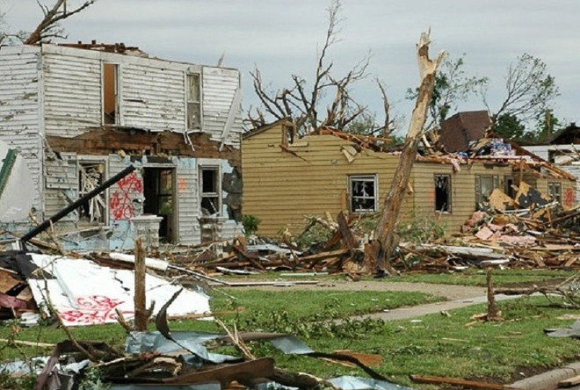
EF2 and EF3
EF2: Significant Tornado Category
111-135 mph
Considerable damage
EF3: Severe Tornado Category
136-165 mph
Severe damage

Slide 11
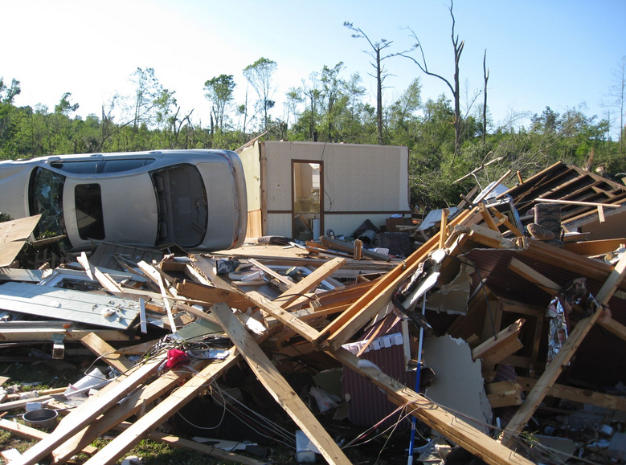
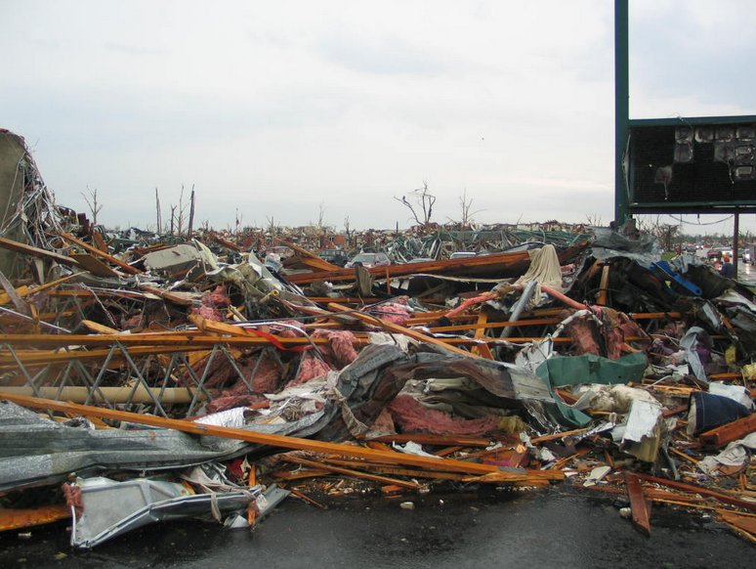
EF4 and EF5
EF4: Devastating Tornado Category
166-200 mph
Devastating damage
EF5: Incredible Tornado Category
>200 mph
Incredible damage

Slide 12
What are tornado safe rooms?
Tornado safe rooms provide protection in high-wind events.
However, the benefits of this project type are limited to life safety benefits, i.e. avoided injuries and deaths.
Notes:
BRIC?

Slide 13
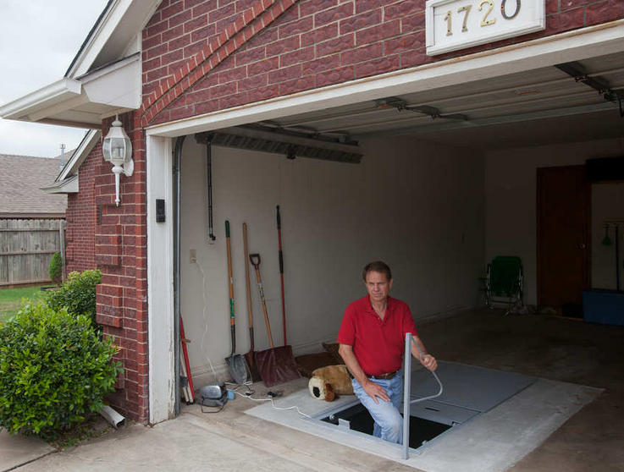
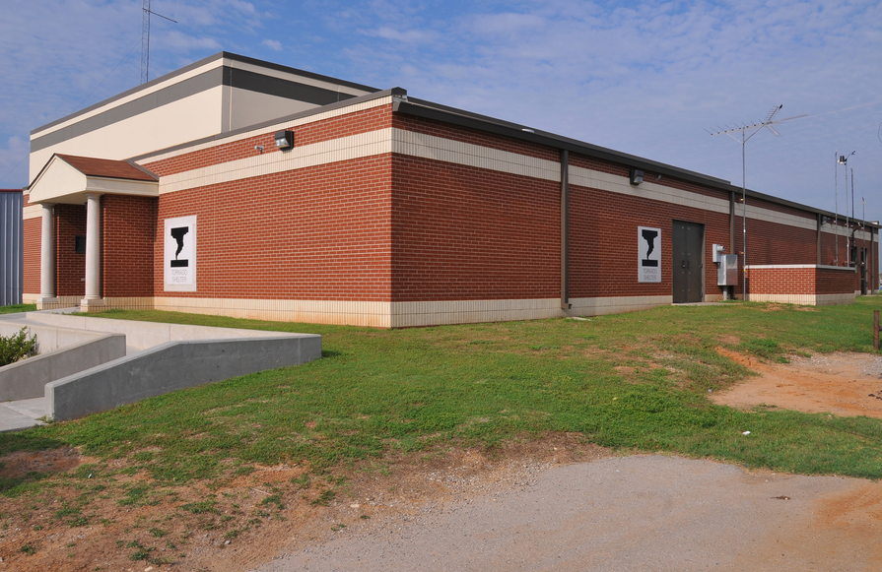
Tornado safe room types
Residential Safe Room
Provides a place of refuge for the people who live in the home
Various types/designs
Community Safe Room
Constructed to protect a large number of people

Slide 14
FEMA guidance on tornado safe rooms
FEMA Publication 361:
Community safe rooms
FEMA Publication 320:
Residential safe rooms

Slide 15
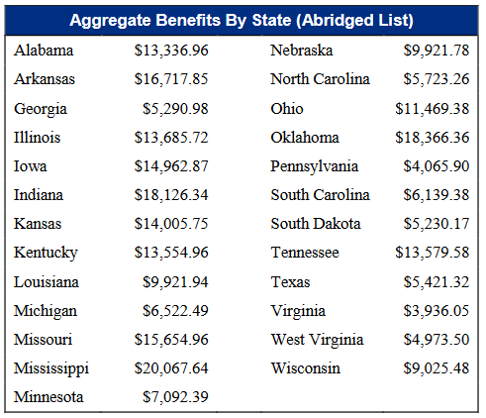
Pre-calculated benefit
For residential tornado safe rooms, FEMA has developed a pre-calculated benefit.
If the total project cost per property does not exceed the values in the table, the project is cost-effective and does not need a separate BCA.
For more information, see the Job Aid.
Notes:
Applicants must use the Expedited Hazard Mitigation Grant Program (HMGP) Application for Residential Safe Rooms to apply pre-calculated benefits under HMGP. See the Job Aid for more details.

Slide 16
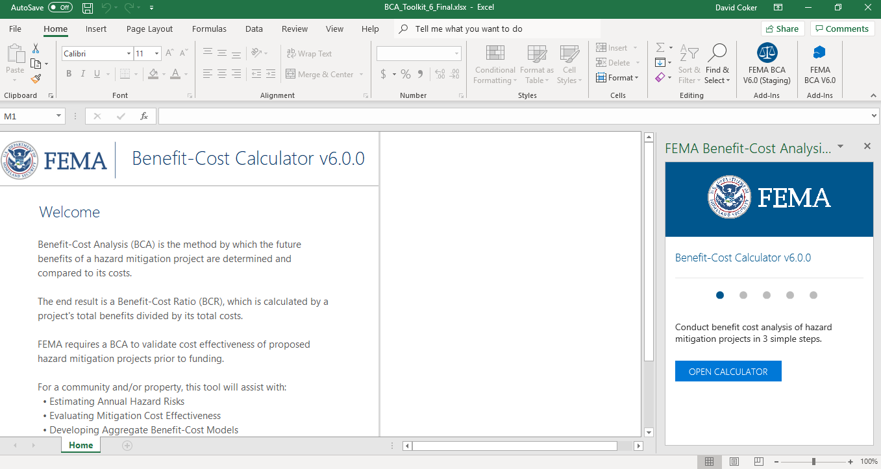
BCA Toolkit Exercise, Part 1
Notes:
The instructor should open the BCA Toolkit on their computer and instruct the students to do the same. Use the following slides to describe each data point as it is input. You may use one of the provided case studies (or another example from a Region or state) to guide the students through data entry on the Project Configuration and then the Project Information screens.
You may also show students the Data Documentation Templates for this project type, which may be found at https://www.fema.gov/benefit-cost-analysis.

Slide 17
Maximum safe room occupancy
Why it’s important:
The occupancy of the safe room is the primary driver of the project benefits. The higher the occupancy, the greater the benefits.
Input required? | Potential sources | Recommended documentation with application
Yes | Project scope of work (SOW) Project manager or engineer | For residential safe rooms: the average household size per U.S. Census data; letter from homeowner certifying number of occupants For community safe rooms: school enrollment records, employment data, and average daily visitor logs; records of number of business employees; historical site usage records
Notes:
Why it’s important:
The occupancy of the safe room is the primary driver of the project benefits. The higher the occupancy, the greater the benefits.
Source(s):
Project SOW
Project engineer
Recommended BCA documentation with application:
For residential safe rooms: the average household size per U.S. Census data; letter from homeowner certifying number of occupants
For community safe rooms: school enrollment records, employment data, and average daily visitor logs; records of number of business employees; historical site usage records

Slide 18
Windspeed design
What it is:
The maximum wind speed (in mph) the safe room is designed to withstand.
Input required? | Potential sources | Recommended documentation with application
Yes | Project scope of work (SOW) Project manager or engineer | None other than normally required project materials
Notes:
What it is:
The maximum wind speed (in mph) the safe room is designed to withstand.
Why it’s important:
The design wind speed of the safe room determines the level of protection, i.e. the project effectiveness.
Source(s):
Project SOW
Project engineer
Recommended BCA documentation with application:
None other than normally required project materials

Slide 19
Type(s) of structure(s) safe room occupants are coming from by %
What it is:
The type(s) of structure(s) the safe room occupants are coming from, by the percentage of total occupants, during different periods of the day. For example, a school safe room might have 100% of its occupants coming from a school during the day, but during the evening 80% of the occupants come from nearby homes and only 20% from the school.
Input required? | Potential sources | Recommended documentation with application
Yes | Project scope of work (SOW) Project manager or engineer | Note from project manager or BCA analyst explaining how percentages were derived
Notes:
What it is:
The type(s) of structure(s) the safe room occupants are coming from, by the percentage of total occupants, during different periods of the day. For example, a school safe room might have 100% of its occupants coming from a school during the day, but during the evening 80% of the occupants come from nearby homes and only 20% from the school.
Why it’s important:
The BCA Toolkit compares the expected injury/death rates within the evacuated structure type(s) to the expected injury/death rates if those people were in the proposed safe room. These are the benefits of the project.
Source(s):
Project SOW
Recommended BCA documentation with application:
Note from project manager or BCA analyst explaining how percentages were derived

Slide 20
Response rate
What it is:
Only a certain percentage of potential occupants is likely to actually come to the safe room in a tornado event, especially during off hours.
The default values are 100% (day), 85% (evening), and 60% (night).
Input required? | Potential sources for non-default values | Recommended documentation with application
No | Project scope of work (SOW) | Note from project manager or BCA analyst explaining why non-default values were used
Notes:
What it is:
Only a certain percentage of potential occupants is likely to actually come to the safe room in a tornado event, especially during off hours.
The default values are 100% (day), 85% (evening), and 60% (night).
Why it’s important:
The BCA Toolkit uses expected response rates to calculate an average occupancy for the safe room.
Source(s) for non-default values:
Project scope of work (SOW)
Recommended BCA documentation with application:
Note from project manager or BCA analyst explaining why non-default values were used

Slide 21
Hurricane Safe Rooms
Notes:
From a BCA standpoint, hurricane safe rooms are almost identical to tornado safe rooms. We’ll do an exercise in the Toolkit in a moment. First we’ll talk about some project basics for hurricane safe rooms.

Slide 22
What are hurricane safe rooms?
Hurricane safe rooms provide sustained protection in high-wind events.
However, they are intended only for occupants that cannot otherwise evacuate, such as first responders, hospital staff/patients, etc.
As with tornado safe rooms, the benefits of this project type are limited to life safety benefits, i.e. avoided injuries and deaths.

Slide 23
Types of hurricane safe rooms
New construction vs. retrofit
Internal vs. stand-alone
FEMA Publication 361 provides guidance on hurricane safe room design and operation requirements.
Notes:
There are multiple ways to construct a hurricane safe room:
New construction vs. retrofit
Internal vs. stand-alone
FEMA Publication 361 provides guidance on hurricane safe room design and operation requirements.

Slide 24
BCA Toolkit Exercise, Part 2
Notes:
The instructor should open the BCA Toolkit on their computer and instruct the students to do the same. Use the following slides to describe each data point as it is input. You may use one of the provided case studies (or another example from a Region or state) to guide the students through data entry on the Project Configuration and then the Project Information screens.
You may also show students the Data Documentation Templates for this project type, which may be found at https://www.fema.gov/benefit-cost-analysis.
Hurricane safe room BCAs are almost identical to tornado safe room BCAs. The only real difference is that you have to input the wind speed and recurrence interval data for the location, which we will discuss on the next slide.

Slide 25
Recurrence intervals and wind speeds
What it is:
The windspeed values and recurrence intervals for the structure location.
Input required? | Potential sources | Recommended documentation with application
Yes | https://hazards.atcouncil.org/ | Screenshot of data from ATC website
Notes:
Navigate to the ATC website and show students how to look up the data for their location.
What it is:
The windspeed values and recurrence intervals for the structure location.
Source(s):
https://hazards.atcouncil.org
Recommended BCA documentation with application:
Screenshot of data from ATC website

Slide 26
Hurricane Wind Retrofits

Slide 27
What are hurricane wind retrofits?
Four project types:
Shutters
Load path
Roof retrofit
Code Plus

Slide 28
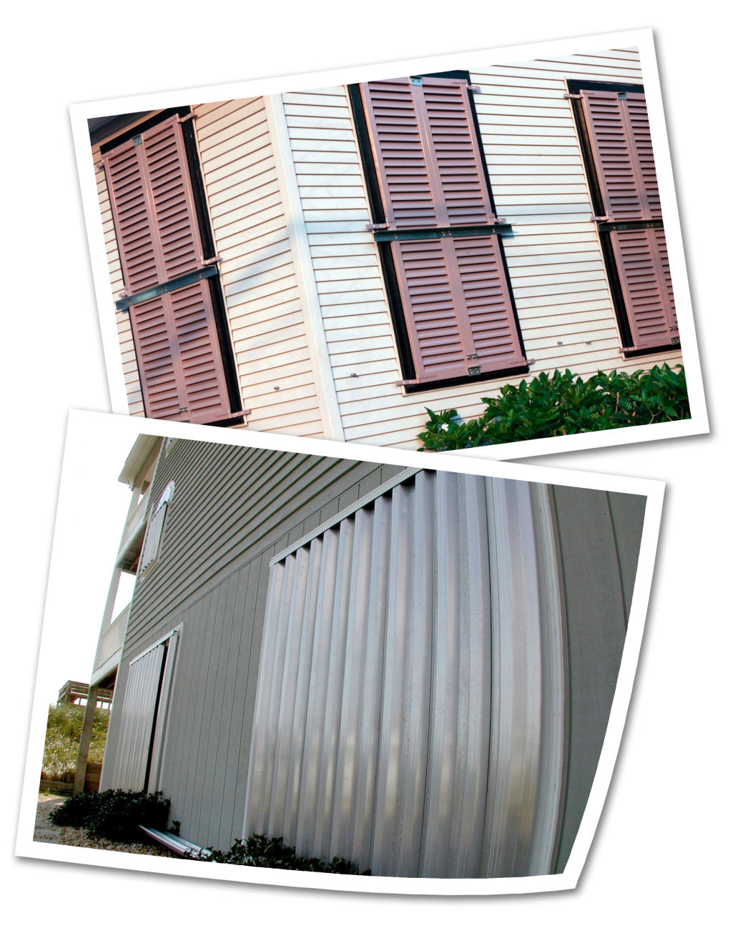
Shutters
Designed to protect all windows and doors
Must meet the debris impact and wind pressure design requirements of the International Residential Code/ International Building Code
Assumes all openings of a building will be protected

Slide 29
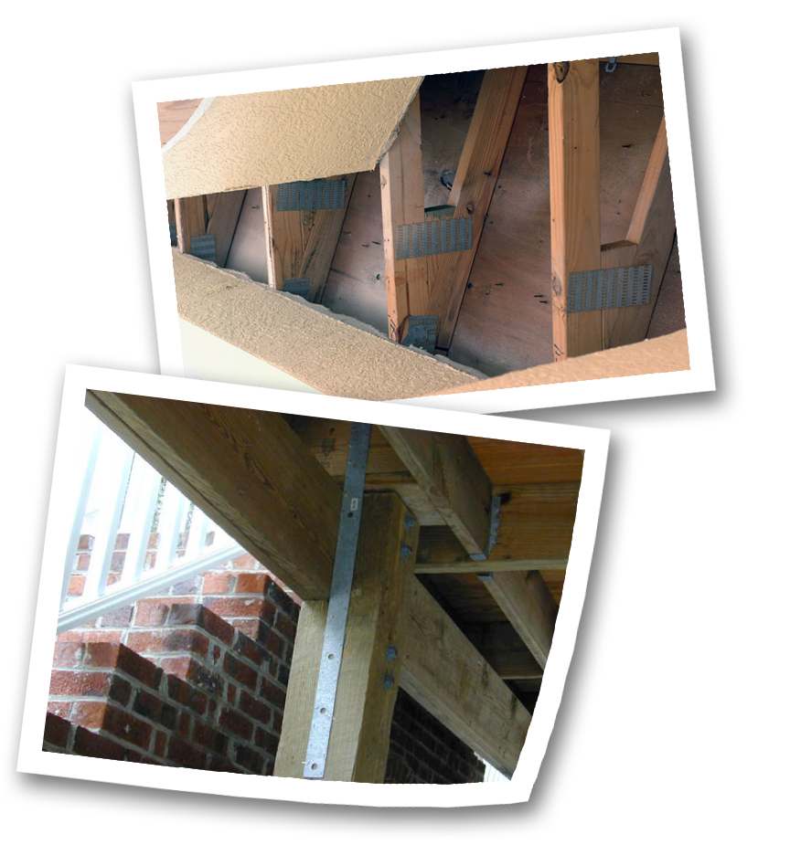
Load path
Structural retrofit project
Aims to improve the structural system of a building to transfer loads from the roof to the foundation

Slide 30
Roof retrofit
Structural retrofit project
Aims to secure the building envelope and integrity during a wind event

Slide 31
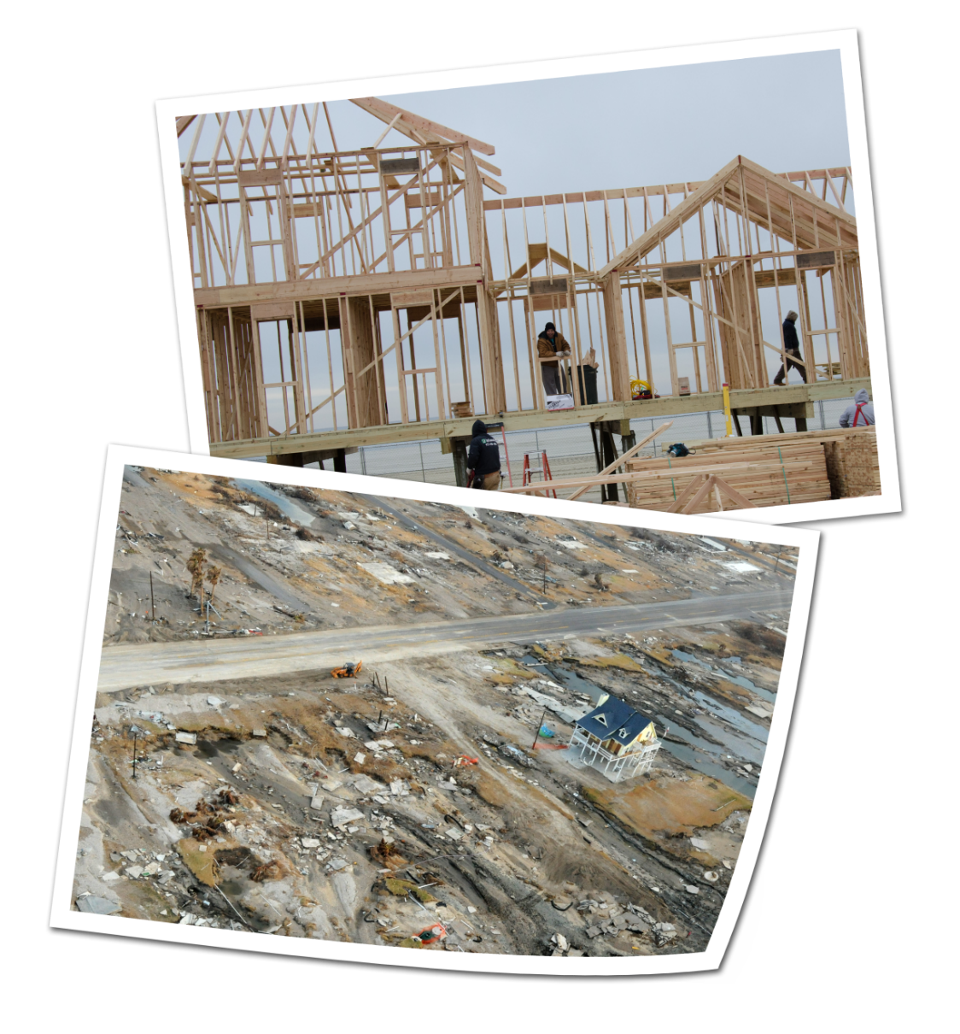
Code Plus
A code plus project is a project designed to exceed the local building codes and standards to achieve a greater level of protection.
An example of a code plus wind project is the construction of a new building to a design wind speed of 120 mph despite the local code only requiring a design wind speed of 90 mph.

Slide 32
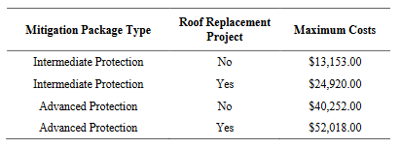
Pre-calculated benefits
Residential wind retrofits
Non-residential wind retrofits
Hospitals, schools, etc.
If total project cost is less than 10% of the Building Replacement Value (BRV), the project is considered cost-effective and a BCA is not required.
Notes:
FEMA has issued pre-calculated benefits for hurricane wind retrofits on both residential and non-residential structures.
The links in your Student Manual provide the relevant documents for more information.

Slide 33
BCA Toolkit Exercise
Notes:
The instructor should open the BCA Toolkit on their computer and instruct the students to do the same. Use the following slides to describe each data point as it is input. You may use one of the provided case studies (or another example from a Region or state) to guide the students through data entry on the Project Configuration and then the Project Information screens.
You may also show students the Data Documentation Templates for this project type, which may be found at https://www.fema.gov/benefit-cost-analysis.

Slide 34
Recurrence interval and wind speed data
What it is:
The windspeed values and recurrence intervals for structure location. The Toolkit populates default values but the user may enter their own.
Input required? | Potential sources for non-default values | Recommended documentation with application
No | Qualified engineer or other professional Study from credible source | Relevant page(s) from study from credible source Note or letter from engineer or other qualified professional explaining why non-default values were used
Notes:
What it is:
The windspeed values and recurrence intervals for structure location. The Toolkit populates default values but the user may enter their own.
Potential source(s) for non-default values:
Project Scope of Work (SOW)
Project engineer
Photos
Recommended BCA documentation with application:
Relevant page(s) from study from credible source
Note or letter from engineer or other qualified professional explaining why non-default values were used

Slide 35
Exposure type
What it is:
Exposure is the characteristics of the ground roughness and surface irregularities in the vicinity of a building.
Input required? | Potential sources | Recommended documentation with application
Yes | Project scope of work (SOW) Project manager or engineer Photos | Note from project engineer or BCA analyst Photos
Notes:
What it is:
Exposure is the characteristics of the ground roughness and surface irregularities in the vicinity of a building.
Why it’s important:
The debris exposure type determines what type of debris might impact the building in a hurricane event, which helps estimate future damages.
Source(s):
Project Scope of Work (SOW)
Project engineer
Photos
Recommended BCA documentation with application:
Note from project engineer or BCA analyst
Photos

Slide 36
Building occupancy class (non-residential only)
What it is:
Building occupancy class is the general use of the building.
Input required? | Potential sources | Recommended documentation with application
Yes | Project Scope of Work (SOW) Property owner | Note from project engineer or BCA analyst
Notes:
What it is:
Building occupancy class is the general use of the building.
Why it’s important:
The occupancy class determines the default contents value and displacement cost multipliers.
Source(s):
Project Scope of Work (SOW)
Property owner
Recommended BCA documentation with application:
Note from project engineer or BCA analyst

Slide 37
Type of construction
Why it’s important:
The BCA Toolkit uses the structure’s construction type to estimate potential losses in a high wind event.
Input required? | Potential sources | Recommended documentation with application
Yes | Property owner Contractor Building inspector Project engineer | Note from project engineer or BCA analyst Photos
Notes:
Why it’s important:
The BCA Toolkit uses the structure’s construction type to estimate potential losses in a high wind event.
Source(s):
Property owner
Contractor
Building inspector
Project engineer
Recommended BCA documentation with application:
Note from project engineer or BCA analyst
Photos

Slide 38
Building properties before and after mitigation
What it is:
Existence/type of roof, shutters, load path, etc. of the structure before and after the mitigation project.
Input required? | Potential sources | Recommended documentation with application
Yes | Property owner Contractor Building inspector Project engineer | Note from project engineer or BCA analyst Photos
Notes:
What it is:
Existence/type of roof, shutters, load path, etc. of the structure before and after the mitigation project.
Why it’s important:
The BCA Toolkit compares estimated losses before mitigation to estimated losses after mitigation. These are the benefits of the project.
Source(s):
Project Scope of Work (SOW)
Project engineer
Recommended BCA documentation with application:
None other than normally required project materials

Slide 39
Unit 6 Review
In this unit we covered:
Project basics, data and documentation requirements, and BCA Toolkit exercises for:
Tornado safe rooms
Hurricane safe rooms
Hurricane wind retrofits

