Slide 1
Unit 5: BCAs for Flood Mitigation Projects

Slide 2
Unit 5 Overview
This unit will cover:
Concepts and terminology related to flooding
Project basics, data and documentation requirements, and BCA Toolkit exercises for:
Acquisitions and elevations/mitigation reconstruction
Flood control projects
Notes:
Welcome to Unit 5. This is a longer unit but we will take at least one break part of the way through. The reason this unit is longer is because (1) it discusses concepts/terminology related to flood hazard data, and (2) it walks students through three separate BCA examples.
This unit will cover:
Concepts and terminology related to flooding
Project basics, data and documentation requirements, and BCA Toolkit exercises for:
Acquisitions and elevations/mitigation reconstruction
Flood control projects

Slide 3
Unit 5 Objectives
At the end of this unit, participants will be able to:
Explain BCA data and documentation requirements for acquisitions, elevations, and flood control projects
Complete a riverine flood acquisition BCA using modeled damages
Complete a coastal elevation BCA using modeled damages
Complete a flood control BCA using historic damages
Estimate damages to residential structures using Depth Damage Functions (DDFs)
Notes:
Unit 5 has several objectives. At the end of this unit, students should be able to:
Explain BCA data and documentation requirements for acquisitions, elevations, and flood control projects
Complete a riverine flood acquisition BCA using modeled damages
Complete a coastal elevation BCA using modeled damages
Complete a flood control BCA using historic damages
Estimate damages to residential structures using Depth Damage Functions (DDFs)

Slide 4
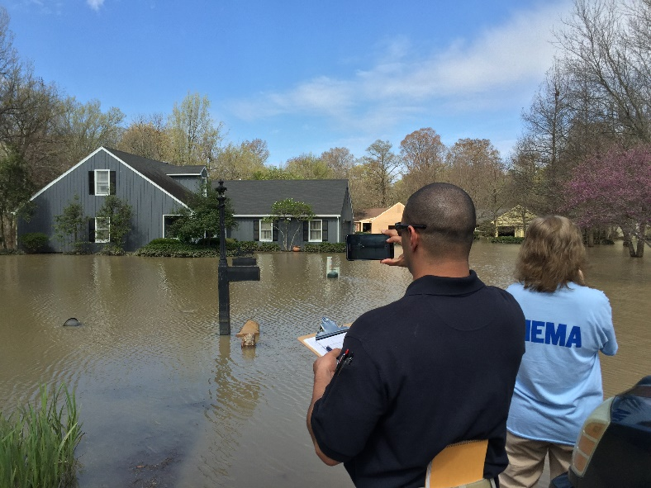
Floods
Floods are the most common, most predictable, and most costly of all natural disasters in the United States.
90% of all presidential disaster declarations involve flooding.
Congress established the NFIP in 1968 to regulate affordable flood insurance for communities in flood-prone areas.
Notes:
First we’ll discuss some concepts and terminology related to flooding.
Floods are the most common, most predictable, and most costly of all natural disasters in the United States.
90% of all presidential disaster declarations involve flooding.
Congress established the NFIP in 1968 to regulate affordable flood insurance for communities in flood-prone areas.

Slide 5
Flood hazard data: key concepts & terms
FIS and FIRM, H&H study
10-, 50-, 100-, and 500-year flood elevations
Special Flood Hazard Area (SFHA)
Base Flood Elevation (BFE)
Riverine vs. coastal flooding
Riverine flooding: streambed elevation, discharge
Coastal flooding: stillwater elevation (SWEL), storm surge, storm tide, coastal zones, and LiMWA
Lowest Floor Elevation (LFE) or First Floor Elevation (FFE)
Building Replacement Value (BRV)
Demolition Damage Threshold (DDT)
Depth Damage Function (DDF) curve
Notes:
Note that this course is not intended to cover these concepts in detail. There are other FEMA courses that cover these concepts.

Slide 6
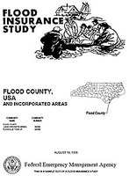
Flood Insurance Study (FIS)
An FIS is a compilation and presentation of flood risk and flood elevation data for specific watercourses, lakes, and coastal flood hazard areas within a community.
An FIS is used to develop Flood Insurance Rate Maps (FIRMs) for the community.

Slide 7
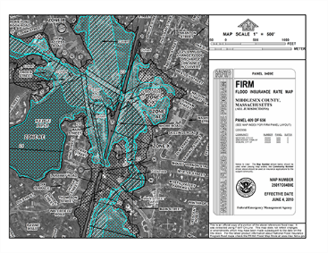
Flood Insurance Rate Map (FIRM)
A FIRM is an official map of a community on which FEMA has delineated the 100-year (1-percent-annual-chance), 500-year (0.2% annual chance) floodplains, Base Flood Elevations, and risk premium zones.
The results of a FIS are presented on a FIRM.
For a tutorial on how to read a FIRM, visit: https://www.fema.gov/media/fhm/firm/ot_firm.htm
Notes:
Note that some (but not all) communities have digital FIRMs, aka DFIRMs.

Slide 8
Hydrologic and Hydraulic (H&H) Study
An H&H study is the study of movement of water, including the volume and rate of flow as it moves through a watershed, basin, channel, or man-made structure.
When an FIS/FIRM is deemed inadequate for evaluating a mitigation project’s impacts (or does not exist for a location), a community may conduct an H&H study.
Must be conducted by licensed, professional engineers.

Slide 9
10-, 50-, 100-, and 500-year flood elevations
Recall our discussion of recurrence intervals in Unit 3.
The 10-, 50-, 100-, and 500-year flood elevations refer to the expected water levels of the 10%, 2%, 1%, and 0.2% annual chance flood events.
Note: The terminology is misleading. Over the span of a 30-year mortgage, the odds of experiencing some of these flood events are shown in the table to the right.
Flood event | % chance of happening over 30-year period
10-year | 96%
50-year | 45%
100-year | 26%
Source: NFIP
Notes:
Source: https://www.fema.gov/pdf/floodplain/nfip_sg_unit_3.pdf

Slide 10
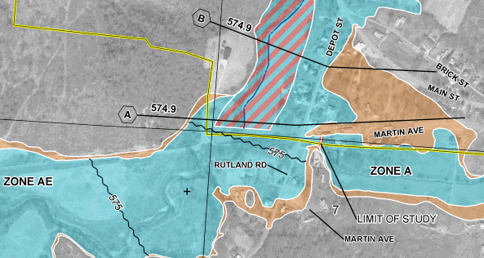
Special Flood Hazard Area (SFHA)
The SFHA is another name for the 100-year or 1% annual chance flood zone.
Notes:
Note: this is different than the Base Flood Elevation (BFE) because it is a zone (i.e. area), not an elevation.
On a flood map, this will be labeled as Zone A or A__.

Slide 11
Base Flood Elevation (BFE)
The Base Flood Elevation (BFE) is another name for the elevation of the 100-year or 1% annual chance flood zone.
Notes:
The BFE can be shown as a number on top of a black wavy line that bisects the floodplain, in parentheses underneath the zone label, or on top of a black straight line that bisects the floodplain.

Slide 12
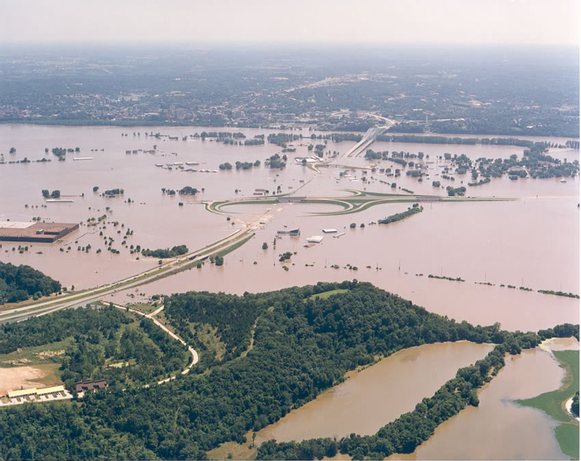
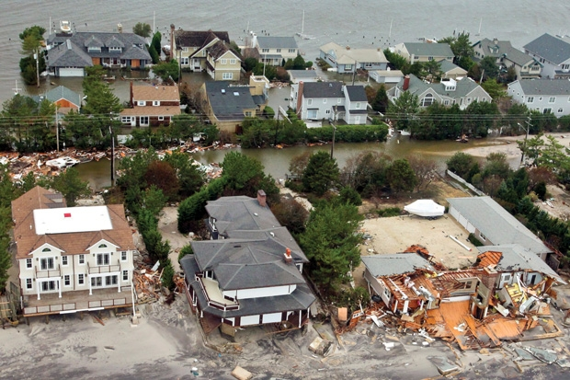
Riverine vs. coastal flooding
Riverine flooding occurs when excessive rainfall causes a river, creek, or stream to exceed its capacity. It can also be caused by heavy snow melt and ice jams.
Coastal flooding is caused by storm surge from extreme weather events, such as tropical storms/hurricanes.
It is possible for an area to have both riverine and coastal flooding.
Notes:
Riverine flooding occurs when excessive rainfall causes a river, creek, or stream to exceed its capacity. It can also be caused by heavy snow melt and ice jams.
Coastal flooding is caused by storm surge from extreme weather events, such as tropical storms/hurricanes.
It is possible for an area to have both riverine and coastal flooding.
Many areas also experience what is known as overland or interior flooding, which is caused by excessive rainfall overwhelming the drainage system, but that this type of flooding is not included in a FIRM. If you are doing a BCA for a project that addresses this type of flooding, you will either need an H&H study or past/expected damage data.

Slide 13
Riverine flooding terms
The streambed elevation is the elevation of the bottom of the flood source.
Discharge is the volumetric flow rate of water through a given cross-sectional area, usually measured in cubic feet per second (cfs).
Notes:
You can use the FIS to find all of this information, as well as flood profiles (WSEL for a specific flood event).

Slide 14
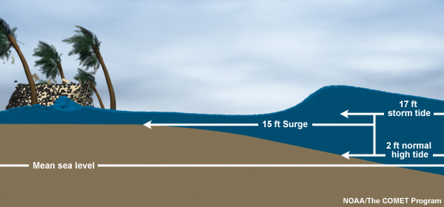
Coastal flooding terms
Stillwater elevation (SWEL) is the flood level not including the effects of waves but including storm surge and astronomic tides.
Storm surge is an abnormal rise of water generated by a storm, over and above the predicted astronomical tides.
Storm tide is the water level rise due to the combination of storm surge and the astronomical tide.
Storm surge vs. storm tide

Slide 15
Coastal flooding
Zone VE and Zone AE refer to the two different flood zones in coastal areas. They are delineated in the FIRM.
Zone VE is mapped in areas that are subject to coastal flooding with wave heights of 3 feet or higher. These areas are referred to as Coastal High Hazard Areas (CHHAs).
Zone AE is mapped in areas subject to coastal flooding with wave heights of less than 3 feet.
LiMWA stands for Limit of Moderate Wave Action. This is an additional data point found in coastal FIRMs. It is an informational line depicting the extent of 1.5-foot wave heights.
Notes:
The primary reason for having two different coastal flood zones is that the risk of structural damage is higher within Zone VE, due to the significant wave energy that can occur in these areas. As a result, flood insurance rates are higher and building codes are stricter for structures in Zone VE.
However, over the past decade, post-storm damage surveys have confirmed that even wave heights as low as 1.5 feet can cause significant structural damage to buildings that were not built to withstand forces such as the wave hazards in VE zones. On its recently updated FIRMs, FEMA notifies communities of the potential for significant wave damage by using both the regulatory Zone VE designation (coastal flooding, plus waves of 3 feet or higher) and an informational line depicting the extent of 1.5-foot wave heights. This line is called the LiMWA.

Slide 16
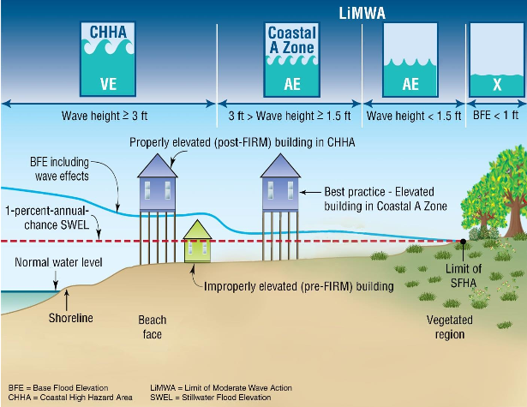
Coastal flooding, cont.

Slide 17
Lowest Floor Elevation (LFE), 1 of 4
The Lowest Floor Elevation (LFE), sometimes referred to as First Floor Elevation (FFE), is the elevation of the “lowest floor of the lowest enclosed area, except for unfinished or flood-resistant enclosures used solely for parking of vehicles, building access, or storage.”
The LFE for a structure depends on the presence and type of basement.
A structure’s LFE is found on its elevation certificate, which documents a building’s elevation.

Slide 18
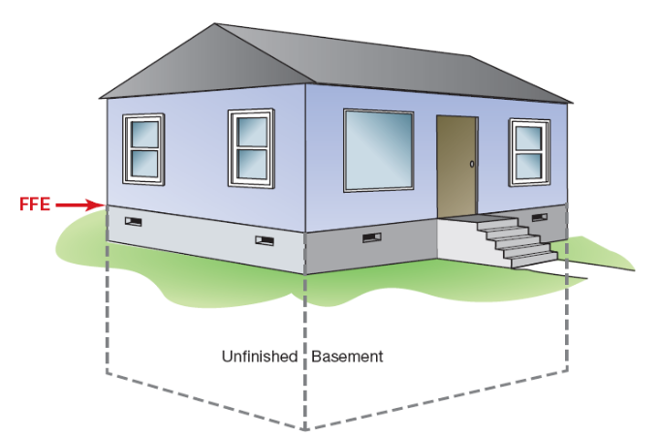
Lowest Floor Elevation (LFE), 2 of 4
Unfinished basement
LFE

Slide 19
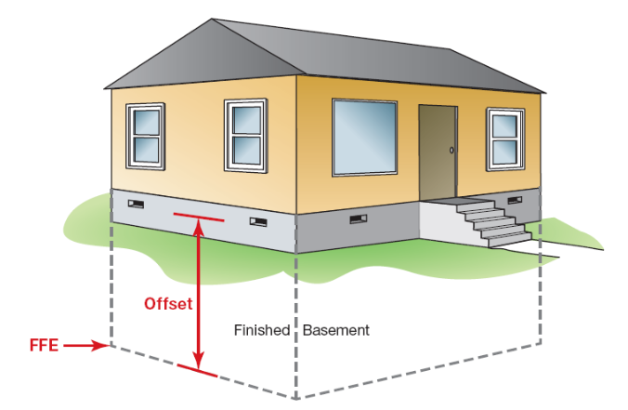
Lowest Floor Elevation (LFE), 3 of 4
Finished basement
LFE

Slide 20
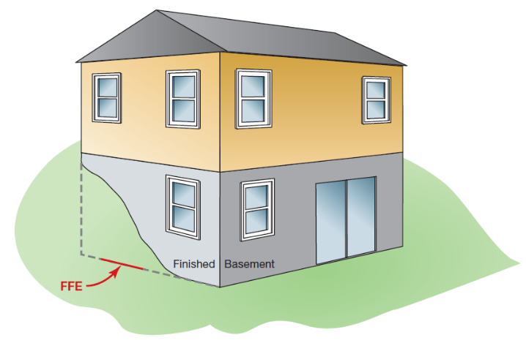
Lowest Floor Elevation (LFE), 4 of 4
Finished walk-out basement
LFE

Slide 21
Building Replacement Value (BRV)
The BRV is the cost per square foot to replace the building with a functionally equivalent building, based on the current cost of labor and materials.
The BRV is not the same as the current market value of the building.
The BCA Toolkit uses a default value of $100/square foot.
Notes:
The BRV is the cost per square foot to replace the building with a functionally equivalent building, based on the current cost of labor and materials.
The BRV is not the same as the current market value of the building.
The BCA Toolkit uses a default value of $100/square foot. If your location has a higher BRV, you may use it as long as you provide documentation with your project application.

Slide 22
Damage Demolition Threshold (DDT)
The demolition damage threshold (DDT) is the percentage of building damage at which demolition and replacement (rather than repair) would be expected to occur as the economically efficient choice.
Many buildings will be demolished rather than repaired when the cost to repair the damage exceeds some percentage of the replacement cost.
For most buildings, a 50% demolition threshold is used as the standard value.
For older, somewhat substandard buildings, the demolition threshold may be quite low (e.g., 20% or 30%). For relatively modern buildings or critical buildings, the threshold will generally be higher.
For historically important buildings, the DDT may approach 100%.
Notes:
The BCA Toolkit has default DDTs for the type of building selected by the user.

Slide 23
Depth Damage Functions (DDFs)
A DDF, also referred to as a damage curve, is a method of estimating direct damage to a building based on a depth of flooding in units of percent damage to structures and their contents.
The DDF is also used to estimate displacement and loss of function at various flood depths, in units of number of days.
DDFs are compiled from a variety of sources, including FEMA and the U.S. Army Corps of Engineers (USACE).
The BCA Toolkit has commonly-used DDFs built into the software. For most riverine flooding projects, the USACE Generic DDF is the correct choice.
Notes:
The BCA Toolkit has commonly-used DDFs built into the software. For most riverine flooding projects, the USACE Generic DDF is the correct choice. If you are doing a project in a coastal zone, however, make sure to use the coastal DDF for that structure type. Coastal DDFs include wave action damage, which we discussed previously.

Slide 24
Acquisitions and Elevations
Notes:
We will talk about acquisitions and elevations together because they require most of the same information to run the BCA.

Slide 25
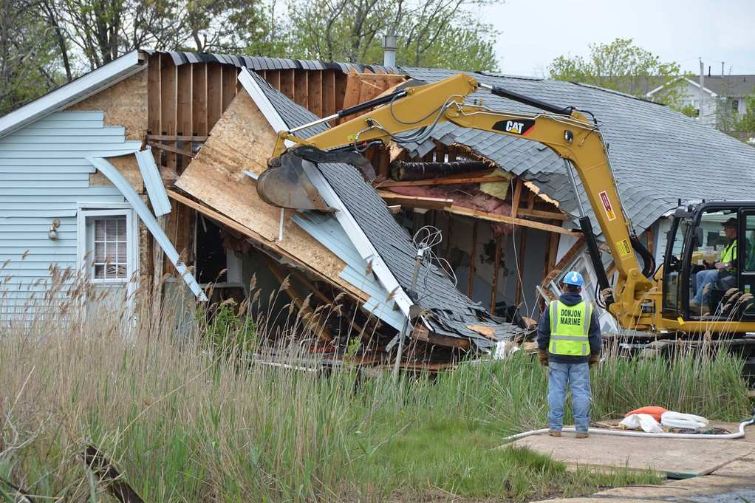
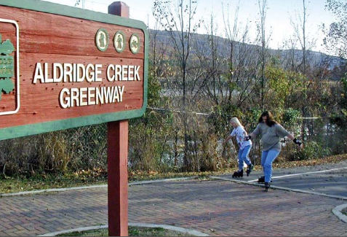
Acquisition projects
The purchase and demolition or relocation of a building. Future damage is eliminated because the project site is deed-restricted as open space.
Many communities utilize the open space as wildlife habitat, active-use parks, or multi-use greenways.

Slide 26
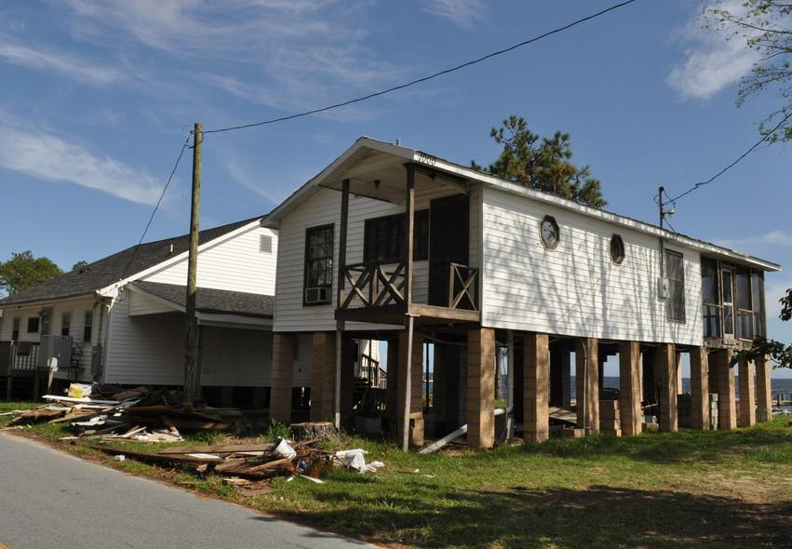
Elevation projects
Elevation projects raise the lowest floor of the structure above the Base Flood Elevation (BFE).
The number of feet above the BFE the LFE is raised is known as freeboard.
Freeboard requirements vary by jurisdiction.

Slide 27
Mitigation reconstruction projects
Mitigation reconstruction is the construction of an improved, elevated building on the same site where an existing building and/or foundation has been partially or completely demolished or destroyed.
Only permitted for structures outside of the regulatory floodway or coastal high hazard area (Zone V) as identified by available flood hazard data.
From a BCA perspective, mitigation reconstruction projects are treated the same way as elevation projects.
Notes:
If the mitigation reconstruction project also protects against another hazard (i.e. wind or seismic), those benefits should also be calculated by analyzing the structure twice – once for each hazard.

Slide 28
Pre-calculated benefit
If your acquisition or elevation project is comprised of structures in the SFHA, and the average cost per structure is less than $276,000 or $175,000, respectively, you do not have to perform a BCA.
If any part of the structure is in the SFHA, or the LFE is lower than the BFE, you may use the pre-calculated benefit.
If your project consists of structures both inside and outside the SFHA, you can either:
Use pre-calculated benefits on the structures inside the SFHA, and perform a BCA on the structures outside.
Note: You cannot transfer the “excess” benefits from the pre-calculated structures to the others.
Perform a BCA with all structures.
Notes:
Note that the $276,000 and $175,000 values are not intended to be project cost estimates. It is advisable to leave some buffer room in your average structure cost in case a property drops out or there are cost overruns.
If any part of the structure is in the SFHA, or the LFE is lower than the BFE, you may use the pre-calculated benefit.
If your project consists of structures both inside and outside the SFHA, you can either:
Use pre-calculated benefits on the structures inside the SFHA, and perform a BCA on the structures outside. Note: You cannot transfer the “excess” benefits from the pre-calculated structures to the others.
Perform a BCA with all structures.

Slide 29
Acquisition & elevation BCAs
Acquisition and elevation BCAs for residential structures may be completed in one of two ways:
Using flood hazard (modeled) data
Using past or expected damage data
Depending on the project specifics, one method may result in a higher BCR than the other for the same structure or set of structures.
This unit will cover data and documentation requirements for the most common method, using flood hazard data.

Slide 30
Completing a residential riverine acquisition BCA using modeled damages
Notes:
First we’ll go through a residential riverine acquisition BCA example in the BCA Toolkit, explaining each data point as it’s input. Your student manual provides details on where you can obtain the data point and appropriate documentation for it.
We’ll then do the same for a residential coastal elevation project. Most of the data points are the same between the two project types.

Slide 31
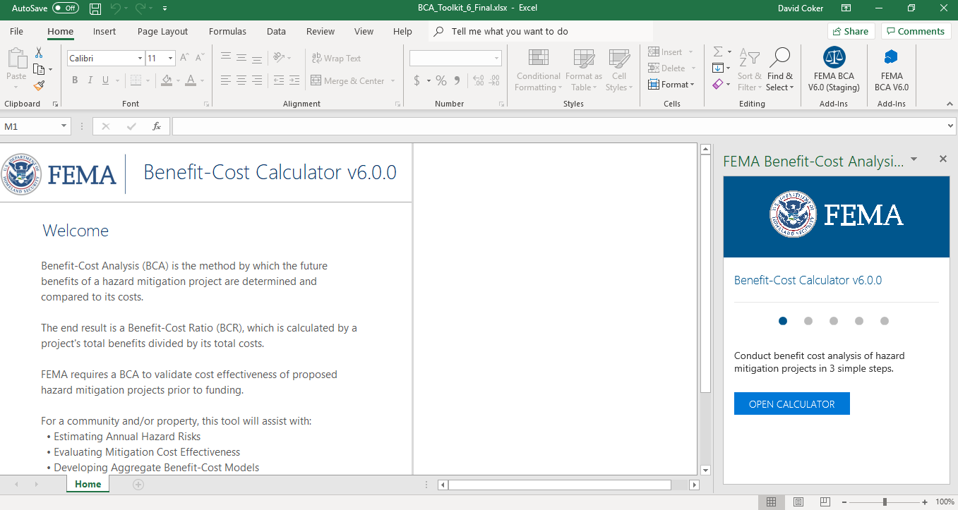
BCA Toolkit Exercise, Part 1
Notes:
The instructor should open the BCA Toolkit on their computer and instruct the students to do the same. Use the following slides to describe each data point as it is input. You may use one of the provided case studies (or another example from a Region or state) to guide the students through data entry on the Project Configuration and then the Project Information screens.
You may also show students the Data Documentation Templates for this project type, which may be found at https://www.fema.gov/benefit-cost-analysis.

Slide 32
Lowest floor elevation (LFE)
What it is:
The LFE is the elevation (in feet) of the lowest floor of the structure.
Input required? | Potential sources | Recommended documentation with application
Yes | Elevation certificate LIDAR data Signed, sealed, and dated structure elevation survey Building permit | Elevation certificate signed by a qualified professional Signed, sealed, and dated structure elevation survey Copy of building permit
Notes:
What it is:
The LFE is the elevation (in feet) of the lowest floor of the structure.
Why it’s important:
The LFE is a key factor in estimating losses before and after mitigation.
If the LFE is lower than the BFE, the project is almost always cost-effective.
The BCR calculation is highly sensitive to this input, meaning that even small changes can have a significant impact on the BCR.
Sources:
FEMA elevation certificates
Signed, sealed, and dated structure elevation surveys
Building permits
Recommended BCA documentation with application:
Elevation certificate signed by a qualified professional
Signed, sealed, and dated structure elevation survey
Copy of building permit

Slide 33
Streambed elevation at property location (riverine only)
What it is:
The streambed elevation is the elevation (in feet) of the channel bottom of a river or stream at the location of the structure being mitigated.
Input required? | Potential sources | Recommended documentation with application
Yes | Flood Insurance Rate Map (FIRM) (available from the FEMA Flood Map Service Center) | Copy of FIRM panel
Notes:
What it is:
The streambed elevation is the elevation (in feet) of the channel bottom of a river or stream at the location of the structure being mitigated.
Why it’s important:
The streambed elevation is used to calculate the depth of flow in the stream.
Sources:
Flood Insurance Rate Map (FIRM), available from the FEMA Flood Map Service Center (Note: Not all locations have FIRMs.)
Hydrologic and Hydraulic (H&H) study
Recommended BCA documentation with application:
Copy of FIRM panel or relevant page(s) from H&H study

Slide 34
10-, 50-, 100-, and 500-year flood elevations and discharge
What it is:
The 10-, 50-, 100-, and 500-year flood elevations are the expected water levels (in feet) of the 10%, 2%, 1%, and 0.2% annual chance flood events.
The discharge (required for riverine only) is the volume (in cubic feet per second) of flow at the different recurrence interval flood events.
Input required? | Potential sources | Recommended documentation with application
Yes | Flood Insurance Study (FIS) Hydrologic and Hydraulic (H&H) study | Copy of relevant page(s) from FIS or H&H study
Notes:
What it is:
The 10-, 50-, 100-, and 500-year flood elevations are the expected water levels (in feet) of the 10%, 2%, 1%, and 0.2% annual chance flood events.
The discharge (required for riverine only) is the volume (in cubic feet per second) of flow at the different recurrence interval flood events.
Sources:
Flood Insurance Study (FIS)
Hydrologic and Hydraulic (H&H) study
Recommended BCA documentation with application:
Copy of relevant page(s) from FIS or H&H study

Slide 35
Building type
What it is:
The type of building.
Residential options include one story, two or more stories, split level, or manufactured home.
For non-residential buildings, there are 22 options.
Input required? | Potential sources | Recommended documentation with application
Yes | Building permit Tax records Project manager or engineer Photo(s) of structure Property owner | Copy of building permit or tax record Photo(s) of structure Note from project manager or engineer
Notes:
What it is:
The type of building.
Residential options include one story, two or more stories, split level, or manufactured home.
For non-residential buildings, there are 22 options.
Why it’s important:
These inputs determine the correct DDF for the property.
Sources:
Building permit
Tax records
Photo(s) of structure
Project engineer
Recommended BCA documentation with application:
Copy of building permit or tax records
Photo(s) of structure
Note from project manager or engineer

Slide 36
Is there a basement?
Why it’s important:
This input helps determine the correct DDF for the property.
The default is No.
Input required? | Potential sources | Recommended documentation with application
No | Building permit Tax records Project manager or engineer Photograph(s) of structure Property owner | Copy of building permit or tax record Photograph(s) of structure Note from project manager or engineer
Notes:
Why it’s important:
This input helps determine the correct DDF for the property.
Sources:
Building permit
Tax records
Photo(s) of structure
Project manager or engineer
Property owner
Recommended BCA documentation with application:
Copy of building permit or tax records
Photo(s) of structure
Note from project manager or engineer

Slide 37
Is the building insured by the NFIP?
Why it’s important:
If the property is insured by the NFIP and is acquired, the avoided administration fee is considered a benefit.
The default is No.
Input required? | Potential sources | Recommended documentation with application
No | Property owner State Hazard Mitigation Officer (SHMO) or State NFIP Coordinator | Copy of current policy or Policy-In-Force number
Notes:
Why it’s important:
If the property is insured by the NFIP and is acquired, the avoided administration fee is considered a benefit.
Sources:
Property owner
State Hazard Mitigation Officer (SHMO) or State NFIP Coordinator
Recommended BCA documentation with application:
Copy of current policy or Policy-In-Force number

Slide 38
Damage curve (DDF) selection
What it is:
A Depth Damage Function (DDF) is the mathematical relationship between the depth of flooding and damage to a building.
For riverine flooding projects, the USACE Generic DDF is the default option in the BCA Toolkit because it is the most commonly used and is applicable regardless of geographic location.
Input required? | Potential sources | Recommended documentation with application
Yes | n/a | If using a curve other than USACE Generic, you should use the comment field to explain why that DDF is appropriate.
Notes:
What it is:
A Depth Damage Function (DDF) is the mathematical relationship between the depth of flooding and damage to a building.
For riverine flooding projects, the USACE Generic DDF is the default option in the BCA Toolkit because it is the most commonly used and is applicable regardless of geographic location.
Depending on your project location and structure characteristics, you may see other DDF options in the Toolkit. If choosing an alternate DDF (or using a custom DDF) you should explain why.
Recommended BCA documentation with application (if choosing an alternate or custom DDF):
Note from project manager, engineer, or BCA analyst (can put in comment field in BCA Toolkit)

Slide 39
Building size
Why it’s important:
The BCA Toolkit uses the building size (in square feet) and Building Replacement Value (BRV) to determine the amount of losses.
Input required? | Potential sources | Recommended documentation with application
Yes | Project Scope of Work (SOW) Tax records Assessor Appraiser Surveyor Title documents Property owner | Tax records Official, signed document from assessor, appraiser, or surveyor Title documents
Notes:
Why it’s important:
The BCA Toolkit uses the building size (in square feet) and Building Replacement Value (BRV) to determine the amount of losses.
Sources:
Project SOW
Tax records
Assessor
Appraiser
Surveyor
Title documents
Property owner
Recommended BCA documentation with application:
Copy of tax records or title documents
Official, signed document from assessor, appraiser, or surveyor
Note from project manager or engineer

Slide 40
Building replacement value (BRV), cont.
What it is:
The cost per square foot to replace the building with a functionally equivalent building, based on the current cost of labor and materials.
The default value for BRV is $100/square foot.
Input required? | Potential sources for non-default value | Recommended documentation with application
No | Industry-standard cost estimating guide such as Marshall & Swift or RSMeans Letter from construction/contracting firm or local building inspector Tax records (must be from assessor’s office) | Copy of page(s) from cost estimating guide Signed letter from construction/ contracting firm or local building inspector Tax records (must be from assessor’s office)
Notes:
For instructors: note that the BRV is NOT the same as the market value of the structure.
What it is:
The cost per square foot to replace the building with a functionally equivalent building, based on the current cost of labor and materials.
The default value for BRV is $100/square foot.
Why it’s important:
The BCA Toolkit uses the building size and Building Replacement Value (BRV) to determine the amount of losses.
Sources for non-default values:
Industry-standard cost estimating guide such as Marshall & Swift or RSMeans
Construction/contracting firm or local building inspector
Tax records (must be from assessor’s office)
Recommended BCA documentation with application:
Copy of relevant page(s) from cost estimating guide
Signed letter from qualified professional (local building inspector, building/construction company)
Copy of tax records from assessor’s office

Slide 41
Demolition Damage Threshold (DDT)
What it is:
The demolition damage threshold is the % of building damage at which demolition and replacement (rather than repair) would be expected to occur as the economically efficient choice.
The default value is 50%.
Input required? | Potential sources for non-default value | Recommended documentation with application
No | Real estate appraiser Local building inspector Building or construction company Economist | Signed letter from qualified professional (real estate appraiser, local building inspector, building/construction company, economist)
Notes:
What it is:
The demolition damage threshold is the % of building damage at which demolition and replacement (rather than repair) would be expected to occur as the economically efficient choice.
The default DDT will populate based on the building type selected.
For outdated or marginal buildings, much lower demolition thresholds are sometimes appropriate. For relatively modern buildings or critical buildings, the threshold will generally be higher. For some particularly important historical buildings, the demolition threshold may approach 100 percent.
Why it’s important:
The demolition threshold is used when calculating the dollar value of expected damages to the building.
Sources for non-default values:
Real estate appraiser
Local building inspector
Building or construction company
Economist
Recommended BCA documentation with application:
Signed letter from qualified professional (real estate appraiser, local building inspector, building/construction company, economist, etc.)

Slide 42
Contents value
What it is:
The value of contents inside the building.
The default contents value is based on the building type.
Input required? | Potential sources for non-default value | Recommended documentation with application
No | Insurance records Appraisals Purchase receipts from property owner Estimates based on current market prices for similar building contents | Copy of insurance records, appraisals, or purchase receipts Signed letter from qualified professional estimating market prices for similar building contents
Notes:
What it is:
The value of contents inside the building.
The default contents value is based on the building type.
Why it’s important:
The BCA Toolkit uses the contents value to determine the amount of losses.
Sources for non-default values:
Insurance records
Appraisals
Purchase receipts from property owner
Estimates based on current market prices for similar building contents
Recommended BCA documentation with application:
Copy of insurance records, appraisals, or purchase receipts
Signed letter from qualified professional estimating market prices for similar building contents

Slide 43
Are the utilities elevated?
Why it’s important:
If utilities are already elevated, the after-mitigation will be slightly less than if they are not.
The default is No.
Input required? | Potential sources for non-default value | Recommended documentation with application
No | Property owner Project manager/engineer Photo(s) of structure | Photo(s) of structure Note from project manager or engineer
Notes:
Why it’s important:
If utilities are already elevated, the after-mitigation will be slightly less than if they are not.
The default value for this input is No.
Sources for non-default values:
Property owner
Photo(s) of structure
Recommended BCA documentation with application:
Photo(s) of structure
Note from project manager or engineer

Slide 44
Federal lodging per diem rate
What it is:
The per diem rate (in $/day) is the daily cost for lodging per person.
The default value is $94/day, which is the General Services Administration (GSA) standard rate for the continental U.S. (CONUS)
Input required? | Potential sources for non-default value | Recommended documentation with application
No | Toolkit default ($94/day) GSA website DoD website | Screenshot or copy of GSA or DoD website showing higher per diem rate for project location If more than one hotel room is needed per family, an explanation of why one standard hotel room cannot accommodate a displaced family.
Notes:
What it is:
The per diem rate (in $/day) is the daily cost for lodging per person.
The default value is $94/day, which is the General Services Administration (GSA) standard rate for the continental U.S. (CONUS)
Why it’s important:
The BCA Toolkit uses the per diem rate to calculate the displacement costs.
Sources for non-default values:
GSA website
DoD website
Recommended BCA documentation with application:
Screenshot or copy of GSA or DoD website showing higher per diem rate for project location
If more than one hotel room is needed per family, an explanation of why one standard hotel room cannot accommodate a displaced family.

Slide 45
Number of building residents
Why it’s important:
The number of residents is used to calculate displacement costs and the mental stress & anxiety portion of the social benefits.
Input required? | Potential sources | Recommended documentation with application
Yes | Property owner Project manager or engineer U.S. Census Bureau State, regional, or local agency estimates for population per household | Note from project manager or BCA analyst
Notes:
Why it’s important:
The number of residents is used to calculate displacement costs and the mental stress & anxiety portion of the social benefits.
Sources:
Project SOW
Property owner
Census data
Recommended BCA documentation with application:
Note from project manager or engineer or BCA analyst

Slide 46
Monthly rent
What it is:
The monthly rent of a tenant-occupied building.
Input required? | Potential sources | Recommended documentation with application
No | Property owner | Receipts, copies of checks, or other documentation showing monthly rent amount
Notes:
Note that counting both displacement costs for the renter and the full loss of rental income is double counting benefits. Users should choose which option provides more benefits.
What it is:
The monthly rent of a tenant-occupied building.
Why it’s important:
For residential properties, when tenants vacate a premise because of damages, it results in a loss of income for the owner.
Sources:
Property owner
Rent receipts
Recommended BCA documentation with application:
Receipts, copies of checks, or other documentation showing monthly rent amount

Slide 47
Annual street maintenance budget (acquisitions only)
What it is:
The annual budget for street maintenance in a community.
Input required? | Potential sources | Recommended documentation with application
No | Local agency or transportation authority | Letter from local agency or transportation authority
Notes:
What it is:
The annual budget for street maintenance in a community.
Why it’s important:
For acquisition projects that clear a large area of structures (and result in removed or abandoned streets), a community might realize an economic benefit in reduced street maintenance costs in the project area.
Sources:
Local agency or transportation authority
Recommended BCA documentation with application:
Letter from local agency or transportation authority

Slide 48
Total number of street miles maintained (acquisitions only)
What it is:
The total number of street miles maintained as reflected in the annual budget for street maintenance in a community.
Input required? | Potential sources | Recommended documentation with application
No | Local agency or transportation authority | Letter from local agency or transportation authority
Notes:
What it is:
The total number of street miles maintained as reflected in the annual budget for street maintenance in a community.
Why it’s important:
For acquisition projects that clear a large area of structures (and result in removed or abandoned streets), a community might realize an economic benefit in reduced street maintenance costs in the project area.
Sources:
Local agency or transportation authority
Recommended BCA documentation with application:
Letter from local agency or transportation authority

Slide 49
# of street miles no longer requiring maintenance (acquisitions only)
What it is:
The number of street miles that will be removed or abandoned as a result of the mitigation project.
Input required? | Potential sources | Recommended documentation with application
No | Project manager or engineer | Map(s) of project area showing which streets/roadways will be abandoned or removed
Notes:
What it is:
The number of street miles that will be removed or abandoned as a result of the mitigation project.
Why it’s important:
For acquisition projects that clear a large area of structures (and result in removed or abandoned streets), a community might realize an economic benefit in reduced street maintenance costs in the project area.
Sources:
Project manager or engineer
Recommended BCA documentation with application:
Map(s) of project area showing which streets/roadways will be abandoned or removed

Slide 50
Volunteers required
What it is:
The number of volunteers that respond to a typical hazard event – for example, sandbagging.
It must be clearly demonstrated in the project application that the proposed project will reduce or eliminate the future need for volunteers.
Input required? | Potential sources | Recommended documentation with application
No | Local emergency management authority Newspaper articles from a credible source | Letter from local emergency management authority describing the number of volunteers needed in the past Copy of newspaper article(s)
Notes:
What it is:
The number of volunteers that respond to a typical hazard event – for example, sandbagging.
It must be clearly demonstrated in the project application that the proposed project will reduce or eliminate the future need for volunteers.
Why it’s important:
The reduced costs associated with volunteers is a benefit of the mitigation project.
Sources:
Local emergency management authority
Newspaper articles from a credible source
Recommended BCA documentation with application:
Letter from local emergency management authority describing the number of volunteers needed in the past
Copy of newspaper article(s)

Slide 51
Number of days lodging for volunteers
What it is:
The number of days volunteers would spend responding to a typical hazard event. It must be clearly demonstrated in the project application that the proposed project will reduce or eliminate the future need for volunteers.
Input required? | Potential sources | Recommended documentation with application
No | Local emergency management authority | Letter from local emergency management authority describing how many days the volunteers were needed in the past
Notes:
What it is:
The number of days volunteers would spend responding to a typical hazard event. It must be clearly demonstrated in the project application that the proposed project will reduce or eliminate the future need for volunteers.
Why it’s important:
The reduced costs associated with volunteers is a benefit of the mitigation project.
Sources:
Local emergency management authority
Newspaper articles from a credible source
Recommended BCA documentation with application:
Letter from local emergency management authority describing the number of volunteers needed in the past
Copy of newspaper article(s)

Slide 52
Number of residents that work
What it is:
The number of building residents that are employed full time.
Input required? | Potential sources | Recommended documentation with application
No | Property owner U.S. Census Bureau State, regional, or local agency estimates for workers per household | Note from project manager or BCA analyst
Notes:
What it is:
The number of building residents that are employed full time.
Why it’s important:
The number of workers is used to calculate the social benefits of the project.
Sources:
Property owner
U.S. Census Bureau
State, regional, or local agency estimates for workers per household
Recommended BCA documentation with application:
Note from project manager or BCA analyst

Slide 53
Total project area (acquisitions only)
Why it’s important:
The size and future land use of the project area (in acres) are used to calculate the environmental benefits of the project.
For acquisition projects with multiple structures, this may be the individual parcel or the entire project area. Note that if you use the entire project area, you may only add this to one structure in your BCA.
Input required? | Potential sources | Recommended documentation with application
No | Project manager or engineer GIS data Tax records | Map(s) showing project area with the acreage clearly identified Copy of tax records denoting parcel size
Notes:
Why it’s important:
The size and future land use of the project area (in acres) are used to calculate the environmental benefits of the project.
For acquisition projects with multiple structures, this may be the individual parcel or the entire project area. Note that if you use the entire project area, you may only add this to one structure in your BCA.
Sources:
Project manager or engineer
GIS data
Tax records
Recommended BCA documentation with application:
Map(s) showing project area with the acreage clearly identified
Copy of tax records denoting parcel size

Slide 54
Future land use of project area by type (acquisitions only)
What it is:
The future land use of the project area by percentage.
For example: 80% open green space, 20% riparian
Input required? | Potential sources | Recommended documentation with application
No | Project manager or engineer GIS data | Map(s) showing project area with post-mitigation land use(s) clearly identified
Notes:
What it is:
The future land use of the project area by percentage.
For example: 80% open green space, 20% riparian
Why it’s important:
The size and future land use of the project area are used to calculate the environmental benefits of the project.
Sources:
Project manager or engineer
GIS data
Recommended BCA documentation with application:
Map(s) showing project area with post-mitigation land use(s) clearly identified

Slide 55
Completing a residential coastal elevation BCA using modeled damages
Notes:
Most of the data points for elevations are the same as for acquisitions. Here we will cover the different data points needed for (1) elevations and (2) coastal flood projects using Modeled Damages.

Slide 56
BCA Toolkit Exercise, Part 2
Notes:
The instructor should open the BCA Toolkit on their computer and instruct the students to do the same. Use the following slides to describe each data point as it is input. You may use one of the provided case studies (or another example from a Region or state) to guide the students through data entry on the Project Configuration and then the Project Information screens.
You may also show students the Data Documentation Templates for this project type, which may be found at https://www.fema.gov/benefit-cost-analysis.

Slide 57
Ground surface elevation at property location (coastal only)
What it is:
The ground surface elevation is the elevation (in feet) of the ground at the location of the structure being mitigated.
Note: Make sure that the LFE and ground surface elevations are in the same elevation datum.
Input required? | Potential sources | Recommended documentation with application
Yes | Elevation certificate Professional survey | Copy of elevation certificate Letter or other signed document from qualified professional
Notes:
What it is:
The ground surface elevation is the elevation (in feet) of the ground at the location of the structure being mitigated.
Note: Make sure that the LFE and ground surface elevations are in the same elevation datum.
Why it’s important:
By subtracting the ground surface elevation from the lowest floor elevation, the height of the building above the ground can be calculated.
Sources:
Elevation certificate
Professional survey
Recommended BCA documentation with application:
Elevation certificate signed by a qualified professional
Copy of survey signed by a qualified professional

Slide 58
Base flood elevation (BFE) (coastal only)
What it is:
The base flood elevation (BFE) (in feet) at the property location.
Input required? | Potential sources | Recommended documentation with application
Yes | Flood Insurance Rate Map (FIRM) (available from the FEMA Flood Map Service Center) Hydrologic and Hydraulic (H&H) study | Copy of FIRM panel or relevant page(s) from H&H study
Notes:
What it is:
The base flood elevation (BFE) (in feet) at the property location.
Why it’s important:
By subtracting the ground surface elevation from the lowest floor elevation, the height of the building above the ground can be calculated.
Source(s):
Flood Insurance Rate Map (FIRM)
Hydrologic & Hydraulic (H&H) study
Recommended BCA documentation with application:
Elevation certificate signed by a qualified professional
Copy of survey signed by a qualified professional

Slide 59
Number of feet the first floor is being raised (elevations only)
Why it’s important:
The number of feet the first floor is raised helps determine the expected damages after mitigation.
Input required? | Potential sources | Recommended documentation with application
Yes | Project scope of work (SOW) Project engineer Engineering designs | None other than normally required project materials
Notes:
Why it’s important:
The number of feet the first floor is raised helps determine the expected damages after mitigation.
Sources:
Project scope of work (SOW)
Project engineer
Engineering designs
Recommended BCA documentation with application:
None other than normally required project materials

Slide 60
Additional projected sea level rise above BFE (coastal only)
What it is:
Sea level rise (SLR) refers to “relative” sea level rise, which takes into consideration whether the ground is rising or falling in addition to the seas rising.
Input required? | Potential sources | Recommended documentation with application
No | National Oceanic and Atmospheric Administration (NOAA) U.S. Army Corps of Engineers (USACE) Local sea level rise study from credible source | Copy of relevant page(s) from source cited Screenshot or copy of map from credible source clearly showing sea level rise estimate at project location
Notes:
Note for instructors: mention that for tidal rivers, flood elevations with SLR can also be included as long as there is sufficient supporting documentation.
Currently, the Toolkit assumes that SLR is static across the PUL of the project.
What it is:
Sea level rise (SLR) refers to “relative” sea level rise, which takes into consideration whether the ground is rising or falling in addition to the seas rising.
Why it’s important:
Incorporating sea level rise improves the accuracy of the estimated future losses.
Adding SLR to stillwater flood elevations creates deeper flood depths used in the BCA Toolkit’s calculations, increasing the benefits of the project.
Sources:
NOAA
U.S. Army Corps of Engineers (USACE)
Local sea level rise study from credible source
Recommended BCA documentation with application:
Copy of relevant page(s) from source cited
Screenshot or copy of map from credible source clearly showing sea level rise estimate at project location

Slide 61
Is the building elevated? Is there an obstruction? (coastal only)
Why it’s important:
These inputs determine the correct DDF for the property.
The defaults are No.
Input required? | Potential sources | Recommended documentation with application
No | Project manager or engineer Property owner | Photo(s) of structure Note from project manager or engineer
Notes:
Why it’s important:
These inputs determine the correct DDF for the property.
Sources:
Elevation certificate
Photo(s) of structure
Project engineer
Recommended BCA documentation with application:
Copy of elevation certificate
Photo(s) of structure
Note from project manager or engineer

Slide 62
Foundation type (coastal only)
What it is:
The type of foundation – slab, pier, or pile.
Input required? | Potential sources | Recommended documentation with application
Yes | Building permit Tax records Photo(s) of structure Project manager or engineer Property owner | Copy of building permit or tax records Photo(s) of structure Note from project manager or engineer
Notes:
What it is:
The type of foundation – slab, pier, or pile.
Why it’s important:
These inputs determine the correct DDF for the property.
Sources:
Building permit
Tax records
Photo(s) of structure
Project manager or engineer
Property owner
Recommended BCA documentation with application:
Copy of building permit or tax records
Photo(s) of structure
Note from project manager or engineer

Slide 63
Damage curve (DDF) selection, cont.
What it is:
A Depth Damage Function (DDF) is the mathematical relationship between the depth of flooding and damage to a building.
For coastal projects, the BCA Toolkit will select the correct DDF based on the structure characteristics entered.
Input required? | Potential sources | Recommended documentation with application
Yes | n/a | If using a curve other than the default, you should use the comment field to explain why that DDF is appropriate.
Notes:
What it is:
A Depth Damage Function (DDF) is the mathematical relationship between the depth of flooding and damage to a building.
For coastal projects, the BCA Toolkit will select the correct DDF based on the structure characteristics entered.
Recommended BCA documentation with application (if choosing an alternate or custom DDF):
Note from project manager, engineer, or BCA analyst

Slide 64
Flood Control Projects

Slide 65
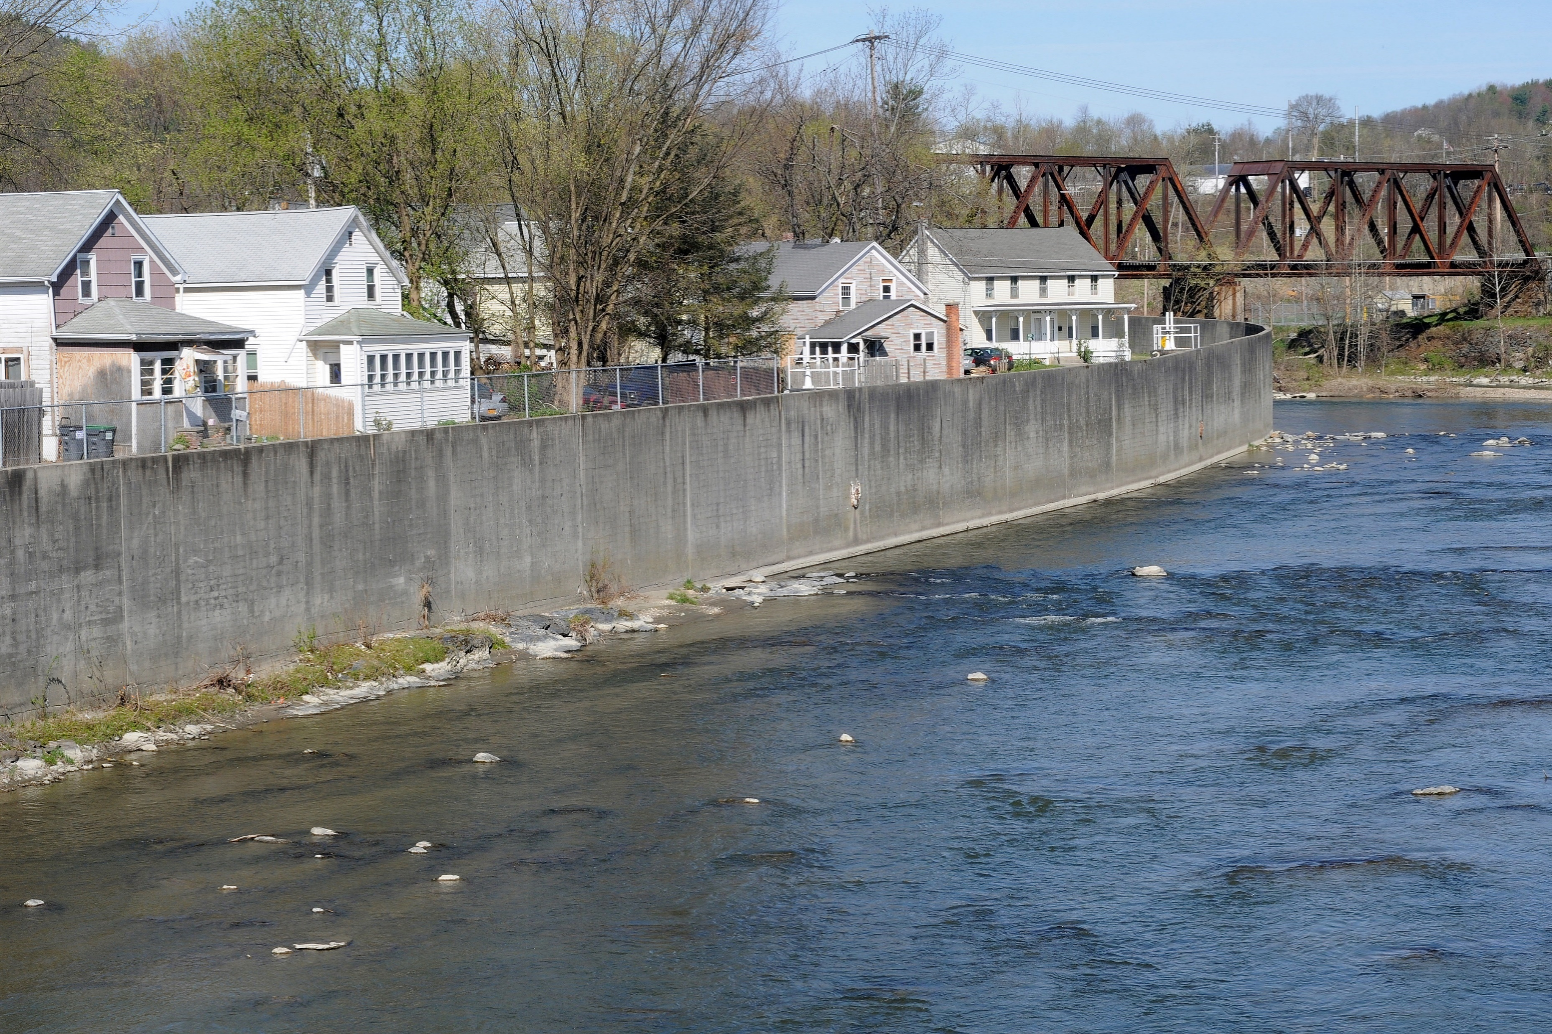
What are flood control projects?
The term “flood control” refers to systemic projects designed to reduce flood damage to a facility or area.
For example:
Culverts
Floodplain & stream restoration
Drainage improvements
Floodwater diversion & storage
Floodwalls
Levees
Pumping stations

Slide 66
Flood control BCAs
BCAs for flood control projects are usually done using the “Historical Damages” or “Professional Expected Damages” option.
You will need past damage data for the structure(s) being protected, or a professional analysis estimating future damages.
Remember – structures can include residential and non-residential buildings, utility infrastructure, and roads and bridges. If your project protects both residential properties and roads, you will enter those as separate structures in one project.

Slide 67
Completing a flood control BCA using historical damages

Slide 68
BCA Toolkit Exercise
Notes:
The instructor should open the BCA Toolkit on their computer and instruct the students to do the same. Use the following slides to describe each data point as it is input. You may use one of the provided case studies (or another example from a Region or state) to guide the students through data entry on the Project Configuration and then the Project Information screens.
You may also show students the Data Documentation Templates for this project type, which may be found at https://www.fema.gov/benefit-cost-analysis.

Slide 69
Project useful life (PUL)
What it is:
The estimated amount of time (in years) that the mitigation action will be effective.
Some types of flood control projects have standard values (see the PUL Summary Tables in the help content), but in many cases the PUL will be determined by the project engineer.
Input required? | Potential sources | Recommended documentation with application
Yes | Project engineer Manufacturer | Letter or note from project engineer justifying PUL chosen Copy of manufacturer guidance
Notes:
What it is:
The estimated amount of time (in years) that the mitigation action will be effective.
Some types of flood control projects have standard values (see the PUL Summary Tables in the help content), but in many cases the PUL will be determined by the project engineer.
Why it’s important:
The PUL determines the duration of project benefits. Higher PULs result in more benefits.
The PUL is also used to calculate the amount of project maintenance costs.
Source(s) for non-standard values:
Project engineer
Manufacturer
Recommended BCA documentation with application:
Letter or note from project engineer justifying PUL chosen
Copy of manufacturer guidance

Slide 70
Year property built
What it is:
The calendar year the property/structure being protected was built.
Note: If local flow conditions have changed since the property was built, you will adjust the analysis duration, not the year built.
Input required? | Potential sources | Recommended documentation with application
Yes | Property owner | Copy of tax records Note from project manager or engineer
Notes:
What it is:
The calendar year the property/structure being protected was built.
Note: If local flow conditions have changed since the property was built, you will adjust the analysis duration, not the year built.
Why it’s important:
The BCA Toolkit uses the year the facility was built to determine the analysis duration for calculating benefits.
The shorter the analysis duration, the higher the BCR.
Source(s):
Tax records
Property owner
Recommended BCA documentation with application:
Copy of tax records
Note from project manager or engineer

Slide 71
Analysis duration
What it is:
The number of years being analyzed for the before-mitigation conditions.
The minimum analysis duration is 10 years.
Input required? | Sources for non-default value | Recommended documentation with application
No | FIS or H&H study | Copy of relevant page(s) from FIS or H&H study A Conditional Letter of Map Revision (CLOMR) or Letter of Map Revision (LOMR) Aerial photos of the area before and after the change in flow conditions with dates clearly documented
Notes:
What it is:
The number of years being analyzed for the before-mitigation conditions.
The minimum analysis duration is 10 years.
The default value is the analysis year minus the year the property was built. However, if there has a been a change in local flow conditions since the property was built, the user may wish to enter a different analysis duration. For example, if a property was built in 1980, but a large shopping center was built nearby in 1990 that changed the local flow conditions, the analysis duration would be:
analysis duration = [analysis year] - 1990
Why it’s important:
The shorter the analysis duration, the higher the BCR.
Source(s) for non-default value:
FIS or H&H study
Recommended BCA documentation with application:
Copy of relevant page(s) from FIS or H&H study
A Conditional Letter of Map Revision (CLOMR) or Letter of Map Revision (LOMR)
Aerial photos of the area before and after the change in flow conditions with dates clearly documented

Slide 72
Damages before mitigation
What it is:
For Historical Damages: The historical damages to the structure and the year(s) in which these damages occurred. If you have fewer than three events, you will also need to know the Recurrence Intervals (RIs) for each event.
For Professional Expected Damages: The RI(s) and estimated damages for each event.
For residential and non-residential structures, damages are in dollars. For critical facilities, utilities, and roads/bridges, damages are in number of days the facility was impacted.
Why it’s important:
The BCA Toolkit uses the before-mitigation damage data to estimate future damages that would be avoided by the mitigation project (i.e., the benefits).
Notes:
What it is:
The historical damages to the structure and the year(s) in which these damages occurred. If you have fewer than three events, you will also need to know the Recurrence Intervals (RIs) for each event.
For residential and non-residential structures, damages are in dollars. For critical facilities and roads/bridges, damages are in number of days the facility was impacted.
Why it’s important:
The BCA Toolkit uses the before-mitigation damage data to estimate future damages that would be avoided by the mitigation project (i.e., the benefits).

Slide 73
Damages before mitigation, cont.
Input | Input required? | Potential sources
Damage Year | Yes* | Property owner or facility operator Insurance claims FEMA Project Worksheets (PWs) Newspaper articles from credible source
Recurrence Interval (years) | Yes** | National Weather Service Precipitation Frequency Data Server USGS stream gauge data Qualified engineer or other professional
Damages ($) or Impact (Days) | Yes | Property owner or facility operator Insurance claims FEMA Project Worksheets (PWs) Estimates using flood depths and DDFs Qualified engineer or other professional Newspaper articles from credible source
Refer to the Data Documentation Template for the recommended documentation for the application.
* If you know the RI for the event, or you are using the Professional Expected Damages methodology, you do not have to enter the damage year.
** If you are using Historical Damages and have at least 3 events, you do not need to know the RI; the BCA Toolkit will calculate it for you. However, a user-entered RI may be more favorable to the BCR than the Toolkit-calculated RI.
Notes:
See the Data Documentation Template for full details.
Remember that extraordinary claims require extraordinary documentation! A 1-year RI means that event happens every year. You must have documentation for this!
We will show how to calculate damages using flood depths and DDFs later in this unit.

Slide 74
Damages after mitigation
What it is:
The damages after mitigation reflect the level of protection that the mitigation measure provides (i.e., a house is elevated to the 100-year flood level).
Input | Input required? | Potential sources | Recommended documentation with application
Recurrence Interval (years) | Yes | Project engineer or other qualified professional H&H study | Letter or note from project engineer describing project effectiveness and expected post-mitigation damages Relevant page(s) from H&H study
Damages ($) or Impact (Days) | Yes | Project engineer or other qualified professional Estimates using flood depths and DDFs | Letter or note from project engineer describing project effectiveness and expected post-mitigation damages Note from project engineer or BCA analyst describing methodology and assumptions for damage estimates using flood depths/DDFs
Notes:
What it is:
Recall that only acquisition projects are 100% effective. All other project types will have some damages after mitigation.
The damages after mitigation reflect the level of protection that the mitigation measure provides (i.e., a house is elevated to the 100-year flood level).
For non-residential structures, the after-mitigation damages will be in number of days the service is expected to be down. Likewise, the number of days of lost service should be lower after mitigation, up to the level of protection.
Why it’s important:
The BCA Toolkit uses project effectiveness to estimate damages after mitigation.
Source(s):
H&H study
Project engineer or other qualified professional
For residential structures, we can use DDFs to estimate these damage amounts, but the difference is that for the after-mitigation damages, we need to know the recurrence interval for the flood depths. For a flood control project, the flood depths for the same recurrence interval should be lower after mitigation, at least up to the level of protection. (Otherwise, the mitigation project is not effective!)
Recommended BCA documentation with application:
Letter or note from project engineer describing project effectiveness and expected post-mitigation damages
Relevant page(s) from H&H study
Note from project engineer or BCA analyst describing methodology and assumptions for damage estimates using flood depths/DDFs

Slide 75
Optional damages before mitigation
What it is:
Recall in Unit 3 we discussed what count as benefits for mitigation projects. In addition to physical damage or loss of service, there may be avoided displacement or emergency management costs.
Input required? | Potential sources | Recommended documentation with application
No | Property owner or facility operator Insurance claims FEMA Project Worksheets | Copies of receipts for repair or displacement costs Copies of insurance claims Copies of FEMA PWs
Notes:
What it is:
Recall in Unit 3 we discussed what count as benefits for mitigation projects. In addition to physical damage or loss of service, there may be avoided displacement or emergency management costs.
For residential and non-residential structures, optional damages might include displacement costs.
For critical facilities, utilities, and roads/bridges, optional damages might include physical damages or one-time displacement costs.
Why it’s important:
Any additional before-mitigation damages that can be identified add to the benefits of the project, increasing the BCR.
Source(s):
Property owner or facility operator
Insurance claims
FEMA Project Worksheets
Recommended BCA documentation with application:
Copies of receipts for repair or displacement costs
Copies of insurance claims
Copies of FEMA PWs

Slide 76
Optional damages after mitigation
What it is:
Any other damages, such as displacement costs, associated with the after-mitigation RI(s).
Input required? | Potential sources | Recommended documentation with application
No | Project engineer Property owner or facility operator | Letter or note from project engineer describing project effectiveness and expected post-mitigation displacement or other damages Letter from property owner or facility operator (preferably on agency or company letterhead) describing any displacement or other costs that would occur in the X-year event, where X is the RI (non-residential structures only)
Notes:
What it is:
Any other damages, such as displacement costs, associated with the after-mitigation RI(s).
Source(s):
Project engineer
Property owner or facility operator
Recommended BCA documentation with application:
Letter or note from project engineer describing project effectiveness and expected post-mitigation displacement or other damages
Letter from property owner or facility operator (preferably on agency or company letterhead) describing any displacement or other costs that would occur in the X-year event, where X is the RI (non-residential structures only)

Slide 77
Remaining data
Volunteer costs, social benefits, and environmental benefits may be also added to your flood control BCA if applicable.
Note: Since environmental benefits are calculated for the entire project area, they may only be added to your BCA once. If you have multiple structures in your flood control BCA, ensure you are not over-counting environmental benefits.
These data points are optional and are discussed earlier in the unit.

Slide 78
Damage estimates using DDFs

Slide 79
Damage estimates using DDFs, 1 of 7
You can estimate damage amounts to structures by utilizing the appropriate Depth Damage Function (DDF) curve.
For each structure, you will need to know:
Building size
Depth of flooding (or LFE and flood elevations)
Structure characteristics (basement or not, foundation type, etc.)

Slide 80
Damage estimates using DDFs, 2 of 7
You will probably want to use a spreadsheet to do the calculations, especially if analyzing multiple structures.
In this simple example we will assume we are mitigating riverine flooding for 2 structures:
A one-story home with no basement
A two-story home with a basement
Create columns as shown below. Calculate the BRVs using the building size and default BRV of $100/square foot.
Notes:
Open Microsoft Excel on your computer and create columns as shown below. Have the students follow along on their own computers. Calculate the BRVs by multiplying the building size by the default BRV of $100/square foot.
Some FEMA Regions and disaster staff have developed their own spreadsheets to do this math quickly. You can ask your Region or disaster POC if they know of any.

Slide 81
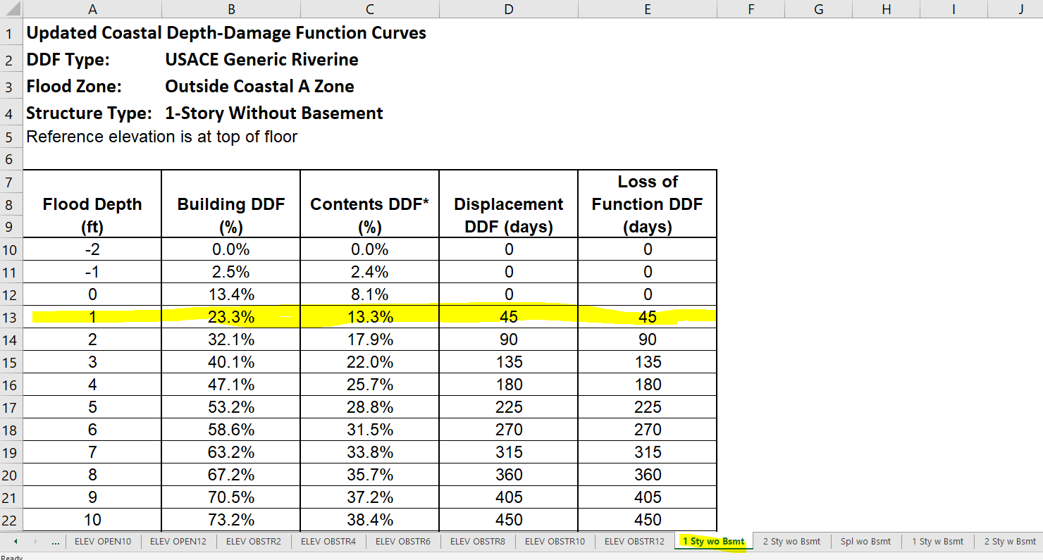
Damage estimates using DDFs, 3 of 7
One-story home with no basement
If the depth of flooding in the home was 1 foot, we would look at the “1” row and put the percentages in the proper columns in our spreadsheet.
Notes:
Open the DDF spreadsheet and navigate to the correct tab (One-story home with no basement):
If the depth of flooding in the home was 1 foot, we would look at the “1” row and put the percentages in the proper columns in our spreadsheet.
For depths of flooding that are in between feet (say 1.4 feet, which is between 1 and 2) you should use the lesser number.

Slide 82
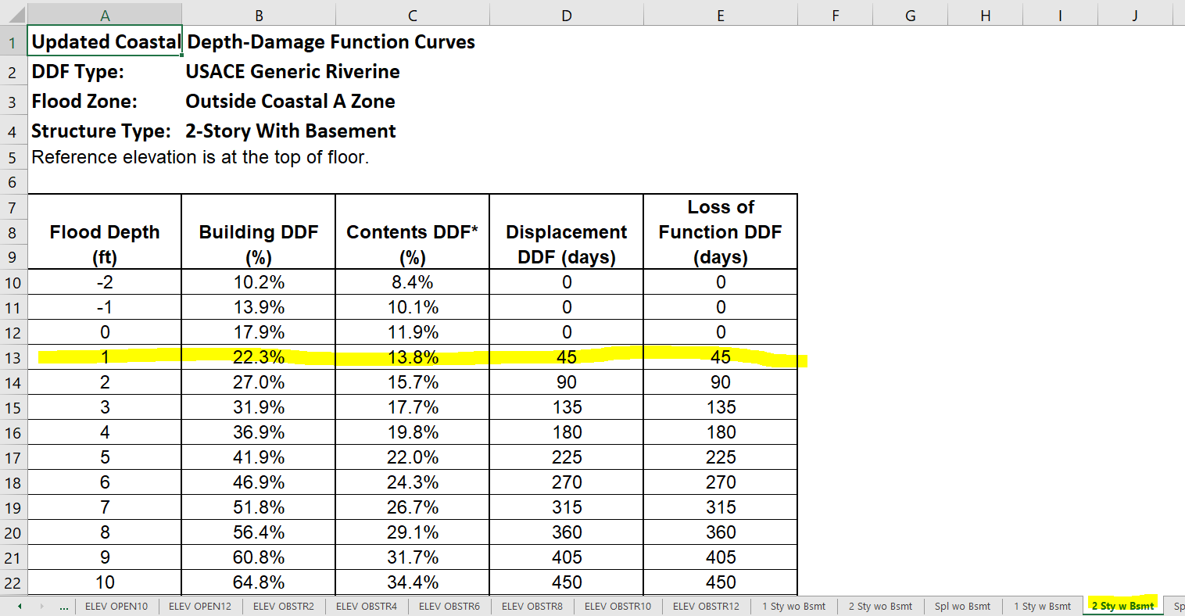
Damage estimates using DDFs, 4 of 7
Two-story home with basement
Again, if depth of flooding was 1 foot, we would put these percentages in our spreadsheet.
Notes:
Open the DDF spreadsheet and navigate to the correct tab for the other structure (Two-story home with no basement):
If the depth of flooding in the home was 1 foot, we would look at the “1” row and put the percentages in the proper columns in our spreadsheet.

Slide 83
Damage estimates using DDFs, 5 of 7
Our spreadsheet now looks like this:
Notes:
Instructor should pause here to make sure everyone understands where the percentages came from.

Slide 84
Damage estimates using DDFs, 6 of 7
To get the Building Damages ($) and Contents Damages ($), multiply the BRV column by the appropriate percentages.
Notes:
Instructor should pause here to make sure everyone understands how to calculate the Building Damages ($) and Contents Damages ($) columns.

Slide 85
Damage estimates using DDFs, 7 of 7
We now have estimated building and contents damages for each structure for 1 foot of flooding. We can then enter these numbers into the BCA Toolkit for each structure. Alternatively, we can enter them as a lump sum by using the total amounts. This is particularly useful for projects with large numbers of structures.
Notes:
In order to enter these values into the BCA Toolkit, we will need to know the recurrence interval for the event that caused these damages OR we must have at least 3 events.
If you use a spreadsheet to do these estimates, you should include it in some form in your project application so the reviewer can see how you arrived at the values.
If time allows, show the students how to enter the damage totals into the BCA Toolkit. You may use the same project file as the flood control project exercise.

Slide 86
Unit 5 Review
In this unit we:
Discussed concepts and terms related to flooding.
Presented data/documentation requirements for acquisition and elevation BCAs showed how to use the BCA Toolkit to complete riverine acquisition and coastal elevation BCAs.
Presented data/documentation requirements for flood control BCAs and showed how to use the BCA Toolkit to complete a flood control BCA using historical damages.
Showed how to estimate damages to a residential structure using DDFs and flood depths.

