Slide 1
Unit 3: The Benefit-Cost Model

Slide 2
Unit 3 Overview
In this unit, we will discuss the following:
What count as benefits?
What count as costs?
How is the BCR calculated for FEMA hazard mitigation projects?
Notes:
In this unit we will cover several topics:
What count as benefits?
What count as costs?
How is the BCR calculated for FEMA hazard mitigation projects?

Slide 3
Unit 3 Objectives
Students should be able to describe what the Benefit-Cost Ratio (BCR) is for hazard mitigation projects.
Students should be able to list allowable benefits and costs for FEMA BCAs.
Students should be able to name the other variables that factor into the BCR calculation, and how they impact the result.
Notes:
The purpose of this unit is for you to become familiar with benefits, costs, and how the Benefit-Cost Ratio is calculated. At the end of this unit, you should be able to:
Describe what the Benefit-Cost Ratio (BCR) is for hazard mitigation projects.
List allowable benefits and costs for FEMA BCAs.
Name the other variables that factor into the BCR calculation, and how they impact the result.

Slide 4
Benefit-Cost Ratio
Remember, to know whether a project is cost-effective, we must calculate the Benefit-Cost Ratio (BCR).
To do this, we must first add up the benefits, then add up the costs, and divide.
Benefits
= BCR
Costs
Notes:
Remember, to know whether a project is cost-effective, we must calculate the Benefit-Cost Ratio (BCR).
To do this, we must first add up the benefits, then add up the costs, and divide.

Slide 5
Benefit-Cost Model
However, this equation is deceptively simple:
How do we know what counts as a benefit, and as a cost?
How do we account for the frequency of the hazard event, the project lifespan, and other factors impacting a project’s effectiveness?
We’ll discuss these questions in this unit.
Keep in mind that the BCR should be thought of as a range. Two different BCA analysts might get different BCRs even with the same basic project information.
Benefits
= BCR
Costs
Notes:
However, the BCR equation is deceptively simple.
How do we know what counts as a benefit, and as a cost?
How do we account for the frequency of the hazard event, the project lifespan, and other factors impacting a project’s effectiveness?
We’ll discuss these questions in this unit.
Why would two different BCA analysts get different BCRs, even with the same basic project information? They might not include the exact same benefits. Let’s talk about what count as benefits.

Slide 6
Benefits
Benefits are any future costs or losses that can be avoided by completing a mitigation project.
i.e., the difference in the costs before mitigation and costs after mitigation.
Future costs should be counted regardless of who pays for them, whether federal, state/local, or property owner.
Benefits
= BCR
Costs
Benefits = Costs Before Mitigation – Costs After Mitigation
Notes:
OMB Circular A-94 states that benefits must always be counted from the perspective of the affected community, not from the perspective of FEMA or the federal government. Thus, for benefit-cost analysis of hazard mitigation projects, a broad range of benefits may legitimately be counted, even if Federal programs do not address actually compensate for the damages when they occur.
Note that just because your project is above a 1.0 does NOT mean you should stop counting benefits. If project costs increase during the project implementation phase, having those benefits included in the original BCA can make sure your project remains cost-effective. Some Regions require that you re-calculate the BCR if the project costs change or at project closeout, so it’s important to capture all your benefits regardless of BCR.

Slide 7
Annualized benefits
Due to the unpredictable nature of hazard events, we estimate the benefits of a hazard mitigation project on an annual basis rather than in specific years.
The BCA Toolkit uses hazard frequency, damage data, and project effectiveness to estimate:
Annual costs before mitigation
Annual costs after mitigation
Annual Costs
Before Mitigation
Annual Costs
After Mitigation
Annual Benefits =
-
Notes:
The BCA Toolkit calculates the annualized benefits for you. This slide is just intended to explain why you see results called “Annual Losses” in the BCA Toolkit.

Slide 8
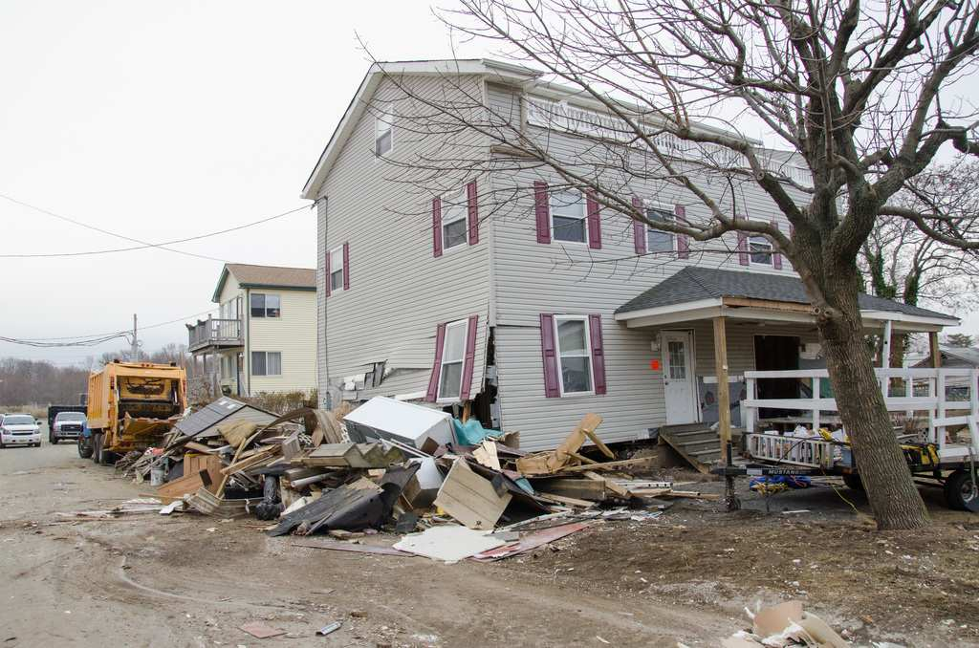
What are considered benefits?
Avoided future costs/losses can include:
Physical damage
Loss of service/function
Injury or death
Displacement costs
Emergency management costs
NFIP administration costs
Let’s discuss each of these.
Notes:
Remember, benefits are any future costs or losses that can be avoided by completing a mitigation project. These avoided future costs/losses can include:
Physical damage
Loss of service/function
Injury or death
Displacement costs
Emergency management costs
NFIP administration costs
Let’s discuss each of these.

Slide 9
Avoided physical damages
One of the primary benefits of a hazard mitigation project is avoided physical damages.
For example, if a property is acquired and demolished, it can no longer be damaged by flood or any other hazard.
Likewise, if a structure is elevated, it will not flood unless the floodwaters rise higher than the lowest floor.
Physical damages can include:
Structural damage to buildings or infrastructure
Contents damage
Damage to historic/cultural resources
Site contamination
Notes:
Physical damages are probably the easiest category of damages and losses and benefits to understand. Buildings, contents, infrastructure, landscaping, vehicles and equipment are damaged by a flood or other disaster event. The monetary damages are simply the cost to repair or replace the damaged property. For physical damages, benefits are simply the avoided damages; that is, the reduction in future damages attributable to a mitigation project.
For example, if a property is acquired and demolished, it can no longer be damaged by flood or any other hazard. Likewise, if a structure is elevated, it will not flood unless the floodwaters rise higher than the lowest floor.
Physical damages are probably the easiest category of damages and losses and benefits to understand. Buildings, contents, infrastructure, landscaping, vehicles and equipment are damaged by a flood or other disaster event. The monetary damages are simply the cost to repair or replace the damaged property. For physical damages, benefits are simply the avoided damages; that is, the reduction in future damages attributable to a mitigation project.
Physical damages can include:
Structural damage to buildings or infrastructure
Contents damage
Damage to historic/cultural resources
Site contamination

Slide 10
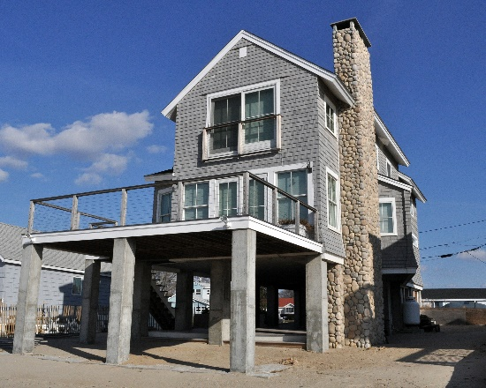
Avoided physical damages, cont.
How do we quantify – that is, express in dollar terms – avoided physical damages?
We can use either (1) hazard-specific information or (2) past or expected damage data to estimate the amount of damage expected in the future.
FEMA’s BCA Toolkit (discussed further in Unit 4) will perform these calculations for you, provided you enter the right data. Units 5-16 cover data requirements for various types of mitigation projects.
Notes:
Remember that to include a benefit in our BCA, it must be quantifiable – that is, able to be put into dollars.
How do we quantify avoided physical damages?
We can use either (1) hazard-specific information or (2) past damage data to estimate the amount of damage expected in the future.
FEMA’s BCA Toolkit (discussed further in Unit 4) will perform these calculations for you, provided you enter the right data. Units 5-16 cover data requirements for various types of mitigation projects.

Slide 11
Avoided loss of service/function, 1 of 3
Another major benefit of a hazard mitigation project can be avoided loss of service or function of the facility.
This benefit is only applicable to public facilities, such as utilities, emergency operations facilities (i.e. police, fire), and infrastructure such as roads and bridges.
For example, a generator project for a fire station can ensure the fire station remains operational even during a storm event.
Likewise, a bridge retrofit project can ensure the bridge remains functional during/after a hazard event.
Notes:
Another major benefit of a hazard mitigation project can be avoided loss of service or function of the facility. This benefit is only applicable to public facilities, such as utilities, emergency operations facilities (i.e. police, fire), and infrastructure such as roads and bridges.
For example, a generator project for a fire station can ensure the fire station remains operational even during a storm event. Likewise, a bridge retrofit project can ensure the bridge remains functional during/after a hazard event.
Loss of function economic impacts are losses and costs that are incurred when facilities are damaged to the point that the normal function of the facility is disrupted. Mitigation projects that reduce physical damages to buildings and other facilities also reduce the loss of function of the facilities, so benefits from mitigation projects often include reducing loss-of-function impacts. The types of reduced loss-of-function benefits to be counted vary, depending on the type of facility, but these benefits can be large and important to count in benefit-cost analysis.
For some types of mitigation projects, especially for utilities, roads, bridges, and critical facilities such as hospitals, the benefits of avoiding the loss-of-function impacts are always important and may be larger than the benefits of avoiding physical damages. Indeed, many mitigation projects for these types of facilities are undertaken primarily to preserve the critical function of the facility, with reduction of physical damages being an important, but secondary consideration.

Slide 12
Avoided loss of service/function, 2 of 3
How do we quantify this benefit?
For most public/nonprofit sector buildings, the value of services lost when the building becomes unusable due to a hazard event is calculated by assuming that services are worth what the public pays to provide the services.
For critical facilities, (i.e. fire/police stations, hospitals), the value of services is estimated based on the service population and the societal benefits of maintaining that facility in the aftermath of a disaster.
For roads and bridges, the value of services is based on the number of one-way trips, additional time/miles required for detour, the GSA mileage rate, and FEMA standard values.
For utilities, the value of service is based on the service population and FEMA standard values.
Notes:
How do we quantify this benefit?
For most public/nonprofit sector buildings, the value of services lost when the building becomes unusable due to a hazard event is calculated by assuming that services are worth what the public pays to provide the services.
For critical facilities, (i.e. fire/police stations, hospitals), the value of services is estimated based on the service population and the societal benefits of maintaining that facility in the aftermath of a disaster.
For roads and bridges, the value of services is based on the number of one-way trips, additional time/miles required for detour, the GSA mileage rate, and FEMA standard values. (FEMA standard values are industry-standard or academically-researched values for various data points.)
For utilities, the value of service is based on the service population and FEMA standard values.
The BCA Toolkit will calculate the daily loss of service value, provided you enter some basic data about the facility.

Slide 13
Avoided loss of service/function, 3 of 3
Loss of service type | FEMA standard value
Electric power | $148/person/day
Potable water | $105/person/day
Wastewater | $49/person/day
Notes:
Loss of service for roads/bridges can also be calculated in terms of detour distance by using the federal mileage rate and the distance of the detour or alternate route if detour time is not applicable or the information is unavailable.
Currently, FEMA does not have standard values for loss of service of communications, Internet, or 911 service.

Slide 14
Avoided fatalities/casualties
For some hazard mitigation projects, a major benefit is avoided human injury and/or death.
This benefit is only applicable to some project types, such as tornado safe rooms, hurricane safe rooms, wildfire mitigation projects, seismic retrofit projects, and others such as tsunami or landslide.
This is because these project types address hazards that have little or no warning time, or protect emergency personnel that must stay behind.
Notes:
For some hazard mitigation projects, a major benefit is avoided human injury and/or death.
This benefit is only applicable to some project types, such as tornado safe rooms, hurricane safe rooms, and seismic retrofit projects. This is because these project types address hazards that have little or no warning time, or protect emergency personnel that must stay behind.
Benefits from avoided injuries/deaths for these hazards are automatically calculated in the BCA Toolkit.

Slide 15
Avoided fatalities/casualties, cont.
How do we quantify this benefit?
These are also FEMA standard values. Injury and death costs come from “Value of Statistical Life” academic research that was completed for the Department of Homeland Security for deaths as well as different levels of injuries:
Severity of Injury | Value
Fatal | $6,900,000
Hospitalized | $2,300,000
Treat & release | $61,000
Self-treat | $14,000
Notes:
How do we quantify this benefit?
These are also FEMA standard values. Injury and death costs come from “Value of Statistical Life” academic research that was completed for the Department of Homeland Security for deaths as well as different levels of injuries.
FEMA standard values for avoided casualties may be found in the table in your student manual.

Slide 16
Avoided displacement costs
Displacement costs occur when occupants (of residential, commercial, or public buildings) are displaced to temporary quarters while damage is repaired.
These costs include rent and other monthly costs, such as furniture rental and utilities, and one-time costs, such as moving and utility hook-up fees.
They can also include loss of business income for commercial buildings.
Notes:
Displacement costs occur when occupants (of residential, commercial, or public buildings) are displaced to temporary quarters while damage is repaired.
These costs include rent and other monthly costs, such as furniture rental and utilities, and one-time costs, such as moving and utility hook-up fees.
They can also include loss of business income for commercial buildings.
For 406 mitigation, Category B is the best place to look for these costs.

Slide 17
Avoided emergency management costs
Emergency management costs include a range of disaster response and recovery costs that may be incurred by communities during and immediately after a disaster. In many disasters, these costs are much smaller than physical damages or loss of service impacts.
These costs can include debris removal and volunteer costs (i.e. sandbagging).
Notes:
Emergency management costs include a range of disaster response and recovery costs that may be incurred by communities during and immediately after a disaster. In many disasters, these costs are much smaller than physical damages or loss of service impacts.
These costs can include debris removal and volunteer costs (i.e. sandbagging).
Many common mitigation projects have little or no significant impact on a community’s emergency management costs. However, in circumstances where a project affects a large part of a community and may significantly reduce future emergency management costs; counting the benefits of reduced emergency management costs is proper. For most projects, however, the benefits in this category are negligible or very small. Thus, in most cases it may not be necessary to make the effort to estimate the benefits of reduced emergency management costs. In cases where a project has a benefit-cost ratio very close to 1.0 and has significant potential benefits in reducing future emergency management costs, it may be worthwhile to calculate the damages from this source, and the benefits of reducing or eliminating them.

Slide 18
Avoided NFIP administration costs
Properties insured under the National Flood Insurance Program (NFIP) incur administrative fees to run the program.
If a property is acquired and demolished, there is no longer an administrative cost to the government for that property; therefore, it is an avoided cost.
Notes:
Properties insured under the National Flood Insurance Program (NFIP) incur administrative fees to run the program. If a property is acquired and demolished, there is no longer an administrative cost to the government for that property; therefore, it is an avoided cost.
Note: Insurance premiums and claims payments are considered transfer payments by OMB, and do NOT count as benefits or costs for BCAs. This means that avoided future flood insurance premiums are NOT an eligible benefit for FEMA mitigation projects. Increased Cost of Compliance coverage can be used to provide the non-federal costs for a project, but they cannot be included as benefits since this would be duplication of benefits.

Slide 19
Other benefits
In addition to avoided costs, hazard mitigation projects can have other benefits.
These can include:
Social benefits
Environmental benefits
Let’s discuss each of these.
Notes:
In addition to avoided costs, hazard mitigation projects can have other benefits. These can include:
Social benefits
Environmental benefits
Let’s discuss each of these.

Slide 20
Social benefits
Social benefits capture the avoided costs associated with mental stress and anxiety and lost wages that disaster survivors would otherwise experience.
Only projects that protect residential structures may include social benefits.
Project must have a 0.75 BCR before social benefits can be applied.
Social Benefit | Value
Mental stress & anxiety | $2,443/person
Lost productivity | $8,736/person
Notes:
Social benefits capture the avoided costs associated with mental stress and anxiety and lost wages that disaster survivors would otherwise experience. This is a one-time benefit, not over the PUL.
Project must have a 0.75 BCR before social benefits can be applied. This is because the primary purpose of FEMA’s hazard mitigation grants is to reduce damages from natural hazards.
FEMA standard values for social benefits may be found in the table in your student manual. These values are one-time benefits, meaning they do not occur on an annual basis.

Slide 21
Environmental benefits
Environmental benefits capture the benefits resulting from an improved natural environment.
These benefits are applicable to any project type that results in a preserved or improved natural environment, such as acquisitions, relocations, and floodplain, stream, or coastal restoration.
Project must have a 0.75 BCR before environmental benefits can be applied.
Notes:
Environmental benefits capture the benefits resulting from an improved natural environment. These benefits are applicable to any project type that results in a preserved or improved natural environment, such as acquisitions, relocations, and floodplain and stream restoration.
Project must have a 0.75 BCR before environmental benefits can be applied. This is because the primary purpose of FEMA’s hazard mitigation grants is to reduce damages from natural hazards.

Slide 22
Environmental benefits, cont.
Type of Space | Value
Green open space | $8,308/acre/year
Riparian | $39,545/acre/year
Wetlands | $6,010/acre/year
Forest | $554/acre/year
Marine & estuary | $1,799/acre/year

Slide 23
What are NOT considered benefits?
Anything that is subjective or non-quantifiable cannot be counted as a benefit in FEMA BCAs. For example:
Ease of project
Aesthetic value of project
Anything not impacted by the proposed project. A definitive connection must be made between the project and claimed benefits.
Additionally, OMB Circular A-94 dictates that indirect benefits must not be considered in a BCA. For example:
Changes in gross regional economic product, incomes, or employment
Avoided criminal justice system costs for disaster-related crime
Notes:
Generally, anything that is subjective or non-quantifiable cannot be counted as a benefit in FEMA BCAs. For example:
Ease of project
Aesthetic value of project
However, although ease of project, aesthetic value, and cheapest/most effective option are not considered benefits for the BCA, these are considerations to take into account when developing the project, as discussed more in the 212 class, Developing Hazard Mitigation Assistance Applications.
Anything not impacted by the proposed project may also not be counted in the BCA. A definitive connection must be made between the project and claimed benefits.
Additionally, OMB Circular A-94 dictates that indirect benefits must not be considered in a BCA. For example:
Changes in gross regional economic product, incomes, or employment
Changes in future economic development or tourism
Avoided criminal justice system costs for disaster-related crime (i.e. looters)

Slide 24
Duplication of benefits and programs
It is important to include all possible quantifiable benefits when developing the project, but you must also be sure that you are not double-counting your benefits or duplicating programs.
Duplication of benefits occurs when:
You are counting the same benefits in two different projects, or counting the same benefits on multiple structures in your project.
An example of duplication of benefits would be elevating a home in one project but then using the original elevation of that home in a separate drainage project.
Duplication of programs occurs when:
Project falls mainly under another federal program (e.g. certain levee projects are the domain of the U.S. Army Corps of Engineers).
Notes:
It is important to include all possible quantifiable benefits when developing the project, but you must also be sure that you are not double-counting your benefits or duplicating programs.
Duplication of benefits occurs when:
You are counting the same benefits in two different projects, or counting the same benefits on multiple structures in your project.
An example of duplication of benefits would be elevating a home in one project but then using the original elevation of that home in a separate drainage project.
Duplication of programs occurs when:
Project falls mainly under another federal program (e.g. certain levee projects are the domain of the U.S. Army Corps of Engineers).

Slide 25
Aggregating project benefits
Aggregating multiple projects into one can often increase the overall BCR. Aggregating project benefits does NOT count as duplication of benefits as long as the benefits apply to multiple structures or the structure is at risk from multiple hazards.
For example, you could:
Count 100 properties protected by one drainage improvement as one project.
Count both avoided physical damages and avoided loss of function if floodproofing utilities.
Count flood reduction benefits and seismic retrofit benefits for the same structure if the project protected against both hazards.
Notes:
Aggregating multiple projects into one can often increase the overall BCR. Aggregating project benefits does NOT count as duplication of benefits as long as the benefits apply to multiple structures or the structure is at risk from multiple hazards.
For example, you could:
Count 100 properties protected by one drainage improvement as one project.
Count both avoided physical damages and avoided loss of function if floodproofing utilities.
Count flood reduction benefits and seismic retrofit benefits for the same structure if the project protected against both hazards.
For more information on how to aggregate projects, please refer to the BCA Guidance.

Slide 26
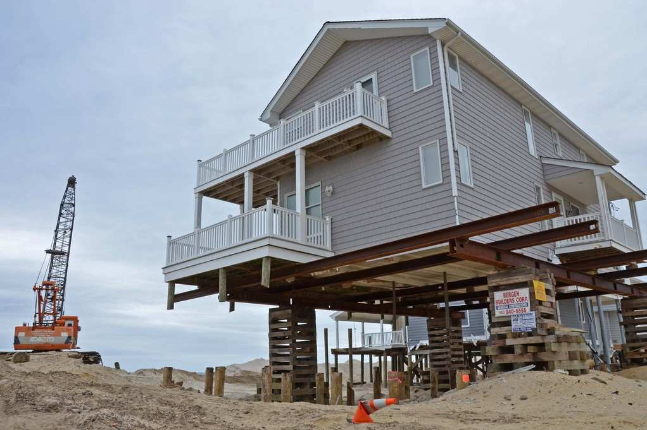
What are considered costs?
Costs of a mitigation project include:
Construction costs
Any other project-related costs such as title searches, permits, etc.
Maintenance costs
Any in-kind contributions or match from the recipient or subrecipient
Notes:
Costs of a mitigation project include:
Construction costs
Any other project-related costs such as title searches, permits, etc.
Maintenance costs
Any in-kind contributions or match from the recipient or subrecipient
Again, all project costs must be counted regardless of who is paying for them.

Slide 27
What are NOT considered costs?
Reduced tax base
Indirect economic losses
Transfer payments: per OMB Circular A-94, insurance premiums (including flood insurance) are considered transfer payments and are thus not considered costs (or benefits)
Notes:
The following are not considered costs for FEMA BCAs:
Reduced tax base
Indirect economic losses
Transfer payments: per OMB Circular A-94, insurance premiums are considered transfer payments and are thus not considered costs (or benefits)

Slide 28
The Benefit-Cost Model
We’ve discussed what can be counted as benefits and costs. Now, we’ll talk about other variables that factor into the BCR calculation, including:
Project Useful Life (PUL)
Recurrence interval (RI)
Project effectiveness
Notes:
We’ve discussed what can be counted as benefits and costs. Now, we’ll talk about other variables that factor into the BCR calculation, including:
Project Useful Life (PUL)
Recurrence interval
Project effectiveness

Slide 29
Project Useful Life (PUL)
Project Useful Life (PUL) is the estimated amount of time (in years) that the mitigation action will be effective.
The PUL is important in the calculation of the BCR because it establishes the timeframe to calculate benefits.
Higher PUL values extend the duration over which benefits are calculated, thus raising the final BCR.
Notes:
Project Useful Life (PUL) is the estimated amount of time (in years) that the mitigation action will be effective.
The PUL is important in the calculation of the BCR because it establishes the timeframe to calculate benefits.
Higher PUL values extend the duration over which benefits are calculated, thus raising the final BCR.

Slide 30
Project Useful Life (PUL), cont.
Let’s think back to the example of the leaky toilet in Unit 1.
Let’s say I’ve decided to replace the toilet.
My PUL is the amount of time I expect the new toilet to last, assuming proper maintenance (the costs of which I must include in my overall project cost).
For this example, we will assume the PUL of the new toilet is 30 years.

Slide 31
Recurrence interval (RI)
A recurrence interval (RI) is how often a hazard event of specific severity is likely to occur in a particular location.
A RI is often talked about as the “X-year” or “Y% annual chance” event.
For example, the “100-year flood” is the 1% annual chance flood, meaning that in any given year, there is a 1% chance it will occur. (The actual depth of the 1% chance annual flood varies by location.)
The percent annual chance is calculated by dividing 1 by X. Here, 1/100.
Projects that mitigate more frequent events are more likely to be cost-effective.

Slide 32
Recurrence interval (RI), cont.
Using the example of the leaky toilet:
Perhaps, just as with hazard events, my toilet does not leak all the time. The RI is how often the toilet is leaking at a particular severity, averaged over the life of the toilet.
For example, let’s say the toilet has been in my house for 20 years, and has leaked 5 times, but only 2 of those times it actually flooded the floor.
The RI for flooding the floor is 2 divided by 20, or 10%. This could be referred to as the “10-year” event.

Slide 33
Recurrence interval vs. Project Useful Life
When calculating benefits and hazard probability, the relationship between the RI and the PUL is important to consider. If the PUL is 10 years but it protects against an event with a 500-year RI, is it likely to be cost-effective?
While these projects can be cost-effective if their benefits are large enough, it’s important to keep in mind that projects that protect against multiple, lower frequency events are more likely to be cost-effective.
RIs can change over time, however, so it’s important to use up-to-date information when possible.

Slide 34
Project effectiveness
Recall that:
How do we know what the costs after mitigation are?
Project effectiveness measures how well the project will reduce future damages.
Only structure acquisition/demolition projects are 100% effective – i.e., they have $0 costs after mitigation.
ALL other project types assume that there is still some (but reduced) hazard risk upon project completion—this is called residual risk.
For example, if a floodwall protects up to the 0.2% annual chance (500-year) flood, then it will no longer be effective in events exceeding the 500-year.
Benefits = Costs Before Mitigation – Costs After Mitigation
Notes:
How do we know what the costs after mitigation are?
Project effectiveness measures how well the project will reduce future damages.
Only structure acquisition/demolition projects are 100% effective – i.e., they have $0 costs after mitigation. All other project types assume that there is still some (but reduced) hazard risk upon project completion—this is called residual risk. For example, if a floodwall protects up to the 0.2% annual chance (500-year) flood, then it will no longer be effective in events exceeding the 500-year.
The maximum level of benefit can be achieved only if the estimated damages and losses are completely eliminated by a mitigation project (i.e., by acquiring and demolishing the house). The relationship between damages and losses before mitigation and the maximum possible benefit achieved after mitigation is very important. The best mitigation projects are often those where the damages and losses are greatest before mitigation is undertaken. In other words, the greater the damage and losses are prior to mitigation project, the greater the potential benefits of mitigation. Conversely, when the damages and losses before mitigation are minor, the maximum possible benefits are limited. This relationship is very important for mitigation planning.
Project effectiveness is also known as level of protection. What level of protection is appropriate is project-specific and best determined in association with the project engineer. There are no standard values for level of protection (except for acquisition), so this must be demonstrated through supporting documentation.

Slide 35
Unit 3 Review, 1 of 3
What count as benefits?
Avoided physical damages
Avoided loss of service/function
Avoided injuries/deaths
Avoided displacement costs
Avoided emergency management costs
Avoided NFIP administration costs
Social benefits
Environmental benefits
Notes:
In this unit, we talked about what count as benefits for FEMA BCAs.
Review each of the following with the students:
Avoided physical damages
Avoided loss of service/function
Avoided injuries/deaths
Avoided displacement costs
Avoided emergency management costs
Avoided NFIP administration costs
Social benefits
Environmental benefits

Slide 36
Unit 3 Review, 2 of 3
What count as costs?
Construction costs
Other project-related costs
Maintenance costs
In-kind contributions/match
Notes:
We also talked about what count as costs:
Construction costs
Other project-related costs
Maintenance costs
In-kind contributions/match

Slide 37
Unit 3 Review, 3 of 3
The BCR is calculated by estimating the difference between damages before mitigation and after mitigation.
The BCA Toolkit does this by using hazard/damage data, recurrence intervals for that hazard, and project information.
Notes:
Finally, we discussed how the BCR is actually calculated.
The BCR is calculated by estimating damages before mitigation and after mitigation. The BCA Toolkit does this by using hazard/damage data, recurrence intervals for that hazard, and project information.

