Slide 1
advancements In Evacuation modeling
Using HEC-LifeSim To Model Evacuation
Woodrow Lee Fields
22 February 2019

Slide 2
outline
Classify the evacuation process
Simulate evacuation with HEC-LifeSim
Applications

Slide 3
Evacuation timeline
Objective
Minimize Life Loss

Slide 4
Warning delay time
Standard Warning Plan and Standard Operating Procedures are Written Down
Warning thresholds are in place
SOP drills are conducted
Responsibilities are identified and clearly define authority to issue warnings

Slide 5
Warning diffusion time
Number and mix of warning channels
Frequency of distribution
Ability to wake people up
Modern technologies

Slide 6
Protective action initiation time
Message content and style

Slide 7
Evacuation time
Multiple exit routes (means of egress)
Clear direction
Limited congestion

Slide 8
What Is HEC-LifeSim?
Tool to estimate life loss from a hazard (e.g. dam breach).
Ability to track individual people throughout the warning and evacuation process (Agent based).
Traffic simulation engine to estimate the evacuation process.
Monte Carlo sampling with uncertainty produces a distribution of life loss results.

Slide 9
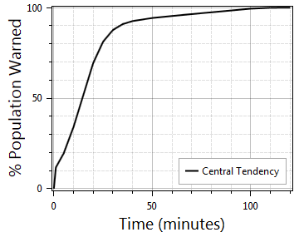
Warning and mobilization
Not Warned
Warned
Mobilized
Caught Vehicle
Caught Structure

Slide 10
Evacuation in hec-lifesim

Slide 11
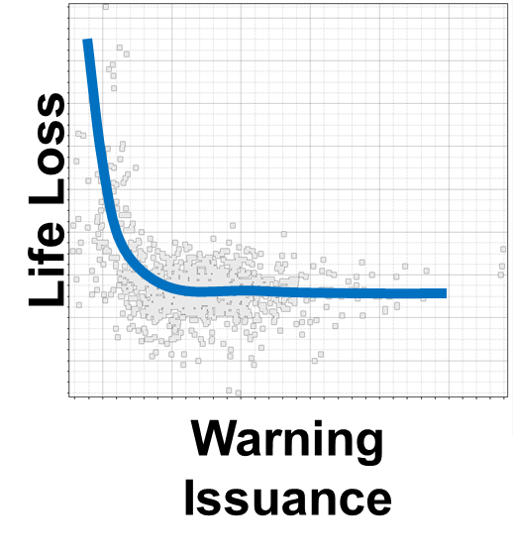
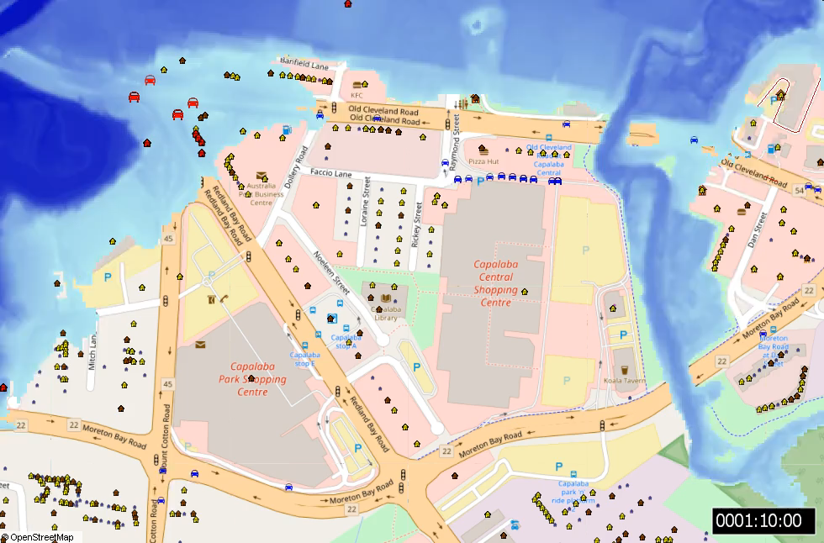
Application - northern Australia

Slide 12
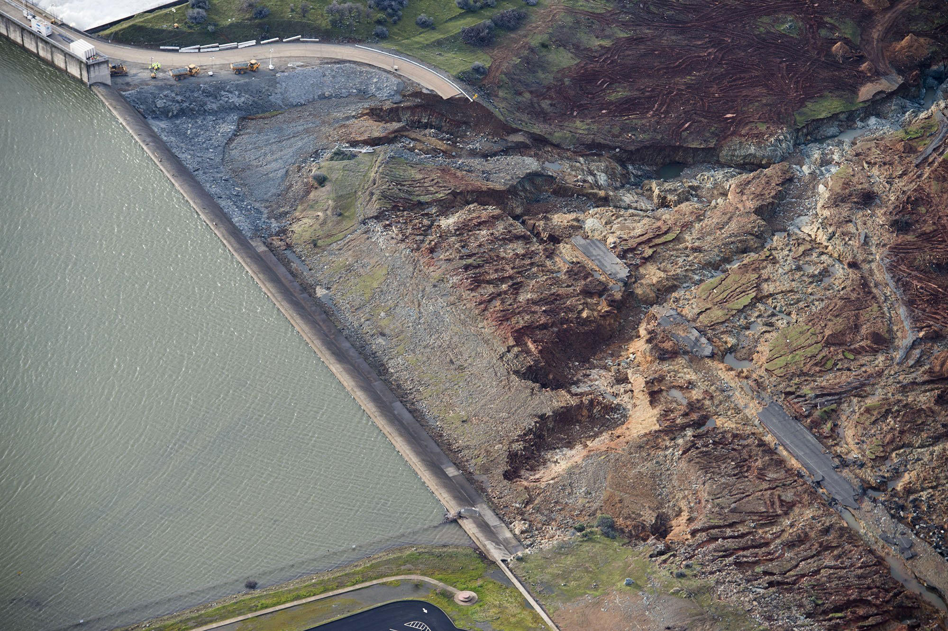
Application - oroville
Goal
Create a HEC-LifeSim model calibrated to the Oroville Dam Emergency Spillway Evacuation Feb 12, 2017.

Slide 13
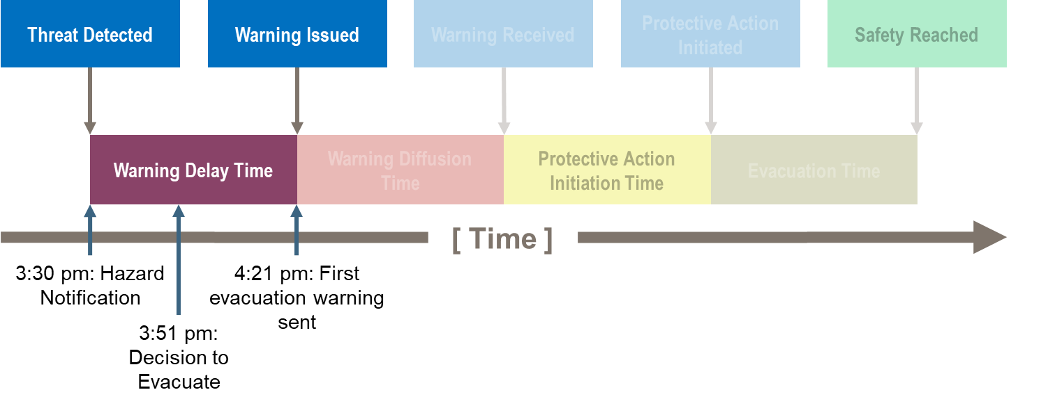
Oroville – warning delay time

Slide 14
Oroville Evacuation orders
Butte County
First message: “Immediate evacuation from the low levels of Oroville and areas downstream is ordered…”
Shutdown Hwy 99 South out of Oroville
All 4 lanes open northbound
Sutter County
First message: “Evacuate on Highway 99/70 south of Highway 20 West. Do not evacuate North” and “Evacuate West on Hwy 20 and/or South on Hwy 99 and Hwy 70 toward Sacramento.”

Slide 15
Oroville evacuation orders cont.
Yuba City (Sutter County)
“Travel options are as follows: South on Hwy 99, West on Hwy 20, Hwy 99 South to Hwy 113, or South on George Washington to Hwy 113. Do not travel on Hwy 20 or Bridge Street as the bridges are closed. Do not travel North.”
All 3 counties:
NWS: Listed the potentially impacted areas and stated, “Move to higher ground now.”

Slide 16
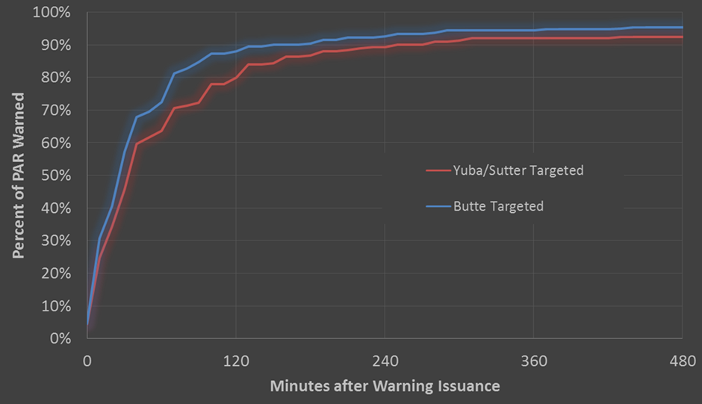
Oroville - Warning diffusion (Survey)

Slide 17
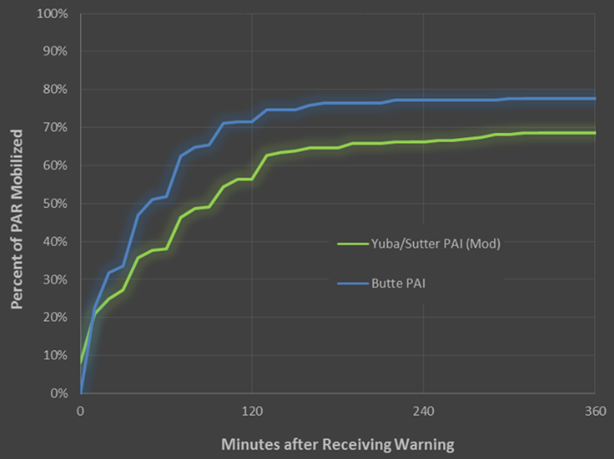
Oroville Protective action initiation (survey)

Slide 18
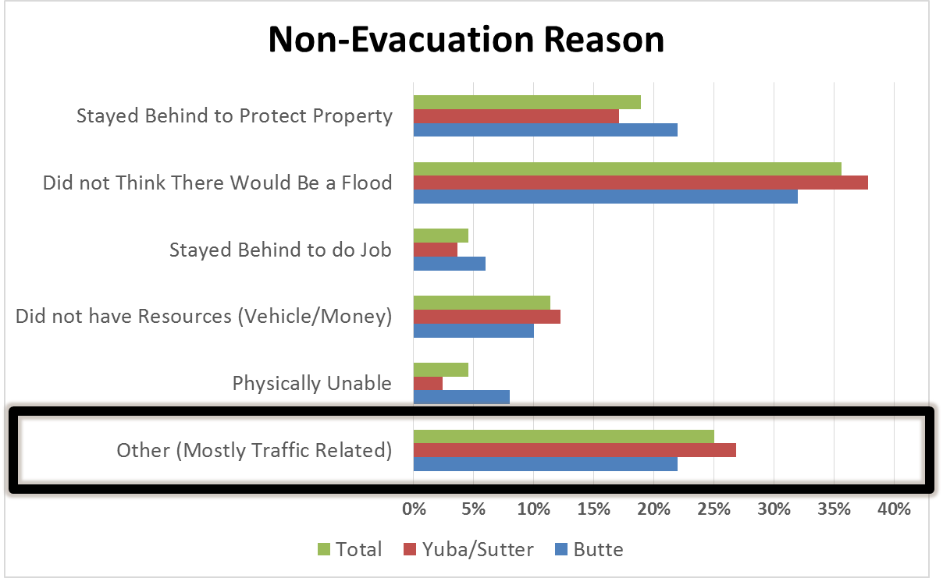
Oroville non-evacuation

Slide 19
Oroville Evacuation time
Observed:
Mean: 3.04 hours
Range: 7 minutes to 50 hours
Median: 2 hours
Simulated:
Mean: 2.6 hours
Range: 5 minutes to 9 hours
Median: 2.4 hours

Slide 20
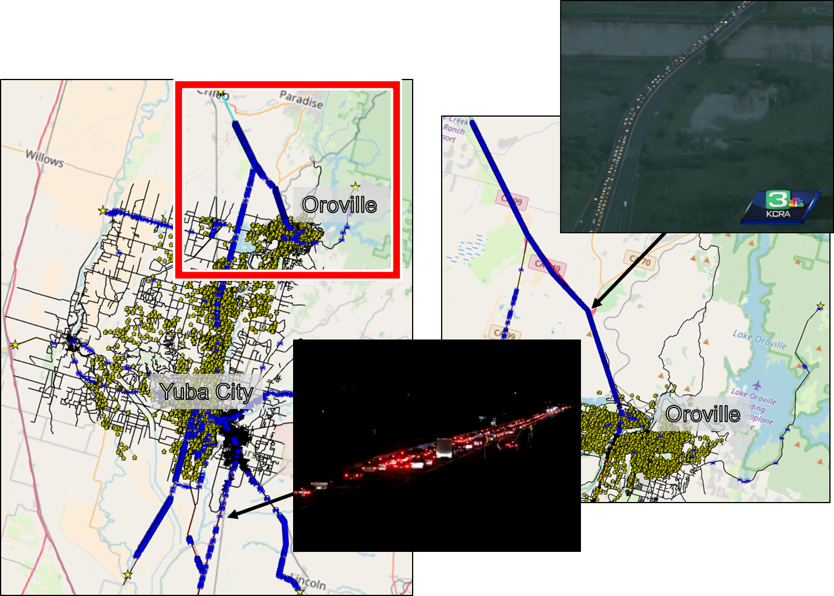
Oroville Traffic comparison

Slide 21
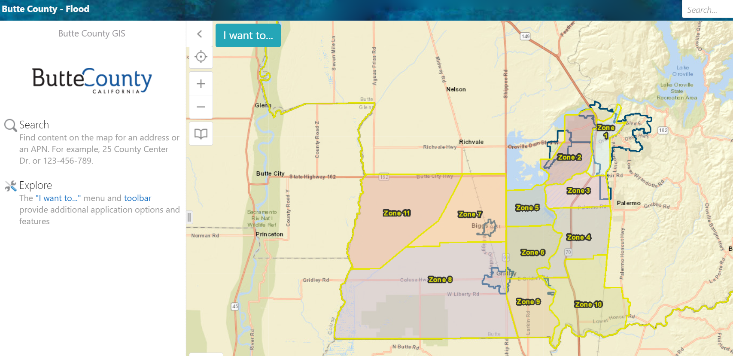
Calibrated hec-lifesim Oroville model
Model Current Evacuation Plan
Quantify Current Plan
Identify Alternative Plans

